Slide 1
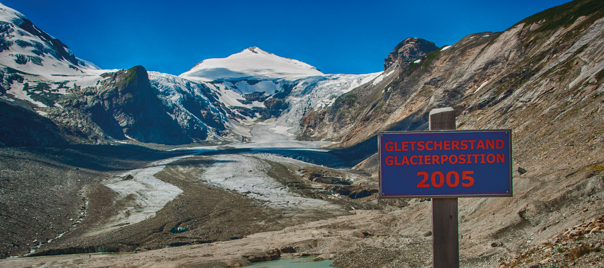
Dr Hans-Martin Füssel I 2 February 2017 I Copenhagen
Presentation of the EEA report
Climate change, impacts and vulnerability in Europe 2016

Slide 2
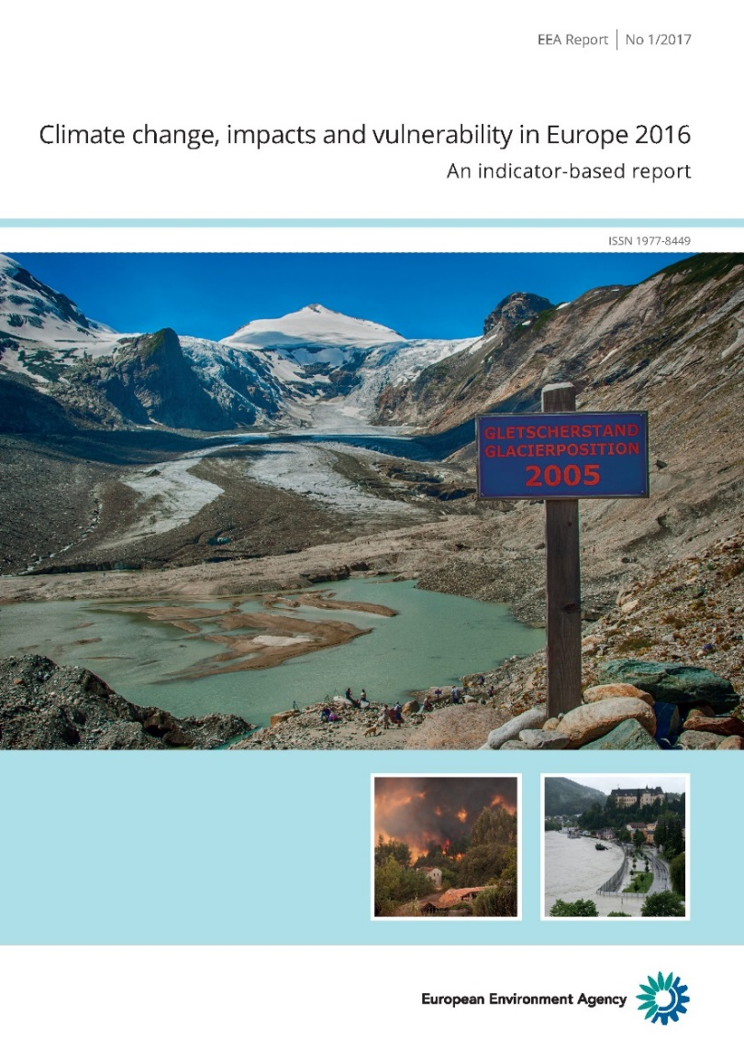
2016 EEA report on climate change, impacts and vulnerability
Previous reports: 2004, 2008 and 2012
More than 60 authors and contributors:
  European Environment Agency (coordinator)
  Three European Topic Centres (CCA, BD, ICM)
  JRC, WHO, ECDC
  Other organisations
Content:
  35 indicators (past trends and projections)
  Multi-sectoral vulnerability and risks
  Global and European policy context
  Development of the adaptation knowledge base
Data sources:
  International databases and reports
  European research projects and data centres
  Academic publications
External Advisory Group
  Scientific Committee
  Commission services and member countries
  European research projects and organisations
Several rounds of external reviews

Slide 3
Timeline of 2016 EEA CCIV report
June 2014 | First discussion at Eionet meeting
Sept. 2014 | Stakeholder survey
Dec. 2014 | Project plan agreed
Febr. 2015 | Presentation to EEA Scientific Committee
March 2015 | Expert workshop on extreme climate events First meeting of Advisory Group
Sept. 2015 | First draft report sent for expert review
Oct. 2015 | Second meeting of Advisory Group
Febr. 2016 | Second draft report sent for expert and Eionet review
June 2016 | Final draft report sent for language editing
Sept. 2016 | Final report sent for layout
Dec. 2016 | Report printed 35 indicators published online
Jan. 2017 | Brochure, animation and press highlight (in all EEA languages) Launch event in Brussels

Slide 4
What is new in the 2016 EEA CCIV report ?
All key findings from the 2012 EEA CCIV report are still valid
Several long-term climate records have been broken since 2014
(e.g. global and European temperatures, global sea level, Arctic sea ice).
Attribution of observed changes in extreme weather events to global climate change has improved (e.g. observed increase in heavy precipitation)
Attribution of observed impacts to climate change has improved
(e.g. disease outbreaks, migration of tree species, establishment of invasive species)
Evidence of future increases of climatic hazards in European regions has strengthened (e.g. heat waves, droughts, top wind speeds, storm surges)
Awareness of Europe's vulnerability to climate events outside Europe has increased (e.g. droughts as a trigger for conflict and population displacement)
Expanded content:
  Policy context (global, European, transnational, national)
  Multi-sectoral climate change assessments (European, transnational)

Slide 5
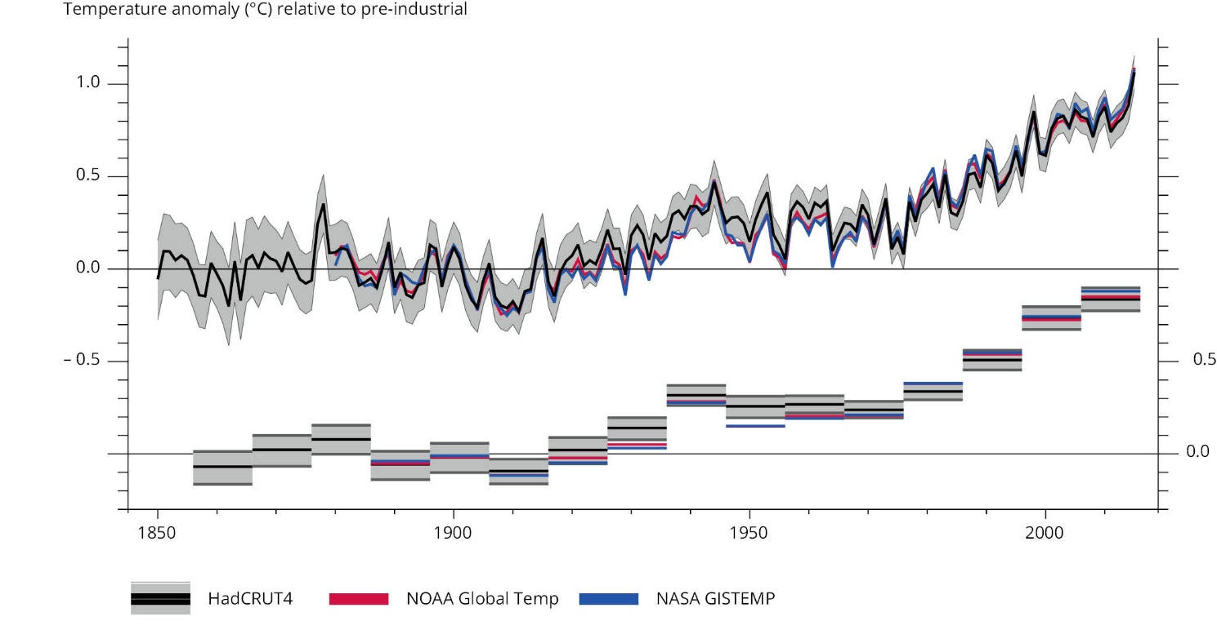
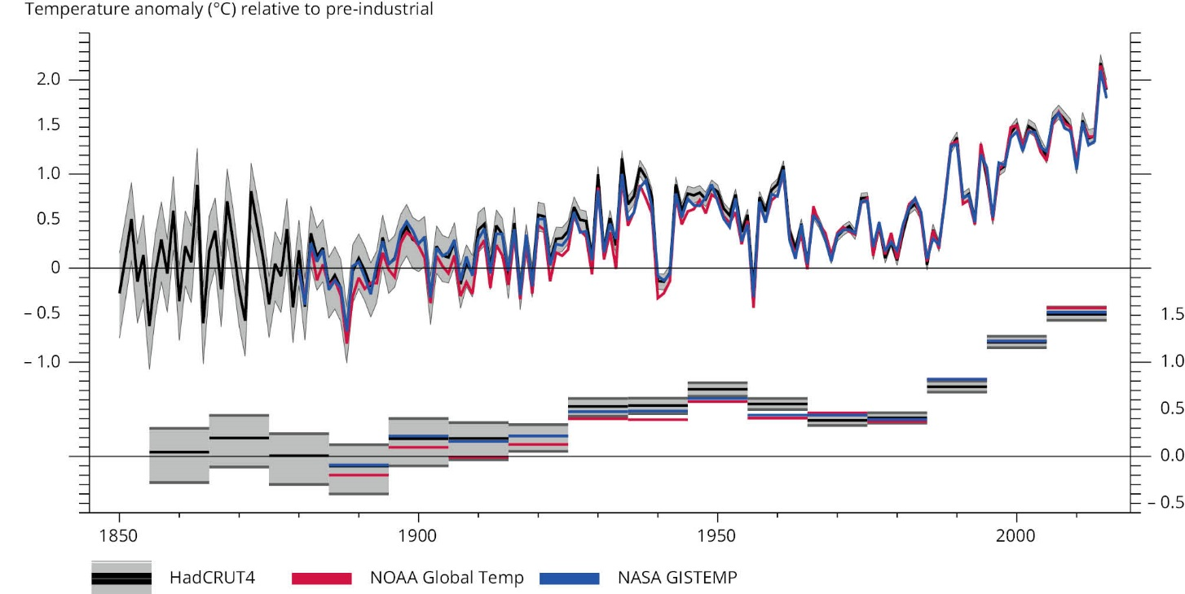
Climate change is breaking records globally and in Europe
Global temperature
(1850–2015/16)
2016: 1.1–1.3 °C
above pre-industrial level
European land temperature
(1850-2015)
Sources:
HadCRUT4 (Met Office),
NOAA Global Temp,
NASA GISTEMP
Notes:
The global temperature record was consecutively broken in 2014, in 2015 and in 2016.
Global temperatures in 2016 were 1.1-1.3 °C higher than the pre-industrial level.
UNFCCC parties agreed in Paris in 2015 to holding global temperature increase to well below 2 °C
and to pursue efforts to limit the increase to 1.5 °C above pre-industrial levels.
2014 and 2015 were also the hottest years in Europe (data for 2016 has not yet been processed).
Other climate records broken in 2015 and 2016 include global sea level (highest ever measured) and annual and winter Arctic sea ice extent (lowest ever measured).
Global temperature (Fig. 3.6);
extended manually for 2016 based on data released by C3S and other institutions:
https://climate.copernicus.eu/news-and-media/press-room/press-releases/earth-edge-record-breaking-2016-was-close-15%C2%B0c-warming
https://www.nasa.gov/press-release/nasa-noaa-data-show-2016-warmest-year-on-record-globally
European temperature (Fig. 3.7)

Slide 6
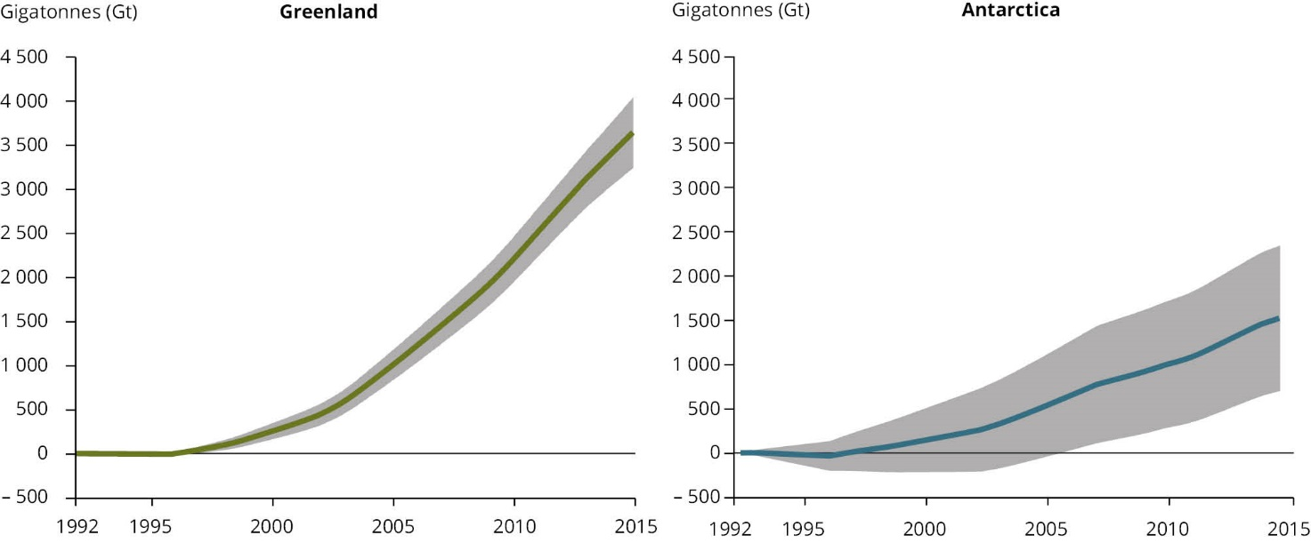
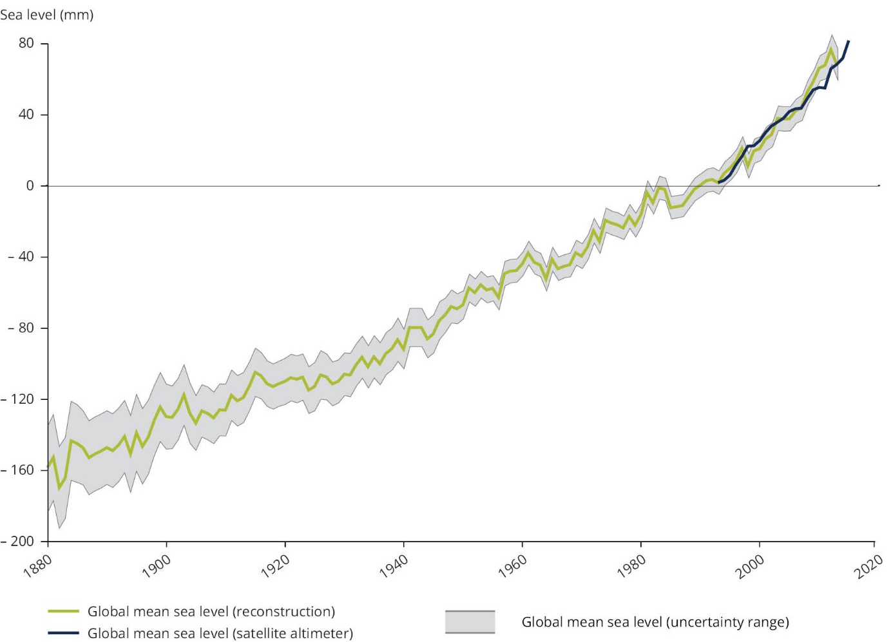
Melting of polar ice sheets is speeding up sea level rise
Cumulative ice loss
Global mean sea level
(1880–2015)
Greenland
(1992–2015)
Antartica
(1992–2015)
Sources:
Shepherd et al. (2015),
Church and White (2011),
Masters et al. (2012)
Notes:
The large ice sheets of Greenland and Antarctica are rapidly losing mass.
This ice loss is accelerating the rise in global sea level, which has reached unprecedented levels in recent years.
Greenland and Antarctic ice sheet (Fig. 3.11)
Global sea level (Fig. 4.7)

Slide 7
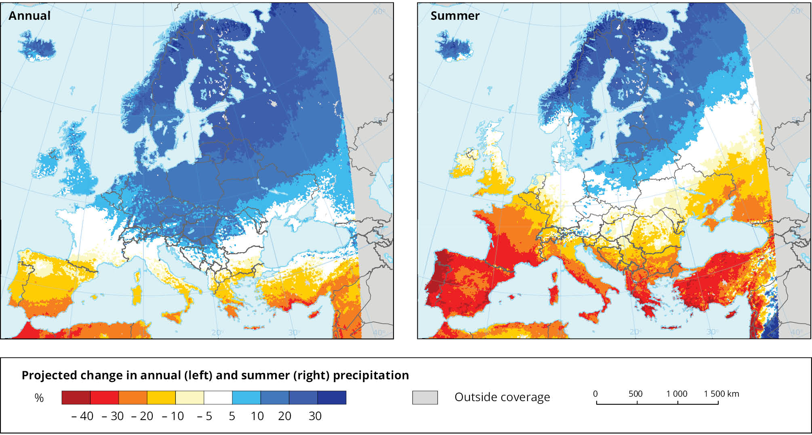
Differences between wet and dry regions will further increase
Precipitation
(projected change for 2080s, RCP8.5)
Source: EURO-CORDEX (Jacob et al., 2014)
Notes:
Annual precipitation is projected to increase in northern and central Europe and to decrease in southern Europe.
Summer precipitation is projected to increase northern Europe and to decrease in southern and large parts of central Europe.
Annual and summer precipitation (Map 3.8)

Slide 8
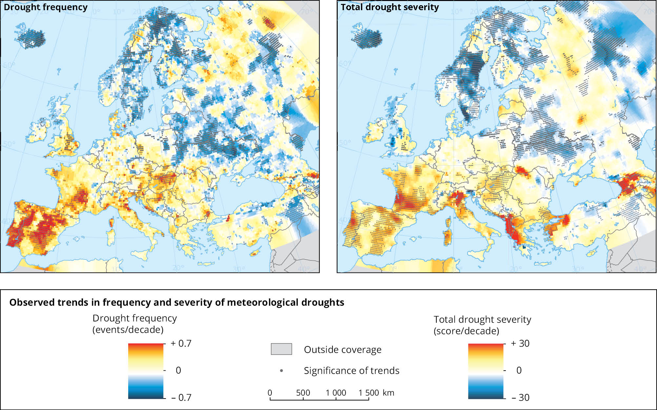
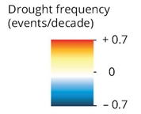
Meteorological droughts are increasing in southern Europe
Drought frequency
(trend for 1950–2012)
Drought severity
(trend for 1950–2012)
Source:
JRC (2016)
Notes:
Meteorological droughts (i.e. periods with exceptionally low rainfall) have become more frequent and more severe in many regions in southern Europe.
Meteorological droughts (Map 4.9)

Slide 9
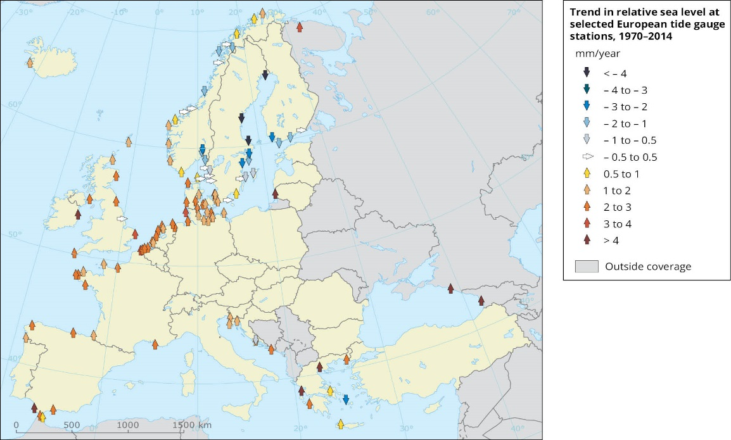
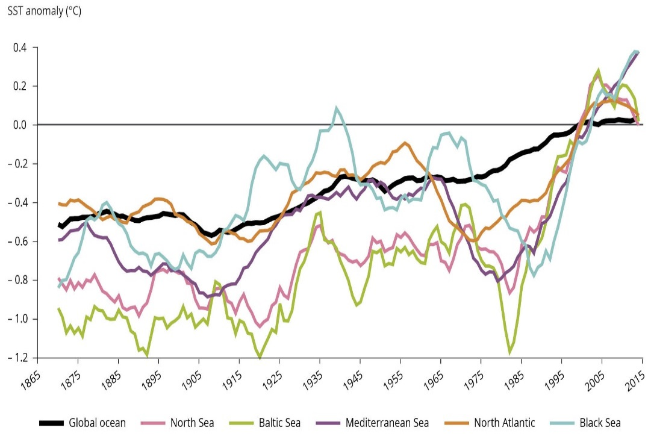
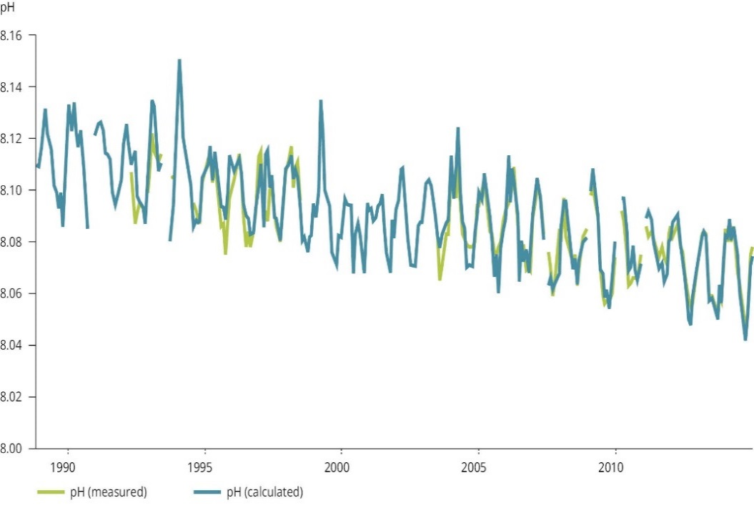
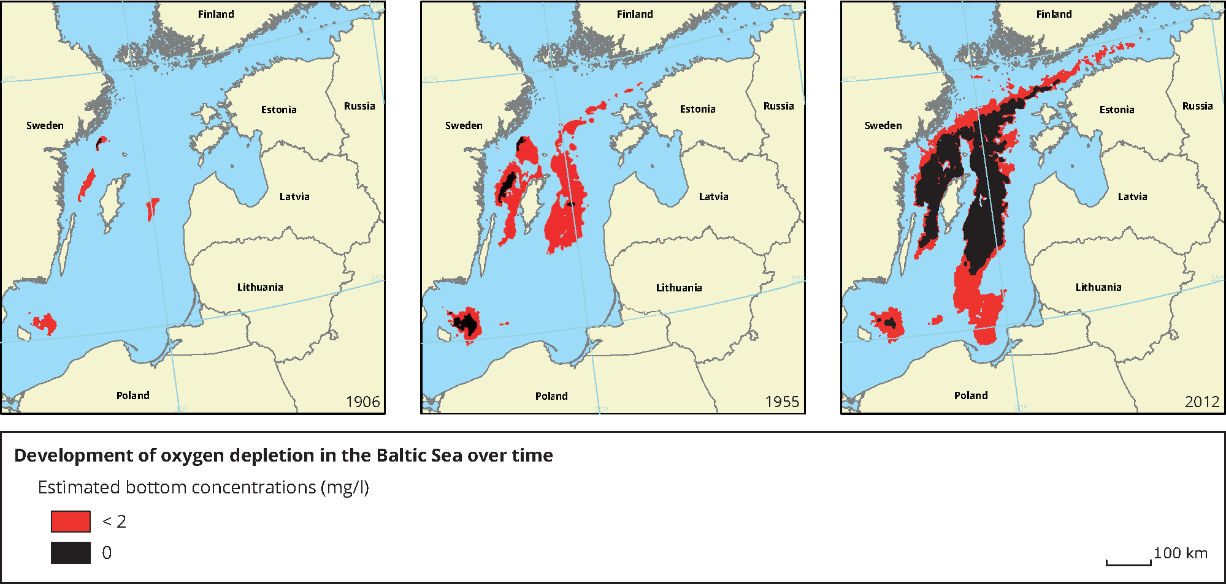
European seas are rising, warming and acidifying;
oxygen-depleted ‘dead zones’ are expanding
Relative
sea level
(1970–2014)
Sea surface temperature
(1870-2015)
Sources:
HadISST1,
CMEMS
Source:
PSMSL (2016)
Ocean ‘dead zones’ (Baltic Sea, 1906–2012)
pH
Ocean acidification (1988-2014)
A decreasing pH value
implies increasing acidity
Source:
Carstensen et al. (2014)
Source:
Updated from Dore (2012)
Notes:
Sea level is increasing along European coasts (except in the northern Baltic Sea where land is still rising after the last Ice Age).
Sea surface temperature is increasing globally and in all European seas.
Ocean water is becoming more acidic across the globae (reflected in a decrease of the pH).
Oxygen-depleted ‚dead zones‘ have been expanding in the Baltic Sea and in some other coastal areas in Europe (caused primarily by nutrient intake, but exacerbated by rising sea temperatures)
Relative sea level rise (Map 4.4)
Sea surface temperature (Fig. 4.4)
Ocean acidification (Fig. 4.1)
Ocean dead zones (Map 4.2)

Slide 10
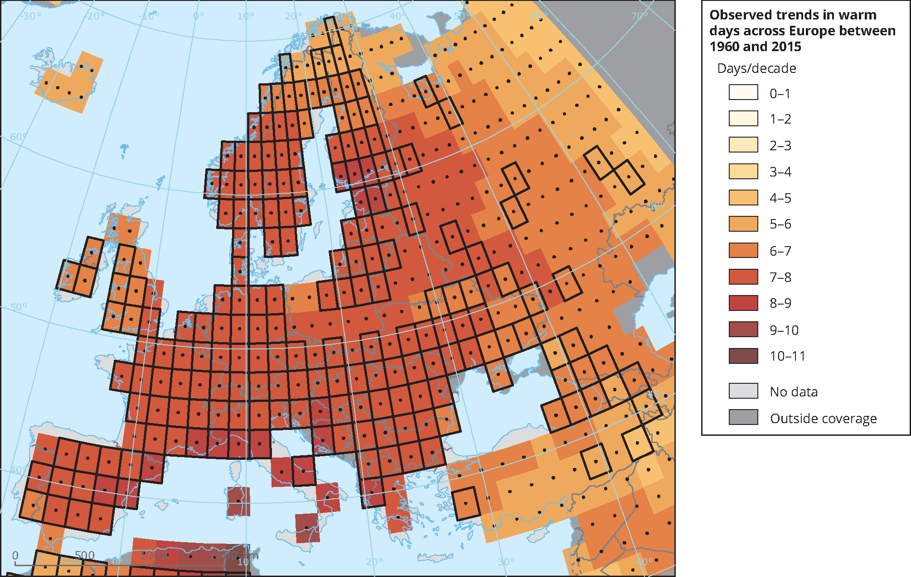
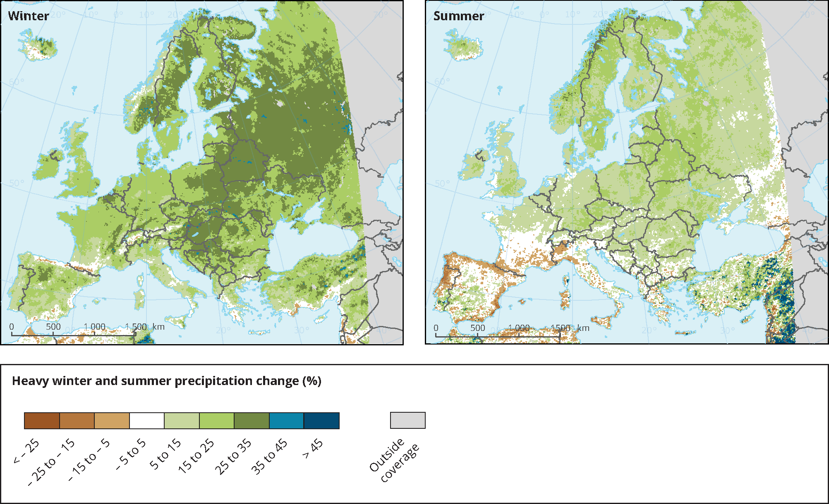
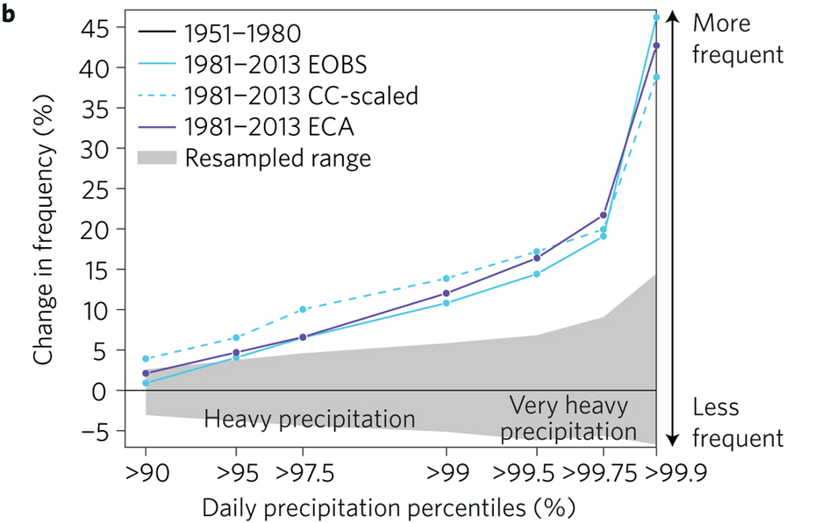
Many extreme weather events are getting stronger
Exceptionally warm days (1960–2015)
Heavy daily precipitation
(projected change for 2080s, RCP 8.5)
Source: HadEX2
(Donat et al. 2013)
Heavy daily precipitation (1951–2013)
Source:
Fischer &
Knutti (2016)
Source: EURO-CORDEX (Jacob et al., 2014)
Notes:
Exceptionally warm days have increased across Europe.
Heavy daily precipitation in Europe has increased substantially in the last 60 years.
Further increases in heavy daily precipitation are projected, in particularly in winter.
Heat waves (Map 3.5)
Heavy precipitation (Map 3.10)
Figure 2.b of this recent paper: http://www.nature.com/nclimate/journal/v6/n11/fig_tab/nclimate3110_F2.html

Slide 11
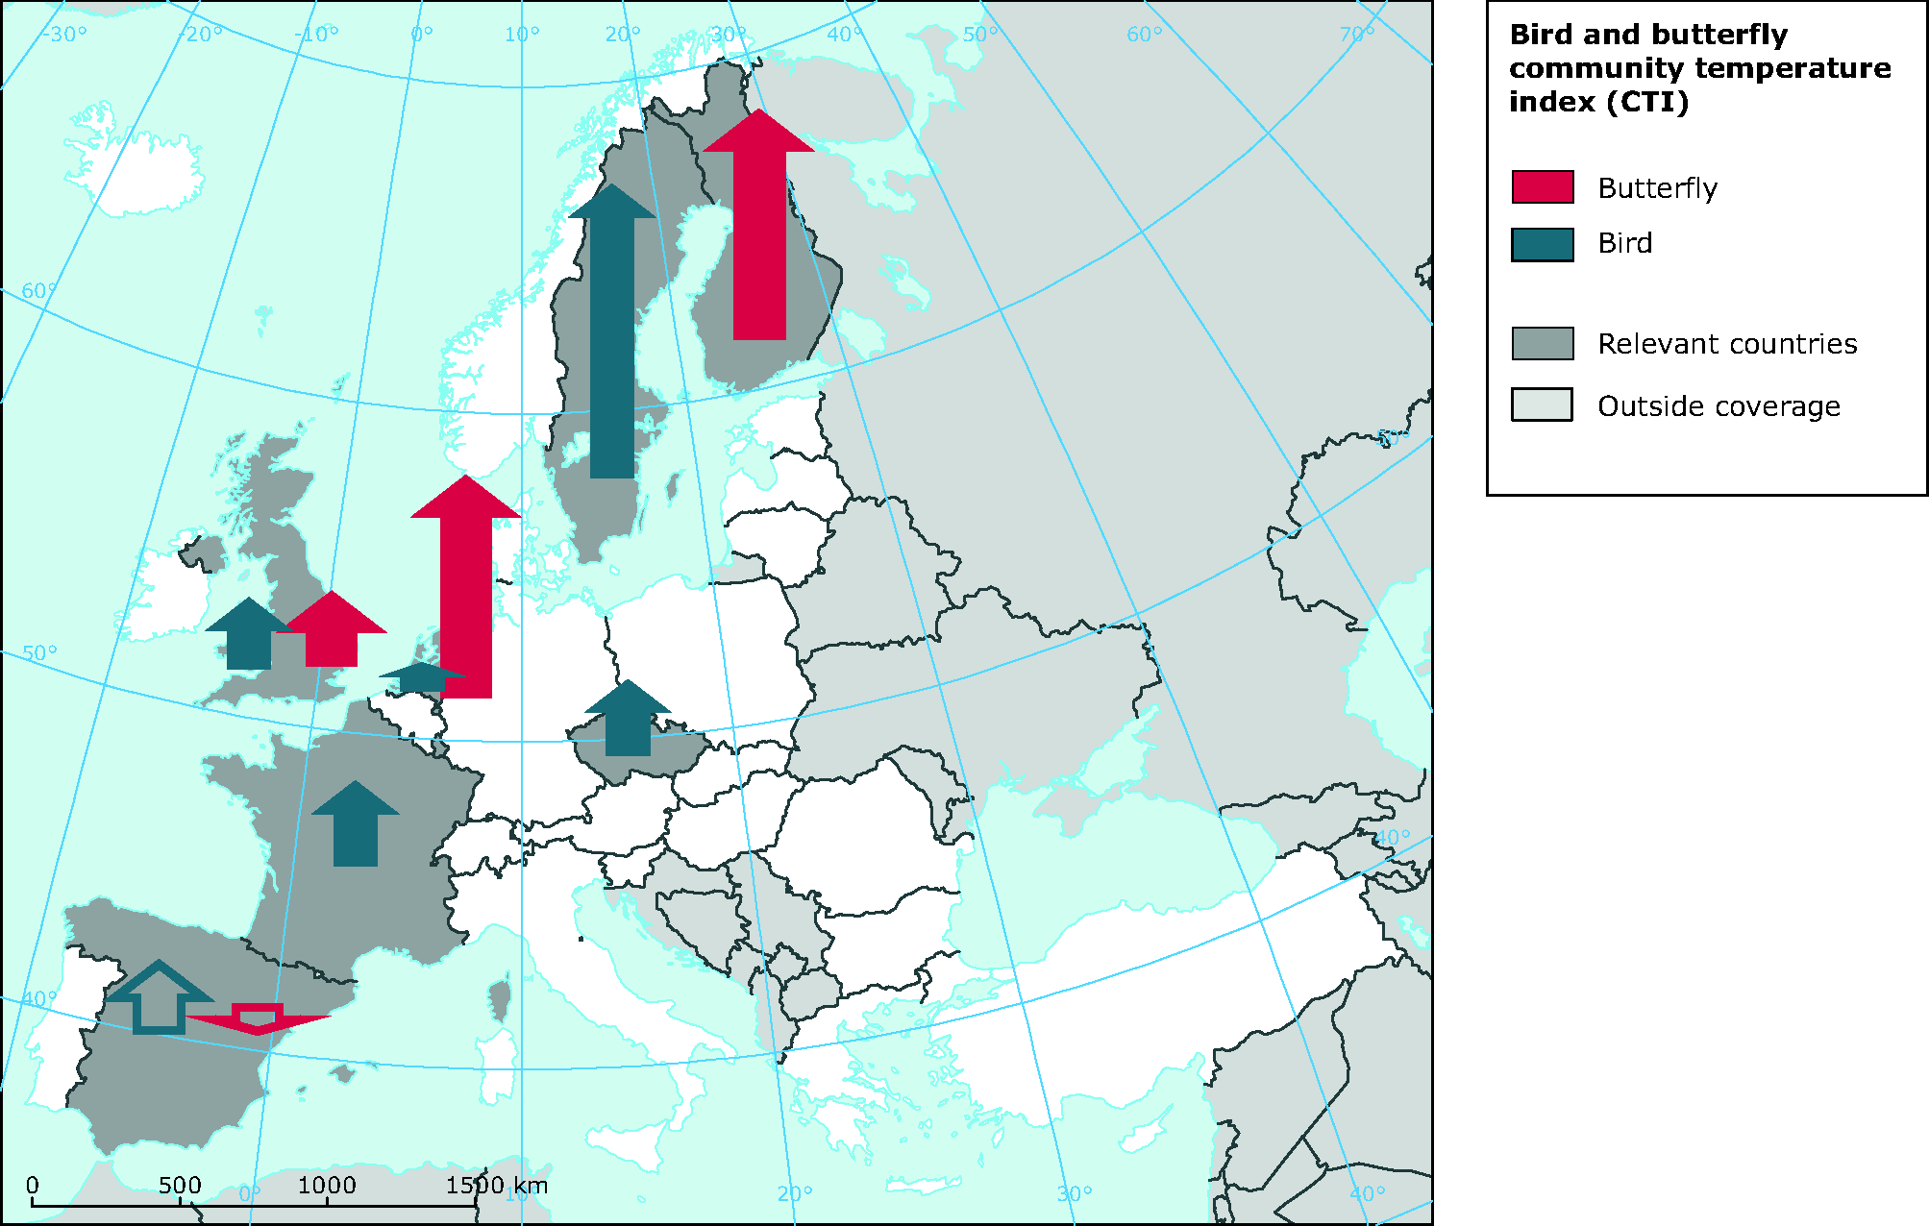
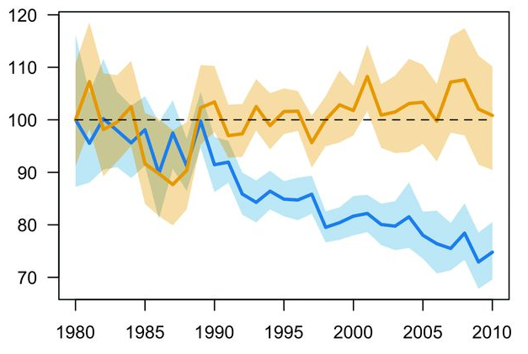
Ecosystems are changing in response to climate change –
but most species cannot follow the pace of climate change
Change in bird and butterfly communities
(community temperature index, 1990–2008)
Abundance of bird species in Europe
(1980–2010)
CST+
CST-
9490 bird communities:
37 km „northward“ on average
2130 butterfly communities:
114 km „northward“ on average
Climate zones:
250 km northward
CST+: Species expected to respond positively to regional climate change → no trend
CST-: Species expected to respond negatively to regional climate change → declining trend
Source:
Devictor et al. (2012)
Source:
Stephens et al. (2016)
Notes:
Climate change is already having widespread impacts on ecosystems in Europe.
For example, bird and butterfly communities are changing, with cold-adapted species losing against warm-adapted species.
Changes in the composition of European bird communities are dominated by decreasing abundance of cold-adapted species;
warm-adapted species show no clear trend.
Trend in thermophilic species in bird and butterfly communities (Map 4.15)
Figure 2.A of Stephens et al. (2016): http://dx.doi.org/10.1126/science.aac4858

Slide 12
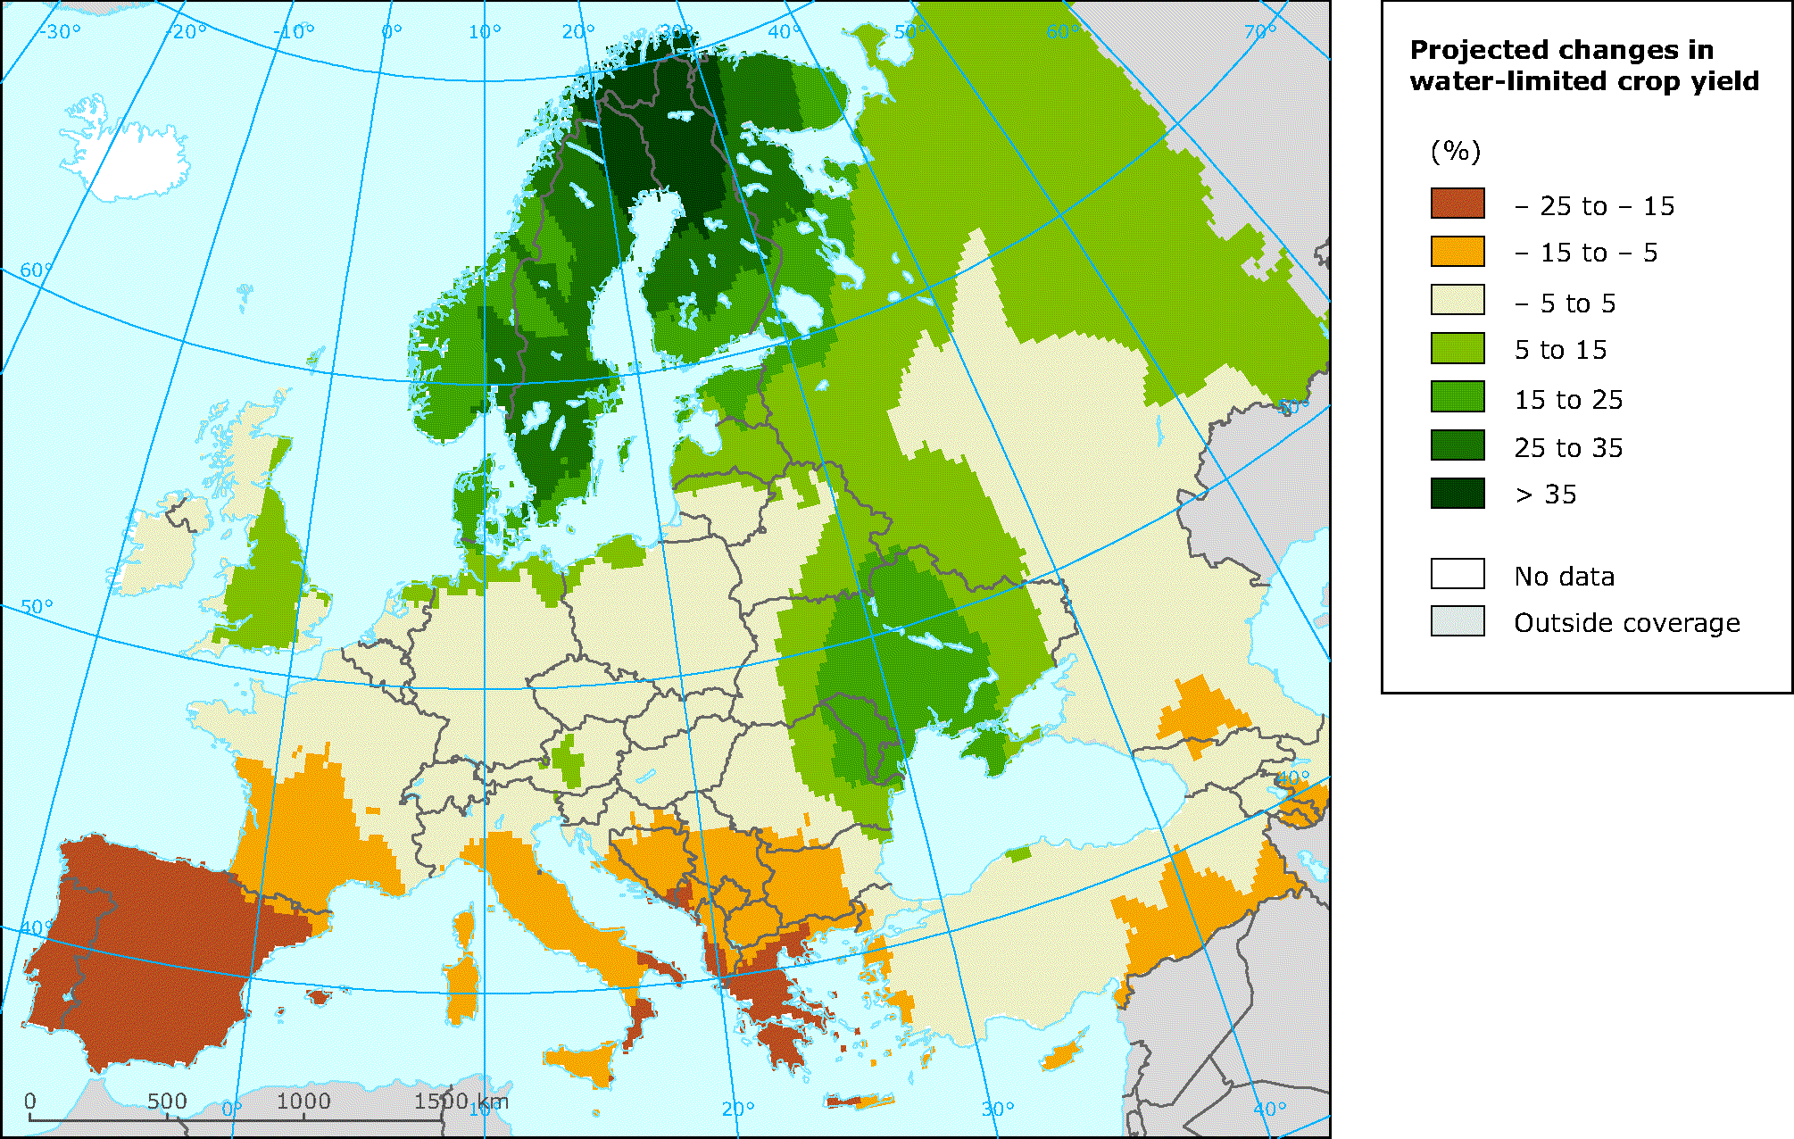
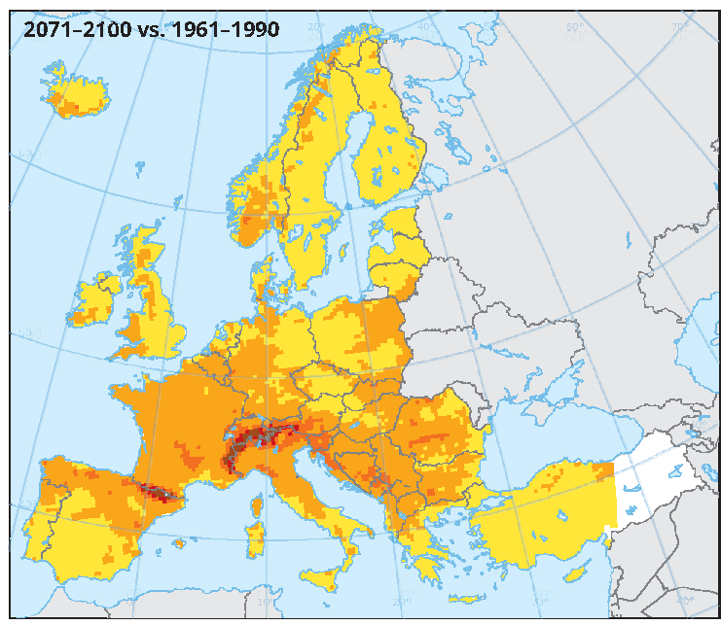
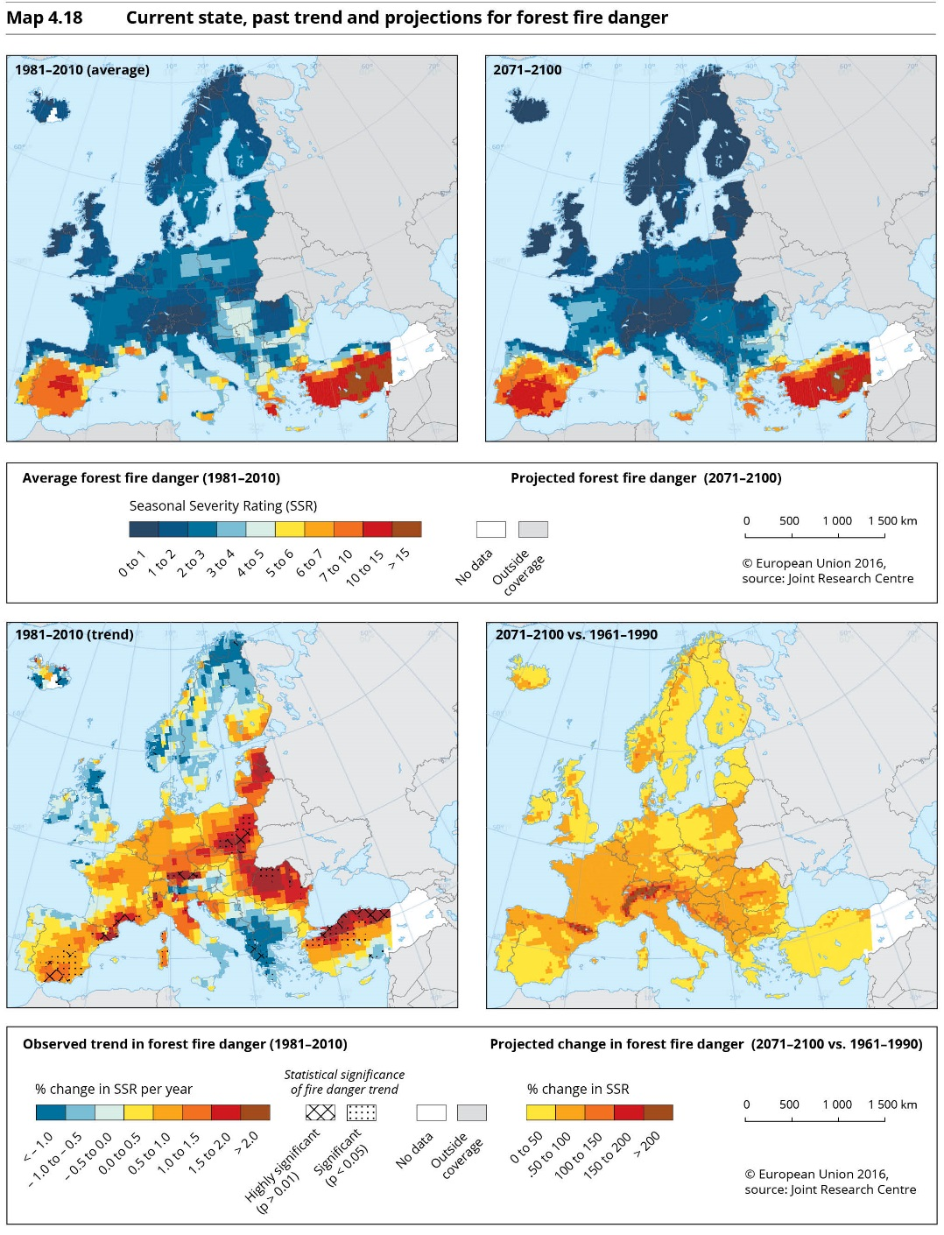
Climate change threatens agriculture and forests –
Southern Europe is most affected
Yield of three staple crops
(projected change for 2050, A1B)
Forest fire risk
(projected change for 2080s, A1B)
Source: Iglesias et al. (2012), Ciscar et al. (2011)
Source: JRC
(Camia, 2012)
Notes:
Meteorological droughts (periods with exceptionally low rainfall) have become more frequent and more severe in many regions in southern Europe.
Decreasing yields of major crops are projected for southern Europe whereas agriculture in northern Europe could benefit.
The risk of forest fires is projected to increase in most regions in Europe; the absolute risk is highest in southern Europe.
Water-limited crop yield (Map 5.13)
Forest fire risk (Map 4.18)

Slide 13
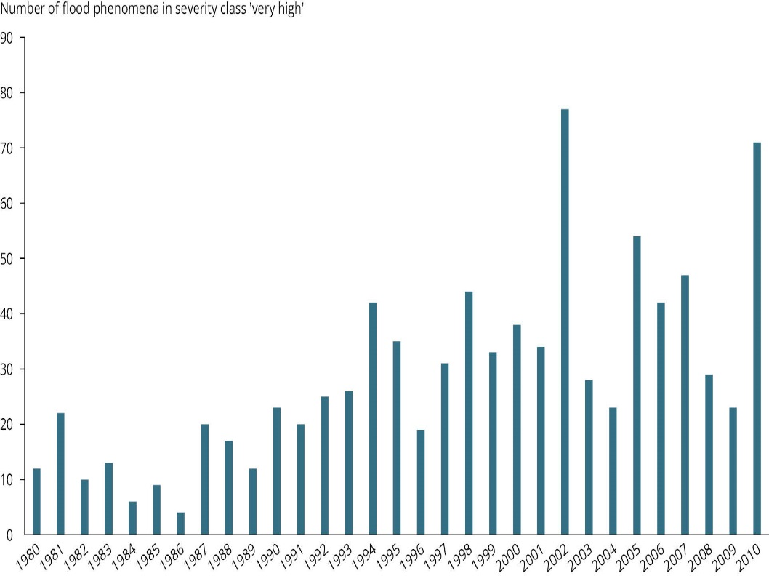
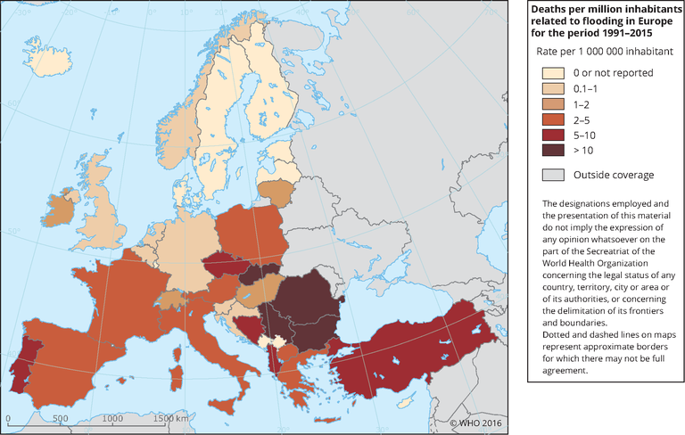
Increasing floods are threatening human lives
‘Very severe’ inland floods in Europe
(1980–2010)
Deaths from flooding
(1991–2015)
Source: EEA (2016), ETC/ICM (2015)
Source: WHO (2016), EMDAT (2016)
Notes:
The number of ‚very severe‘ floods in Europe (based on a number of criteria) has increased in recent decades.
The death toll of floods differs across Europe.
Severe river floods (Fig. 4.12)
Deaths from flooding (Map 5.1)

Slide 14
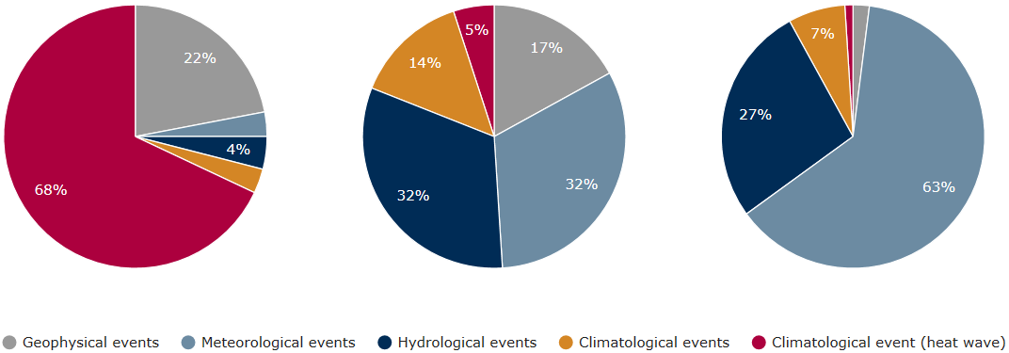
Extreme climate events are costly and life-threatening
Impacts of extreme events in EEA member countries
(climate-related and geophysical hazards; 1980–2015)
Fatalities
114 807
Total economic losses
EUR 520 billion (2015 prices)
Insured losses
EUR 155 billion (2015 prices)
Source: Munich RE NatCatSERVICE
Notes:
Extreme weather and climate events are costly and live-threatening.
The overwhelming majority of the 90,000 deaths from climate-related events are caused by heatwaves.
The largest share of the EUR 430 billion in total economic losses from climate-related events are caused by floods and storms.
Impacts from all natural hazards (updated from Figure 5.3)

Slide 15
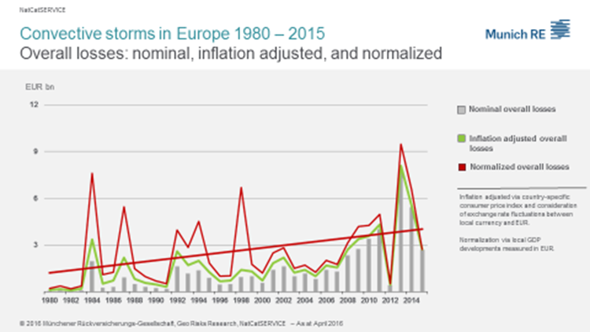
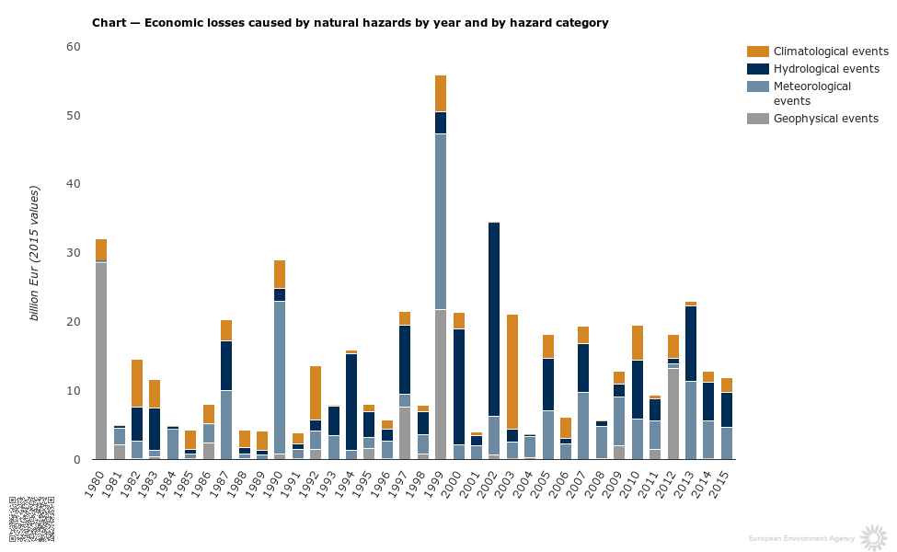
There is no clear trend in the losses from extreme climate events –
but losses from convective storms are increasing
Economic losses from extreme events in EEA member countries (1980–2015)
All hazards
Convective storms
Source: Munich RE NatCatSERVICE
Notes:
After adjustment for inflation and increases in wealth, there is no clear trend in the economic losses from all extreme weather and climate events together; however, the losses from convective storms have increased over time.
Economic losses from all natural hazards (Figure 5.4)
Losses from convective storms (provided directly by Munich Re)

Slide 16
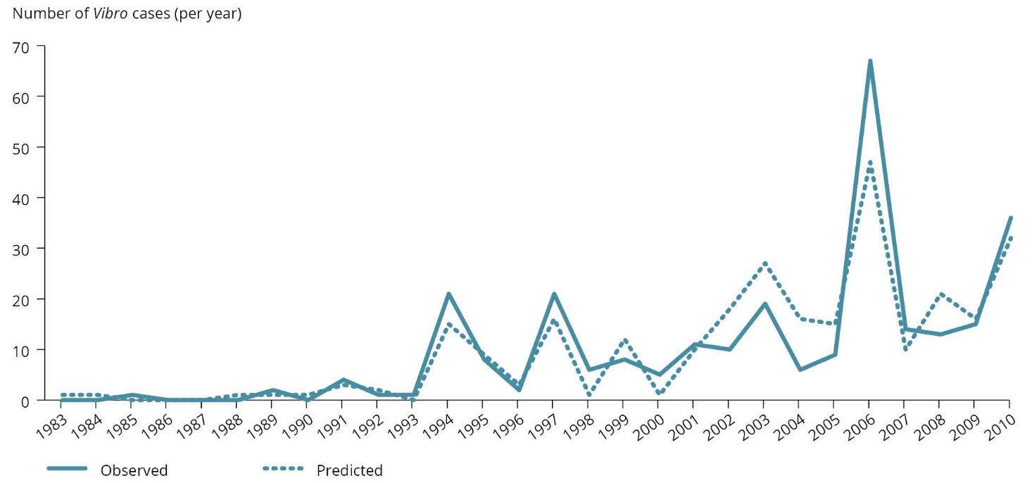
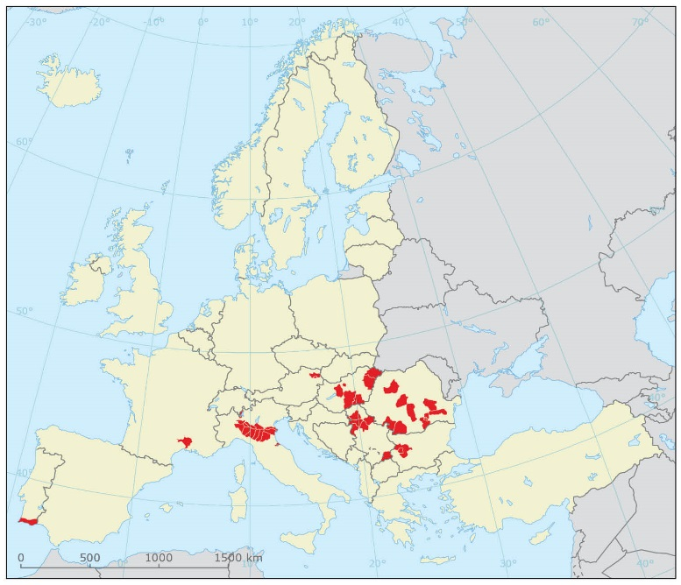
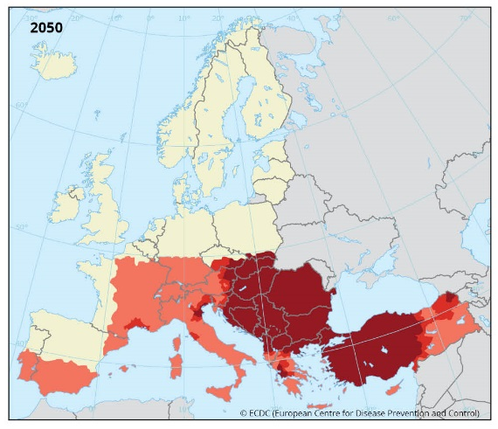

Climate change is facilitating the spread of infectious diseases
Vibrio infections
(Baltic sea region, 1983–2010)
Source:
Baker-Austin et al. 2012
West Nile fever
(observed, 2014)
West Nile fever
(projected, 2050)
Source: ECDC
(Semenza et al. 2014)
Notes:
Vibrio infections have increased substantially (in particular in the Baltic Sea region), triggered by unprecedentedly warm sea surface temperatures.
Climate change is facilitating the spread of the West Nile virus in Europe.
Vibriosis infections (Figure 5.7)
West Nile fever – observed (Map 5.5)
West Nile fever – projected (Map 5.7)

Slide 17
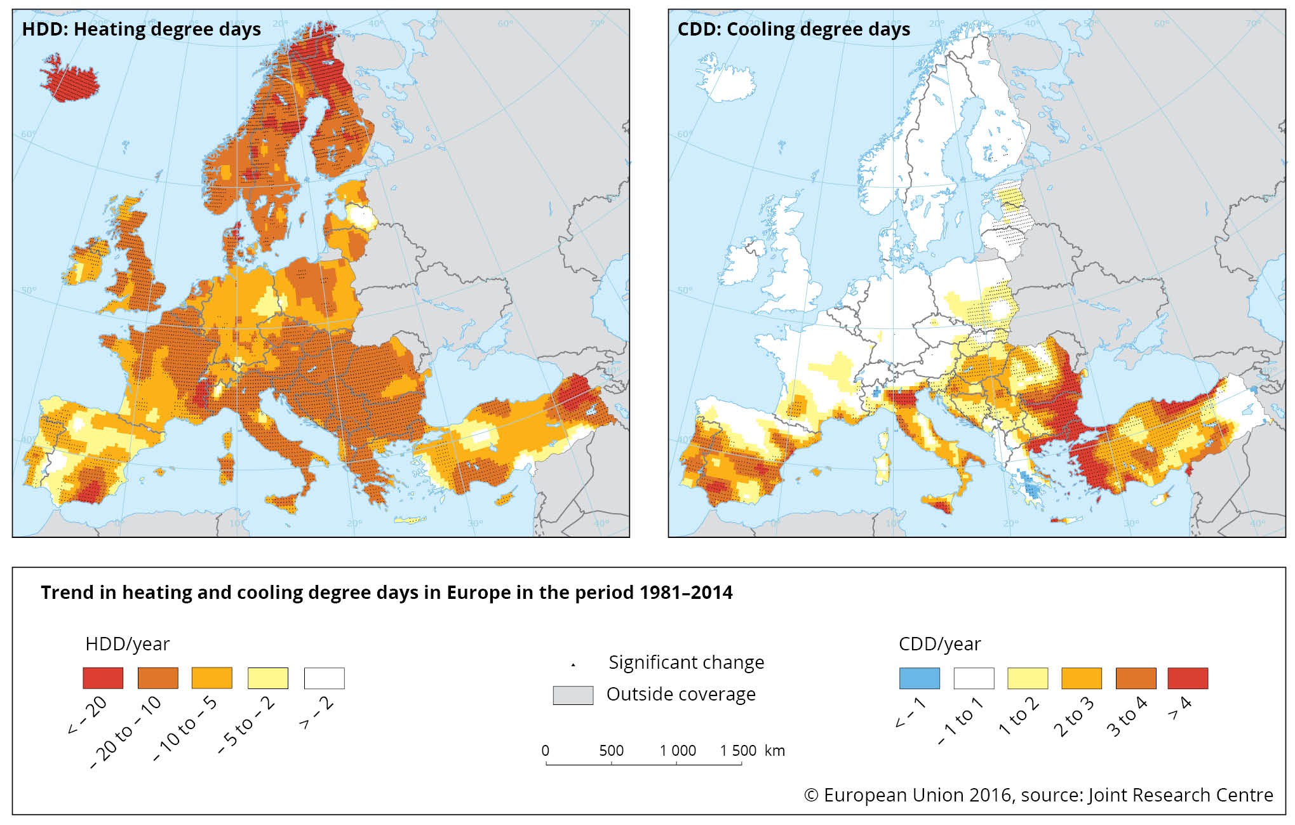
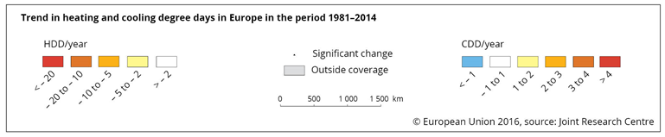
The energy sector is crucial for climate change mitigation –
but it also needs to adapt to climate change
Cooling degree days (trend for 1981–2014)
Source: JRC (Spinoni et al. 2015)
Notes:
Heating demand is decreasing across Europe, with the strongest decrease in northern Europe.
Cooling demand is increasing, in particular in southern Europe;
increases in peak electricity demand in summer can overburden the supply system.
The impacts of climate change on electricity production vary across regions and supply modes;
projected impacts in northern Europe are predominantly positive whereas impacts in other regions are predominantly negative.
Trend in cooling degree days (Map 5.17)

Slide 18
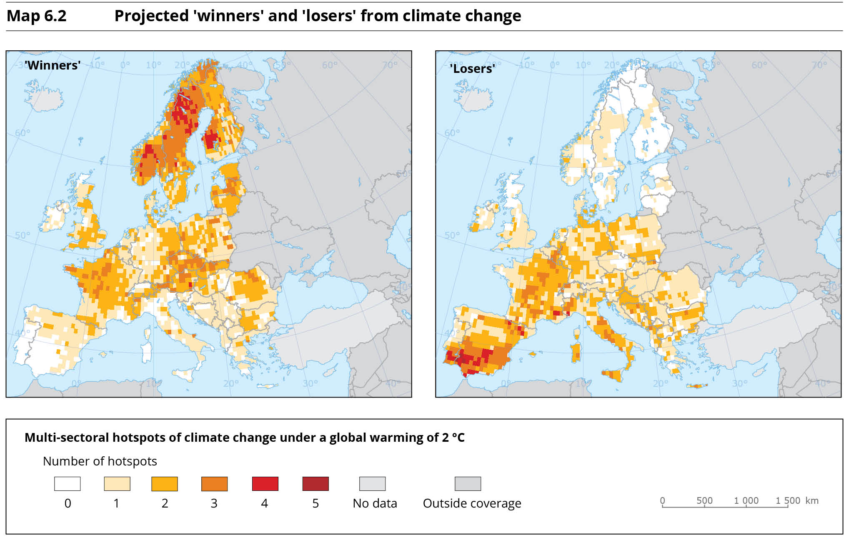
Climate change can aggravate existing disparities in Europe
Projected ‘winners’ and ‘losers’ from climate change
(number of sectors and systems positively and negatively affected)
Source: IMPACT2C project (2015)
Notes:
The regions with the largest number of sectors being positively affected (climate change ‘winners’) are located in northern Europe;
the regions with the largest number of sectors being negatively affected (climate change ‘losers‘) are located in southwestern Europe.
‘Winners’ and ‘losers’ from climate change (Map 6.2)

Slide 19
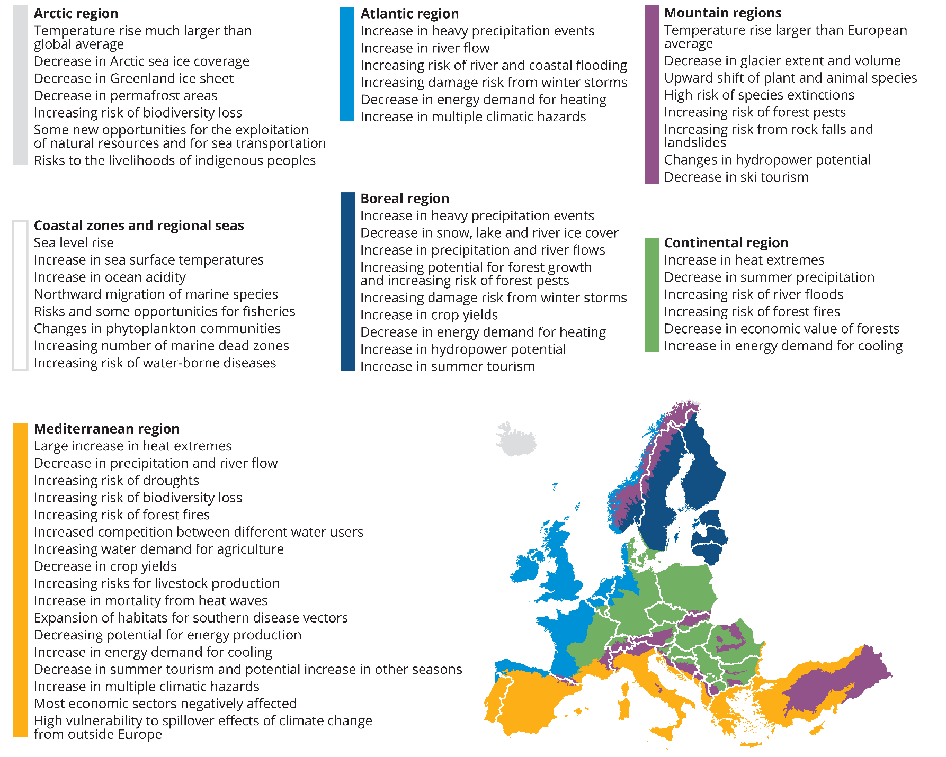
Climate change is affecting all European regions –
but adaptation needs differ across regions
Notes:
All regions in Europe are affected by climate change, but the specific impacts and vulnerabilities and adaptation needs vary across Europe;
they depend on the current climate and its projected changes as well as on environmental and socio-economic factors.
The Mediterranean region (southern and southeastern Europe) shows the largest number of sectors that are adversely affected.
Overview of climate change impacts across regions (Map ES.1)

Slide 20
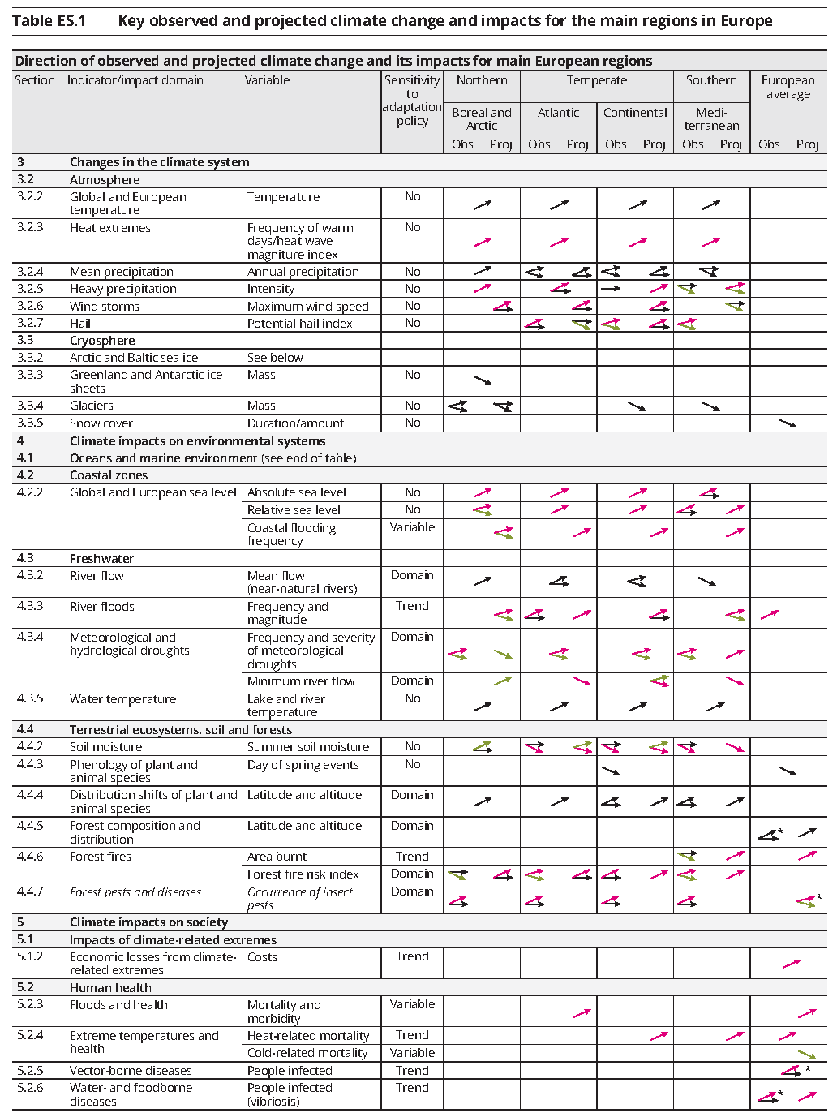
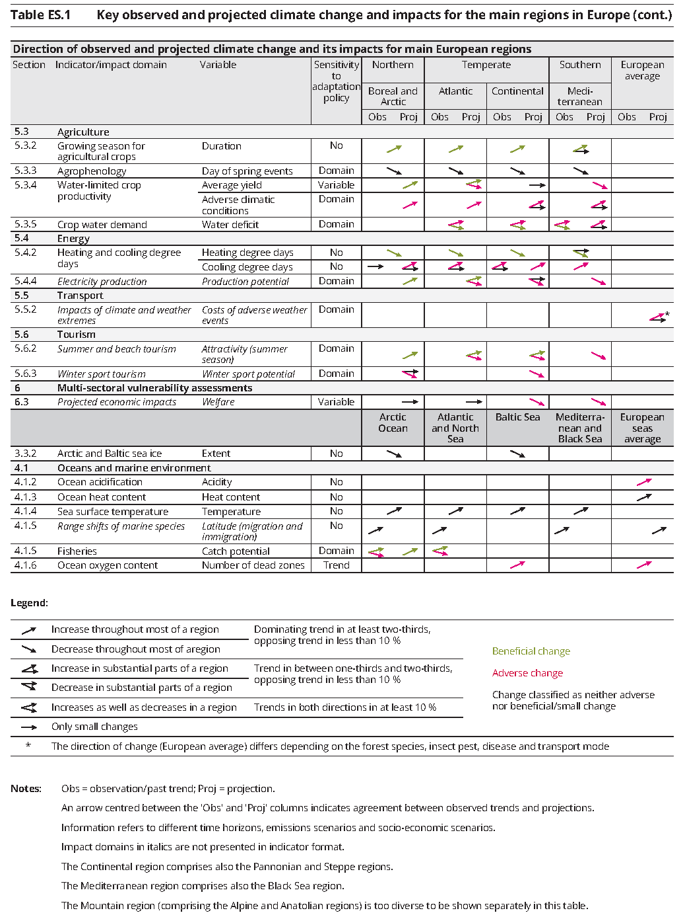
Much more information is available for all regions and sectors –
but it is difficult to summarize
Notes:
This table summarizes the observed and projected changes in climate and its impacts in the main regions in Europe for all indicators.
This table is not legible on a slide; it is an invitation to look further at the large amount of information presented in this EEA report.
Overview table for all indicators and regions (Table ES.1)

Slide 21
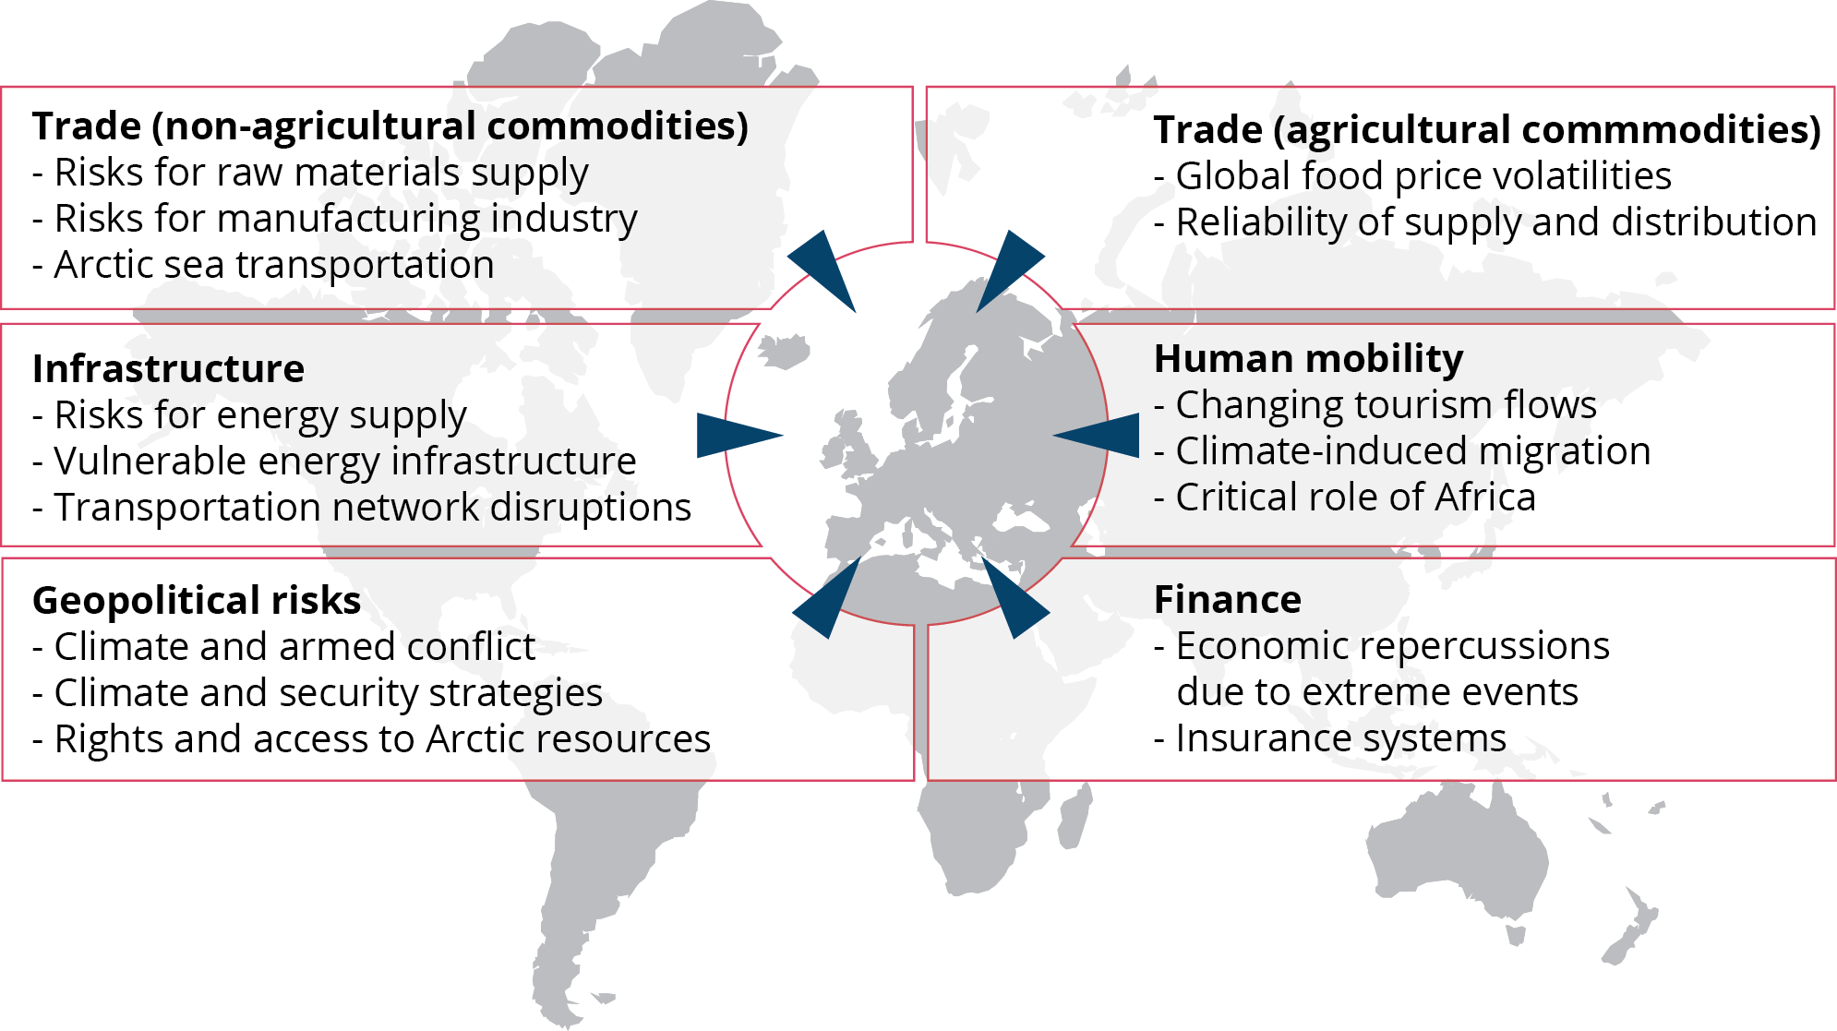
Europe is also vulnerable to climate change impacts outside Europe
Source: EEA (2016)
Notes:
The impacts of climate change occurring outside Europe can affect Europe along several pathways, including trade, infrastructure risks, geopolitcal risks, and human migration.
The strongest evidence for Europe’s vulnerability to cross-border impacts are the economic effects seen as a result of climate-related global price volatilities and disruptions to transportation networks.
The Mediterranean area is most vulnerable to shocks in the flow of agricultural commodities, while small, open and highly developed European economies are particularly vulnerable to shocks in the flow of non-agricultural commodities.
European vulnerability to cross-border effects is expected to increase in the coming decades, but quantitative projections are not available.
Indirect impact pathways (Fig. 6.4)

Slide 22
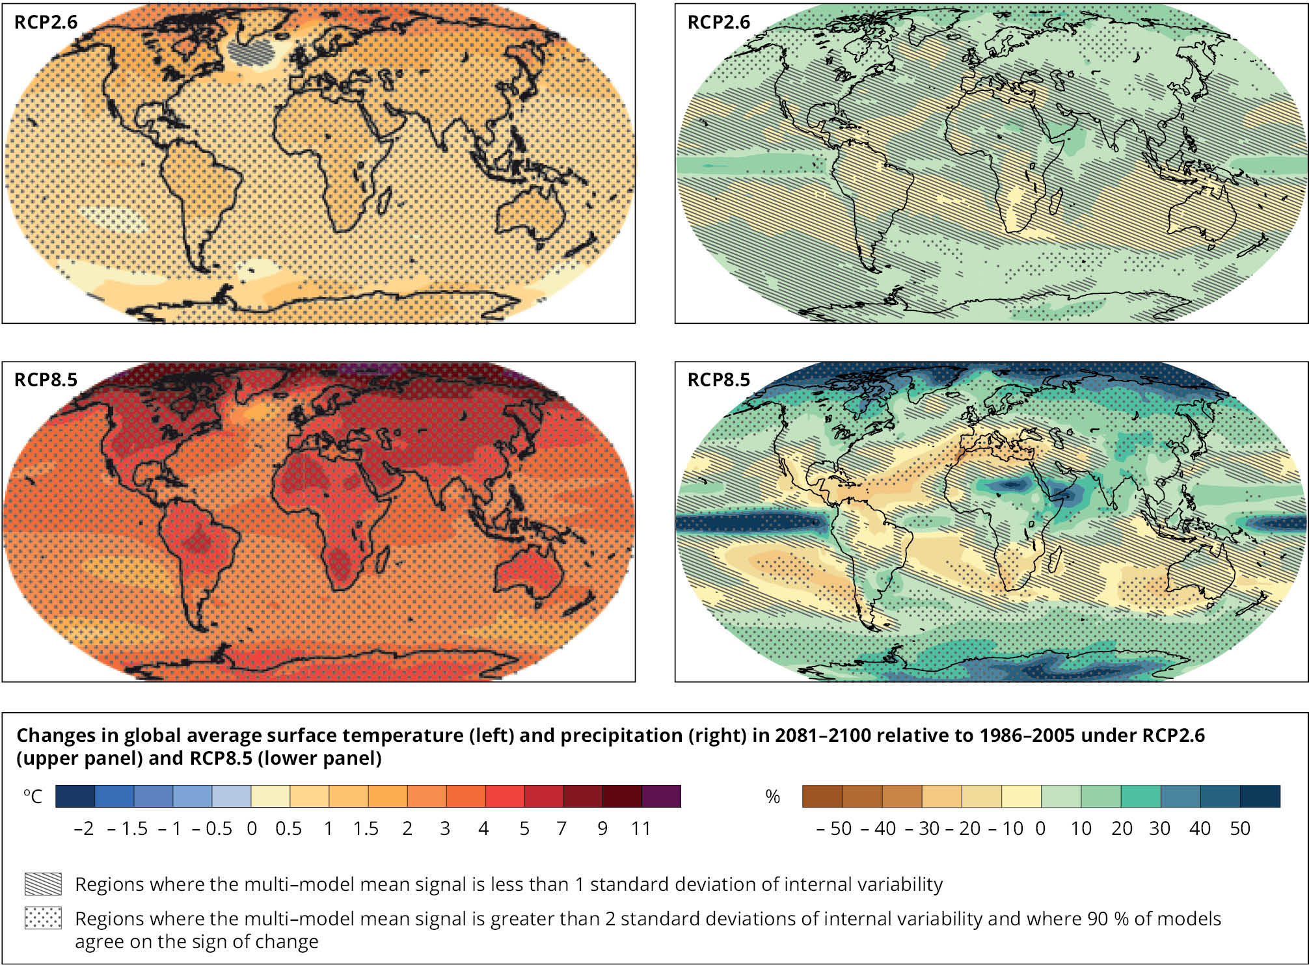
Climate change will continue throughout the century –
ambitious mitigation is required to limit the long-term risks
Increase in temperature
Change in precipitation
Ambitious
mitigation
scenario
(RCP2.6)
High
emissions
scenario
(RCP8.5)
Source: IPCC (2013)
Notes:
Climate change will continue for many decades in the future.
The rate and magnitue of future climate change depends on the effectiveness of global mitigation efforts.
Projected changes in temperature and precipitation (Map 3.2)

Slide 23
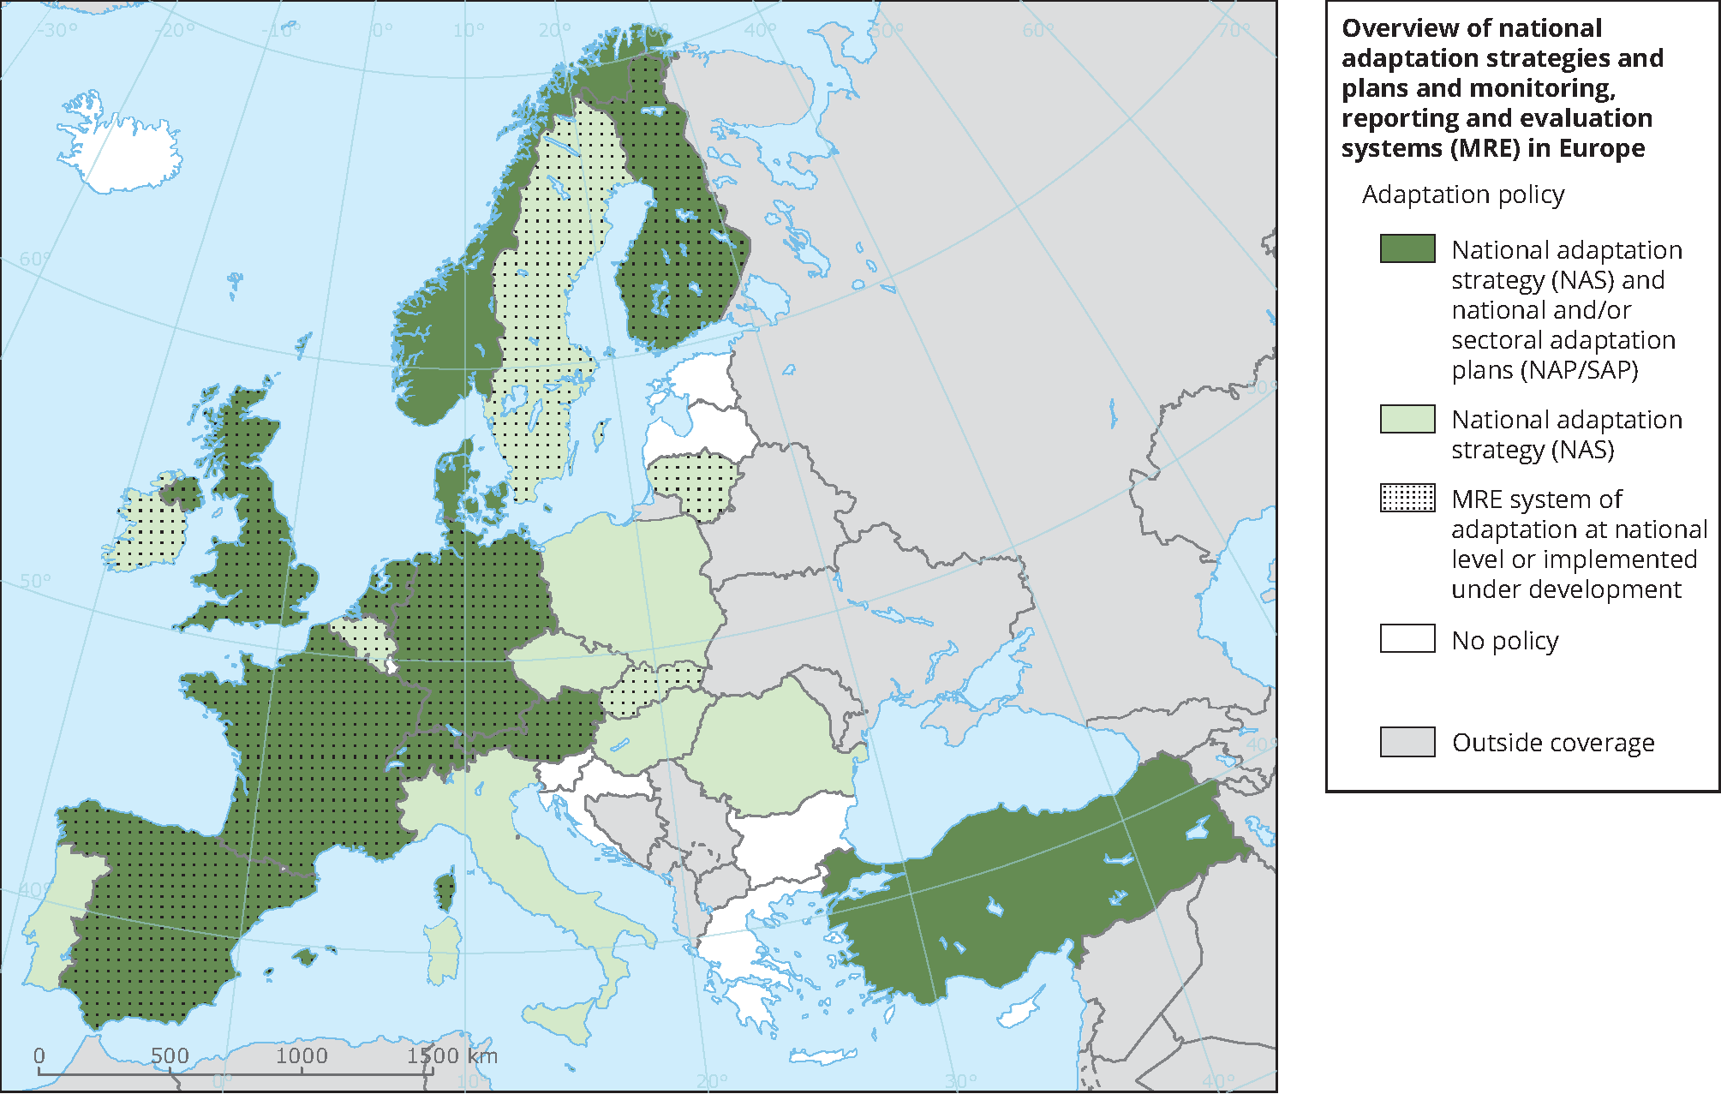
Most European countries have developed national adaptation strategies and/or action plans
State: May 2016
NAS adopted
after May 2016
Source: EEA (2016)
Notes:
Most countries in Europe have developed national adaptation strategies in recent years;
many countries have also adopted national and/or sectoral adaptation action plans.
An increasing number of countries is developing monitoring, reporting and evaluation systems for adaptation.
Overview of national adaptation strategies and action plans in Europe (updated from Map 2.1)

Slide 24
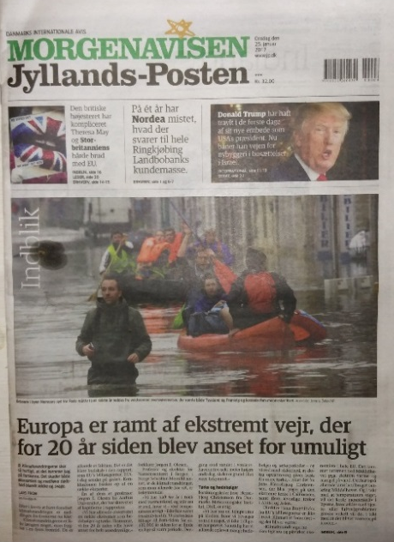
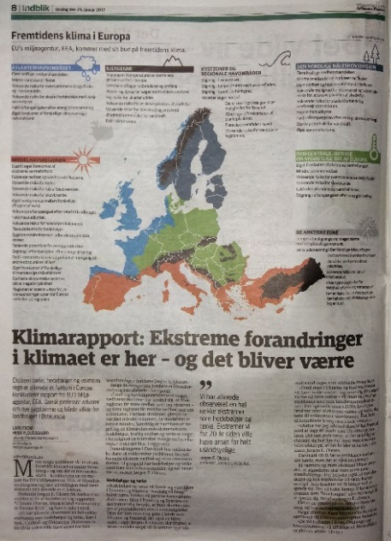
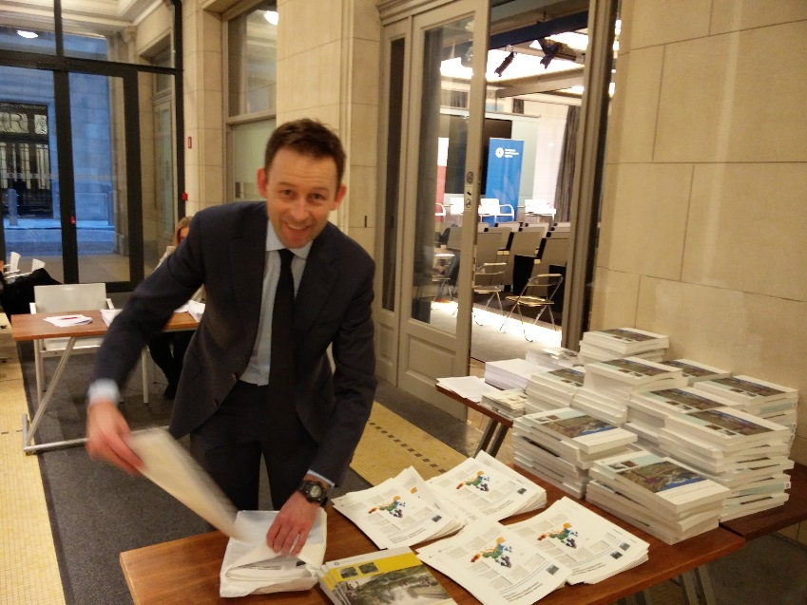
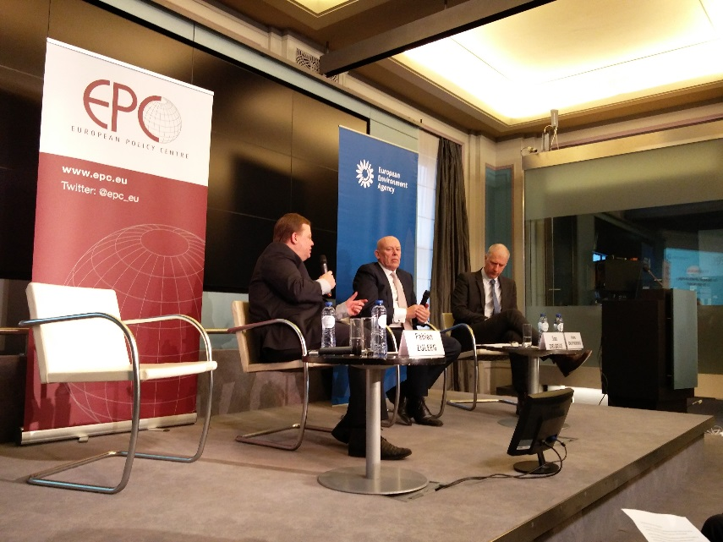
CCIV launch event in Brussels
Press pre-briefing on 24 January
  Journalists from leading newspapers
Official launch event on 25 January
  More than 100 participants
  Hans Bruyninckx (Exec. Dir., EEA) &
  Jos Delbeke (Dir. Gen., DG CLIMA)
  JRC, WHO, ECDC
  EEA Scientific Committee

Slide 25
Media outreach so far
Over 1000 articles
Potential reach 530-740 million
Major European print
and online media
Associated Press, Reuters,
Bloomberg, DPA, Xinhua

Slide 26
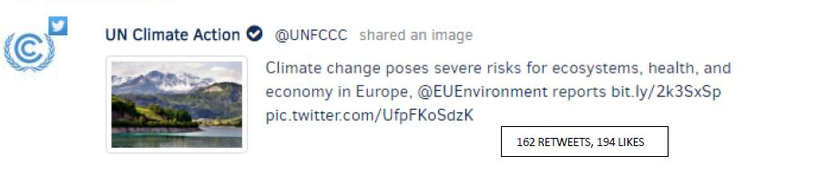
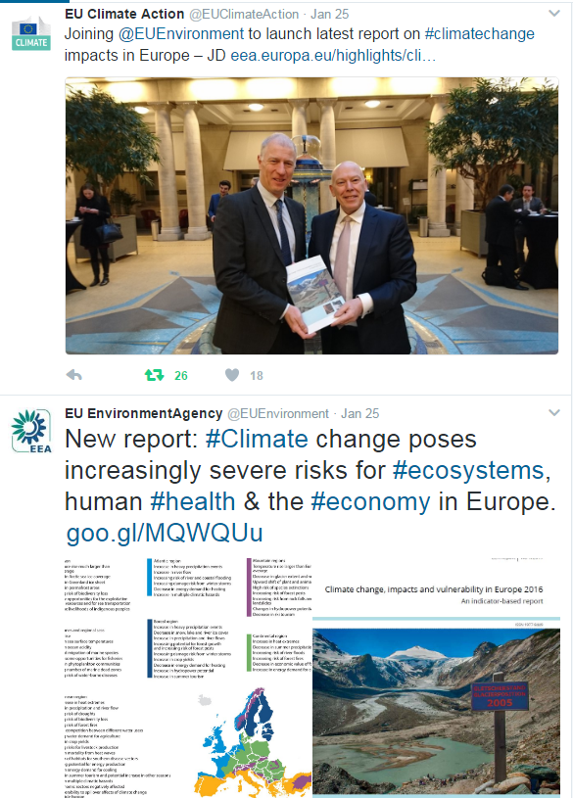
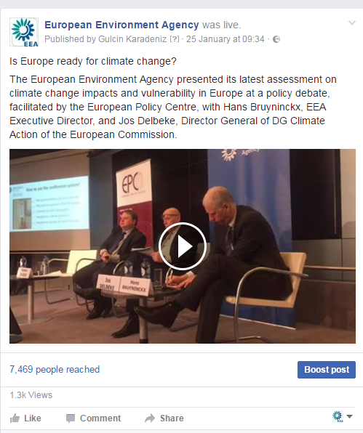
Social media outreach
Twitter: 9 tweets
69,650 impressions (number of views)
1,441 engagements
(link click, replies, retweets, likes etc.)
338 re-tweets
Facebook: 5 posts
168,695 impressions
4,487 engaged users
Facebook live video:
more than 1,000 unique viewers,
reaching more than
7,000 people within 36 hours

Slide 27
Thank you
The 2016 EEA CCIV report is available here:
eea.europa.eu/publications/climate-change-impacts-and-vulnerability-2016
All indicators underlying this report are available online:
eea.europa.eu/data-and-maps/indicators/#c5=climate-change-adaptation
Further information is available on Climate-ADAPT:
climate-adapt.eea.europa.eu
eea.europa.eu

