Slide 1
Gašper Šubelj | 17 November 2020 | BWD 2020 reporting webinar
BWD reporting on 2020 season:
Monitoring and Classification of Bathing Waters

Slide 2
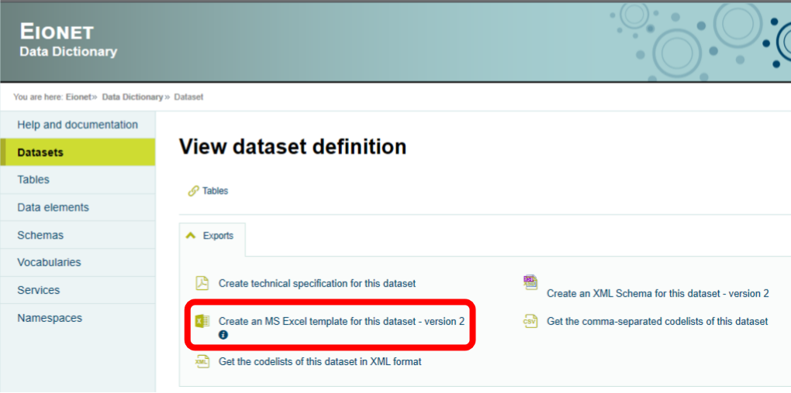
Composition of the dataset: Data Dictionary
Download the reporting template from the Data Dictionary: http://dd.eionet.europa.eu/datasets/latest/BWD_2006

Slide 3
Composition of the dataset
Monitoring results on intestinal Enterococci and Escherichia coli
Description of the bathing water season and other applicable periods
Characterisation of the bathing water

Slide 4
Composition of the dataset: Characterisation
*
Definition: year of the bathing season
Type: integer (gYear)

Slide 5
Composition of the dataset: Characterisation
Definition: unique identifier of a bathing water. Must be a valid bathing water identifier in the Protected Area registry.
Type: string, 3-43 characters

Slide 6
Composition of the dataset: Characterisation
Definition: unique identifier of the group of bathing waters. The identifier must follow the syntax rules set for the WISE identifiers.
Type: string, 3-43 characters

Slide 7
Composition of the dataset: Characterisation
Definition: national bathing water quality classification.
Type: integer
Codes: • 0 – not classified
• 1 – excellent
• 2 – good
• 3 – sufficient
• 4 – poor

Slide 8
Composition of the dataset: Characterisation
Definition: whether the bathing water is situated in a region subject to special geographical constraints in accordance with Annex IV of BWD.
Type: boolean (yes/no)
Codes: • 0 – no
• 1 – yes

Slide 9
Composition of the dataset: Characterisation
Definition: hyperlink to document or web pages with the bathing water profile established in accordance with Article 6 and Annex III of BWD.
Type: string, 0-2083 characters

Slide 10
Composition of the dataset: Characterisation
Definition: Remarks, comments or explanatory notes.
Type: string, 0-1000 characters

Slide 11
Composition of the dataset: SeasonalPeriod

Slide 12
Composition of the dataset: SeasonalPeriod
Definition: specifies the type of seasonal period.
Type: string
Codes: • bathingSeason
• bathingProhibition
• shortTermPollution
• abnormalSituation
• inaccessible
• qualityChanges
• cyanobacteriaBloom
• delisted
• other

Slide 13
Composition of the dataset: SeasonalPeriod
Definition: start date (YYYY-MM-DD) of the seasonal period. For some period types if the startDate is unknown or is yet undetermined, the conventional value '9999-12-31' should be reported.
Type: date

Slide 14
Composition of the dataset: SeasonalPeriod
Definition: Description of significant management measures taken in the scope of reported seasonal period. Additional information must be reported in the managementMeasures element for all period types except 'bathingPeriod'.
Type: string, 0-5000 characters

Slide 15
Composition of the dataset: MonitoringResult
*

Slide 16
Composition of the dataset: MonitoringResult
Definition: sampling date (YYYY-MM-DD).
Type: date

Slide 17
Composition of the dataset: MonitoringResult
Definition: Measured concentration of bacteria per sample in "colony forming unit" per 100 ml (cfu/100ml).
Type: integer

Slide 18
Composition of the dataset: MonitoringResult
Definition: information regarding missing samples, specific circumstances of samples etc.
Type: string
Codes: • missingSample (highest importance)
• confirmationSample
• shortTermPollutionSample
• replacementSample
• preSeasonSample (lowest importance)

Slide 19
Composition of the dataset: MonitoringResult
Definition: information regarding specific bacteria value.
Type: string
Codes: • confirmedValue
• limitOfDetectionValue
• missingValue

Slide 20
Specific issues in BWD reporting:
Management periods, delisting a bathing water
Bathing waters with disturbances in operation and management should be reported through different periods, namely: bathingProhibition, inaccessible, delisted.
The term "closed" is not used any more!
More than one period can be reported for describing the same situation/event.
periodType | Possible reasons | Related to water quality | Still officially identified | Duration of the period
bathingProhibition | Short-term pollution, poor quality annual status, or expected pollution due to foreseen reasons | Yes | Yes | Temporary or permanent
inaccessible | Physical inaccessibility due to earthquake, eroded path, construction on the site; or legal reasons that impede bathing and monitoring | No | Yes | Temporary or permanent
delisted | Decreased number of bathers, implementation of protected area that does not allow bathing, long-term poor quality (more than four years) | Yes or no | No | Permanent - no identification planned for the future

Slide 21
Specific issues in BWD reporting:
Management periods, delisting a bathing water
More than one period can be reported for describing the same situation/event. List of the available periods in the DD, accessible through BWD Help section.
Sheet „seasonalPeriod“:

Slide 22
Specific issues in BWD reporting:
Short-term pollution
One reported period, three reported samples.
Sheet „seasonalPeriod“:
Sheet „MonitoringResult“:

Slide 23
Specific issues in BWD reporting:
Bathing water groups
Sheet „Characterisation“:
Sheet „seasonalPeriod“:
Sheet „MonitoringResult“:

Slide 24
We support you
BWD Help section
http://cdr.eionet.europa.eu/help/BWD/
BWD Helpdesk
bwd.helpdesk@eionet.europa.eu
CDR Sandbox
https://cdrsandbox.eionet.europa.eu/
User: datareporter | Password: datareporter

