Slide 1
Data call for 2020 bathing season:
Identification of Bathing Waters – Frequently Asked Questions

Slide 2
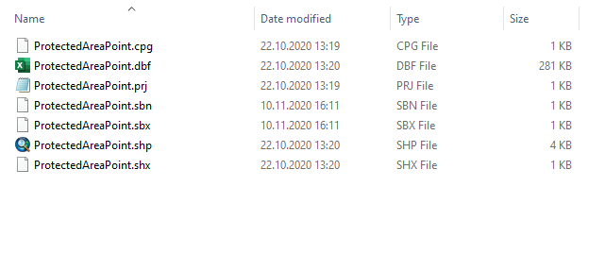
The SHP was not converted to GML, how can I convert it?
1. The SHP was not converted to GML, how can I convert it?
You should save all the files composing SHP file as „ProtectedAreaPoint“, put it in the folder with the same name and compress the folder into ZIP file.

Slide 3
WFD SWB codes (relatedZoneIdentifier and relatedZoneIdentifierScheme)
2. What if a bathing water is not within a WFD waterbody? Can I report the code which was in the old format ‘NWUnitID’
If bathing water is not situated on WFD (or EIONET) water body, you do not have to fill relatedZoneIdentifier and relatedZoneIdentifierScheme.
Please do not report previous "NWUnitID" since the Automatic QC will not find these codes in the WISE register and will return Blockers.
The following link may help you to verify which SWB codes are included in the WISE register: https://dd.eionet.europa.eu/vocabulary/wise/SurfaceWaterBody/view

Slide 4
New bathing waters
3. Should wiseEvolutionType=‘creation’ only be used for new bathing waters identified in 2020 and entry of ‘creation’ be removed for any bathing waters identified in previous year?
Correct! wiseEvolutionType='creation' is reserved only for bathing waters which were in 2020 season operating for the first time and whose identifiers are thus not yet registered in the WISE registry. Bathing waters which were newly identified in one of the previous seasons should have wiseEvolutionType updated to 'noChange' (if there was indeed no change applied to the geometry of the object)

Slide 5
beginLifeSpanVersion & endLifespanVersion
4. How do I report beginLifeSpanVersion and endLifespanVersion?
beginLifespanVersion can be filled with a valid date which can be equal to the date when this version of spatial object was created (e.g. if you are editing the dataset today you can report today's date: 2020-12-01). The attribute should be filled with a valid date for new bathing waters (wiseEvolutionType= ‘creation‘) or when changes to the existing object are applied (wiseEvolutionType= 'change‘, 'changeCode‘, 'aggregation‘, 'splitting', 'changeBothAggregationAndSplitting‘).
You are also welcomed to report inspireIdVersionId (when changes to the object are applied). For the 2020 reporting you can simply report ‘BWD2020‘.
If you did not apply any changes to the object (wiseEvolutionType=‘noChange‘), you do not have to update beginLifespanVersion and inspireIdVersionId!

Slide 6
No change
5. Is it correct to use wiseEvolutionType=‘noChange’ where no changes at all have occurred since last reporting, or should the field be left blank in this case?
The field cannot be left blank. Please report 'noChange'.

Slide 7
Not applicable attributes
6. The description of some fields available in pre-filled dataset is not available in WISE BWD Guidance? What values should be reported under these fields?
Following fields are used by the EEA and ETC and do not require your attention: cYear, confStatus, lon, lat, statusCode, statusDate, remarks and qcCheck. You do not have to change the values reported in these fields. If you report new bathing waters, you can simply leave them empty (NULL).

Slide 8
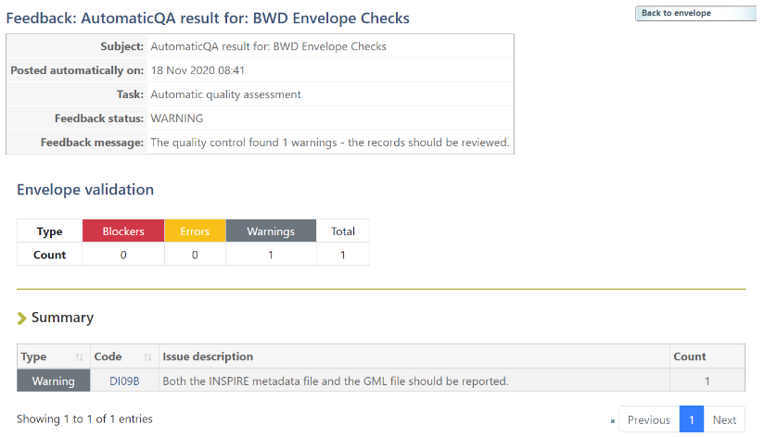
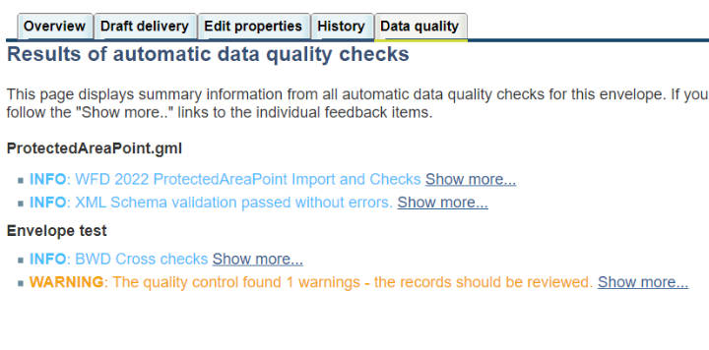
INSPIRE metadata file
7. After I corrected the data and submitt „blocker-free“ delivery, the QC returned one only a warning that I could not sort out…
Please ignore warning DI09B as it is not (yet) applicable for BWD reporting.
It will however become relevant in years to come when INSPIRE metadata file will have to be delivered beside GML file.

Slide 9
wiseEvolutionType=‚change‘
8. Should be wiseEvolutionType=‘Change‘ when the bathing water name (nameText) has changed from previous report?
wiseEvolutionType= ‘Change‘ should be applied only to bathing waters where minor changes to the geometry were applied (e.g. minor adjustments to the bathing water location). If you only update the bathing water‘s name (nameText) and you did not change bathing water‘s location you can update the wiseEvolutionType to 'noChange'.

Slide 10
Name of the attributes in SHP and GML
9. Name of the columns in the attribute table of the pre-filled shapefile are different from those in the webinar presentation. Should we update field names?
GML | SHP
inspireIdLocalId | localId
inspireIdNamespace | namespace
inspireIdVersionId | versionId
thematicIdIdentifier | tematicId
thematicIdIdentifierScheme | thematicIdSch
beginLifespanVersion | beginLife
endLifespanVersion | endLife
predecessorsIdentifier | predecesId
predecessorsIdentifierScheme | predeIdSch
successorsIdentifier | successoId
successorsIdentifierScheme | succesIdSch
wiseEvolutionType | wEvolution
nameTextInternational | nameTxtInt
nameText | nameText
nameLanguage | nameTxtLan
designationPeriodBegin | desigBegin
designationPeriodEnd | desigEnd
zoneType | zoneType
The attributes in the SHP files have been shortend because SHP format supports only attribute names not longer than 10 characters. When the SHP is converted to GML using the online converter, the full attribute names are created.
Please do not change the field names because this will be done within the conversion!

