Slide 1
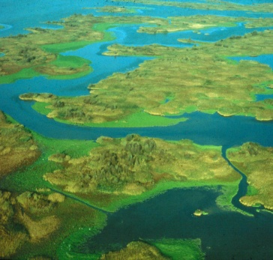
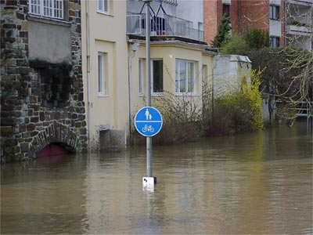
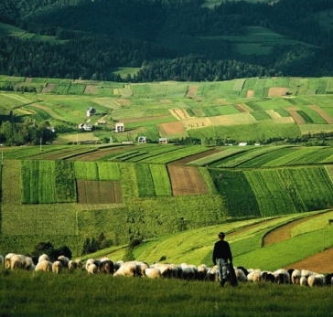
2012
State Of Water Reports
Eionet- stakeholder Workshop
-- Synthesis and concluding structure
Beate Werner

Slide 2
Water 2012 – suit of assessments
Other EEA reports
2011 Chemicals report
2012 Bathing water report
Coastal report
Climate Change impact indicator report
Urban adaptation
Cohesion fund report
& Results from different COM contracts on resource efficiency and scenarios
Water resources and efficiency; water economics;
Hydromorphology, state and pressures;
Water and vulnerability (WS&D, floods;)
Freshwater status, biodiversity and related pressures;
Synthesis – integrated assessment

Slide 3
Blueprint
Blueprint impact assessment
DG ENV
Synthesis 2012 EEA report linking thematic assessments in strategic perspective
EEA
EEA 2012 water report 4 “Thematic assessments” details of evaluation WFD, state/pressures, WS&D, CC adaptation, Wa Accounts
3
Notes:
3

Slide 4
human and ecological economy thresholds of sustainability
Distance to Target - to fit availability
- Depreciation of natural capital
Natural system
Trans-
port
Agri- culture
Public supply
Indus- tries
Energy
Leisure
Sustainability thresholds; e.g.
Good Ecological Status (WFD), environmental flow
EEA, Modified after S. Postel / Natural Resources Forum 27 (2003); 89-98
Notes:
The intensity of human activities puts the integrity of our ecosystems on risk
However there is not only a competition between nature and human economy; there is also a competition between different human uses and different economic sectors, which might depending on Region and Priorities lead to a different balance.
However, all activities together should not impair the integrity of the natural system regarding water quantity, water quality, and any other functions we could call non-extractive or in-stream benefits (swim in, drive on, retain flood, sediment transport….)
The ecological limit of sustainability could be for example posed with the requirement of good ecological status under the WFD.
We need to find tangible expressions of how to compare the intensity and value of the different elements. – to account for them in cost benefit analyses is so far the most discussed. –
The WFD has with several provisions and elements put focus on the economic aspects end requires the specification also of environmental and resource costs
The methodology of water accounts given by the Hand book of economic and environmental accounts for water (SEEAW) is developed on a global level, but not yet too much in EU; EEA is actively working to implement it and promote the integration of water accounting approaches into the water administration governed by the WFD implementation.
It is not the good ecological status itself that costs, but the way to get there.

Slide 5
Resilience and decoupling – distance to target for resource management
Economic water use
- Sectors
Ecosystem
Functionality,
maintanance of
provisioning services
Resilience-stress
Pressures
Abstraction, Use, pollution
Environmntal flow,
Retention, biodiv.
Nat. capital
accounts
reduce
Targets to
Keep
functionality
Resource
Efficiency to
Reduce pressure
Impact
decoupling

Slide 6
EEA synthesis → policy questions for the Blue Print
Summary of TA
Integration across policies and in economic perspective how better implement WFD; CAP, UWWTD, Economics, env. flows,…
-Relation to the main policy issues and responses keep WFD + find ways for improving water resource management
Resource efficiency
Vulnerability
Tools
Unlocking measures
Economic incentives
Governance
Knowledge Base & Innovation
Hydromorphology
Ecological status

Slide 7
Structuring 2012 thematic assessments
synthesis
EEA-reports
✓
Baseline status
RE
Vul
Other EEA reports
Tech. Reps.
ECOSTAT
HYMO

Slide 8
EEA synthesis → 5 policy areas of the Blue Print
Summary TA
Forward looking vision
Integration across policies and in economic perspective
-Relation to the main policy issues and responses
tools, WA
Promising measures
Economic incentives
Governance
Knowledge Base &Innovation
Impl./Integr./Compl.
Pressures/measures&2015; Biodiv/status; Indicators; EU27/EEA, land use, ES serv, WA
VUL
HYMO
Status
ECOSTAT
RE

Slide 9
Synthesis easy to read report & interlinking all material in a web platform
Baseline on Europe’s status of water resources
Quality; ii. Quantity; iii. Hydromorphology
Water resource management
Land use ii. Energy iii. Nature across sectors,
Good cases for promising measures & governance
Towards water management in 2050
perspective 2015 status-pressures-measures, indicators
perspective for EEA/nonEU 27
in a wider framework of ecosystem assessments
Notes:
How to deal with the short term/ long term vision?

Slide 10
Coordination EEA thematic assessments and COM Blueprint
Inf. Council CY
EIONET-review & WS
6th WWF
EU H2O
BP + ImpA
Policy options
Impact assessment
IA - consultation
EcoS TR
RE Rep
Hymo TR
Vul. Rep
Syn thesis
Jan.
March
June
Nov.
Hymo, Ecostat as technical reports on the web with web announcement RE, Vul and Syn as full EEA reports printed and launched;

Slide 11
Thank you for you attention

