Slide 1


WISE – Freshwater WFD visualization tool
Eionet Freshwater workshop
14-15 June 2018
Peter Kristensen
European Environment Agency (EEA)

Slide 2
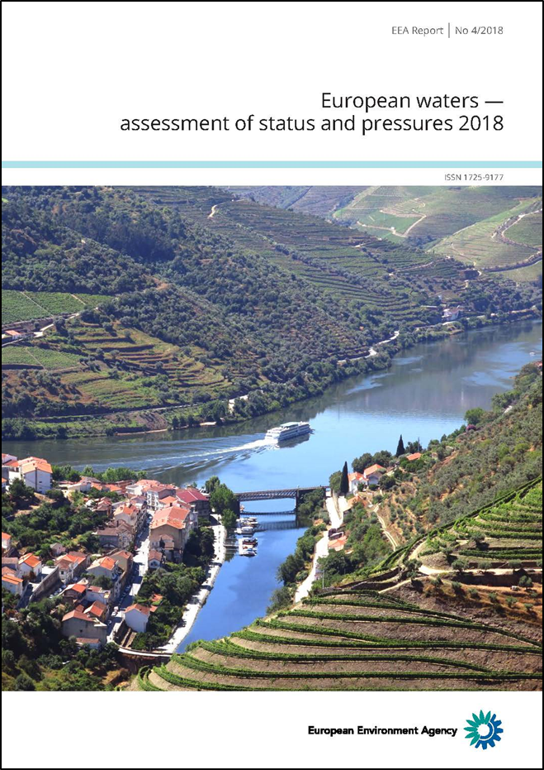
European waters - assessment of status and pressures 2018

Slide 3
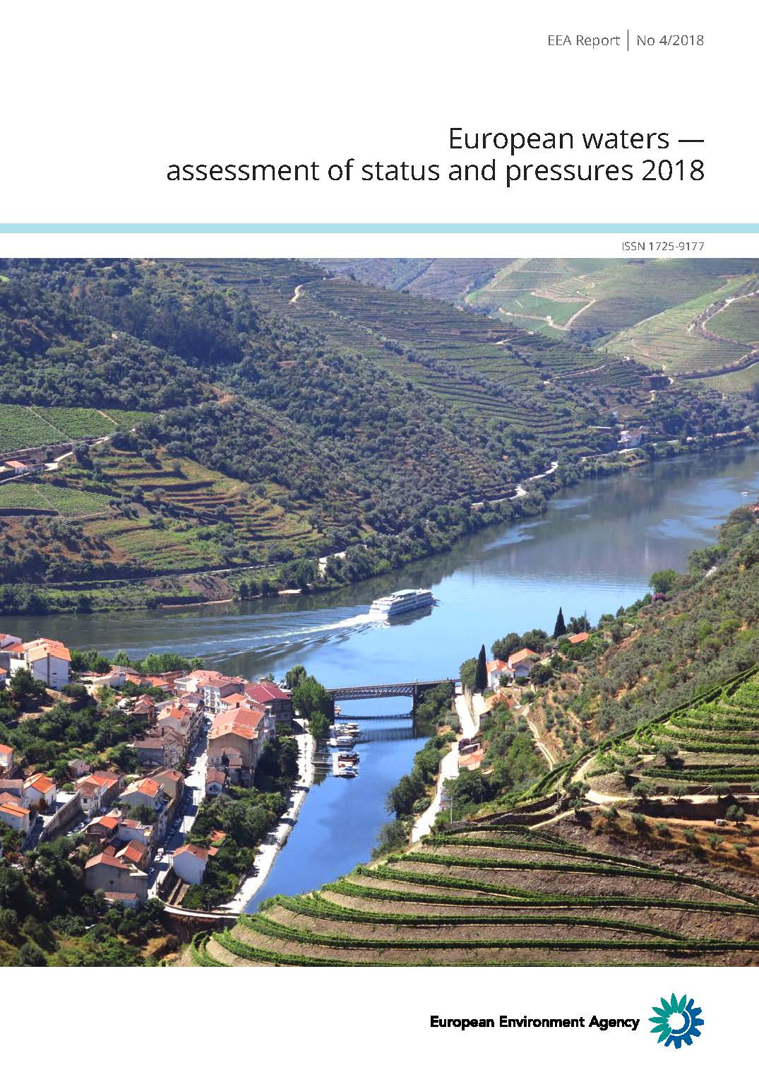


European waters - assessment of status and pressures 2018
The report aims to present results on:
the status of EU waters, based on the second River Basin Management Plans (RBMPs);
the pressures that are causing less than good status;
the progress that was achieved during the first RBMP cycle (2010-2015).
The report presents key results, while more detailed results are presented in an interactive tool in WISE-Freshwater (incl also the transitional and coastal waters).
Ecological status Chemical status

Slide 4
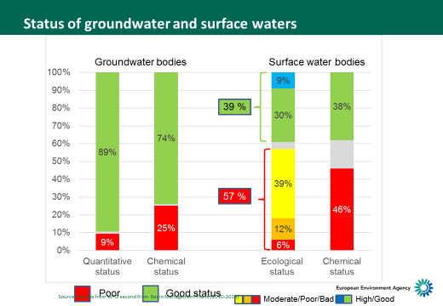
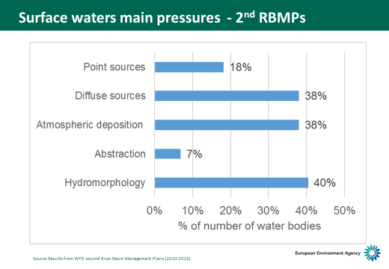
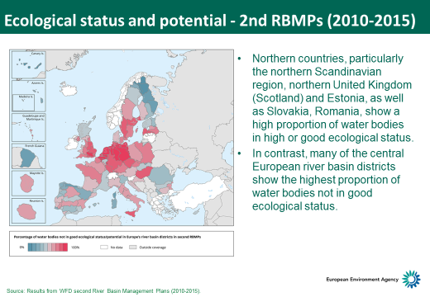
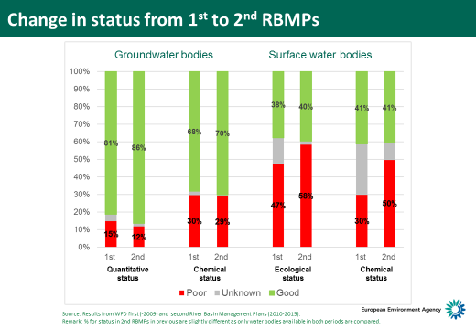

Slide 5
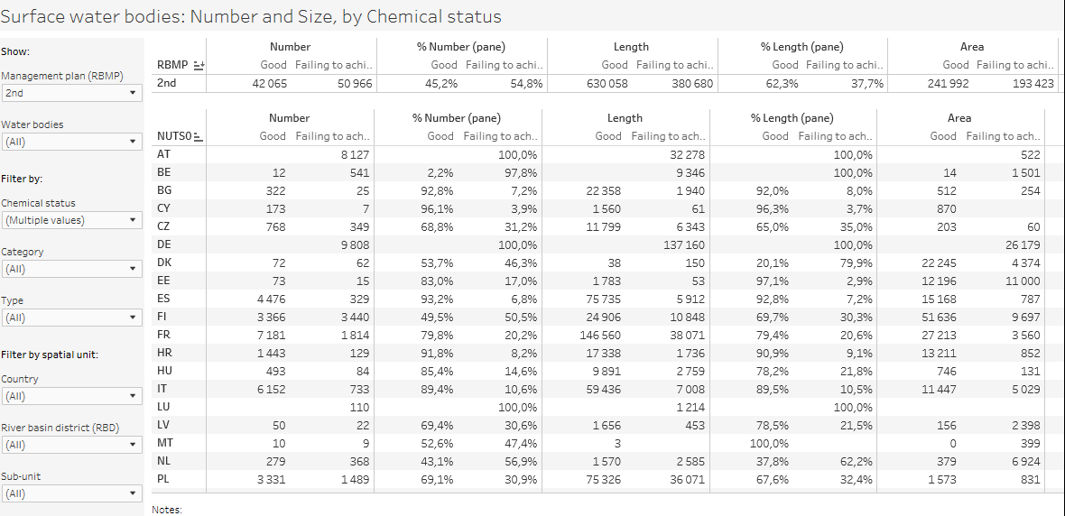
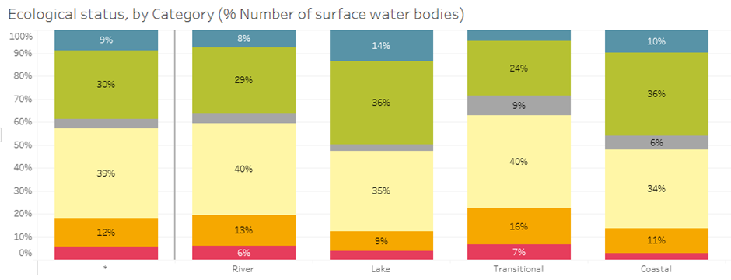
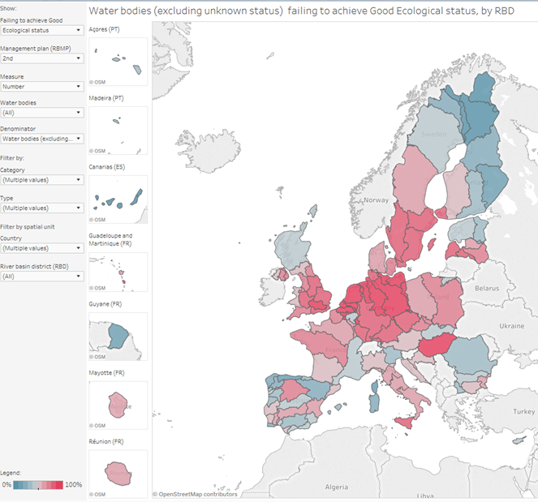
WISE-Freshwater WFD visualisation tool
Tables
WFD
2nd RBMPs
2016 WFD reporting guidance
WISE
SoW
Db
Graphs
WFD
1st RBMPs
Interactive maps
2010 WFD reporting guidance
Blue: Tables; Green: Graphs; Orange: Maps

Slide 6
WISE-Freshwater visualisation tool
(including all the water categories)
More detailed results are presented in an interactive tool in WISE-Freshwater.
WISE-Freshwater visualisation tool is based on data reported by Member States in 2nd and 1st RBMPs*
The tool present tables, graphs and maps on status and pressures aggregated to EU, Member States, RBD and subunit level.
The current version has +160 dashboards (see overview in last slides) on status and pressures.
Dashboards on monitoring and methodologies are planned during the autumn 2018 or in 2019.
EEA hopes that Eionet NRCs and the CIS Working Groups will use and further access the information presented
Disclaimer: Caution is needed when comparing results between Member States and between the first and second RBMPs, as the results can be significantly affected by the methodology applied by individual Member States.
*EU28 Member States, except Greece, Ireland and Lithuania (due to late reporting)
Norway is also not included for the same reason (reporting finalized last week)

Slide 7
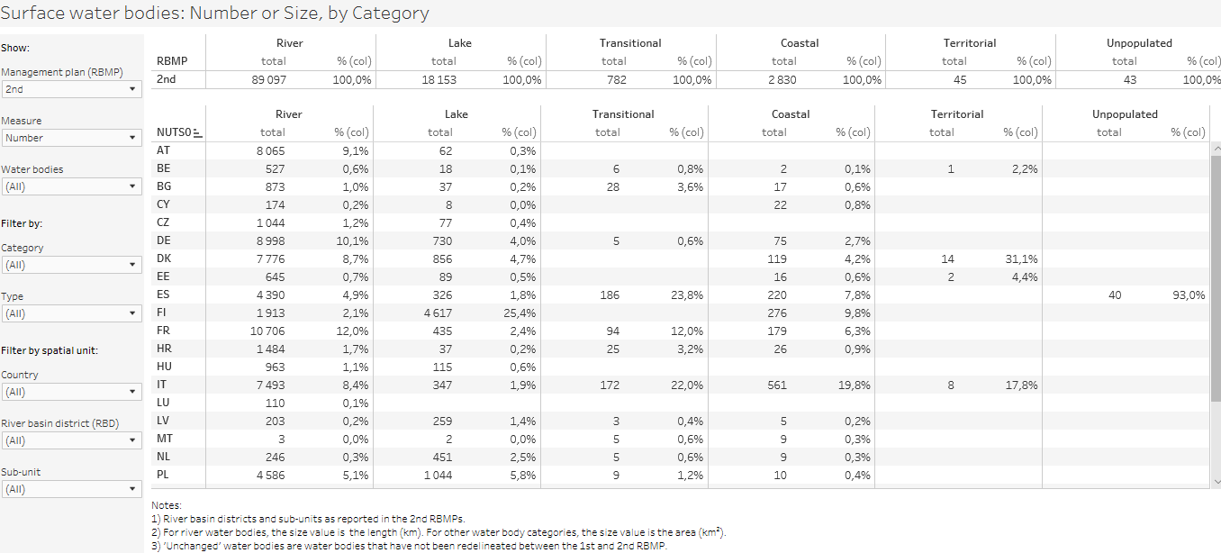
Explanation of tabular information
Title
EU results
Filters,
e.g.
1st & 2nd RBMPs
Measure (number or size)
Category RW,LW,TW,CW
Type (natural, HMWBs)
Spatial scale
Status
Member State results
scroll down RBDs, subunits
Notes
Surface water bodies: Number and Size

Slide 8
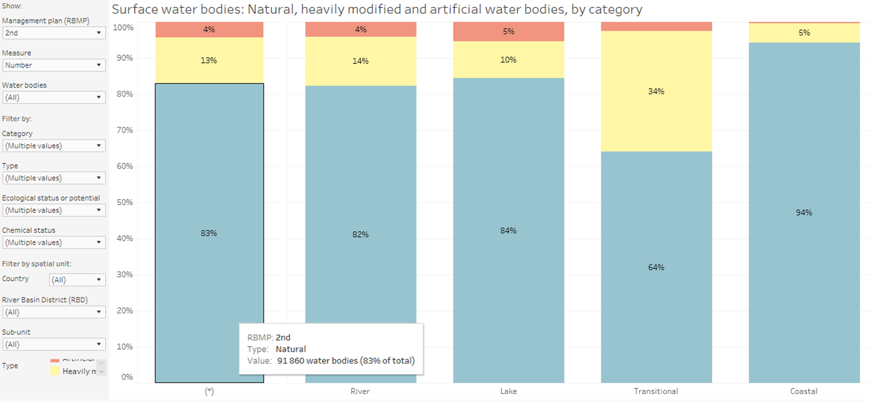
Graphs – general template
Graph shows % natural (blue), HMWBs (yellow), AWBs (red)
Title
Filter,
Selections
e.g.
1st & 2nd RBMPs
Measure
Category
Type
Spatial scale
Status
EU results (default) or selection
Pop-ups – tool tips
(*)
All in selection
River
Lake
Transitional
Coastal
Surface water bodies: Natural, heavily modified and artificial water bodies, by category

Slide 9
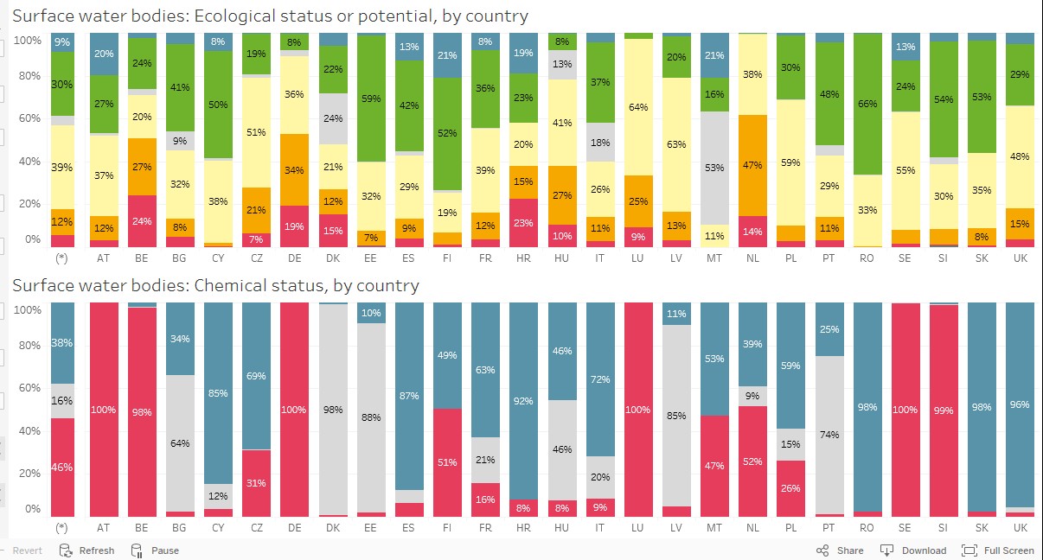
Surface water bodies: Ecological status or potential and chemical status, by country
Alternative; Chemical status with and without uPBTs
Surface water bodies: Chemical status with and without uPBT maps, by RBD

Slide 10
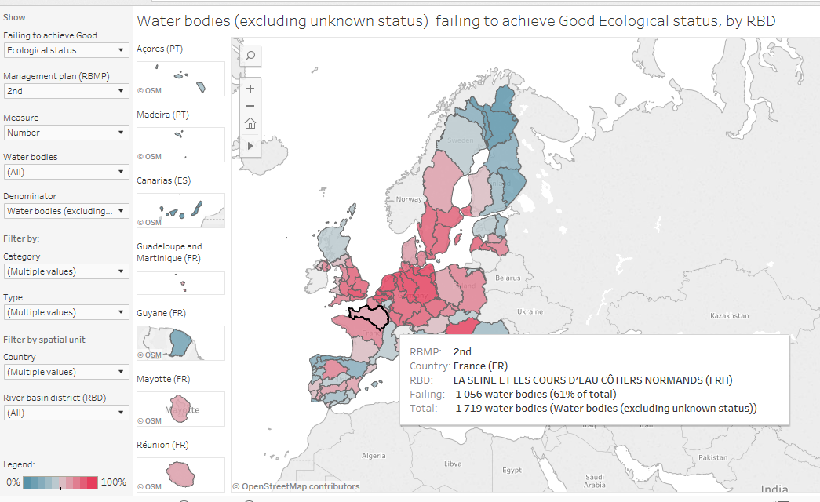
Surface water bodies failing to achieve good status, by RBD LINK
Select ecological status
Surface water bodies failing to achieve good status, by RBD

Slide 11
Filters and selections (left side of each dashboard)

Slide 12
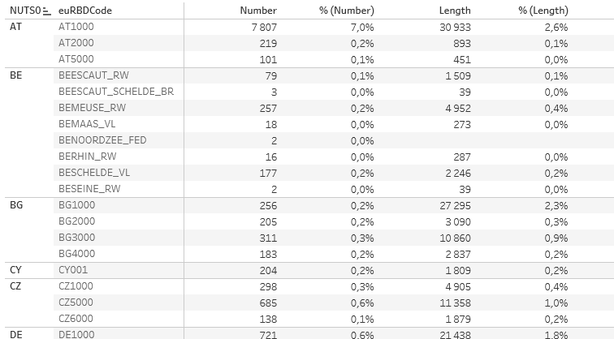
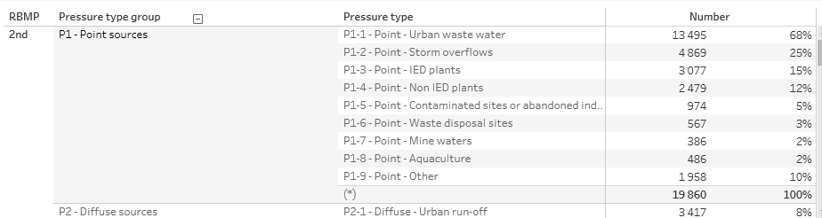
Functions: scroll down, sort, exclude etc.
Example: scroll down RBDs
Example: scroll down pressures

Slide 13
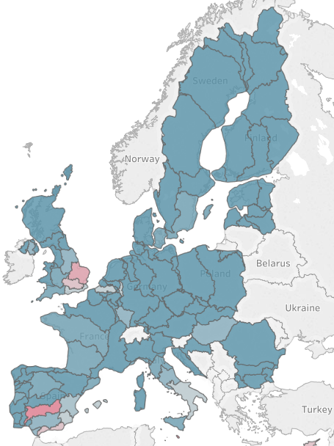
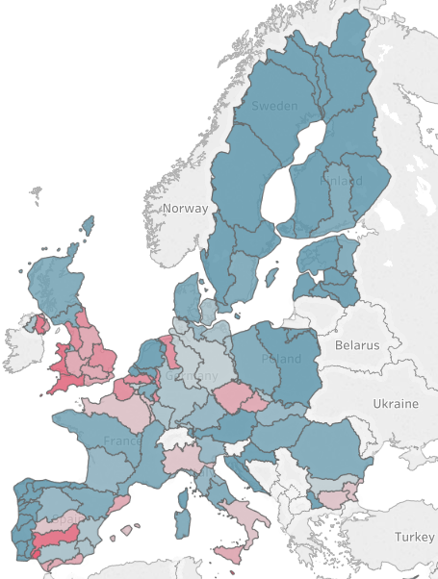

Groundwater status (% water body area)
Quantitative status Chemical status
Groundwater chart

Slide 14
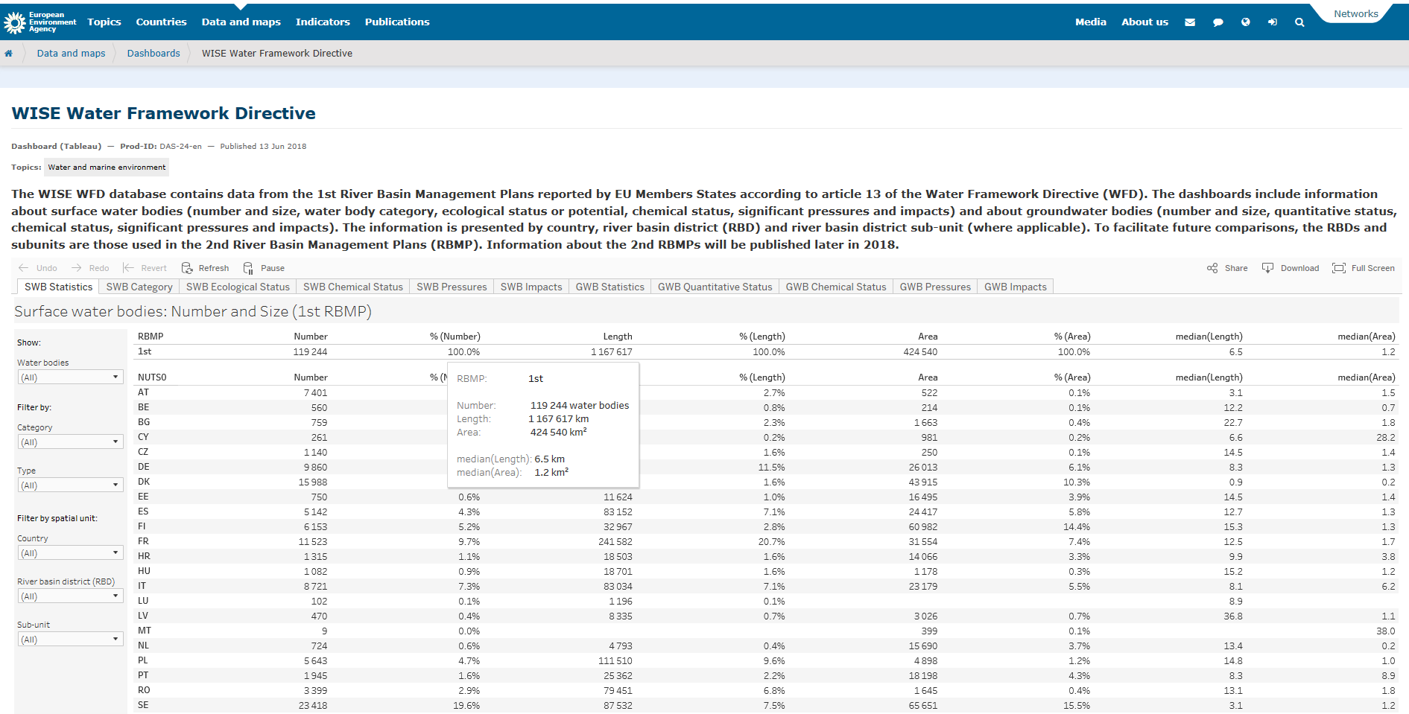
WISE-Freshwater WFD visualisation tool
Available at EEA homepage – and in WISE
https://www.eea.europa.eu/data-and-maps/dashboards/wise-wfd

Slide 15
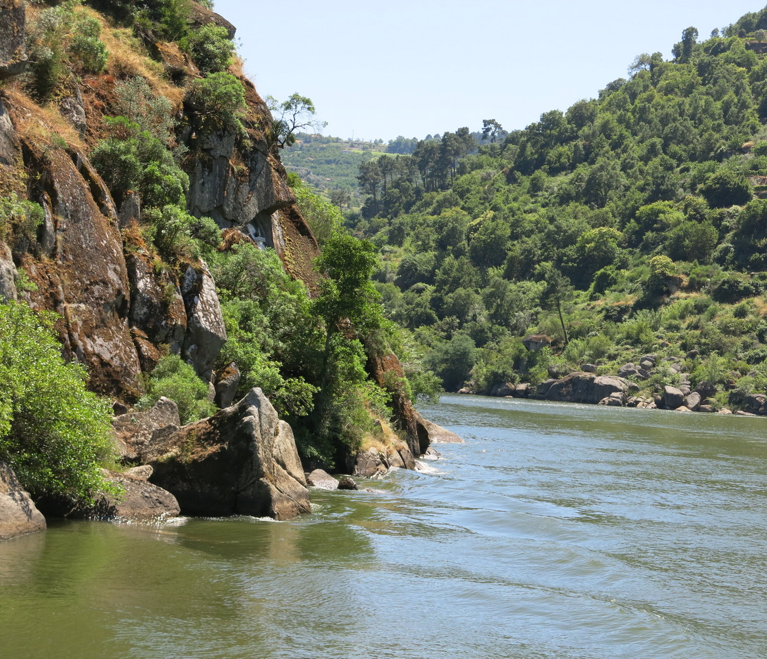
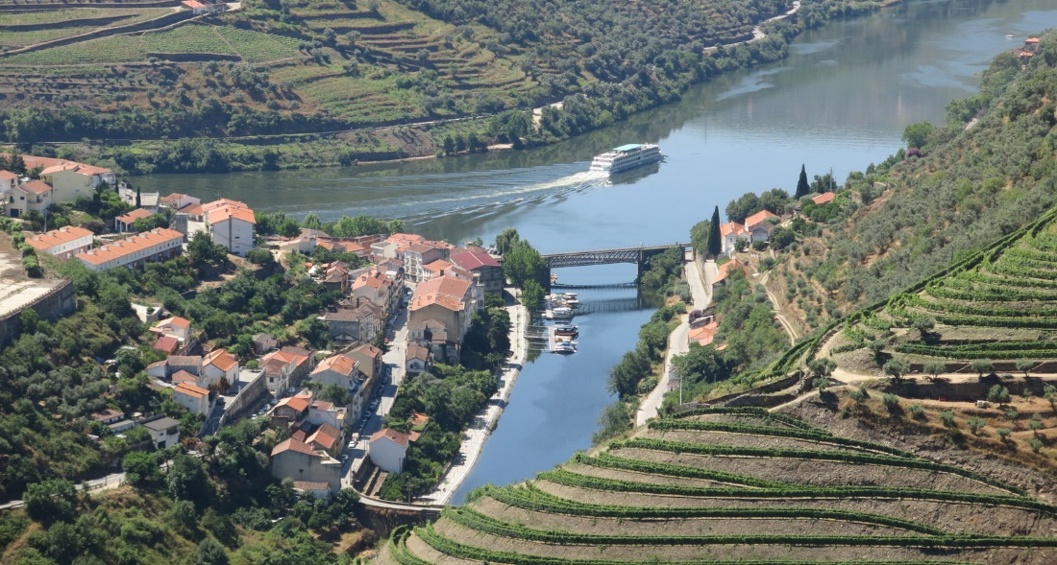
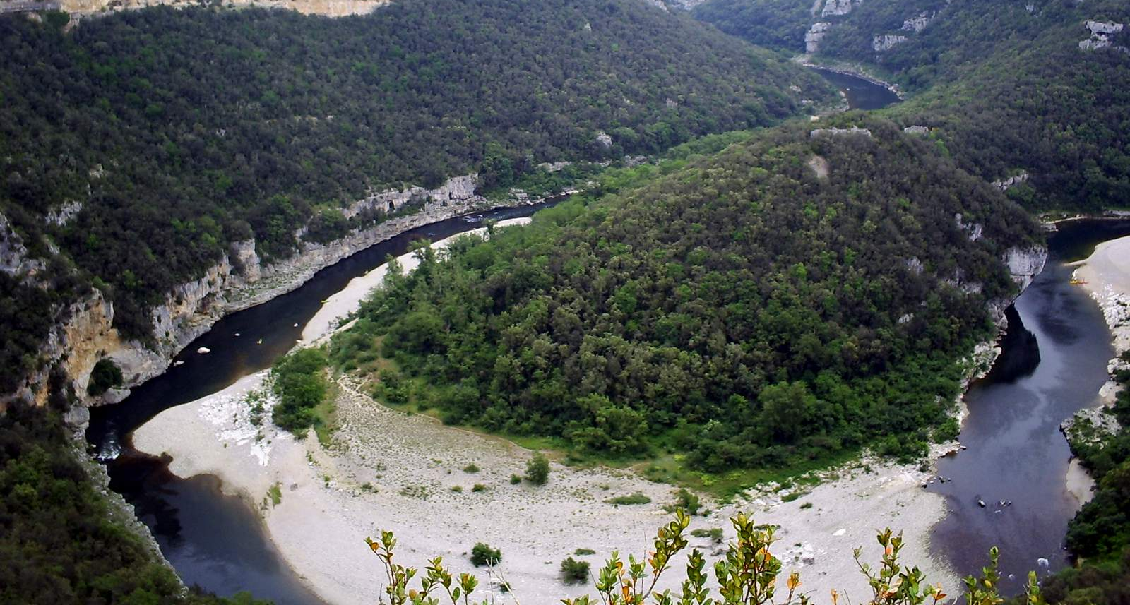
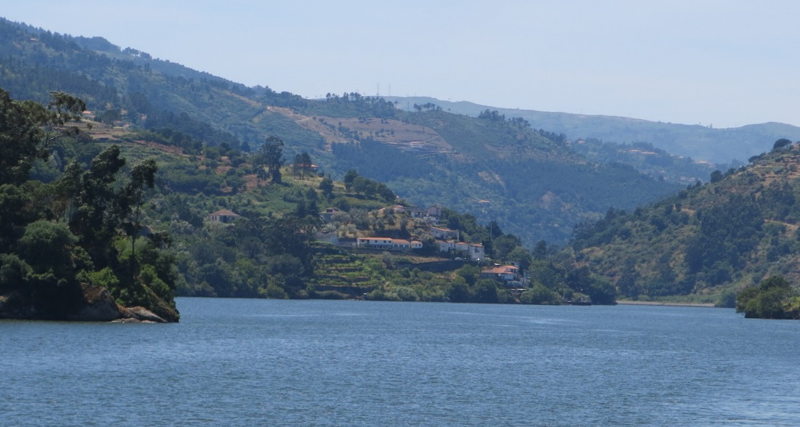
Thanks also to Member States, Reporters, colleagues in DG Environment, ETC-ICM, Bilbomatica and at EEA, particularly Fernanda Nery and Caroline Whalley.
Questions?
Peter.Kristensen@eea.europa.eu

Slide 16

Thank you for your attention
Many (+150) more dashboards and information on monitoring are available,
see the following slides
Questions
Peter.Kristensen@eea.europa.eu
eea.europa.eu

Slide 17
Delineation of water bodies (number, length, area, natural, heavily modified and artificial)
Surface water bodies: Number and Size
Surface water bodies: Number and Size
Surface water bodies: Number or Size, by Category
Surface water bodies: Number or Size, by Category and Type (natural, heavily modified and artificial)
Surface water bodies: Natural, heavily modified and artificial water bodies
Surface water bodies: Natural, heavily modified and artificial water bodies, by category
Surface water bodies: Natural, heavily modified and artificial water bodies, by country
Surface water bodies: Natural, heavily modified and artificial water bodies, by category and country
Surface water bodies: Physical alterations and designated water uses
Surface water bodies: Physical alterations
Surface water bodies: Designated water uses
Surface water bodies: Delineation of the management units in the 2nd and 1st RBMP
Surface water bodies: delineation of the management units in the 1st and 2nd RBMP
Surface water bodies: Delineation of water bodies in the 2nd and 1st River Basin Management Plans (RBMP)
Surface water bodies: Evolution type, by category
Surface water bodies: Evolution type, by country
Surface water bodies: Evolution type, by category and country
Groundwater bodies
Groundwater bodies: Number and Size (aquifer type, productivity)
Groundwater bodies: Delineation of water bodies in the 2nd and 1st RBMP
Groundwater bodies: Evolution type, by geological formation
Groundwater bodies: Evolution type, by country
Groundwater bodies: Evolution type, by geological formation and country
Blue: Tables; Green: Graphs; Orange: Maps

Slide 18
Ecological status and potential
Surface water bodies: Status
Surface water bodies: Number and Size, by Ecological status or potential
Surface water bodies: Number or Size, by Category and Ecological status or potential
Surface water bodies: Ecological status or potential and chemical status
Surface water bodies: Ecological status or potential and chemical status, by category
Surface water bodies: Ecological status or potential and chemical status, by country
Surface water bodies: Ecological status or potential and chemical status, by category and country
Surface water bodies: Status maps
Surface water bodies failing to achieve good status, by RBD
Surface water bodies failing to achieve good status, by country
Surface water bodies failing to achieve good status, by country and RBD
Surface water bodies: Expected status
Surface water bodies: Good ecological status expected in 2015
Surface water bodies: Good ecological status expected achievement date
Surface water bodies: Status assessment confidence
Surface water bodies: Ecological status assessment confidence
Surface water bodies: Ecological status or potential and chemical status assessment confidence
Surface water bodies: Ecological status or potential and chemical status assessment confidence, by category
Surface water bodies: Ecological status or potential and chemical status assessment confidence, by country
Surface water bodies: Ecological status or potential and chemical status assessment confidence, by category and country
Surface water bodies: Ecological status or potential in the 2nd and 1st RBMP
Surface water bodies: Ecological status or potential, by category
Surface water bodies: Ecological status or potential, by country
Surface water bodies: Ecological status or potential, by category and country
Ecological status: Intercalibration types, broad types and by sea regions

Slide 19
Ecological status and potential – quality elements
Surface water bodies: Quality element status
Surface water bodies: Quality element status
Surface water bodies: Quality element group status
Surface water bodies: Quality elements with less than good status or with moderate, poor or bad status - overview
Surface water bodies: Quality element status
Surface water bodies: QE status, by category
Surface water bodies: QE status, by quality element and category
Surface water bodies: QE status, by quality element and country
Surface water bodies: QE status, by quality element, category and country
Surface water bodies: Quality element group status
Surface water bodies: QE group status, by category
Surface water bodies: QE group status, by quality element and category
Surface water bodies: QE group status, by quality element and country
Surface water bodies: QE group status, by quality element, category and country
Surface water bodies: Quality element status in the 2nd and 1st RBMP
Surface water bodies: QE status in the 2nd and 1st RBMP, by category
Surface water bodies: QE status in the 2nd and 1st RBMP, by quality element and category
Surface water bodies: QE status in the 2nd and 1st RBMP, by quality element and country
Surface water bodies: QE status in the 2nd and 1st RBMP, by quality element, category and country
Surface water bodies: Quality element group status in the 2nd and 1st RBMP
Surface water bodies: QE group status in the 2nd and 1st RBMP, by category
Surface water bodies: QE group status in the 2nd and 1st RBMP, by quality element and category
Surface water bodies: QE group status in the 2nd and 1st RBMP, by quality element and country
Surface water bodies: QE group status in the 2nd and 1st RBMP, by quality element, category and country

Slide 20
Ecological status and potential – quality elements II
Surface water bodies: Number of Quality Elements used in the assessment of the Ecological status or potential
Surface water bodies: Number of quality element used, by category
Surface water bodies: Number of quality element used, by country
Surface water bodies: Number of quality element used, by category and country
Surface water bodies: Ecological status or potential calculated from Quality Elements
Surface water bodies: Ecological status or potential calculated from Quality Elements, by category
Surface water bodies: Ecological status or potential calculated from Quality Elements, by country
Surface water bodies: Ecological status or potential calculated from Quality Elements, by category and country
Surface water bodies: River basin specific pollutants (RBSP)
Surface water bodies: River basin specific pollutants
Surface water bodies: River basin specific pollutants - overview
Surface water bodies: River basin specific pollutants - other RBSP
Surface water bodies: River basin specific pollutants
Surface water bodies: River basin specific pollutants - causing failure
Blue: Tables; Green: Graphs; Orange: Maps

Slide 21
Surface water bodies: chemical status I
Surface water bodies: Status
Surface water bodies: Number and Size, by Chemical status
Surface water bodies: Number or Size, by Category and Chemical status
Surface water bodies: Ecological status or potential and chemical status
Surface water bodies: Ecological status or potential and chemical status, by category
Surface water bodies: Ecological status or potential and chemical status, by country
Surface water bodies: Ecological status or potential and chemical status, by category and country
Surface water bodies: Status maps
Surface water bodies failing to achieve good status, by RBD
Surface water bodies failing to achieve good status, by country
Surface water bodies failing to achieve good status, by country and RBD
Surface water bodies: Chemical status with and without uPBT
Surface water bodies: Chemical status with and without uPBT, by category
Surface water bodies: Chemical status with and without uPBT, by country
Surface water bodies: Chemical status with and without uPBT, by country and category
Surface water bodies: Chemical status in the 2nd and 1st RBMP
Surface water bodies: Chemical status, by category
Surface water bodies: Chemical status, by country
Surface water bodies: Chemical status, by category and country
Blue: Tables; Green: Graphs; Orange: Maps

Slide 22
Surface water bodies: chemical status II
Surface water bodies: Expected status
Surface water bodies: Good chemical status expected in 2015
Surface water bodies: Good chemical status expected achievement date
Surface water bodies: Status assessment confidence
Surface water bodies: Chemical status assessment confidence
Surface water bodies: Ecological status or potential and chemical status assessment confidence
Surface water bodies: Ecological status or potential and chemical status assessment confidence, by category
Surface water bodies: Ecological status or potential and chemical status assessment confidence, by country
Surface water bodies: Ecological status or potential and chemical status assessment confidence, by category and country
Surface water bodies: Priority substances (PS)
Surface water bodies: Priority substances
Surface water bodies: Priority substances - overview
Surface water bodies: Priority substances in the 2nd River Basin Management Plans
Surface water bodies: Priority substances in the 2nd River Basin Management Plans - causing failure
Surface water bodies: Priority substances in the 2nd River Basin Management Plans - improving chemical status
Blue: Tables; Green: Graphs; Orange: Maps

Slide 23
Surface water bodies: Pressures and impacts
Surface water bodies: Pressures and impacts
Surface water bodies: Significant pressures
Surface water bodies: Significant impacts
Surface water bodies: Significant pressures reported as 'Other'
Surface water bodies: Significant impacts reported as 'Other’
Surface water bodies: Number of different pressures
Surface water bodies: Number of pressures, by category
Surface water bodies: Number of pressures, by country
Surface water bodies: Number of pressures, by category and country
Surface water bodies: Number of pressure groups, by category
Surface water bodies: Number of pressure groups, by country
Surface water bodies: Number of pressure groups, by category and country
Surface water bodies: Number of different impacts
Surface water bodies: Number of impacts, by category
Surface water bodies: Number of impacts, by country
Surface water bodies: Number of impacts, by category and country
Missing
Graphs pressure groups
Groundwater bodies: Pressures and impacts
Groundwater bodies: Significant pressures - Chart
Groundwater bodies: Significant impacts - Chart
Maps pressures and impacts
Methodologies
Blue: Tables; Green: Graphs; Orange: Maps

Slide 24
Groundwater bodies status: Quantitative Status I
Groundwater bodies: Status
Groundwater bodies: Number or Size, by Quantitative status
Groundwater bodies: Number or Size, by Geological formation and Quantitative status
Groundwater bodies: Quantitative status and chemical status
Groundwater bodies: Quantitative status and chemical status, by geological formation
Groundwater bodies: Quantitative status and chemical status, by country
Groundwater bodies: Quantitative status and chemical status, by geological formation and country
Groundwater bodies: Status maps
Groundwater bodies failing to achieve good status, by RBD
Groundwater bodies failing to achieve good status, by country
Groundwater bodies failing to achieve good status, by country and RBD
Groundwater bodies: Quantitative status in the 2nd and 1st RBMP
Groundwater bodies: Quantitative status, by geological formation
Groundwater water bodies: Quantitative status, by country
Groundwater water bodies: Quantitative status, by country and geological formation
Blue: Tables; Green: Graphs; Orange: Maps

Slide 25
Groundwater bodies status: Quantitative Status II
Groundwater bodies: Status assessment confidence
Groundwater bodies: Quantitative status assessment confidence
Groundwater bodies: Quantitative status and chemical status assessment confidence
Groundwater bodies: Quantitative status and chemical status assessment confidence, by geological formation
Groundwater bodies: Quantitative status and chemical status assessment confidence, by country
Groundwater bodies: Quantitative status and chemical status assessment confidence, by geological formation and country
Groundwater bodies: Expected status
Groundwater bodies: Good quantitative status expected in 2015
Groundwater bodies: Good quantitative status expected achievement date
Groundwater bodies: Reasons for failure
Groundwater bodies: reasons for failure to achieve good quantitative status
Groundwater bodies: reasons for failure to achieve good quantitative status - overview
Missing
Groundwater bodies at risk
Methodologies
?
Blue: Tables; Green: Graphs; Orange: Maps

Slide 26
Groundwater bodies status: Chemical status I
Groundwater bodies: Status
Groundwater bodies: Number or Size, by Chemical status
Groundwater bodies: Number or Size, by Geological formation and Chemical status
Groundwater bodies: Quantitative status and chemical status
Groundwater bodies: Quantitative status and chemical status, by geological formation
Groundwater bodies: Quantitative status and chemical status, by country
Groundwater bodies: Quantitative status and chemical status, by geological formation and country
Groundwater bodies: Status maps
Groundwater bodies failing to achieve good status, by RBD
Groundwater bodies failing to achieve good status, by country
Groundwater bodies failing to achieve good status, by country and RBD
Groundwater bodies: Chemical status in the 2nd and 1st RBMP
Groundwater water bodies: Chemical status, by geological formation
Groundwater water bodies: Chemical status, by country
Groundwater water bodies: Chemical status, by country and geological formation
Blue: Tables; Green: Graphs; Orange: Maps

Slide 27
Groundwater bodies status: Chemical status II
Groundwater bodies: Status assessment confidence
Groundwater bodies: Chemical status assessment confidence
Groundwater bodies: Quantitative status and chemical status assessment confidence
Groundwater bodies: Quantitative status and chemical status assessment confidence, by geological formation
Groundwater bodies: Quantitative status and chemical status assessment confidence, by country
Groundwater bodies: Quantitative status and chemical status assessment confidence, by geological formation and country
Groundwater bodies: Expected status
Groundwater bodies: Good chemical status expected in 2015
Groundwater bodies: Good chemical status expected achievement date
Groundwater bodies: Reasons for failure
Groundwater bodies: reasons for failure to achieve good chemical status
Groundwater bodies: reasons for failure to achieve good chemical status - overview
Groundwater bodies: Pollutants
Groundwater bodies: Pollutants
Groundwater bodies: Pollutants - Overview
Groundwater bodies: Pollutants - Trend reversal
Groundwater bodies: Pollutants - Upward trend
Groundwater bodies: Pollutants - other pollutants
Blue: Tables; Green: Graphs; Orange: Maps

Slide 28
Groundwater bodies: Pressures and impacts
Groundwater bodies: Pressures and impacts
Groundwater bodies: Significant pressures - Overview
Groundwater bodies: Significant impacts - Overview
Groundwater bodies: Significant pressures
Groundwater bodies: Significant impacts
Groundwater bodies: Significant pressures reported as 'Other'
Groundwater bodies: Significant impacts reported as 'Other’
Groundwater bodies: Pressures and impacts
Groundwater bodies: Significant pressures - Chart
Groundwater bodies: Significant impacts - Chart
Missing
Groundwater bodies: Number of different pressures
Maps pressures and impacts
Methodologies
Blue: Tables; Green: Graphs; Orange: Maps

