Slide 1
Towards the next EEA multi-annual workprogramme
EEA Freshwater team
Trine Christiansen

Slide 2
Conditions for EEA activities
Eionet is our main stakeholder network
Network organisation => Strong dependency on Eionet partners
Data provision
Expertise
Priorities
Experience shows that implementation takes place in small steps made over several years => Strategic view on building end product is needed
Early discussions on next EEA Multiannual Workprogramme are needed – next Multiannual workprogramme will take effect in 2021.

Slide 3
Objective of discussion
Eionet is our main stakeholder network
Informal gathering of reflections on overall direction of work
Reflections on:
EEA aspirations
Key topics of work
Key products
Input for discussion
Presentations and discussion provided in earlier sessions
Presentation on early ideas for future EEA objectives and activities
Outcome of discussion
Your input to future EEA activities

Slide 4
Context of the EEA Freshwater area
Biodiversity (Nature Directives, ecosystems, allien species, protected areas, green infrastructure
Climate change
Floods, drought, water quality, adaptation
Economy
Water price, investment, measures,
Urban
Infrastructure, rivers&lakes
Waste
Sewage sludge
Forest & forestry
Agriculture
Irrigation, nutrients, pesticides, erosion, HYMO
Marine
(data work, WISE, MFSD water quality, loading, litter/plastic, contamination, eutrophication)
Industry
Emissions, chemicals,
EEA
Freshwater
Energy
Hydropower, cooling water
Land
(Copernicus, riparian zone, drought, fragmentation, floodplain,
Transport
Inland water navigation, HYMO
Recreation
Soil
soil (nutrients, heavy metals, erosion)
Mining
Fish farms
Air quality
(deposition, acidification, monitoring)
Water service sector
Public water supply, urban waste water treatment
Nature-based solutions
Green Infrastructure, Natural Water Retention Measures
Chemicals
Hazards

Slide 5
2019
2020
2021
2022
2023
2024
2025
Towards an integrated freshwater assessment – targeting sustainability of water
Integrated water assessment
- to target
sustainability of water
Freshwater and its ecosystems Rivers, lakes, transitional, coastal waters, Groundwater, Floodplains,
Wetlands,
Five challenges:
Water and waterways have many uses – not all are sustainable
Water supports ecosystems and is an ecosystem in its own right
Clean water is essential for human health and for ecosystems
Water is an essential and valuable resource, influenced by a changing climate
Water policies are needed to secure progress towards sustainability
Getting better or worse?
Licence to operate
EEA Regulation: SoER 2025
7th Environmental Action Programme: Conservation of Europe’s Natural Capital
Water Framework Directive, UWWTD, Nitrates Directive, Bathing Water, Drinking Water, MSFD
Biodiversity Strategy 2020
Habitats and Birds Directives
Common Agricultural Policy

Slide 6
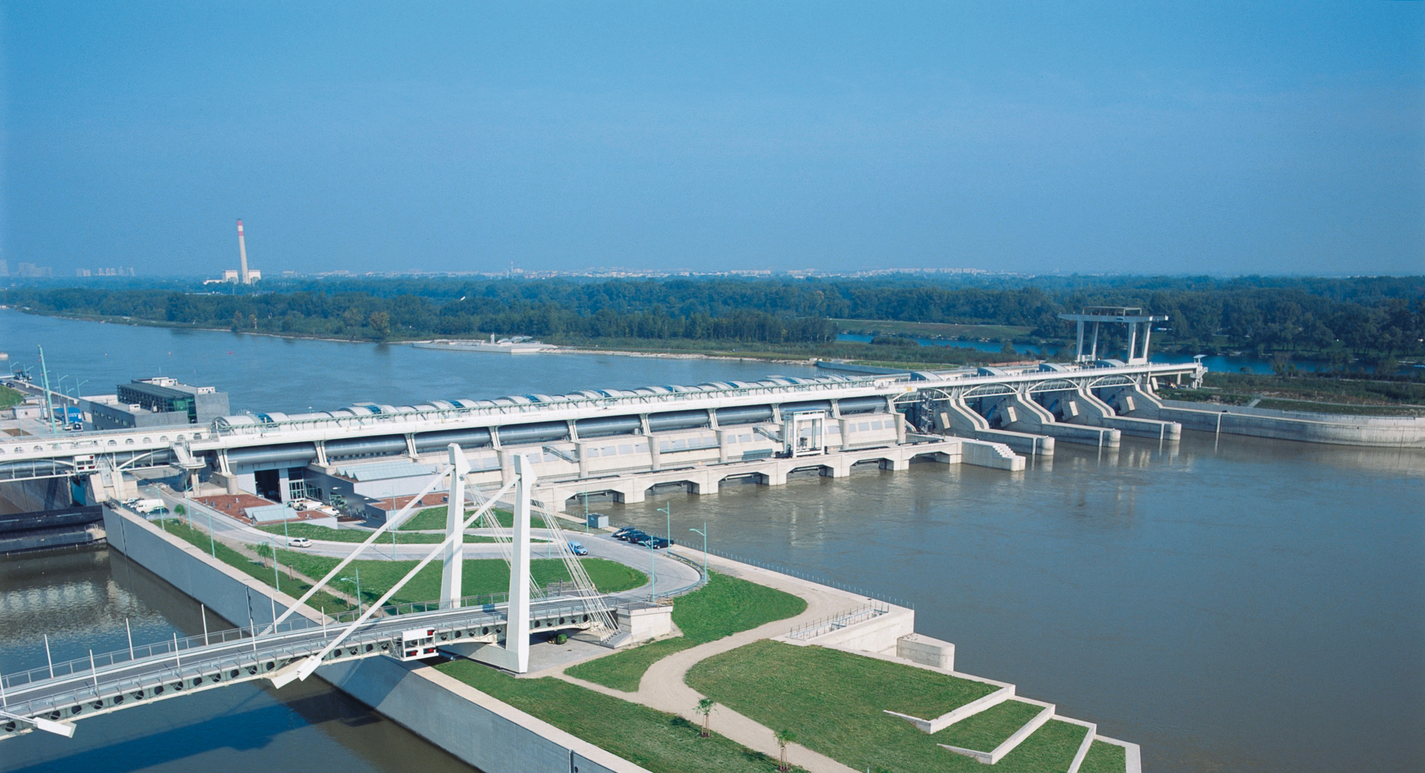
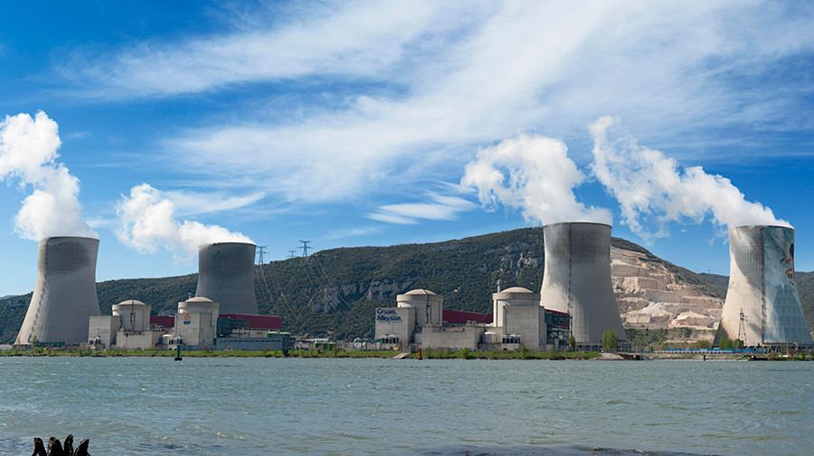
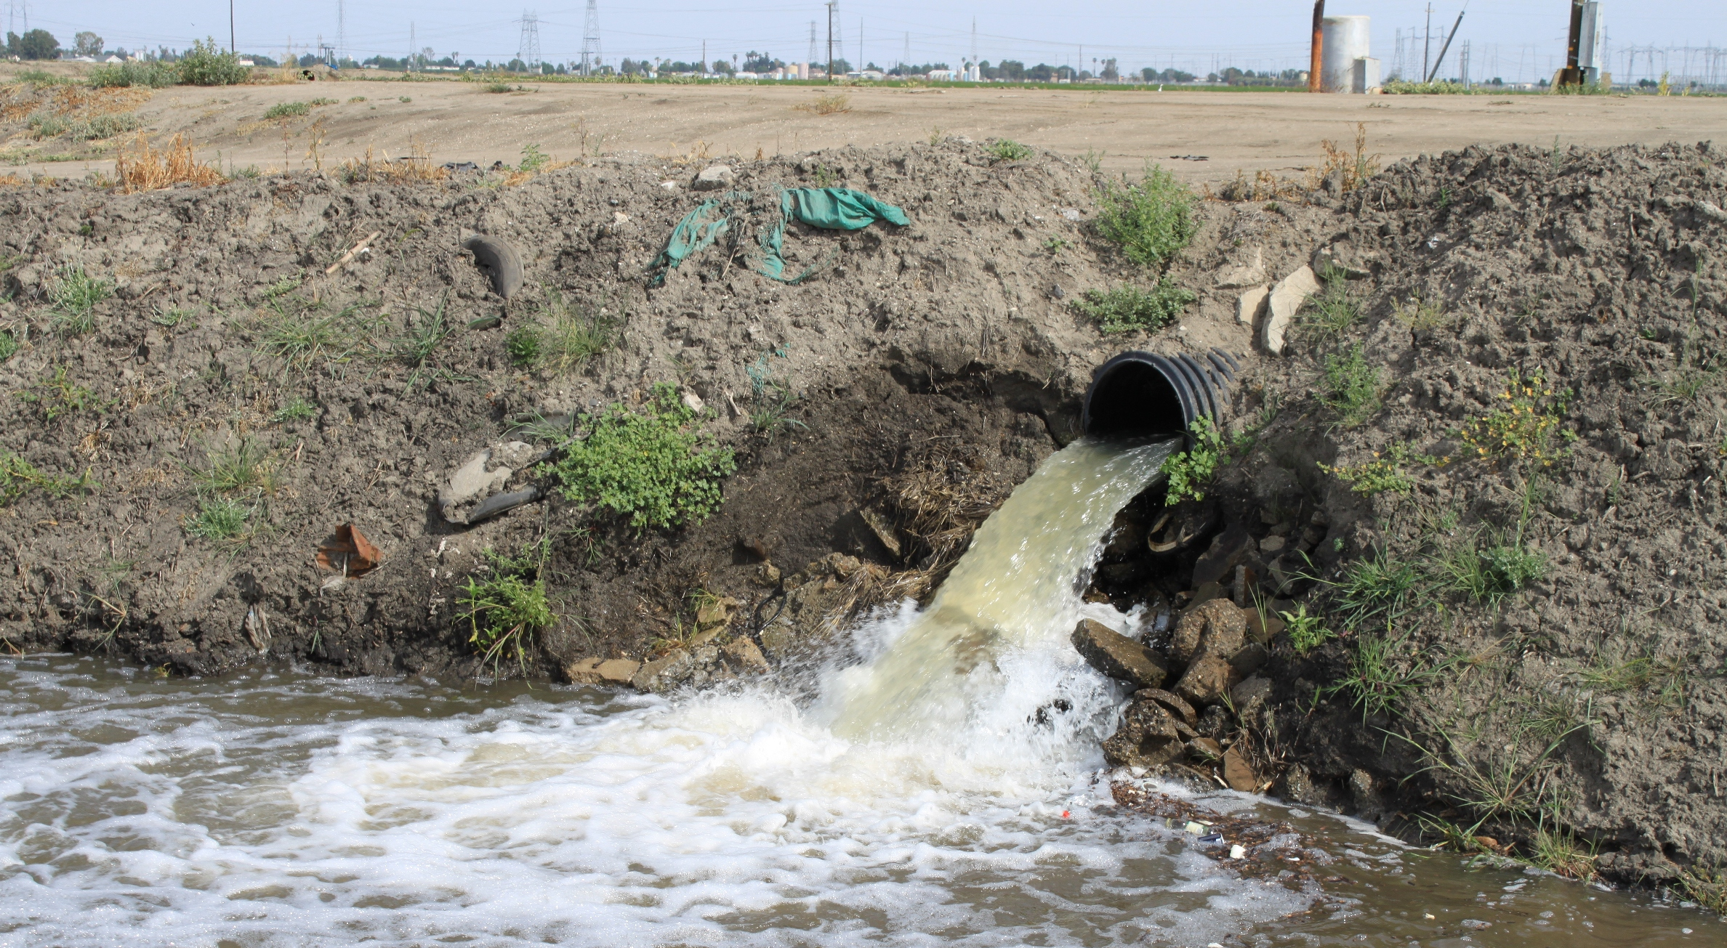
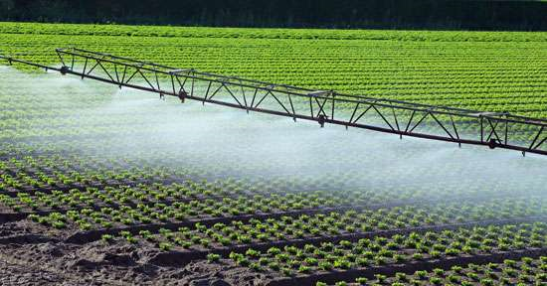
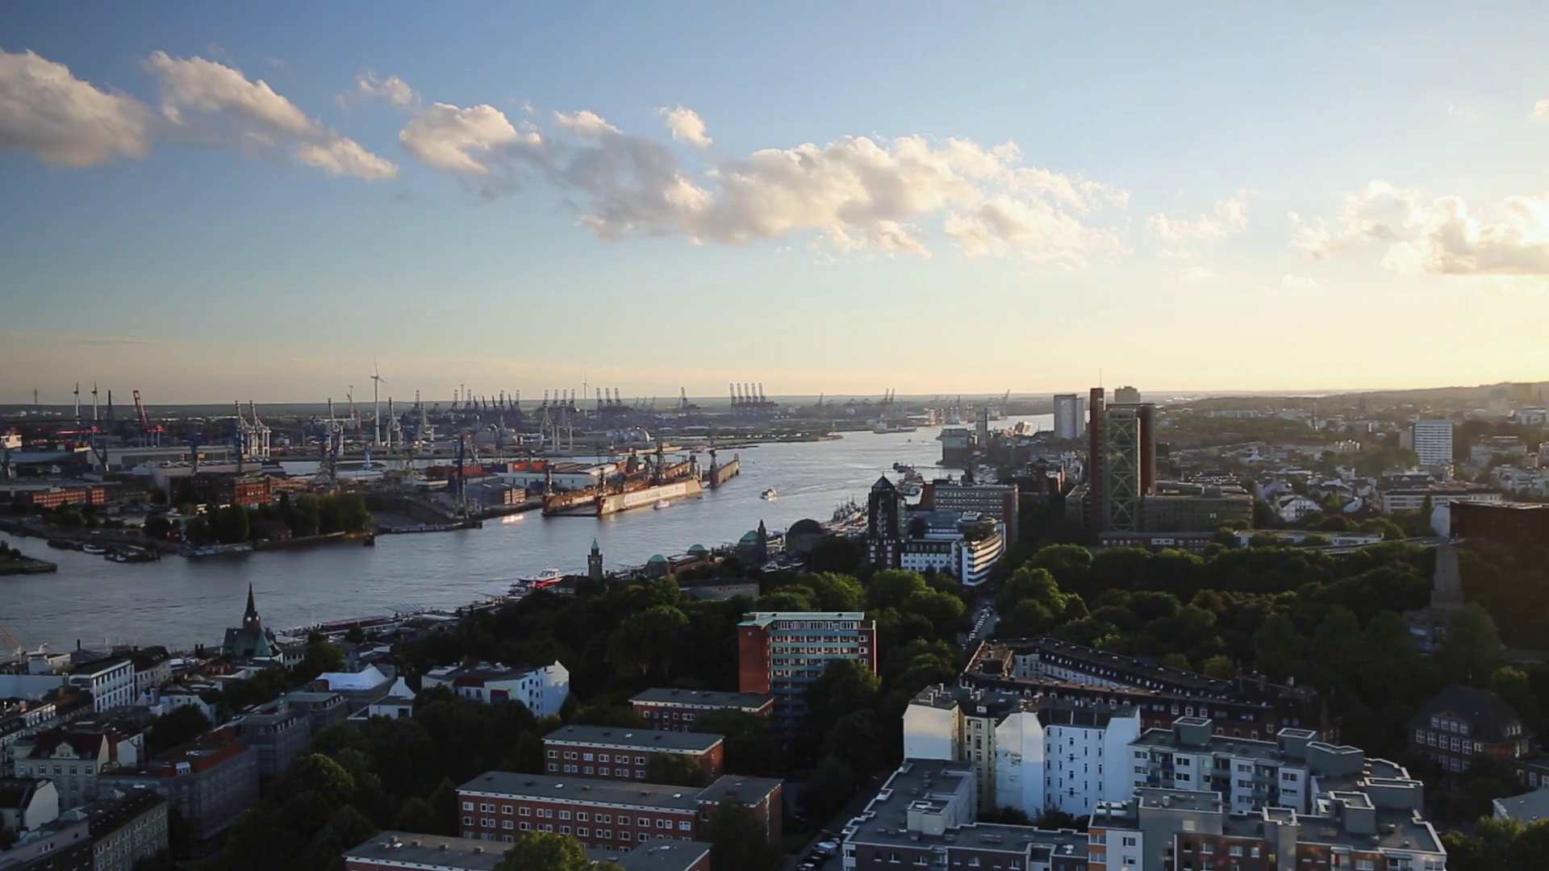
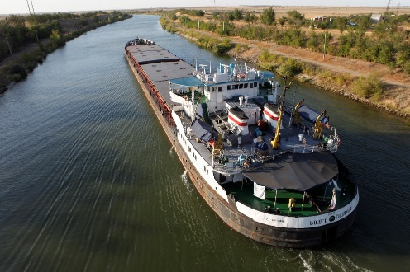
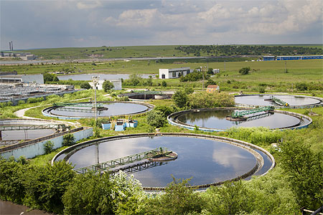
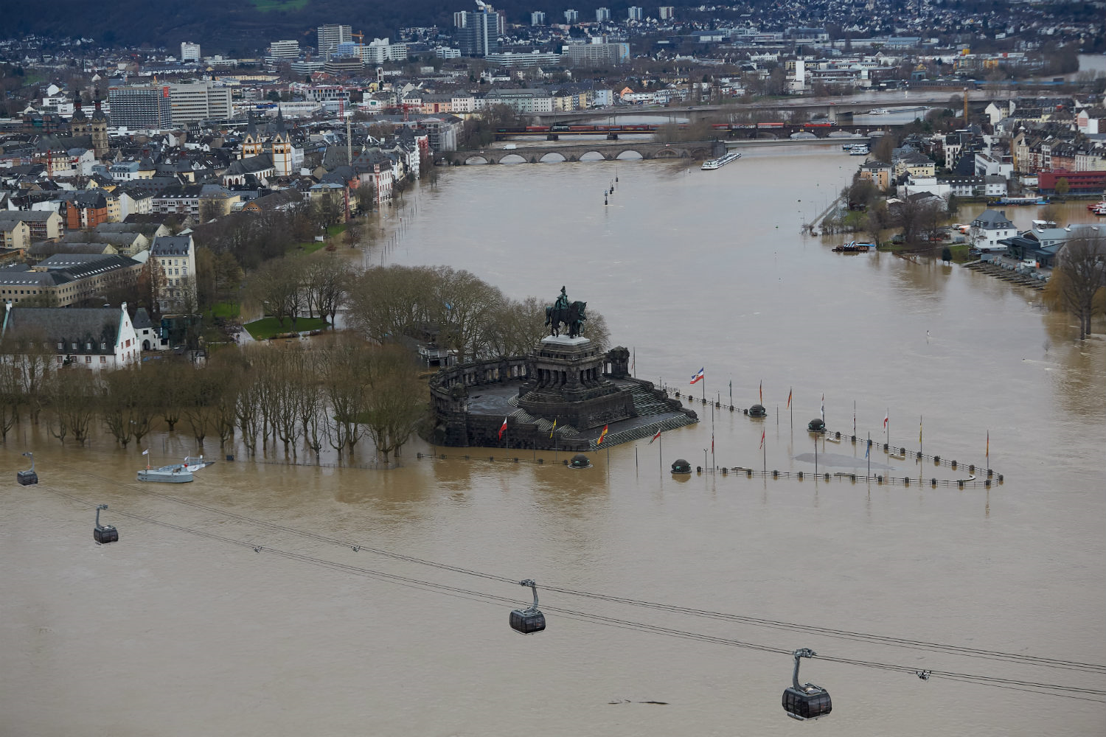
1. Water and waterways have many uses – not all are sustainable
Key sectors to address?
Hydropower and cooling
Agricultural production
Urban wastewater treatment
Ports and navigation
Flood protection
Water abstraction

Slide 7
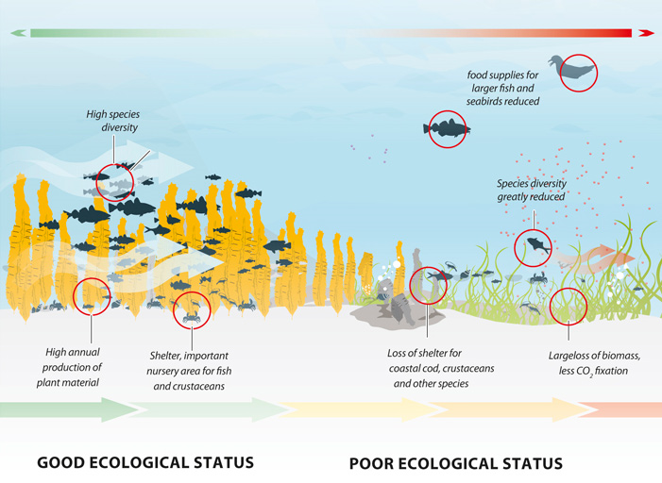
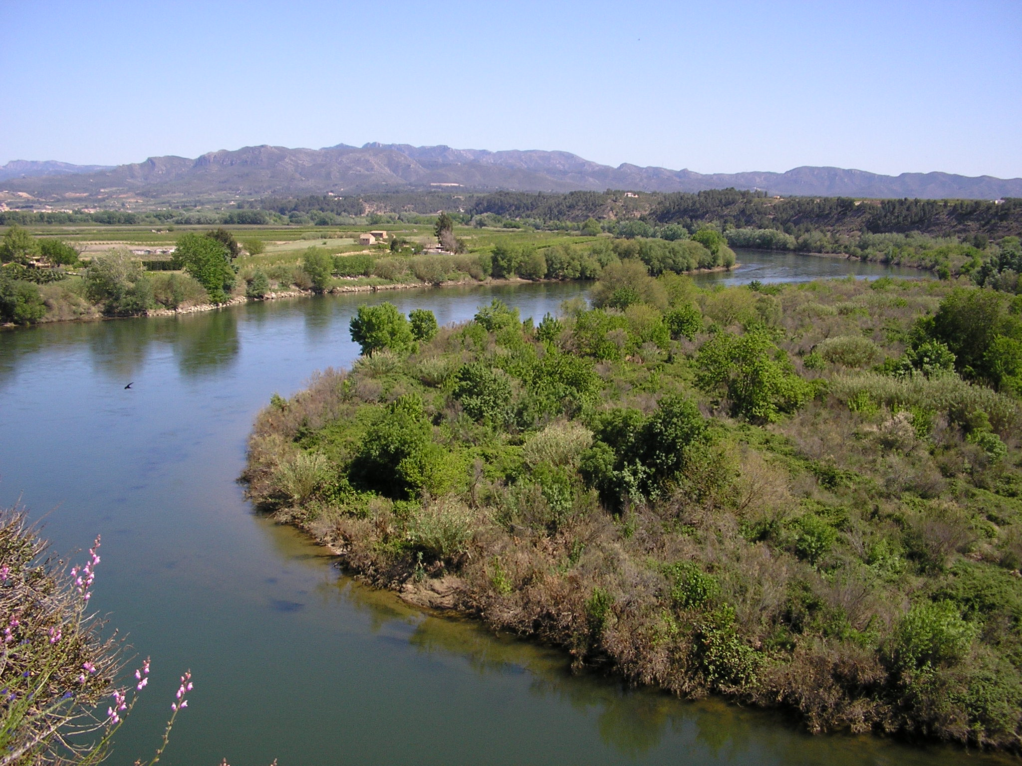
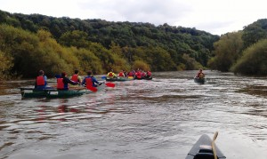
2. Water supports ecosystems and is an ecosystem in its own right
Status or condition of water, aquatic ecosystems, floodplains and wetlands
Understanding ecological status of water
Biological elements
Water quality
Hydromorphology
Understanding condition of floodplains and wetlands
Extent and condition of riparian zone and wetlands
Conservations status of water dependent species and habitats
Ecosystem services provided by healthy ecosystems
Nutrient retention
Water purification
Recreational and cultural services

Slide 8
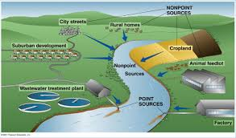
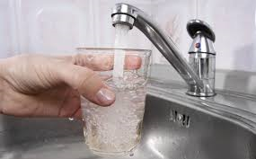
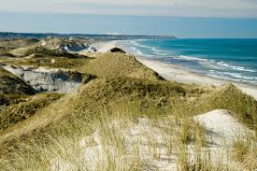
3. Clean water is essential for human health, our production systems and for ecosystems
Pollution pressures on water
Point sources
household and industrial waste – treated in urban waste water plants
Diffuse pathways
nutrients and other chemicals
atmospheric deposition
Treatment not possible due to the diffuse nature.
Human health & recreation
Polluted drinking water
Poor bathing water

Slide 9
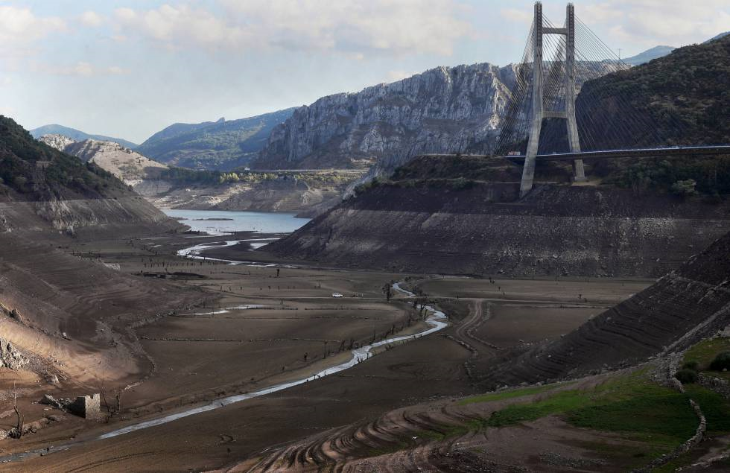
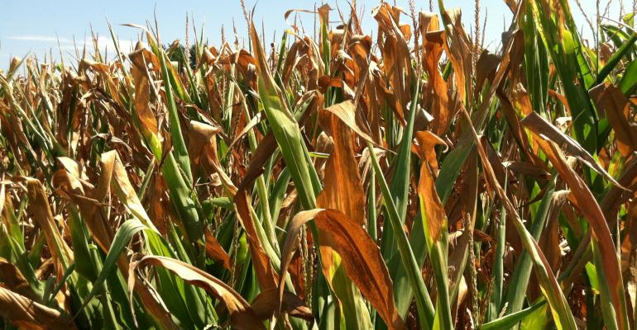
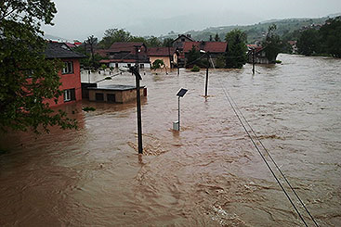
4. Water is an essential and valuable resource, influenced by a changing climate
Across Europe, climate change alters
precipitation
temperature

Slide 10
5. Water policies are needed to secure progress towards sustainability
Global aspirations:
UN sustainability goals
Global conventions
Europe’s aspirations:
7th Environmental Action Programme
EU Biodiversity Strategy 2020
Common Agricultural Policy
Climate Change Adaptation

Slide 11
Our EEA task: integrated freshwater assessment
Integrated assessment implies working with full DPSIR cycle, also illustrated by themes
We need to propose the right indicators to adress progress
To propose relevant solutions we need to know what is already being done.
We invite you to contribute to this informal and very early discussion
What are the right themes for the EEA to cover?
What are the right products and how should they be mapped over time?
What does the Eionet need from EEA?

Slide 12
What is most important towards 2025?
2020
2021
2022
2023
2024-2025
1. Water and waterways have many uses – not all are sustainable
2. Water supports ecosystems and is an ecosystem in its own right
3. Clean water is essential for human health, our production systems and for ecosystems
4. Water is an essential and valuable resource, influenced by a changing climate
5. Water policies are needed to secure progress towards sustainability
Integrated Freshwater Water Assessment
SoER 2025

