Slide 1
Climate change, water and agriculture
Blaž Kurnik
Climate change adaptation group
Notes:
.

Slide 2
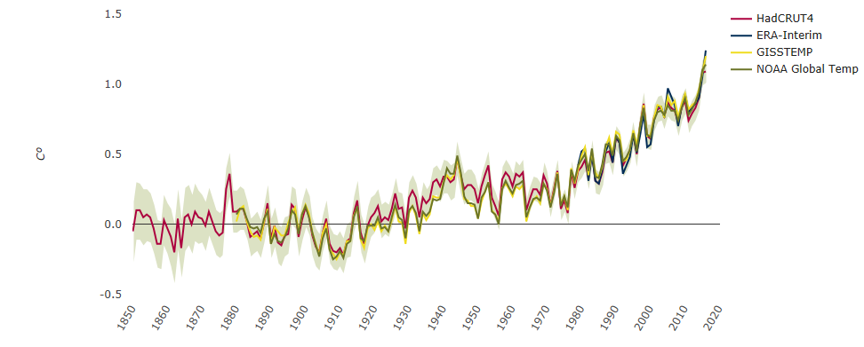
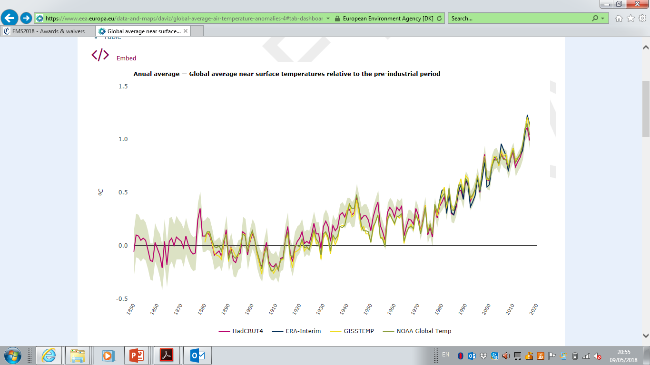
Global and European temperature increase to around 1 ⁰C
Anomaly in ⁰C

Slide 3


Policy frameworks for climate change and agriculture
Global level (2015 agreements)
UNFCCC Paris Agreement
Sendai Framework for Disaster Risk Reduction
Sustainable Development Goals
European level
Climate Adaptation Strategy
The Common Agriculture Policy (CAP)
Land Use, Land Use Change and Forestry (LULUCF) regulation
Governance regulation
EU Floods Directive, EU Green Infrastructure Strategy, etc.
Notes:
There are many policy drivers which frame the topics. The topic on climate change and agriculture is framed by different policy developments at the global and the EU levels.
At the global level both concepts are explicitly included in:
The Paris Agreement on Climate Change of the United Nations Framework Convention on Climate Change (UNFCCC) which requires major action to adapt to the adverse impacts of climate change and to enhance climate resilience.
The Sendai Framework for Disaster Risk Reduction (SFDRR) identifying climate change and variability as a driver of disaster risk.
The 2030 Agenda for Sustainable Development which recognizes DRR and CCA as a way of achieving progress in other areas, in particular eradication of poverty, ending hunger and ensuring healthy lives.
The EU strategy on adaptation to climate change, currently undergoing an evaluation, aims to help EU Member States adapt to current and future impacts of climate change through enhancing national adaptation strategies, improving knowledge, funding of actions and mainstreaming adaptation in other policy areas.
CAP – Common agriculture policy – one of the oldest policies in the EU focusing on agriculture and rural development. Future of the cap
proposes a more flexible approach to implementing the policy in order to guarantee more effective results.
LULUCF Land Use, Land-Use Change and Forestry – The EU regulation on mitigation of climate change focusing on sinks into the different land covers.
Other EU policies are also very relevant including the EU Floods directive, which requires EU Member States to map flood risks and to take measures to reduce these risks; and the EU Green Infrastructure strategy that aims to enhance Europe's natural capital and improve biodiversity. Measures to increase natural and semi-natural areas can also help to prevent climate related hazards.

Slide 4
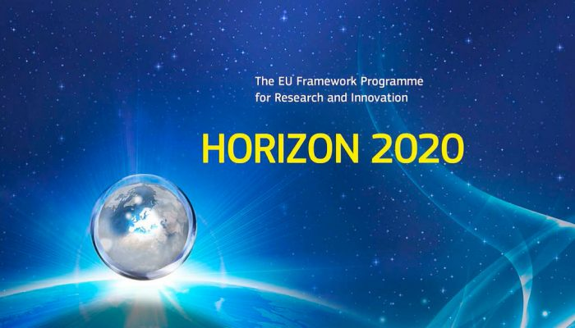



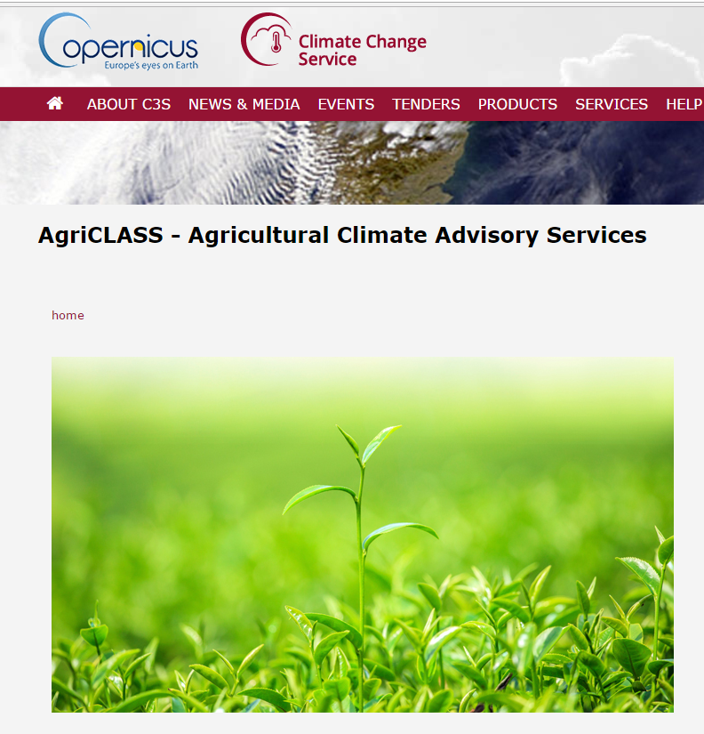
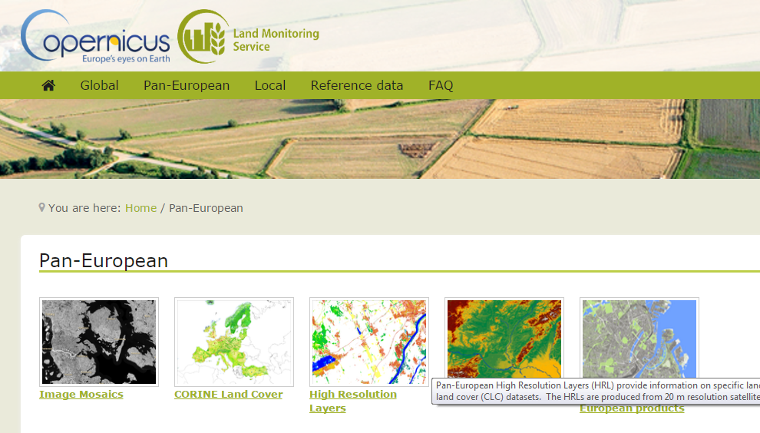

Data underpinning policies – European contribution
Research
and
actions
Copernicus Land Monitoring Service
Copernicus Climate Change Service
Operational
Notes:
*Implementing the polices cannot be done without reliable, accurate and up-to-date data sources.
•Europe has invested significantly into development of data and knowledge which underpins policy developments.
•The EU research programmes, such as the 7th Framework Programme and Horizon 2020 are financing many research projects for example to develop accurate climate datasets and future climate projections; assessing extreme events and their attribution to climate change, analysing impacts, vulnerabilities and risks of climate change; how to adapt to climate change and on how to prevent disasters or decrease their impacts when they happen.
•The Copernicus programme, in particular the Copernicus Emergency Management Service and Climate change services, as detailed in the lower half of the screen, provide data and knowledge to observe, understand, and prevent disasters and provide help after disasters happen.

Slide 5
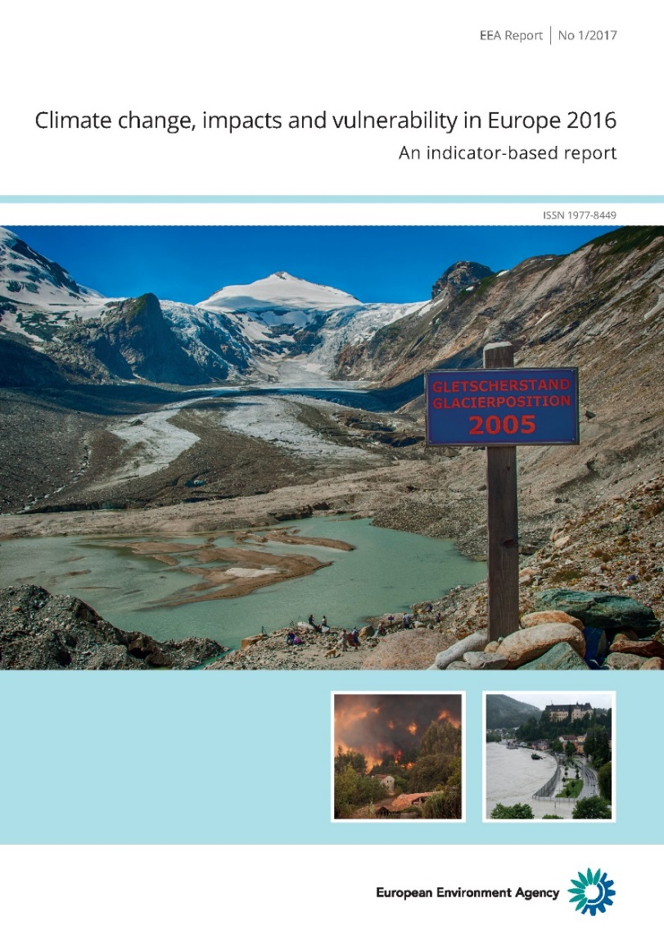
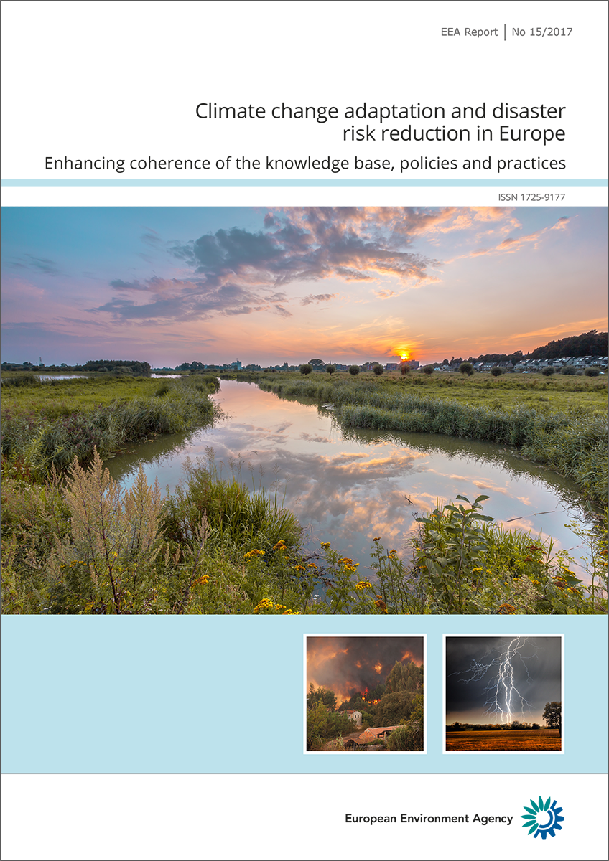
Recent EEA reports on climate change adaptation
Notes:
•The EEA contributes to the EU policymaking and implementation by preparing assessments on various topics.
The report on CC –impacts and the report on coherence between CCA and DRR practices.
CC-IV
This report presents a largely indicator‑based (35 indicators) assessment of past and projected climate change, impacts, and the associated vulnerabilities of and risks to ecosystems, human health and society in Europe. It is based on a wide range of observations and model simulations.
The report summarises key adaptation policy developments at European, transnational and national levels and highlights the need for further adaptation actions.
CCA/DRR
the main global and European policies on CCA and DRR;
the knowledge base on weather-and climate-related hazards and their impacts;
the best practices linking CCA and DRR in countries which are members of the European Environment Agency;
opportunities and benefits in linking CCA and DRR in EEA member countries.

Slide 6
Climate change and agriculture in Europe report (key building blocks)
Climate change impacts
Mean and extreme
Focus on future projections
Multiple impacts
Cascading impacts
Impacts outside Europe
Regional dependencies
Emission from the sector
Analysing trends (and projections) in GHGs in Europe
Case studies
Regional differences in emissions
Co-benefiting approaches (with adaptation+ other sectors)
Economic effects and consequences of climate change
Trade
Food security
Effects on welfare and income
Economic consequences of extreme events outside Europe
Addressing the problem
Policies
Topics:
Agriculture
Climate change adaptation
Environment
Adaptation
Technical measures
Supportive measures
Case studies
Focus on co-benefits – mitigation and other sectors
Levels:
Globe
Europe
Regions
Member countries
(examples)
Presenting solutions
Notes:
Ongoing report on agriculture with different chapters addressing different topics.
Chapter on policy framework addresses the links between relevant policies at the different geographical levels
Chapter on climate change impacts assesses the changes in trends and projections of key relevant climate variables like:
- mean changes
water availability (droughts)

Slide 7
Time plan
Task | Date
Final scoping paper on agriculture | December 2017
Decision on the chapters | early January 2018
Advisory group meeting | February/March 2018
First draft (w/o mitigation parts) | 15 May 2018
Expert review (incl. AG review) | 15 June – 15 July 2018
Stream 1: Addressing comments from the expert review | 1 July – 30 August 2018
Stream 2: Including the sections from the FWC | 10 July – 30 August 2018
Second draft (full) | 30 September 2018
EIONET review | 15 October - 1 December 2018
Addressing EIONET comments | 1 December – end December 2018
Final draft | 15 December 2018
Data for figures, maps and references ready | 15 June - 15 December 2018
Map, graph production | December 2018-February 2019
Layout | February 2018
Publication | March/April 2019

Slide 8
Reported number of extreme events between 1980 and 2013 increased
Notes:
Number of extreme weather and climate events is increasing in Europe

Slide 9
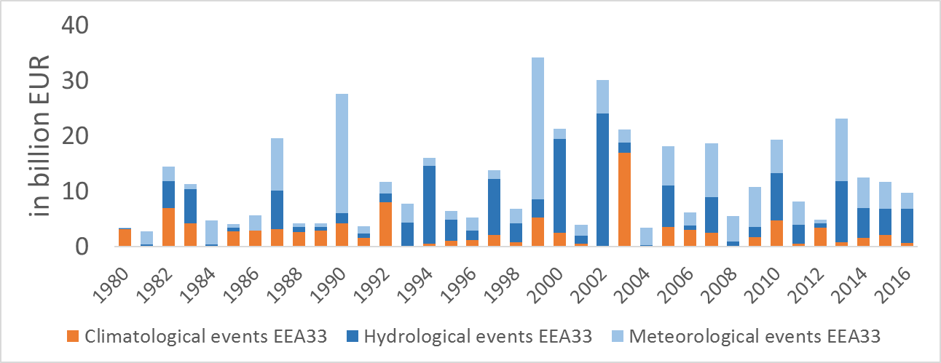
Economic losses between 1980 and 2016 in Europe vary
Total loss
EUR 436 billion
Only 1/3 insured
Heatwaves, droughts,
forest fires
River floods, landslides, avalanches
Storms, heavy precipitation, hail
Notes:
Total losses amounted to 436 B EUR since 1980 and only 1/3 losses were insured.

Slide 10
The agriculture sector in Europe in numbers
Farmers represent about 5 % of the EU’s working population. In average
the number of farms have declined and farm sizes increased across the EU;
farmers manage 47 % of the EU's land area, however in the EU in the period
from 2000 to 2017 the arable land decreased by 5 %, grassland by 1 %,
and permanent crop land by 1 %.
farmers in the EU produce:
about 12 % of the global cereal
about 20 % of global dairy products
about 66 % of the global wine
around 50 % of global sugar beet
almost 75 % of global olive oil
the EU is among the two largest agri-food exporter worldwide
Notes:
about 12 % of the global cereal
about 20 % of global dairy products
about 66 % of the global wine
around 50 % of global sugar beet
almost 75 % of global olive oil
Significant global amount of livestock production
Mostly due to urbanisation. The EU losses about 85.000 ha/year of agriculture land

Slide 11
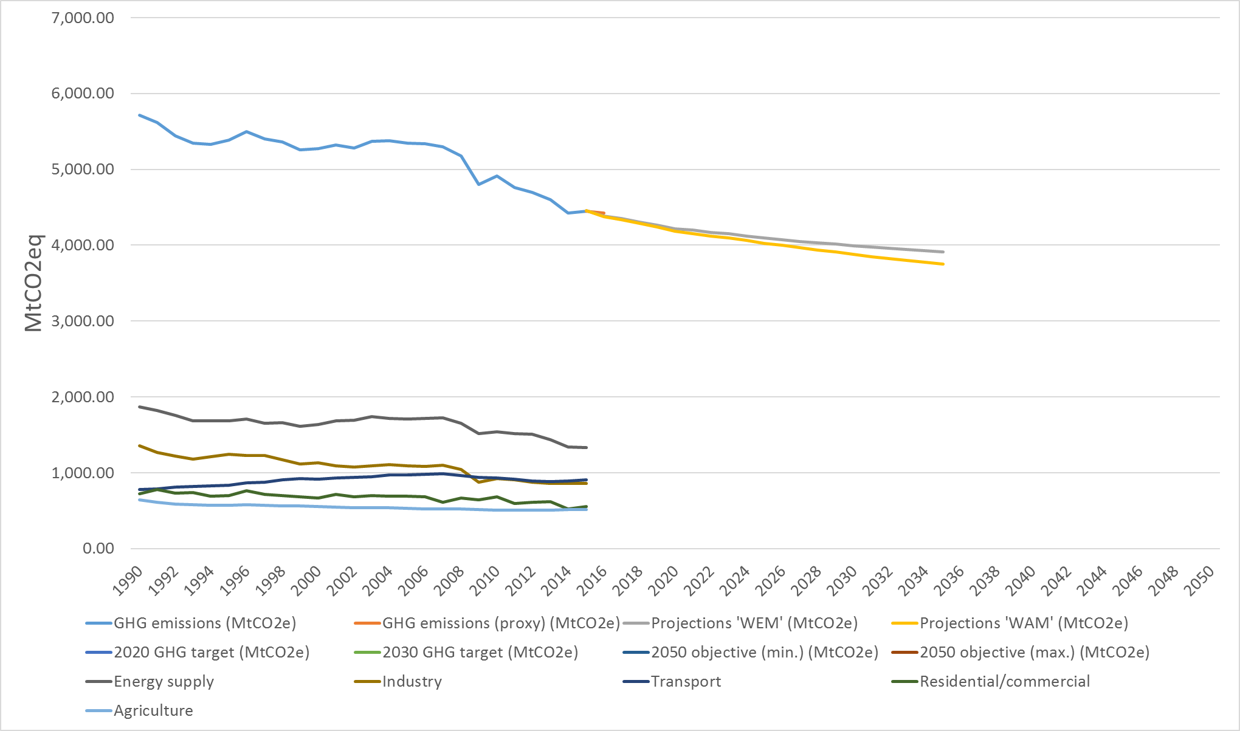
Emissions from agriculture sector are decreasing
2020 GHG target – 20 %
2030 GHG target – 40 %
2050 GHG goal – 80 %
Agriculture sector
2050 GHG goal – 95 %
Notes:
GHG emissions in Europe are decreasing. Agricultrure contributes to emissions and it is 5th largest contributor responible for about 11 % of EU GHG emissions .
The 2050 goals with current approach will not be reached. 80 % of GHG emissions from agriculture are related to the livestock sector

Slide 12
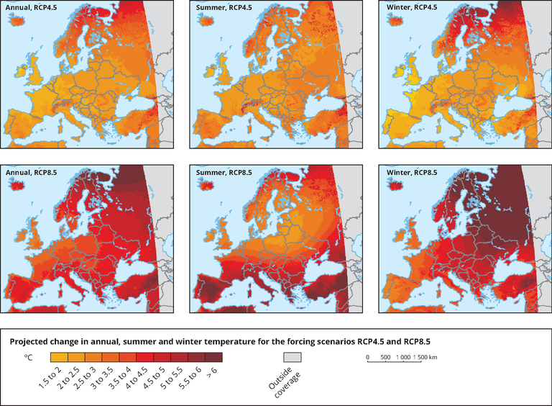
Europe is getting warmer
Annual, summer and winter
temperature change
(projected change
for 2080s, two scenarios)
Source: EURO-CORDEX (Jacob et al., 2014)
Notes:
Tempreture is projected to increase
Annual and summer precipitation (Map 3.8)

Slide 13
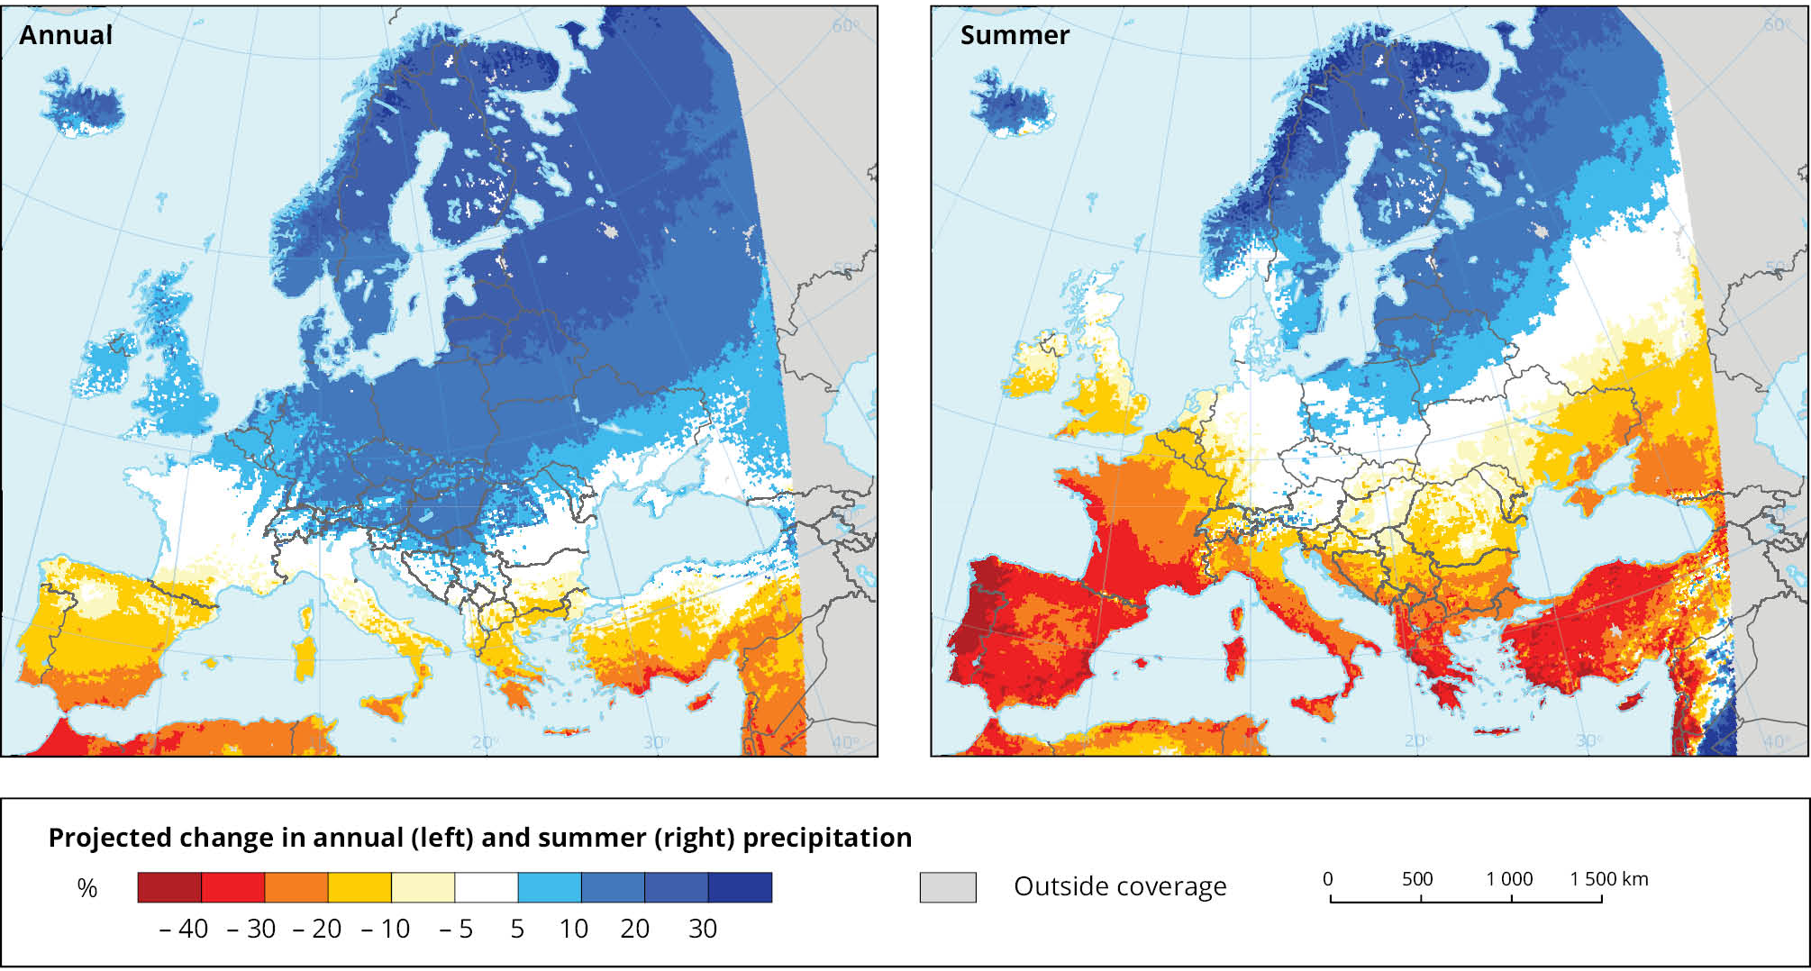
Differences between wet and dry regions will further increase
Annual and summer precipitation
(projected change for 2080s, RCP8.5)
Source: EURO-CORDEX (Jacob et al., 2014)
Notes:
Annual precipitation is projected to increase in northern and central Europe
and to decrease in southern Europe.
Summer precipitation is projected to increase in northern Europe
and to decrease in southern Europe and large parts of central Europe.
Annual and summer precipitation (Map 3.8)

Slide 14
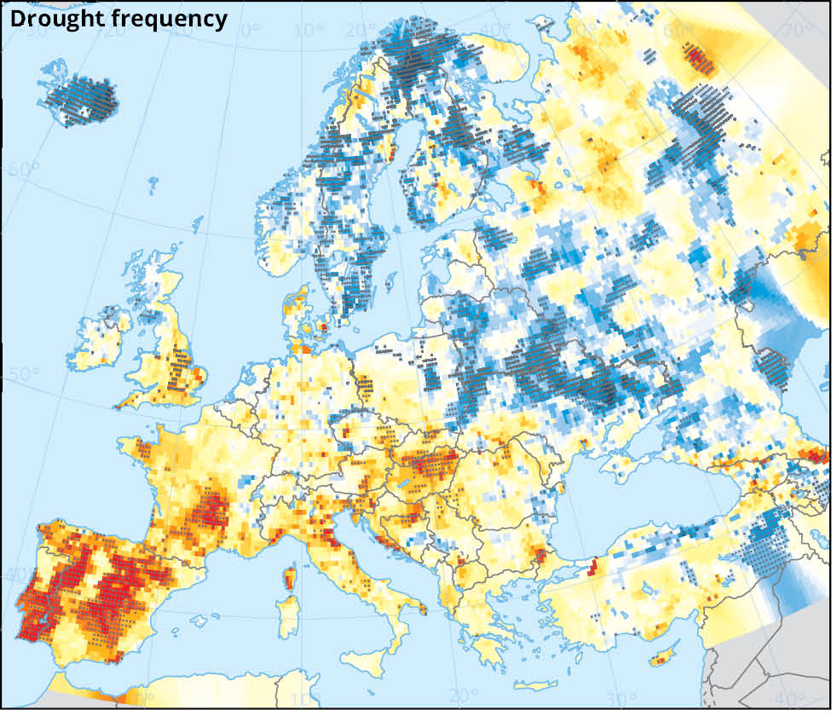
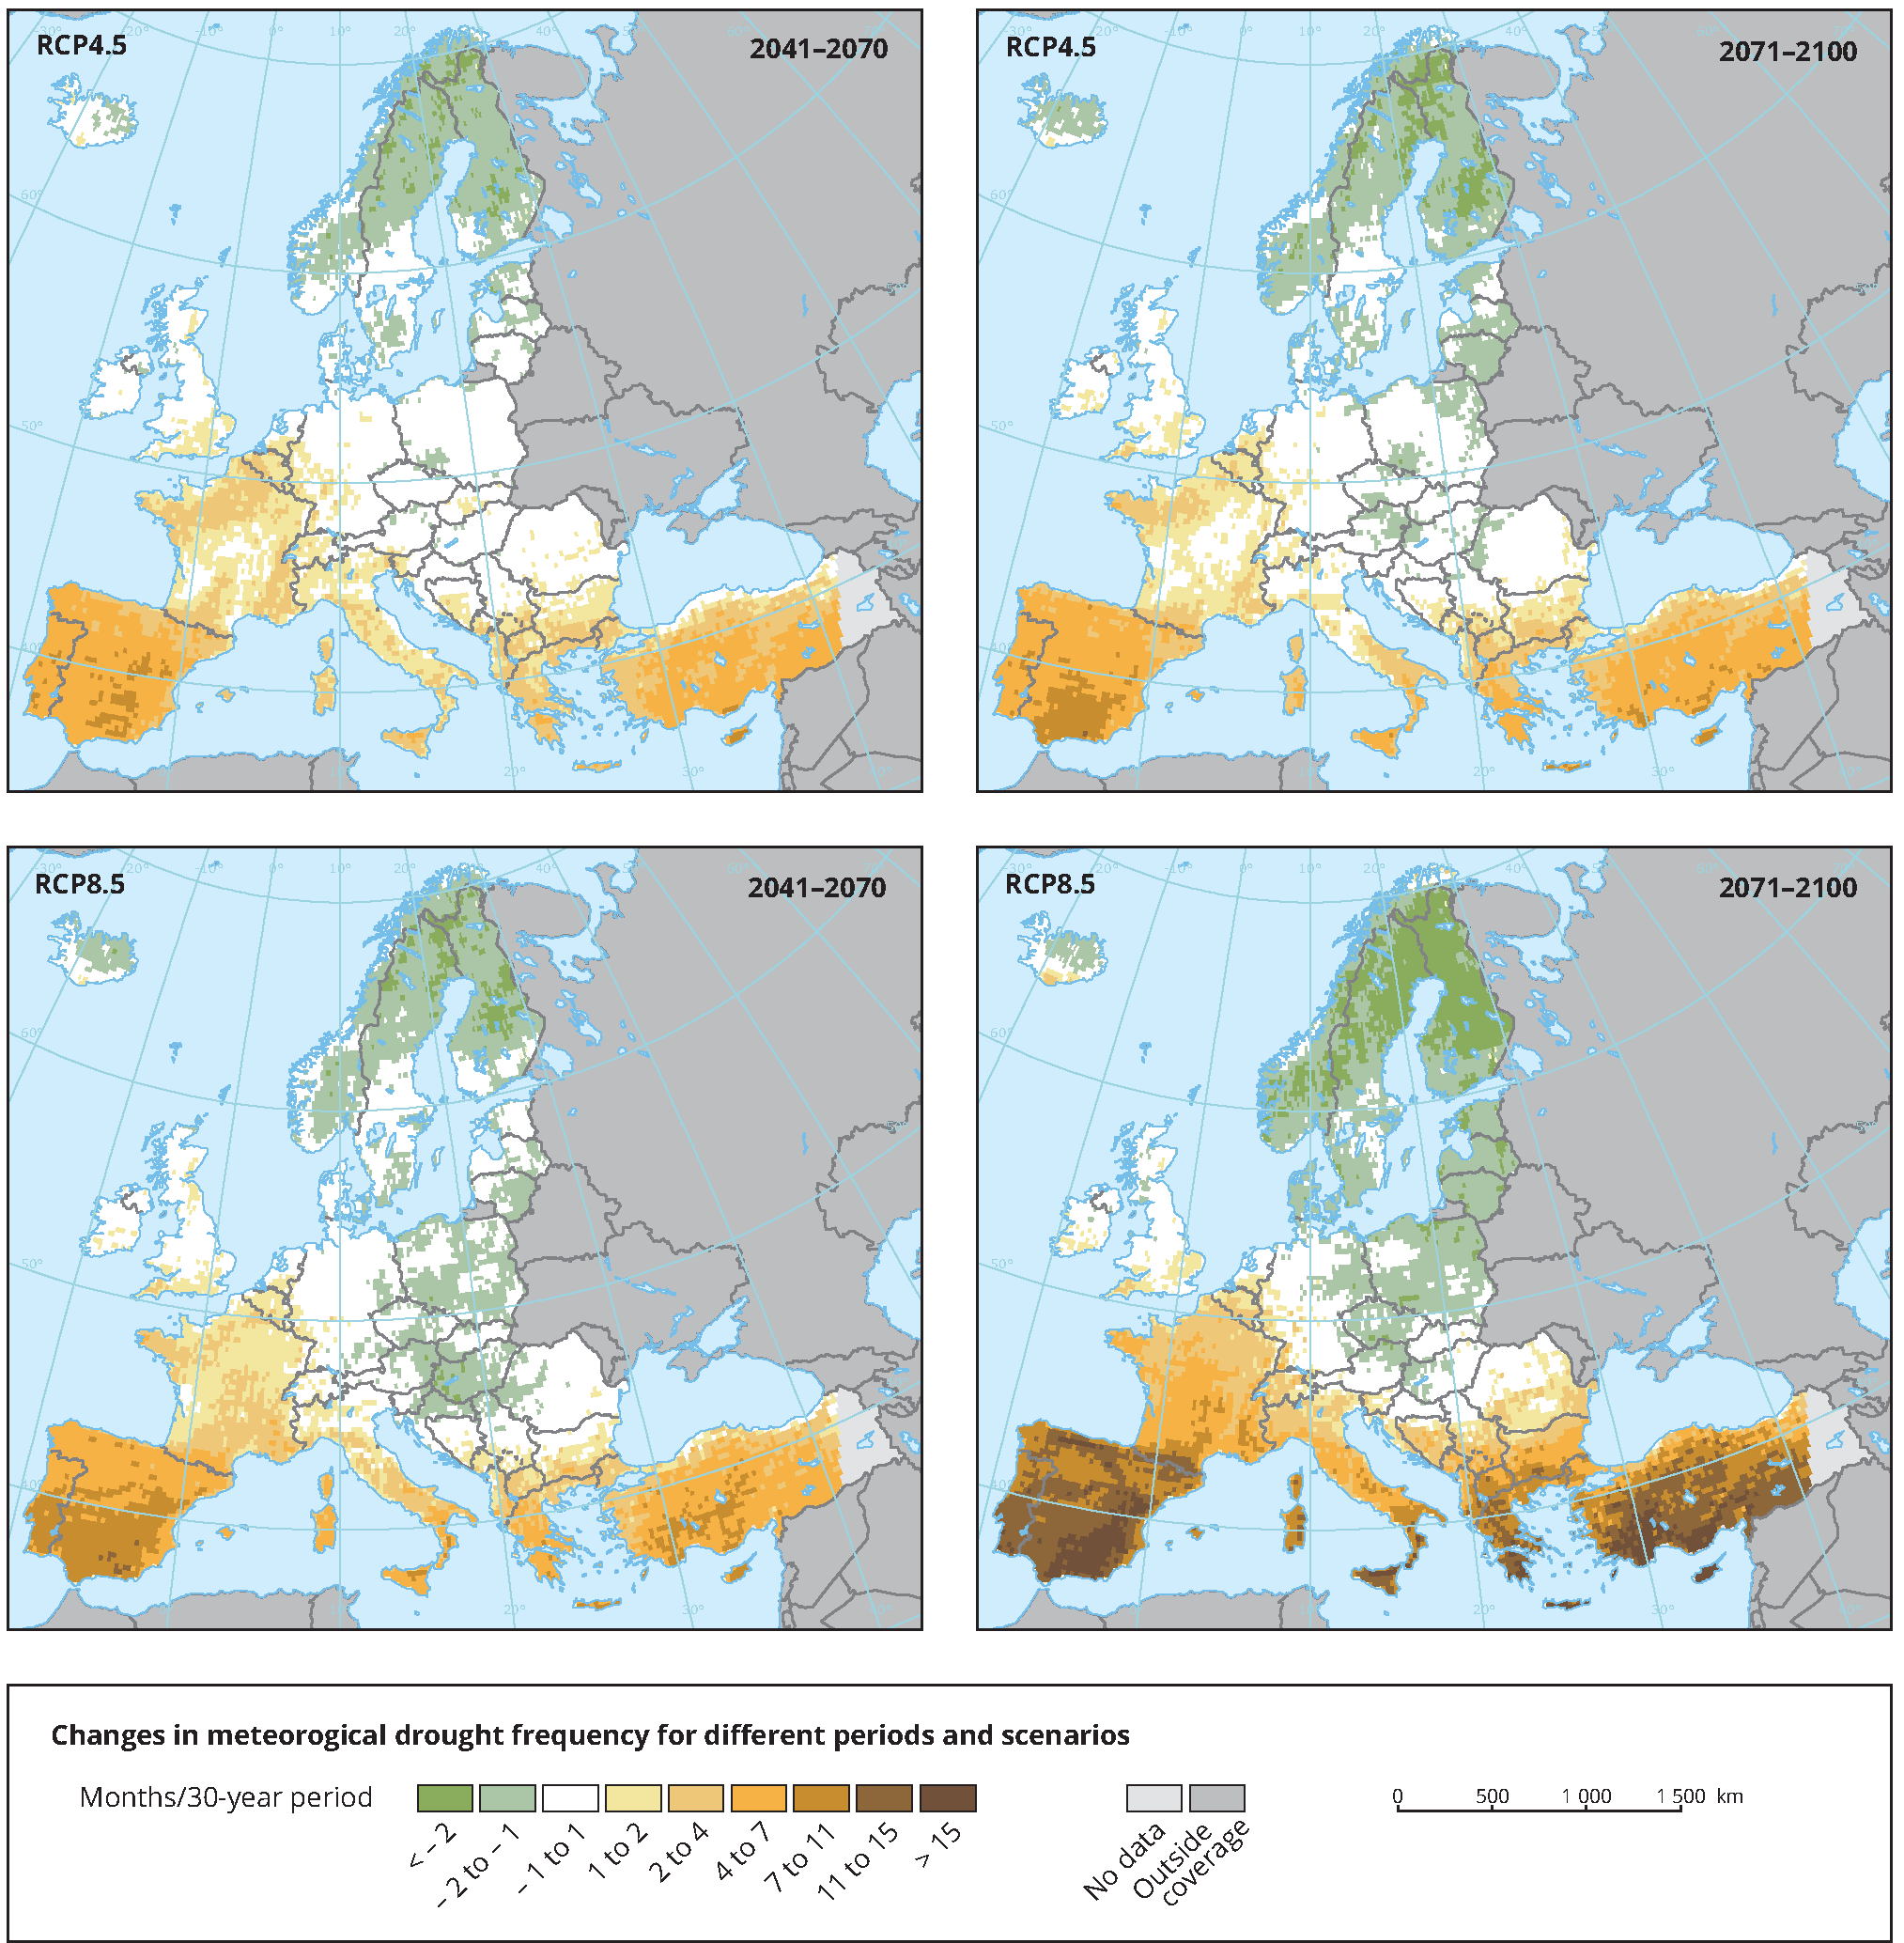
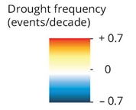
Meteorological droughts are increasing in southern Europe
Drought frequency
(trend for 1950–2012)
Drought frequency
(projected change for 2071–2100)
Source:
JRC (2016)
Source: Stagge et al. (2015)
Notes:
Meteorological droughts (i.e. periods with exceptionally low rainfall) have become more frequent in some regions in southern Europe;
they are projected to increase further in most parts of southern Europe.
Meteorological droughts (Map 4.9, Map 4.11)

Slide 15
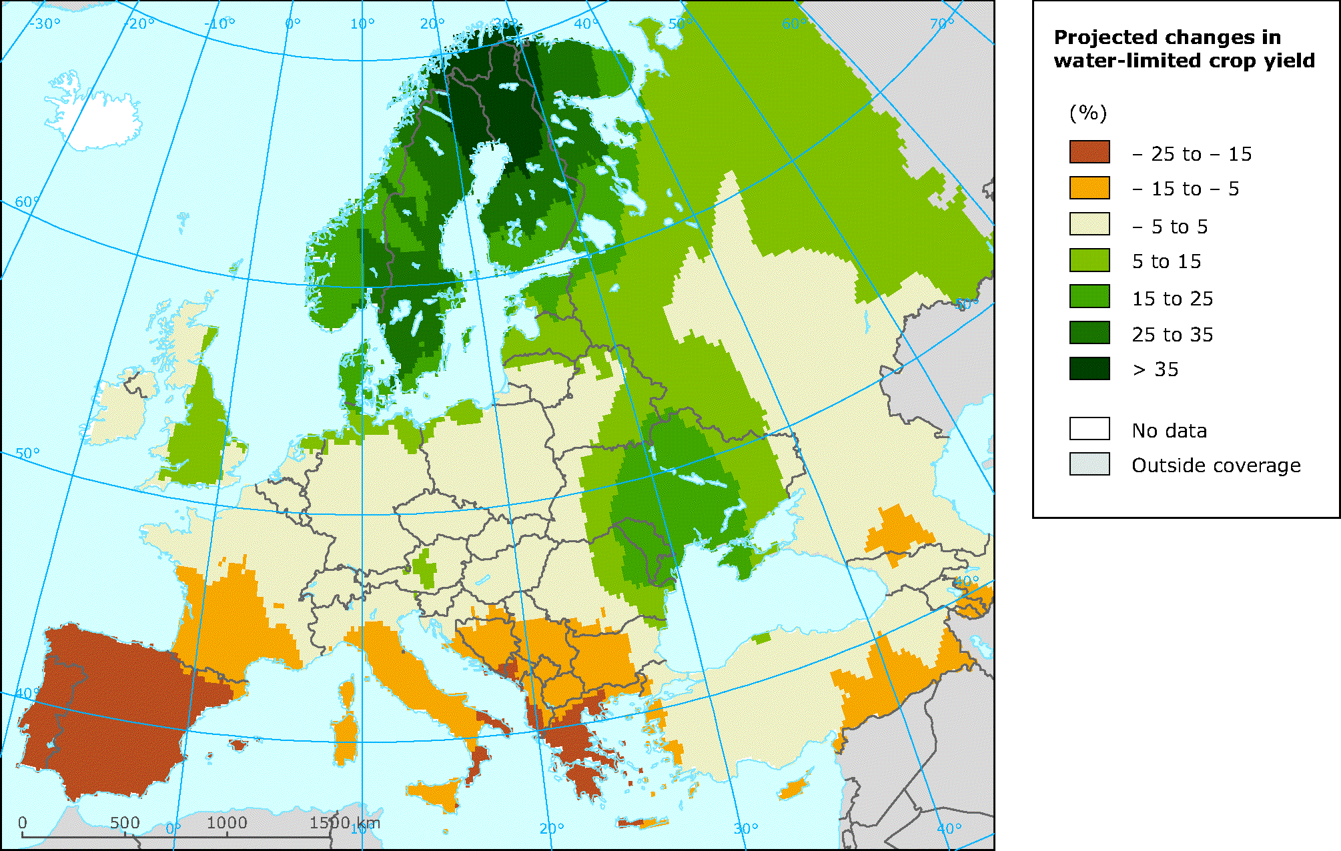
Climate change impacts on agriculture differ across Europe –
Southern Europe is most negatively affected
Projected changes in water limited crop yield (three staple crops )
(projected change for 2050, A1B)
Source: Iglesias et al. (2012), Ciscar et al. (2011)
Notes:
The (frost-free) growing season has increased, in particular in northern and eastern Europe.
Decreasing yields of major crops are projected for southern Europe
whereas agriculture in northern Europe could benefit.
Frost-free days (Map 5.13)
Water-limited crop yield (Map 5.13)

Slide 16
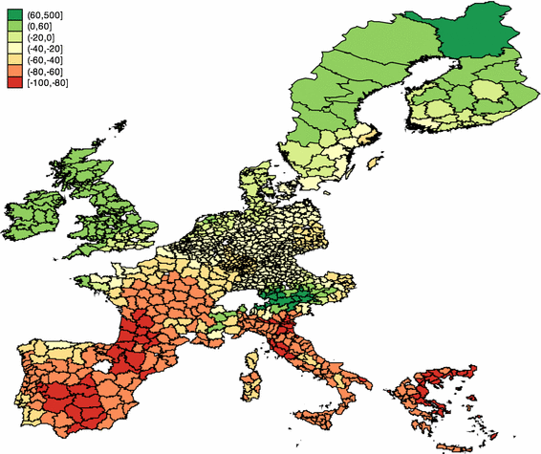
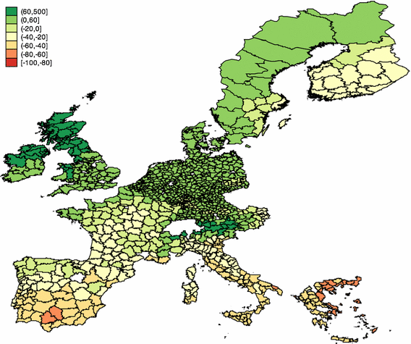
Climate change causes significant economic risks for agriculture
Projected change in farmland value in Europe
(EU-15, 2100 vs. current, SRES A2 scenario)
Pessimistic climate projection
Optimistic climate projection
% change
Source:
Van Passel et al. (2016)
No adaptation
No consideration of beneficial effects of CO₂ fertilisation
Notes:
Projected climate change can have strong beneficial and adverse impacts on farm values in Europe.
Northern and northwestern Europe is projected to be positively
whereas southern Europe is projected to be negatively affected.
The sign of the effect in central Europe as well as its magnitude across Europe depends on the particular climate projection.
Figures 3 and 5 of Van Passel et al. (2016): http://dx.doi.org/10.1007/s10640-016-0001-y
The price of European farmlands is sensitive to climate change and for over 41 000 farms in Europe, 24 economic value could drop by up to 32% by 2100, depending on the climate scenario considered (van 25 Passel et al. 2016) (Figure 3.3). 26
27
Farms in southern Europe (Spain, Portugal, Italy, Greece and South of France) are particularly vulnerable 28 to climate change and could suffer value losses of up to 9% per 1 °C rise in global temperature. In 29 particular, the study predicts that about two thirds of the loss in land values in the EU is concentrated in 30 Italy because the country contains most of the vulnerable agricultural land. The study emphasizes that 31 policies on water and land use, for example, will be crucial to help farmers to mitigate economic losses.

Slide 17
Adaptation measures
Early warning systems
Precision farming
Smart farms
Risk management and insurance
Education and awareness raising
Global/regional level
Measures for crops
Adapted crops
Cover crops and artificial soil covers
Crop diversification and rotation
No or minimum tillage
Field margins
Increase plant coverage per hectare
Measures for improved irrigation and fertilization
Optimising drainage
Improved irrigation efficiency – drip irrigation
On farm rainwater harvesting and storage
Farm level
Measures for livestock production
Breeding livestock for greater tolerance
Increase stocks of forages
Increase the quantity of forages
Improve pasture and grazing management
improved grasslands and pastures
Improvement of animal rearing conditions (shading and sprinklers, ventilation systems).
Measures for horticulture and viniculture
Modification of crop calendars
Modifying fertilizers and spray applications for viniculture and horticulture
Installation of greenhouses
Protective and monitoring equipment in viniculture
Notes:
Adaptation measures - combination of good measures at different levels (EU→ Farms)
Measures at the regional/national level need to be supported by countries and/or regions. Examples: weather services/ early warning systems, education, insurance…
Farm level meausres depend from agriculture practices and differs amoung them.
Measures to adapt to climate change focus on risk prevention/risk management and building resilience of the agricultural sector and its environmental resources (biodiversity, soil, water) with a long-term perspective. Adaptation can include:
technical measures that change production patterns, methods, farm structures and strategies;
• support measures of legislative support, administrative actions, encouraging behavioural changes of rural and agricultural actors, and awareness raising activities.

Slide 18
Most European countries have developed national adaptation strategies and/or action plans
Source: EEA (2018)
Notes:
Most countries in Europe have developed national adaptation strategies in recent years;
many countries have also adopted national and/or sectoral adaptation action plans.
An increasing number of countries is developing monitoring, reporting and evaluation systems for adaptation.
All strategies and plans include agriculture

Slide 19
Conclusions
Agriculture is one of the most important socio-economic sector which is affected by changing climate;
emissions from agriculture are decreasing mainly due to changes in technologies and consumption patterns;
negative effects of climate change on the agriculture are increasing and can significantly affect the agriculture production;
warmer temperature will also positively influence agriculture in parts of Europe;
the agriculture sector in Europe has to adapt to climate change with introducing combination of measures at different levels (EU, national, region, farms) ;
agriculture and forestry can be a solution to decrease emissions through the emissions sinks.

Slide 20
Time plan
Task | Date
Final scoping paper on agriculture | December 2017
Decision on the chapters | early January 2018
Advisory group meeting | February/March 2018
First draft (w/o mitigation parts) | 15 May 2018
Expert review (incl. AG review) | 15 June – 15 July 2018
Stream 1: Addressing comments from the expert review | 1 July – 30 August 2018
Stream 2: Including the sections from the FWC | 10 July – 30 August 2018
Second draft (full) | 30 September 2018
EIONET review, NRCs CCA, Agri, water | 15 October - 1 December 2018
Addressing EIONET comments | 1 December – end December 2018
Final draft | 15 December 2018
Data for figures, maps and references ready | 15 June - 15 December 2018
Map, graph production | December 2018-February 2019
Layout | February 2018
Publication | March/April 2019

Slide 21
Thank you
The 2016 EEA CCIV report is available here:
eea.europa.eu/publications/climate-change-impacts-and-vulnerability-2016
The 2017 EEA CCA/DRR report is available here:
eea.europa.eu/publications/climate-change-adaptation-and-disaster
All indicators underlying this report are available online:
eea.europa.eu/data-and-maps/indicators/#c5=climate-change-adaptation
Further information is available on Climate-ADAPT:
climate-adapt.eea.europa.eu
eea.europa.eu

