Slide 1
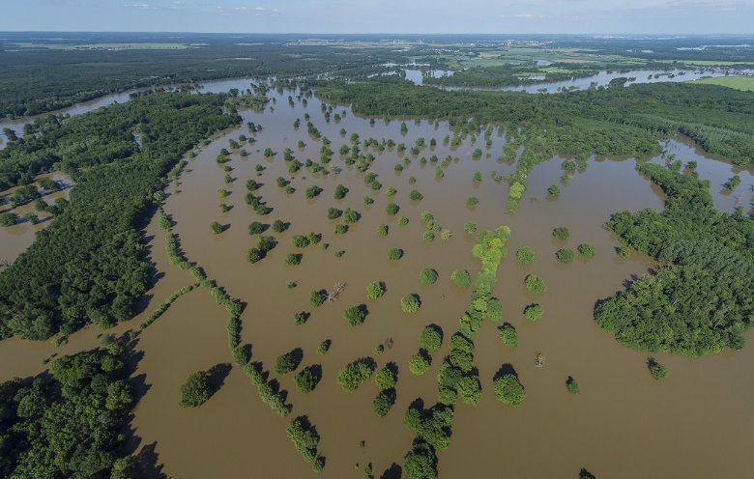
Floodplain ecosystems and floods
Trine Christiansen (EEA)
ETC/ICM
Mathias Scholz, Christiane Schulz-Zunkel & Klaus Henle (UFZ)
Lidija Globevnik & Luka Snoj (TC Vode)
Ursula Schmedtje (UBA)
Eleftheria Kampa (Ecologic)
Photo: UFZ - A Künzelmann

Slide 2

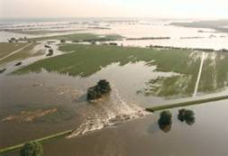
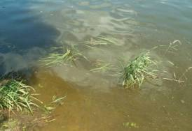
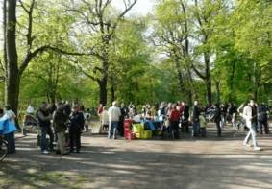
Why floodplain ecosystems?
Floodplains are part of Europe’s natural capital, covering 3-5% of Europe’s area, and 50-60% of Europe’s Natura 2000 sites.
Depending on country, 2-20% of the population lives in flood prone areas (based on statistics from 9 countries)
Natural and restored floodplains provide important ecosystem services like
  water purification
  nutrient retention
  improved conditions for biodiversity conservation
  recreational value
Scientific estimate suggests 80-90% of the floodplain area is ecologically degraded.

Slide 3
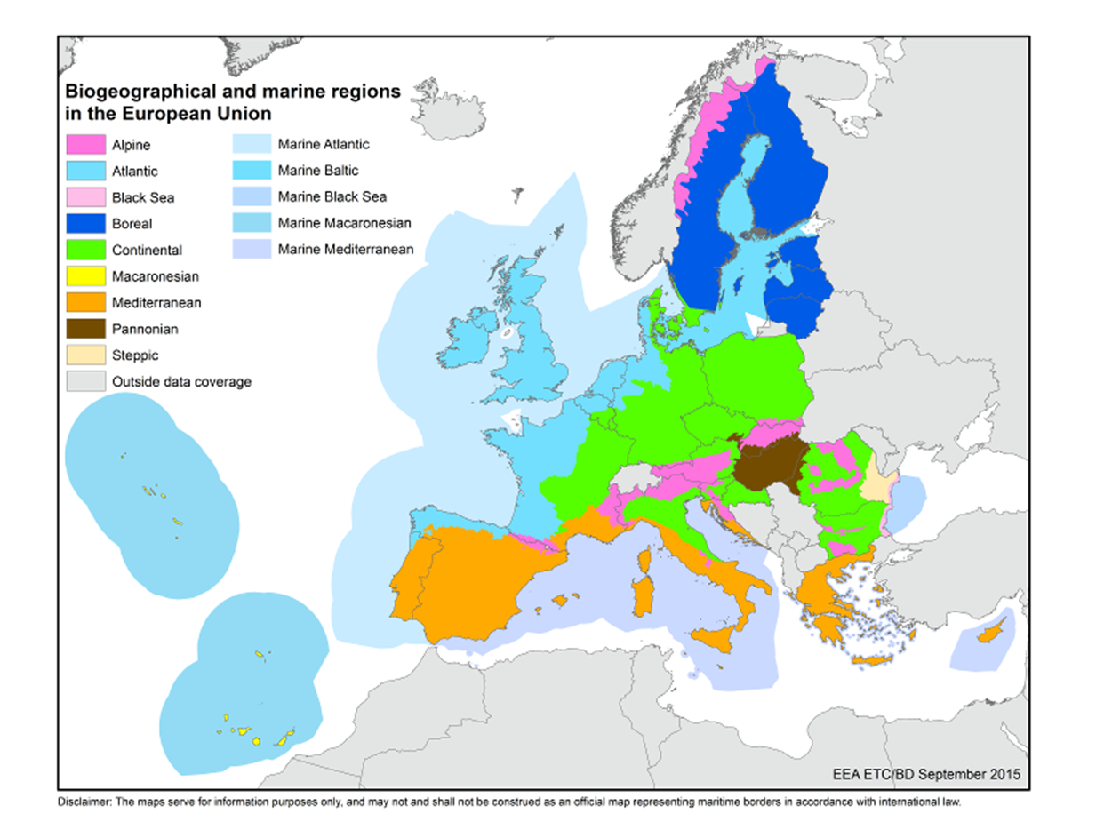
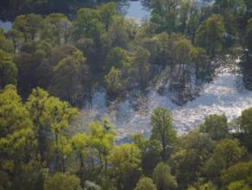
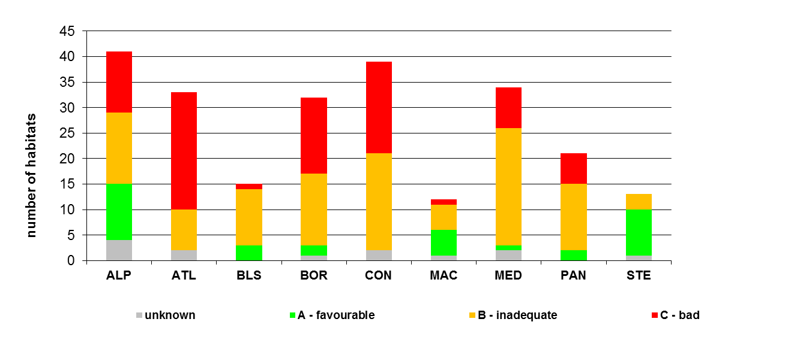
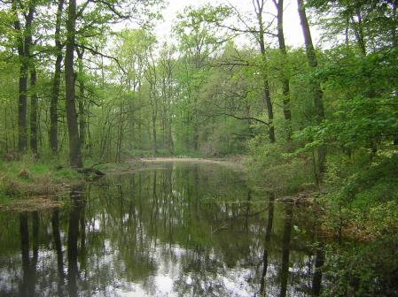
Conservation status of floodplain habitats
Photo: André künzelmann, UFZ
49 floodplain habitats assessed
  9 floodplain forest habitats
  9 floodplain grassland habitats
  19 aquatic floodplain habitats
  12 bog and mire habitats
Photo: Mathias Scholz

Slide 4
Policy context: our licence to operate
Floodplains are part of Europe’s natural capital and deliver ecosystem services in support of:
  Water Framework Directive Objectives – Good Ecological Status
  Birds and Habitats Directive Objectives – Favourable Conservation status
Restoration measures are promoted in
  15% restoration target of Biodiversity Strategy 2020 (target 2)
  Floods Directive
  Green Infrastructure – enhancing Europe’s
  Climate change adaptation.

Slide 5
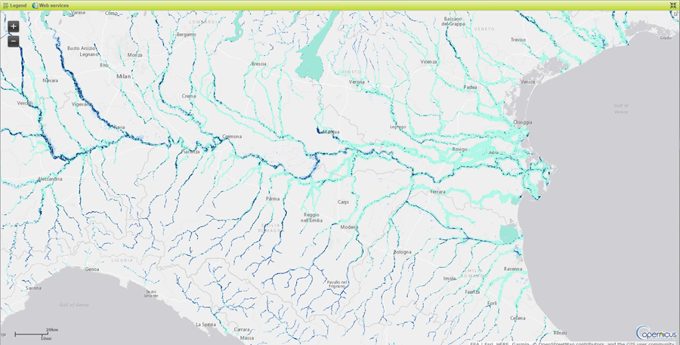
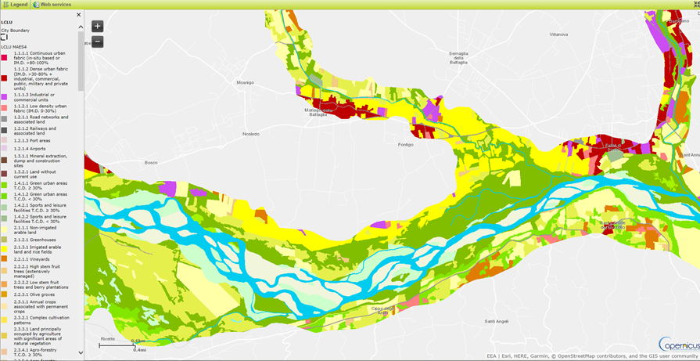
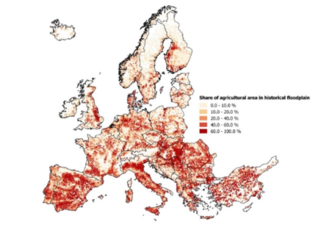
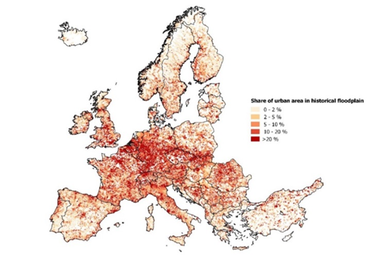
Copernicus Riparian Zone
Riparian zone delineation and habitat mapping based on MAES classification up to Strahler level 3 rivers in Europe.
Analysis at catchment scale (functional elemental catchments (FEC) ~50-100km2)

Slide 6

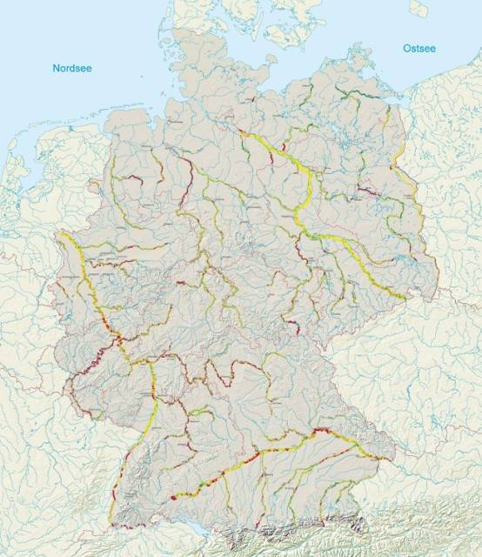
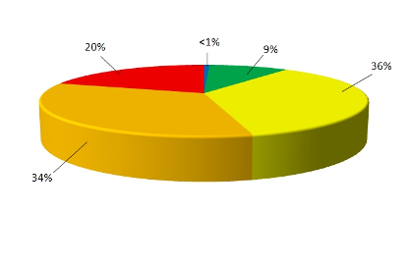




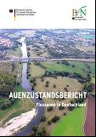

Status of German floodplains
Only ~ 10 % of active floodplains reach a good or very good status
Status of floodplain
modification:
Very low
low
medium
high
Status of active floodplains
Very high
Not assessed
Source: Brunotte et al. 2009: BfN & BMU 2009

Slide 7
Exploring a European assessment for floodplain condition
Possible parameters summarized in FECs
A) Natura2000-sites
% in 5 classes,
Coverage of N2 area/ presence of habitats
high
low
Possible assessment
classes
water
wetlands
forest
grassland
arable land use
settlements
others
B) Land uses intensity
in 5 classes
very high
high
Algorithm
medium
C) Wetness
(if quality of data allow)
yes
not
∑ (A+B+C)
low
% in 5 classes
Index =
-- D
3
very low
Data source:
D) Anthropogenic pressures (dams & population)
high
low
Yes / no
RZ, Spatial data
NATURA2000
CORINE LC, Copenicus

Slide 8
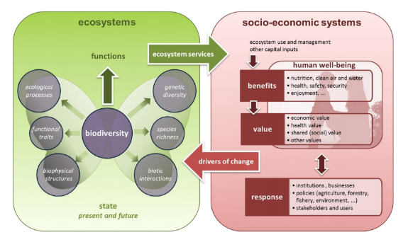
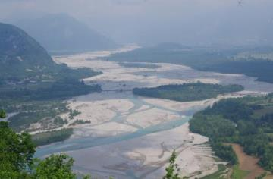
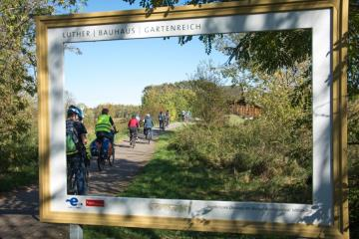
2019 EEA publication on floodplains
(possible Eionet review Q4, 2018)
Report objectives:
Increase awareness of the role of floodplain ecosystems for meeting WFD objectives and for nature conservation and biodiversity targets;
Highlight the current condition of floodplain ecosystems;
Increase awareness of synergies between floodplain land use and flood risk management in achieving environmental policy targets;
Highlight challenges and opportunities in the planning and implementation of floodplain management.
Photo: Mathias Scholz
Photo: C. Schulz-Zunkel

Slide 9
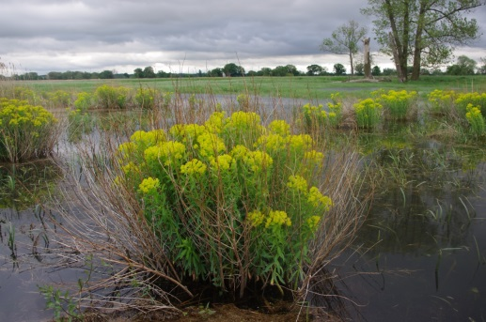
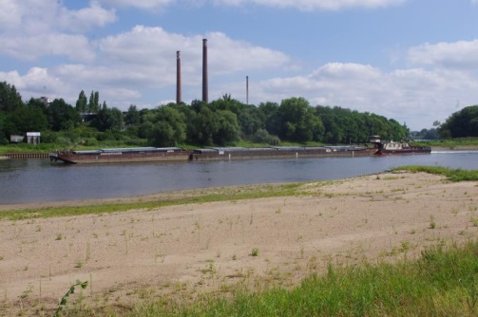
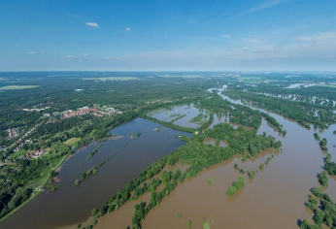
Possible key messages
Degraded floodplain ecosystems is due to many structural measures that have been put in place to provide flood protection.
Shifting management focus towards natural retention measures represents a transition towards broader consideration of management objectives.
Restoration requires public support, investments, and time.
It will remain a priority to provide adequate flood protection of people, but perhaps it can be done smarter.
Photo: Mathias Scholz
Photo: Mathias Scholz
Photo: UFZ – A. Kuenzelmann

Slide 10
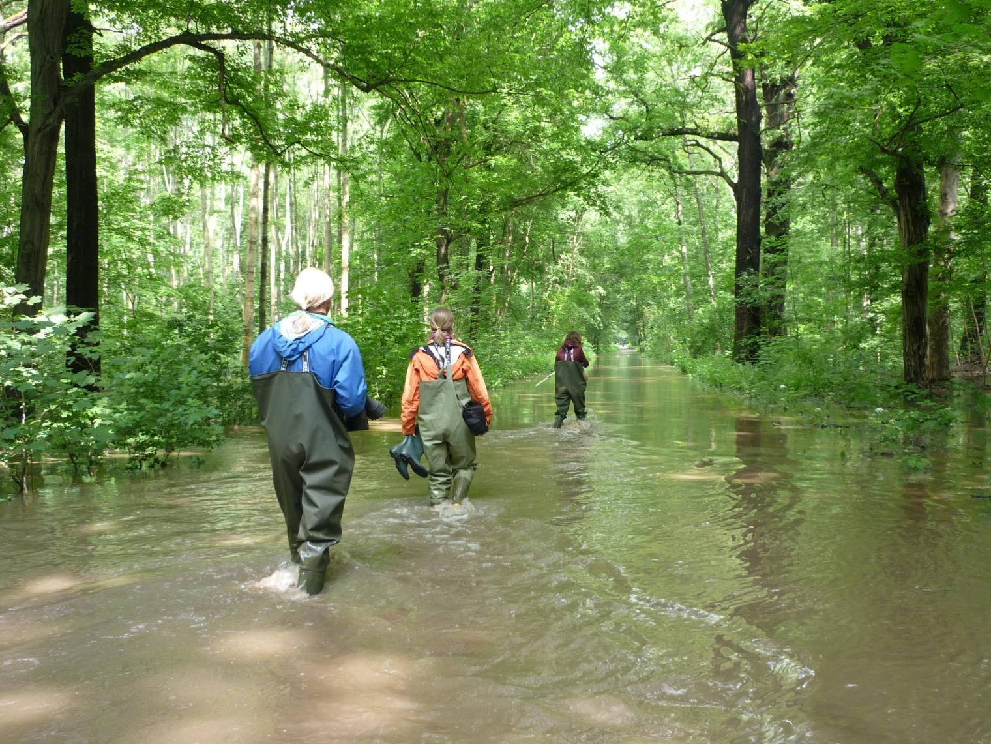





Thank you for your attention
Photo: Carolin Seele

