Slide 1
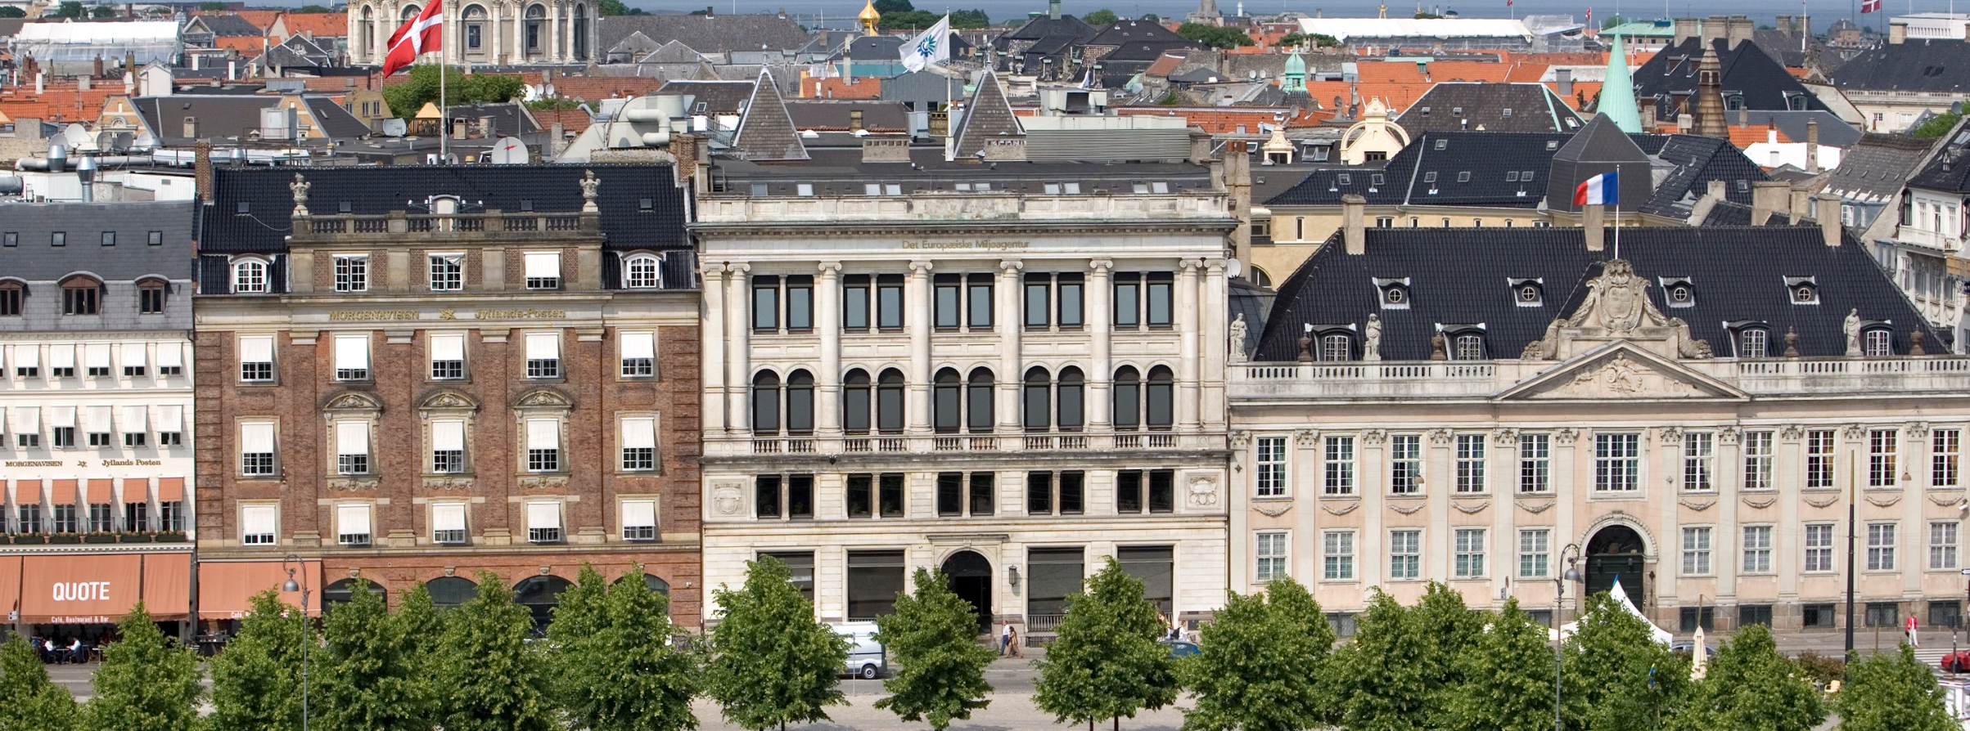
Stéphane Isoard
Water and Marine – Head of Group
Stephane.Isoard@eea.europa.eu
Freshwater EIONET Workshop
14-15 June 2018, EEA, Copenhagen
Setting the scene: the EEA Freshwater activities

Slide 2
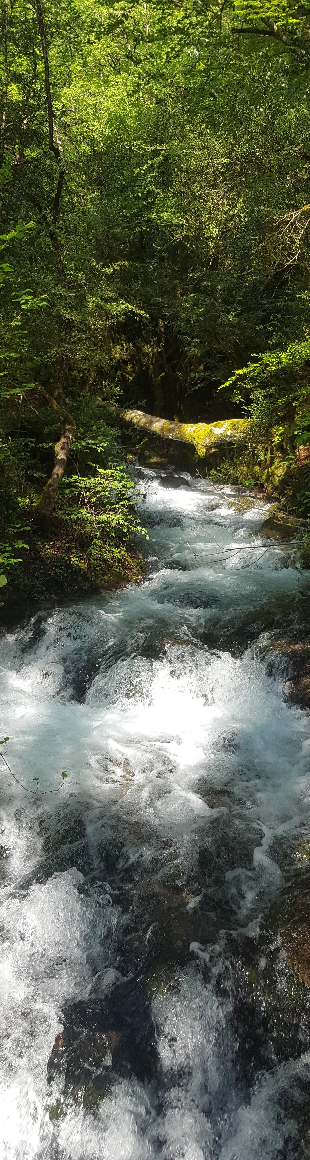
Objectives of the EIONET workshop
To provide member countries an update of the activities of the past year and an outlook on the next years
To seek feedback from member countries on main EEA products, activities and plans
Ensure an active role and participation of member countries in EEA’s activities, in connection with its key mandate of supporting and inform policy development and implementation and specifically the following tasks:
  Data flows/reporting, data management
  Assessments supporting the implementation and development of EU policies
  Information sharing and indicators
  Networking
To initiate the consultation process of member countries on EEA’s Freshwater Roadmap of activities for the next multi-annual workprogramme, including the WISE Implementation Plan.

Slide 3
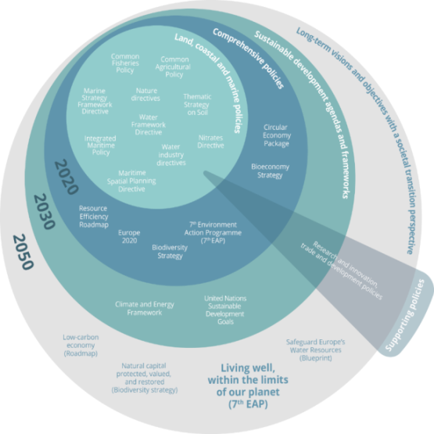


EU policy context
  7th EAP (Priority Objectives 1, 2, 3)
  Water Framework Directive
  Floods Directive
  Water Industry Directives
  Nitrates Directive
  WS&D strategy
  Marine Strategy Framework Directive
  Integrated Maritime Policy / Maritime Spatial Planning Directive
  Common Fisheries Policy
  2020 EU Biodiversity Strategy (e.g. Target 2/Action 5)
  Nature Directives
  Common Agricultural Policy

Slide 4
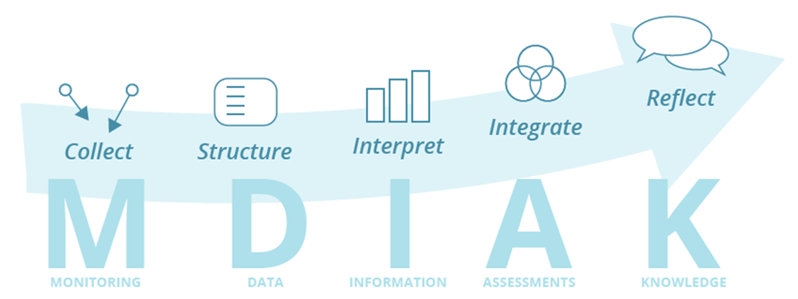
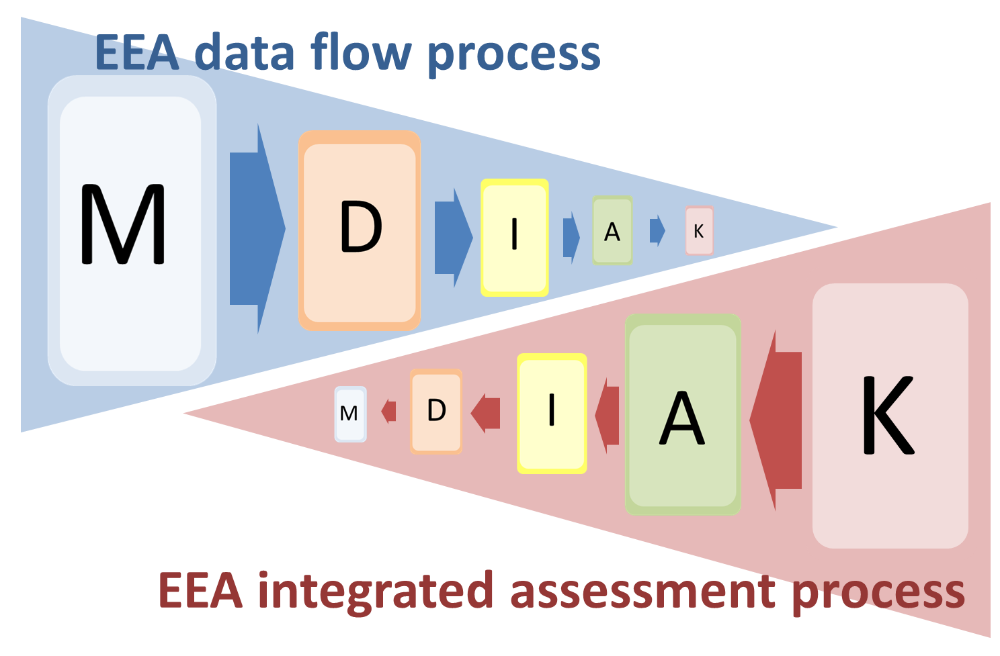

EEA’s mandate: To support and inform policy development and implementation
Generic tasks across the Water and Marine tasks:
  Data flows/reporting, data management
  Assessments supporting the implementation and development of EU policies
  Information sharing and indicators
  Networking
Resources:
EEA Water and Marine group
EEA ICT and data management colleagues
European Topic Centre on Inland, Coastal and Marine waters (ETC/ICM; http://icm.eionet.europa.eu)
EIONET network of EEA member and collaborating countries (NFPs, NRCs)
Collaborating partners (Regional Sea Conventions, ICES)

Slide 5
Upcoming changes in the strategic and policy context
Priorities and opportunities
Factors framing multi-annual planning | Certainty | Uncertainty
Internal factors | State of the Environment and Outlook report (SOER2020) 2016-2022 Marine Roadmap | New ETC/ICM (Jan 2019) Draft Freshwater Roadmap Draft Marine Roadmap+ (beyond 2020)
External factors | - 2020 Biodiversity Strategy (e.g. Target 2/Action 5; Target 4) | Revised priorities related to: MFF 2021-2028 8th EAP (2020 onwards)? New EP and EC (2019) EEA’ evaluation (2017/20018), Regulation, EEA ED MRR Fitness Check and Streamlining Environmental Reporting initiative EEA’s MAWP (beyond 2020) Evaluation and possible reviews of WFD and water-related directives
Given the level of uncertainty and constraints on human and financial resources (EEA’s flat or decreasing budget; staff cuts), it is important to develop realistic and robust planning (e.g. roadmaps).

Slide 6



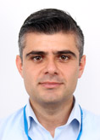

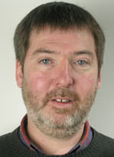




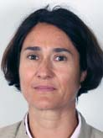
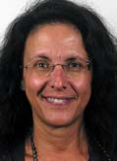

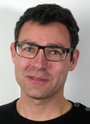
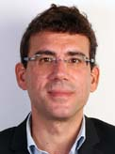




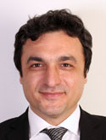
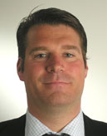

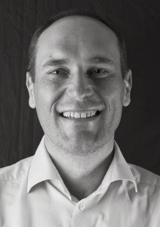


EEA Water and Marine group – Human resources
Water
Muhammet
Hydro-morphology and diffuse pollution
Andrea
Water assessment, floodplains and ecosystem assessment
Caroline
Water industries and pollution
Nihat
Water quantity and accounts, ENI East
Peter
Water assessments
Trine
Freshwater assessments and floods
Marine
Ana
WISE-Marine and regional cooperation
Cécile
Regional cooperation – ENI South
Eva
Marine assessments
Irene
Marine Data and reporting
Johnny
Marine assessments
Michael
Regional cooperation – ENI South
Monika
Marine assessments
Mustafa
Regional cooperation (Black Sea)
Nikolaj
Ocean governance, Arctic
Charlotta
Secretarial support
Stéphane
Head of Group

Slide 7
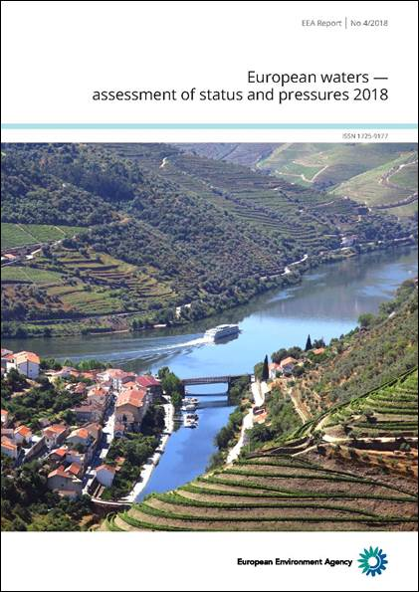
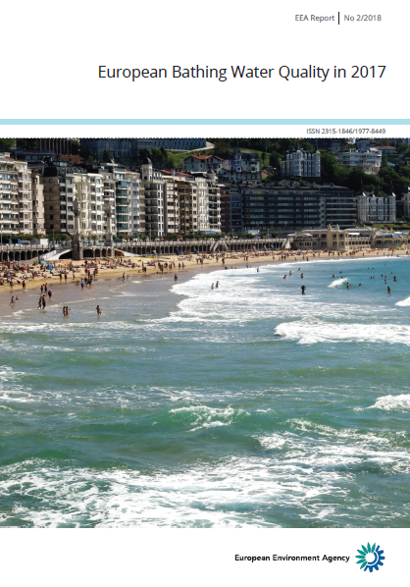
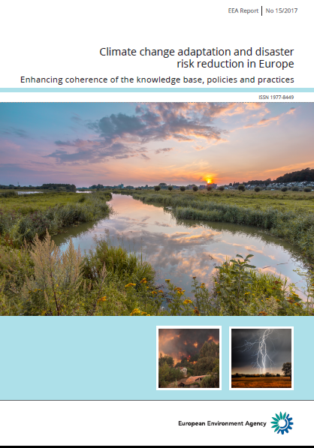
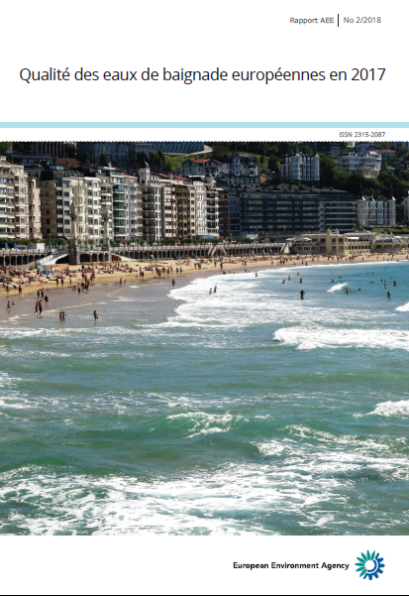

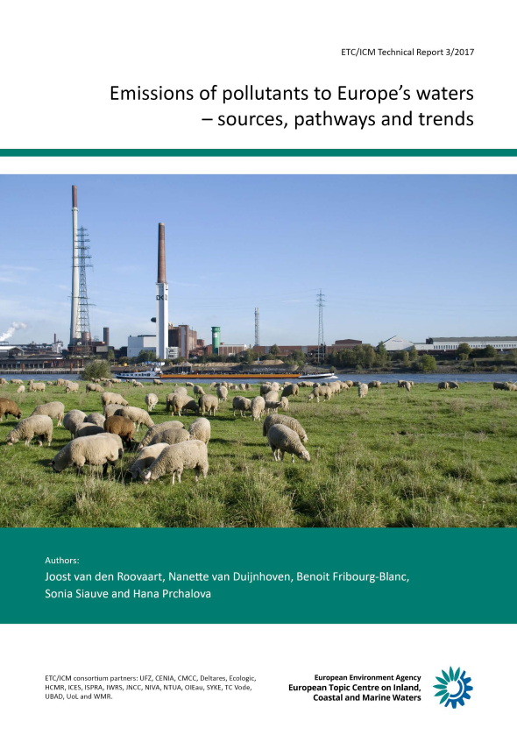
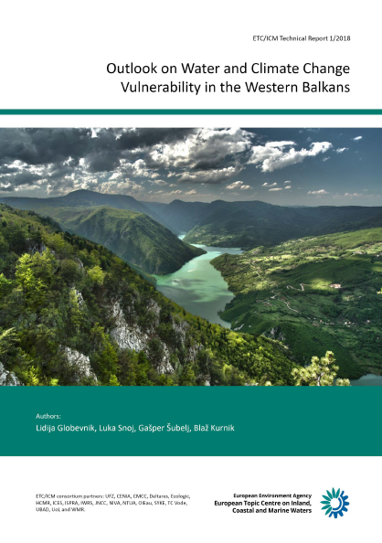
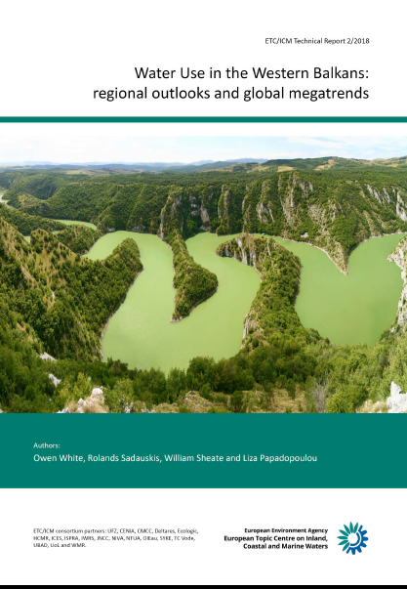
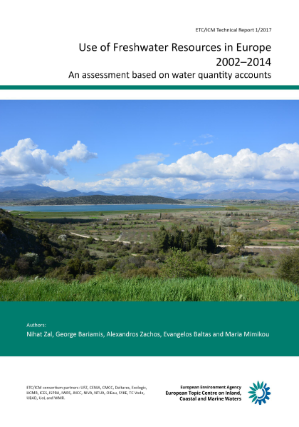
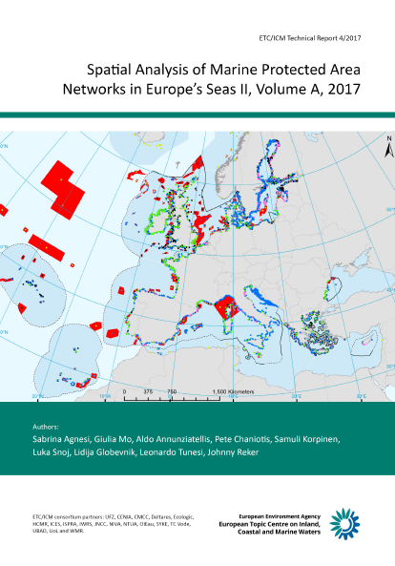
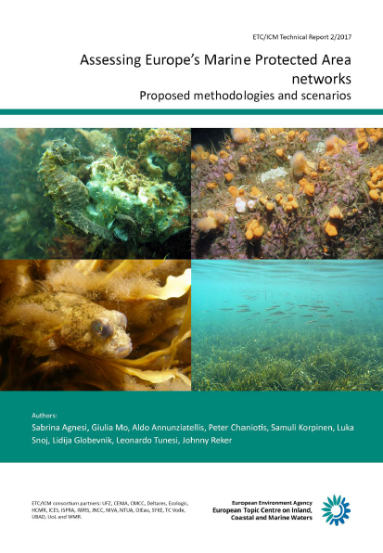
The EEA, a knowledge provider - Recent reports
Assessments supporting the implementation and development of EU policies
ETC/ICM Technical Reports (http://icm.eionet.europa.eu/)

Slide 8
European waters - assessment of status and pressures 2018
Why, what, for who and when
  The European Commission:
    publishes its report on “Implementation of WFD and the review of the 2nd River Basin Management Plans (RBMPs)” (mid/late 2018)
    starts the process of evaluating the Water Framework Directive (EU Water Conference, Vienna, 20-21 September).
  To accompany and inform this process, the EEA has long planned a report of status of European waters (WFD art 18).
The report, based on data reported by 25 MS, addresses:
  What is the status of European waters?
  Which pressures is causing less than good status;
  What progress has been achieved in the 1st River Basin Management cycle (2010-2015)?
WFD Article 18:The EU Commission shall publish a report on the implementation of the directive two years after the Member States have delivered the RBMPs.
•The report shall include a review of the status of surface water and groundwater in the Community undertaken in coordination with the European Environment Agency (EEA)

Slide 9
European waters - assessment of status and pressures 2018
The target audience is:
EU institutions (EP, COM, JRC);
Countries (national, River Basin District administrations working with WFD and other water policy implementation);
International River Basin and Regional Sea Conventions;
Water experts and scientists; and
General public.
Launch of the report on 3rd July:
Planned for 3 July in Brussels at the EPC (European Policy Centre);
With EEA’s Executive Director, European Commission-ENV.C Director Ms Veronica Manfredi, and (tbc) representatives of MS and/or water business or environmental organisations;
The report provides the EU overview and key results. It is complemented with more detailed results available on the interactive WISE-Freshwater visualisation tool.

Slide 10
European waters - assessment of status and pressures 2018
Involvement of EU member states and EEA member countries: a 2-year process with regular presentations of the EEA approach and draft results, and consultation of EU member states and EEA member countries:
2016 and 2017 Eionet NRCs Freshwater workshops
CIS SCG and Working Groups (e.g. DIS, Chemicals, Groundwater, Ecostat)
Water Directors meeting (Malta, Estonia, Sofia)
Eionet consultation on draft EEA report (15 Jan – 28 Feb 2018; more than 600 comments)
Bilaterals with countries on specific topics (e.g. groundwater)

Slide 11
European waters - assessment of status and pressures 2018
The EEA wishes to acknowledge the valuable input and commitment of countries to this process and thank them for the constructive and positive feedback received so far, particularly with regard to:
Many good comments and constructive suggestions + Control of values (few errors found; not consistent values)
Addressing MS comments and demonstrating flexibility/versatility, e.g. charts and graphs, granularity of results, factual explanations/footnotes/disclaimers
Show progress beyond the ‘one-out all-out principle’, e.g. with analysis at QE level
Provide a visualisation tool that allows stakeholders to access and extract the data according to their needs and to exploit the full depth of the information/data reported under the WFD
Demonstrated the importance of the coordination of activities and feedback at national level between EEA NRCs and colleagues attending the CIS Working Groups.
However, some critical comments relate to the interpretation of the WFD, which are for the European Commission and MS to consider in the next CIS workprogramme.
Please let us know in case you wish to have an EEA presentation of the report and its key EU results at upcoming events/conferences.

Slide 12
European waters - assessment of status and pressures 2018
Non-WFD/non-EU member countries
Development of a dedicated Box that provides links to the key national status/state assessments, RBMPs, and data sources that are available at the time of publication.
CH, IS, TR + West Balkans (EEA cooperating countries; e.g. the Sava International RBMP covering most of the West Balkans).
Data submitted via the WISE-SoE call will be incorporated and reflected, as for all other EEA member countries, in Chapter 6 of the report for trend analysis (EEA indicators on nutrients and BOD).
2-week consultation of non-WFD/non-EU countries from 1st June
Norway included in a box with dedicated text together with Greece, Ireland and Lithuania

Slide 13
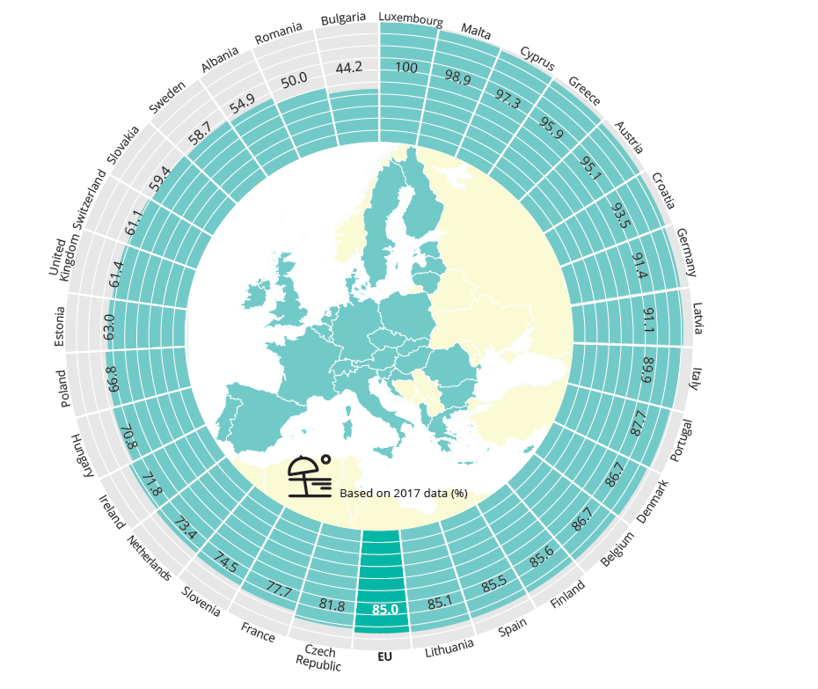
European Bathing Water Quality in 2017
10th Annual EEA report
Based on member countries annual reporting
Launched on 29 May jointly with the European Commission
Key results:
  Nearly all 21.801 bathing water sites monitored last year across Europe.
  'Excellent' quality standards across Europe dropped marginally from 85.5% in 2016 to 85% last year.
  The reason for the slight drop was due mostly to the effect of summer rain as well as changes in methodology in Romania and Sweden.
Proportion of bathing water sites with excellent water quality in European countries

Slide 14
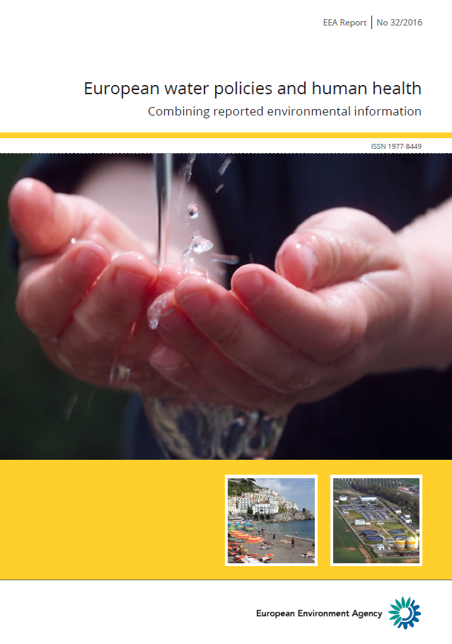
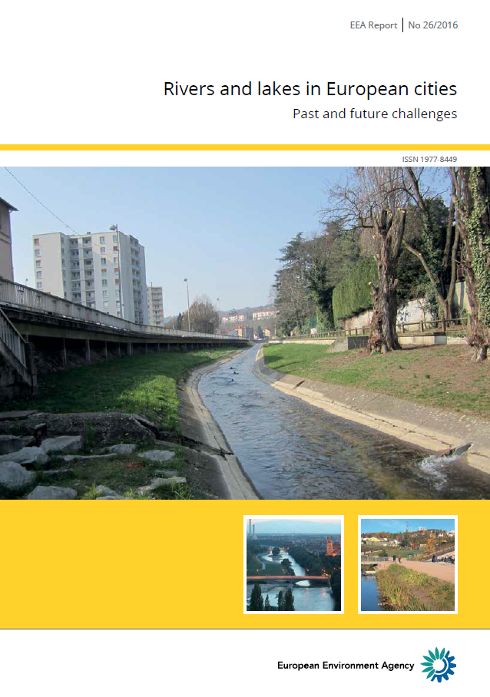
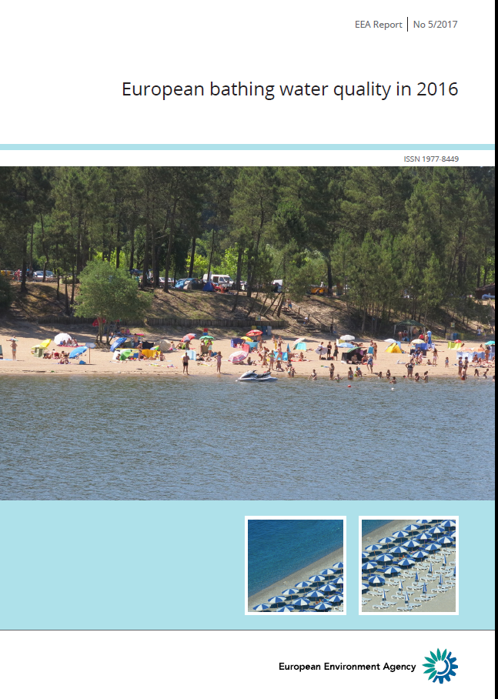
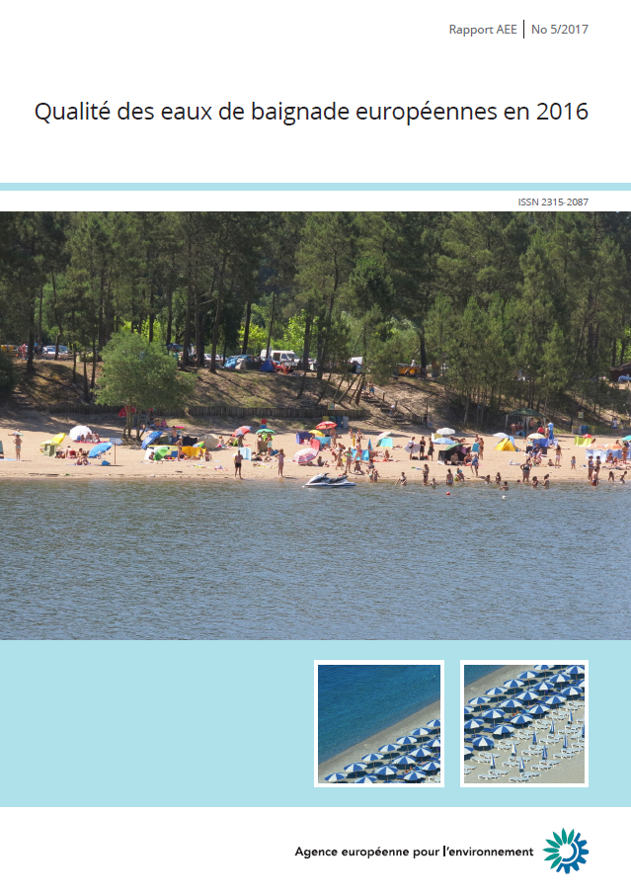

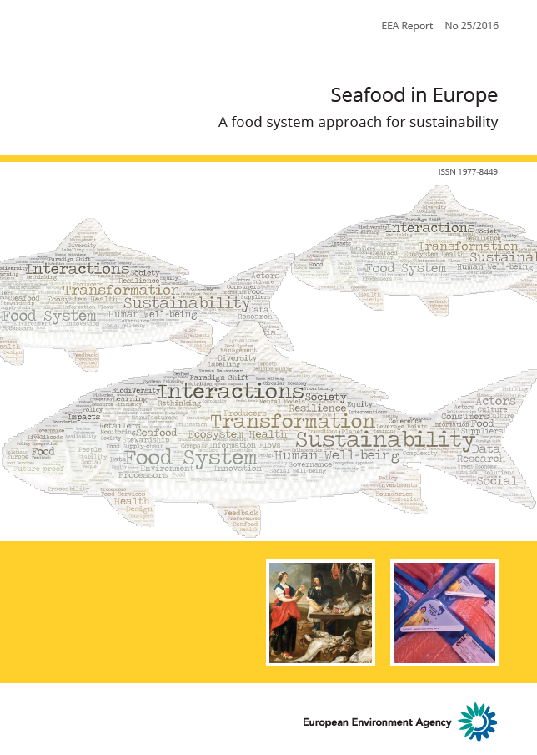
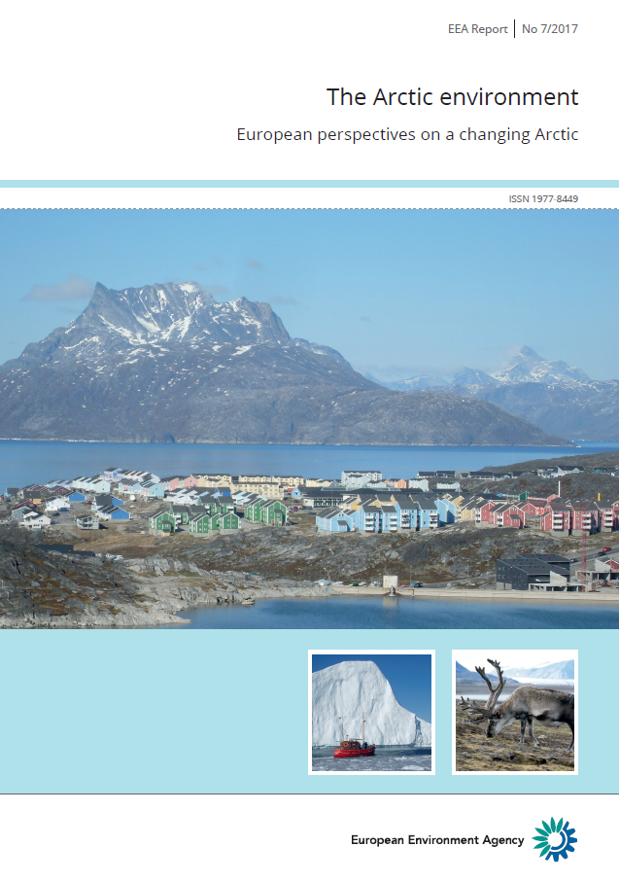
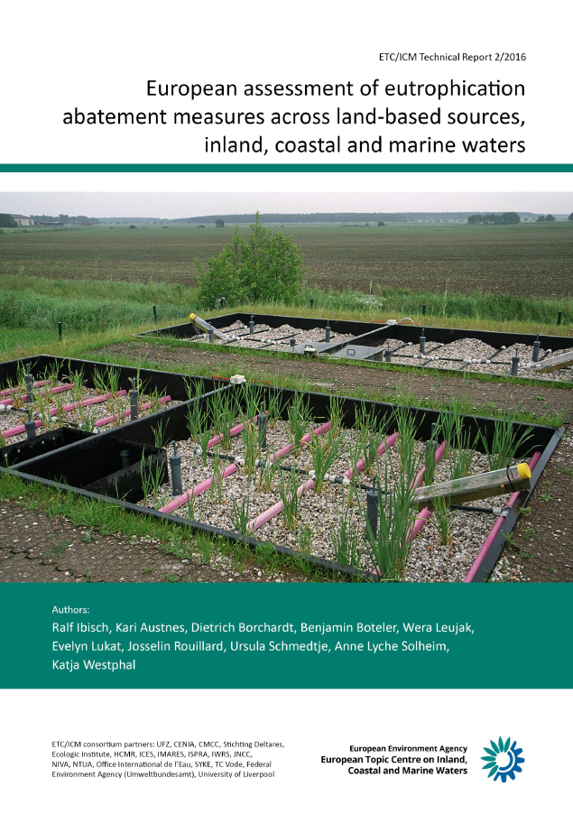
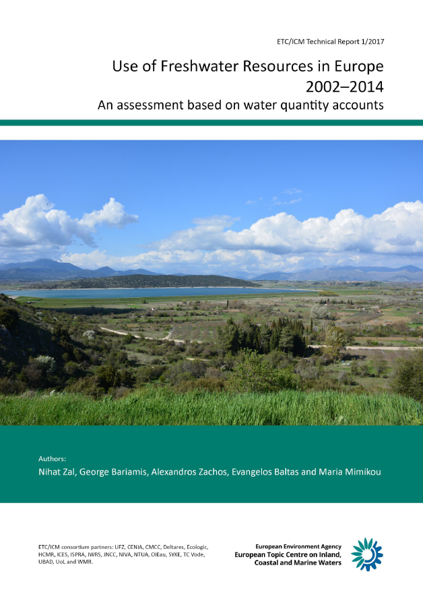
The EEA, a knowledge provider - Recent reports (2017 update)
Assessments supporting the implementation and development of EU policies
ETC/ICM Technical Reports (http://icm.eionet.europa.eu/)

Slide 15
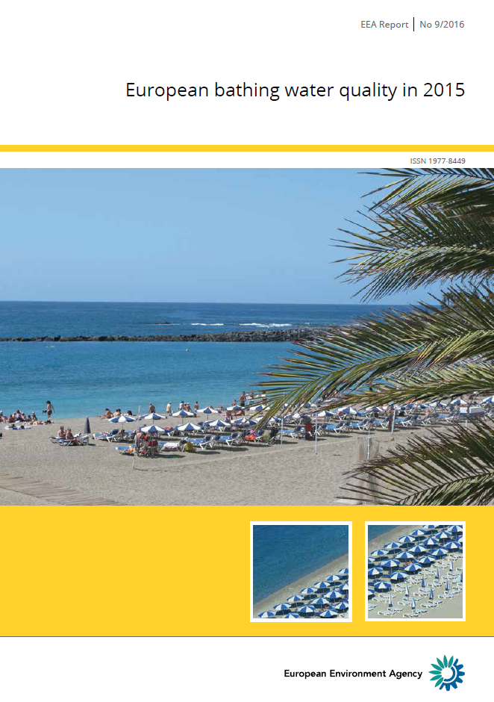
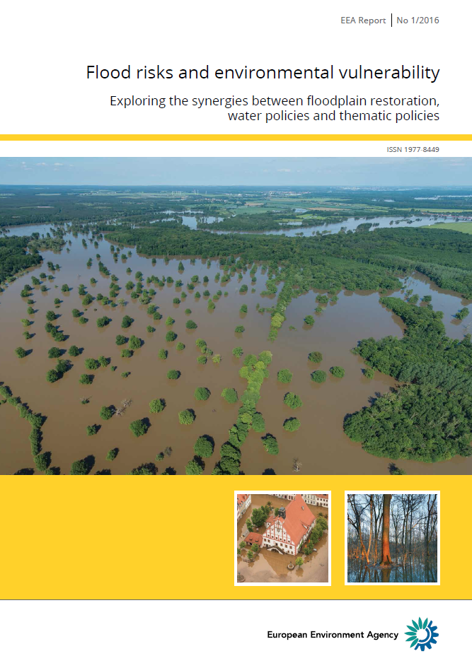
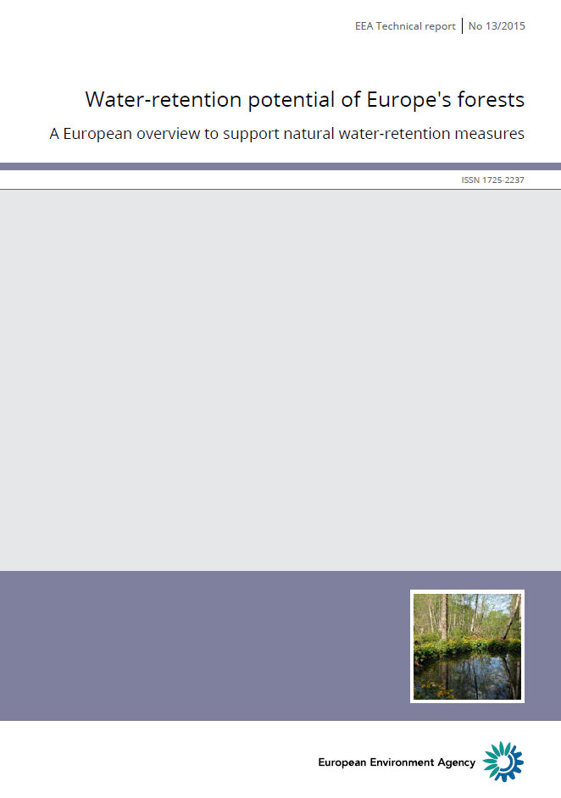
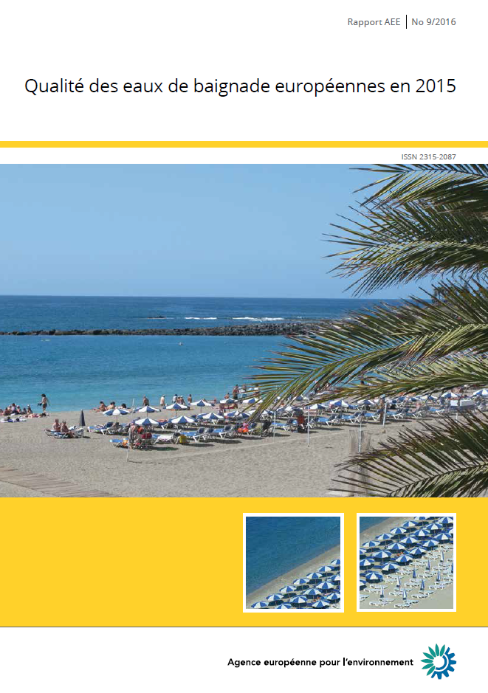
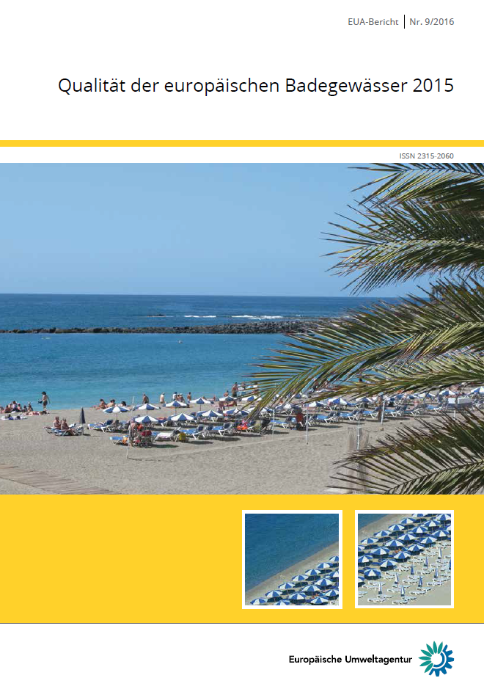
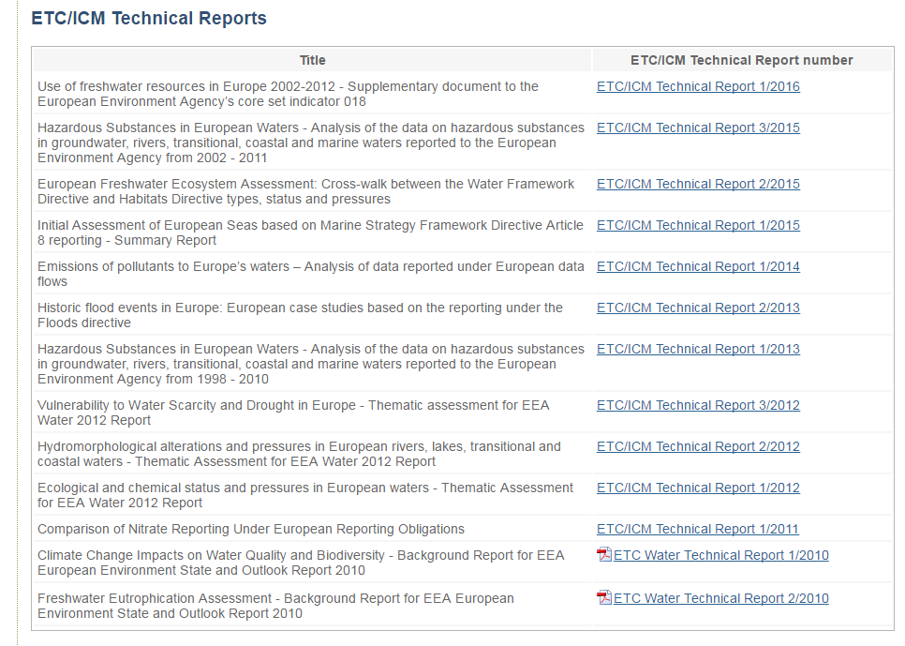

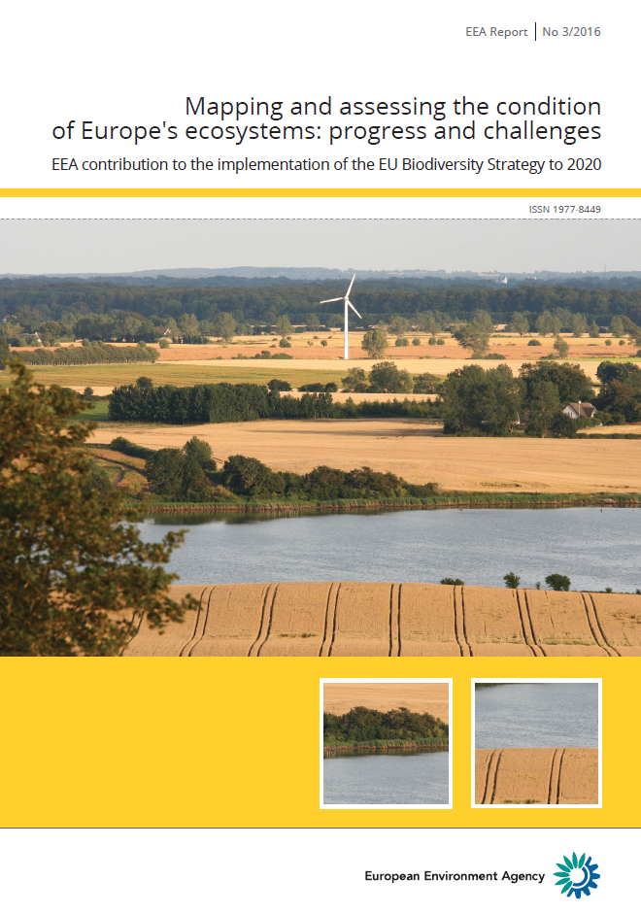
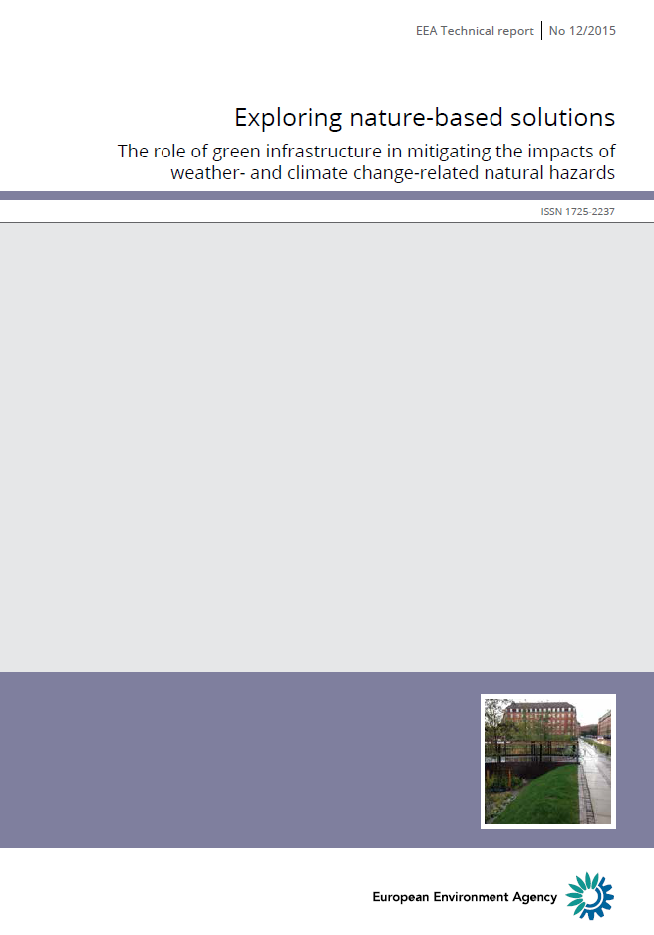
The EEA, a knowledge provider - Recent reports (2016 update)
Assessments supporting the implementation and development of EU policies
Contributions

Slide 16
Data flows/reporting, Information sharing and indicators, Networking
Data flows/reporting, data management
  Support the common implementation strategy and the water data reporting under EU Directives: Water Framework D./FD., Urban Waste Water Treatment D. and Bathing Water D.
  Support to the WFD and FD.
  Plan WISE-SoE 1, 3, 4, 5 data calls (voluntary reporting)
Information sharing and indicators
  Updated indicators on water:
    Use of freshwater resources (Water Exploitation Index; WEI+, CSI018): https://www.eea.europa.eu/data-and-maps/indicators/use-of-freshwater-resources-2/assessment-2 (Updated version up for Eionet consultation)
    Water intensity of crop production (WAT006): https://www.eea.europa.eu/data-and-maps/indicators/economic-water-productivity-of-irrigated-1/assessment
    Urban waste water treatment (CSI024): https://www.eea.europa.eu/data-and-maps/indicators/urban-waste-water-treatment/urban-waste-water-treatment-assessment-4
  Water information for Europe (WISE) maintenance and development of 3rd WISE Implementation Plan 2018-2020 (Draft version)
Networking
  WFD Common Implementation Strategy (CIS) Working Groups (DIS, floods, chemical)
  UWWTD Working Group, BWD Working Group
  EIONET Workshop
  Attendance of key conferences (e.g. SOLUTIONS, MARS)

Slide 17
Looking forward: upcoming activities to strengthen the water knowledge
Assessments supporting the implementation and development of EU policies
  Active dissemination of the European waters – assessment of status and pressures 2018
  European bathing water quality in 2018 (2019) – Second generation
  Chemicals in Europe’s surface waters (2018)
  Water and agriculture
  Floodplains and ecosystems assessment
  Initiate dedicated work on hydro-morphology
  EEA Briefings
Data flows/reporting, data management
  Support on water data reporting under Directives (Water Framework D., Urban Waste Water Treatment D., Bathing Water D., and Floods D.).
  Water quantity and quality accounts.
  WISE-SoE data calls (October 2018).
Information sharing and indicators
  Water information for Europe (WISE) maintenance and Implement WISE-Freshwater Implementation Plan
  Updated core set of indicators on water (Nutrients in freshwater (CSI 020), Oxygen consuming substances in rivers - biochemical oxygen demand (BOD) (CSI 019))
Networking
  Common Implementation Strategy (CIS) Working Groups
  Eionet Workshops

Slide 18
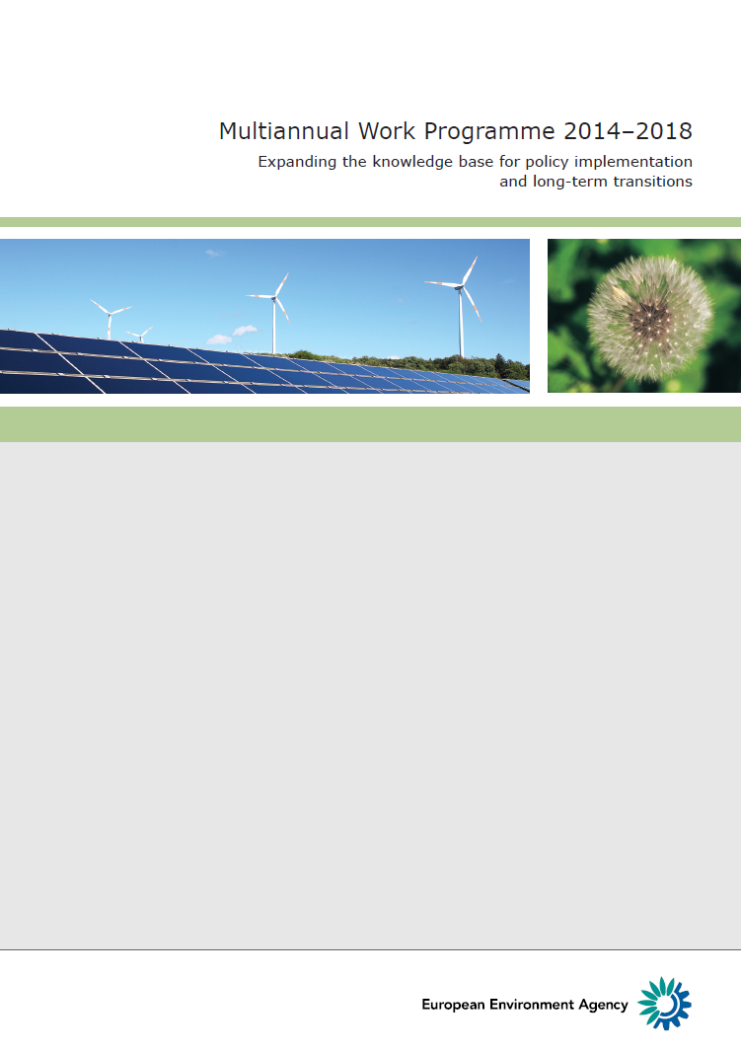
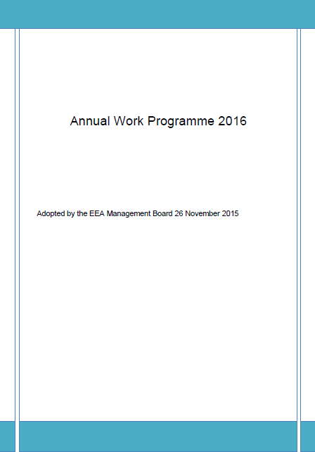
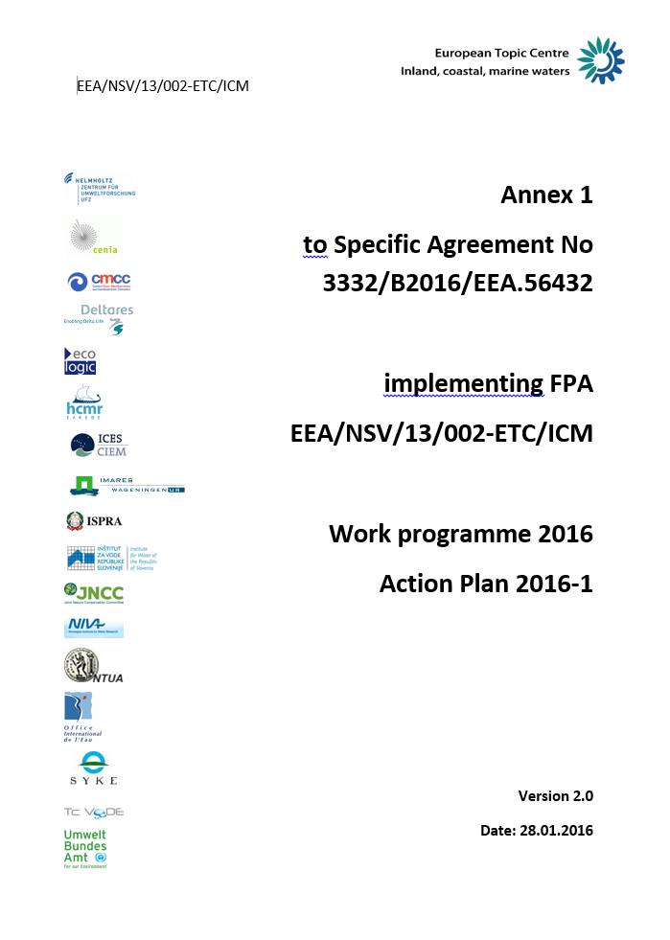

EEA Freshwater Roadmap
EEA Freshwater Roadmap
Policy developments
Availability of data and information
Analytical and assessment methods

Slide 19
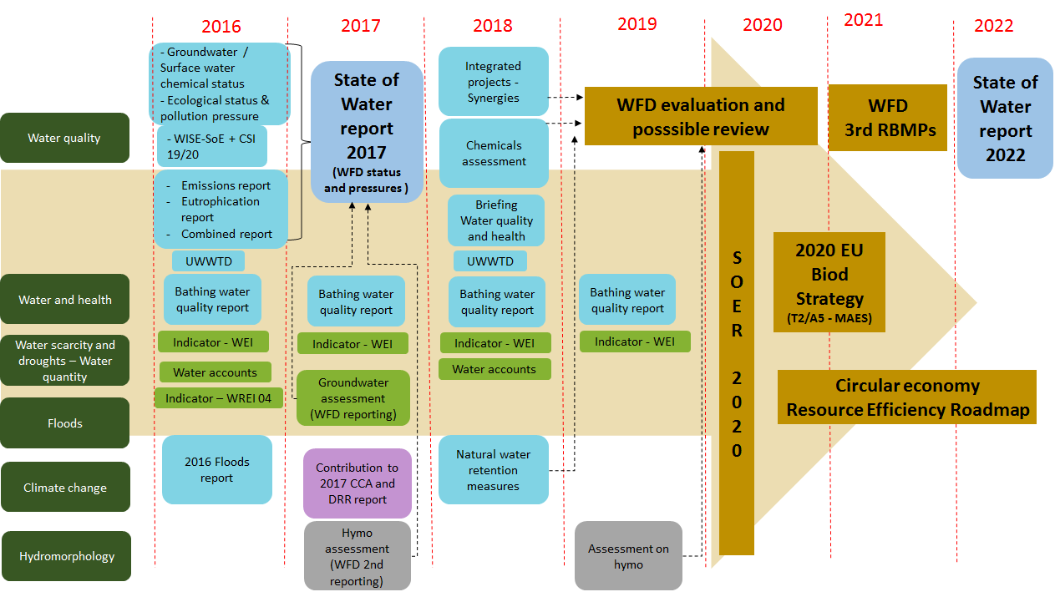

Water knowledge - EEA freshwater Roadmap to support EU policy implementation

Slide 20
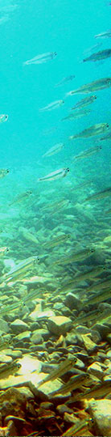
Marine knowledge - EEA 2016-2022 Marine Roadmap to support EU policy implementation

Slide 21
Stéphane Isoard
Water and Marine – Head of Group
Stephane.Isoard@eea.europa.eu
Sign up to receive EEA news, reports
and alerts on your areas of interest at
http://eea-subscriptions.eu/subscribe
Thank you for your attention

Slide 22
Planning the collaboration with EIONET member countries in 2018/2019
Data reporting (request)
WISE SoE: 2018 Freshwater data-call (1 October-31 December 2018)
Data requests for thematic assessments (please share if you have relevant information as soon as possible – bilateral)
Indicators (consultation)
To be consulted in Q4:
To be consulted in 2019:

Slide 23
Planning the collaboration with EIONET member countries in 2018/2019
Thematic assessments (consultation)
Eutrophication in Europe’s seas (Q2/3)
Contaminants in Europe’s seas (Q3)
Sustainable use of Europe’s seas (Q3)
Chemicals in surface waters (Q3)
Industrial Pollution: Industrial waste water
Quick Guide for assessing marine ecosystem capacity for service supply (Q4)
Pressures & impacts on Europe’s seas (incl. a spatial apprach for assessing cumulative pressures) (Q4)
Marine biodiversity (Q4)
Floodplains and ecosystems assessment (potentially Q4)
Note: We will send out a package of products when possible

