Slide 1
Anita Künitzer/14-15 June 2018/Freshwater Eionet workshop 2018
Update on ETC/ICM activities

Slide 2
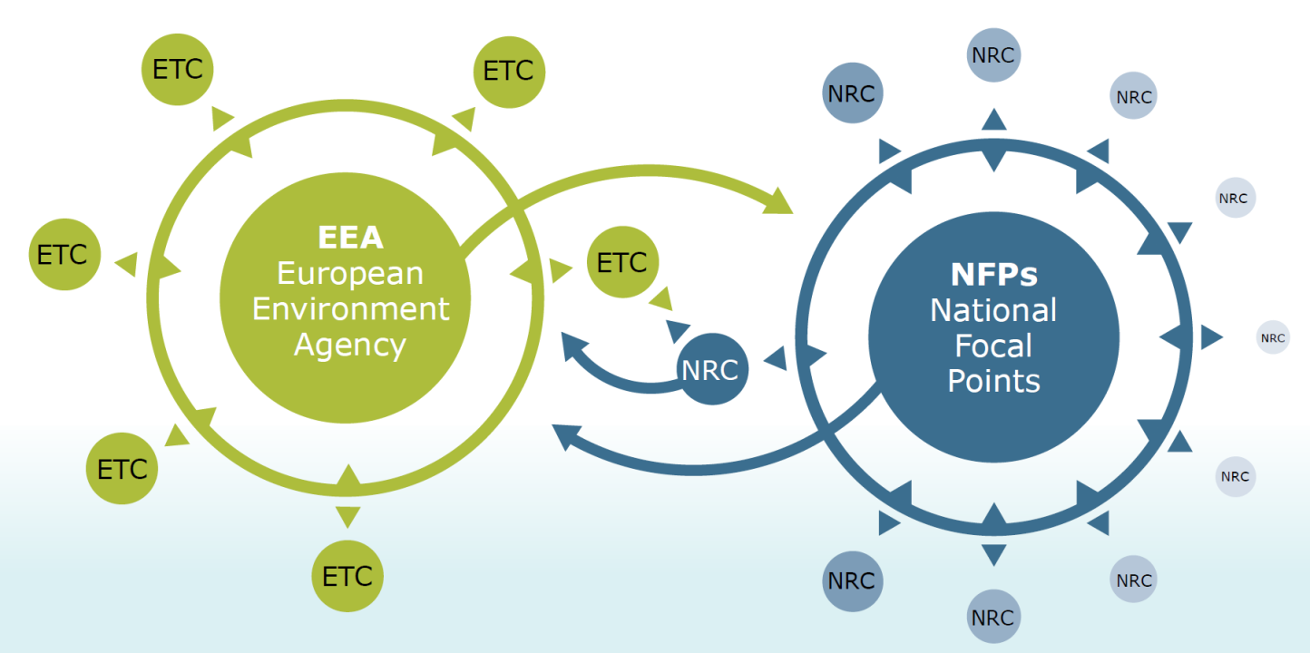
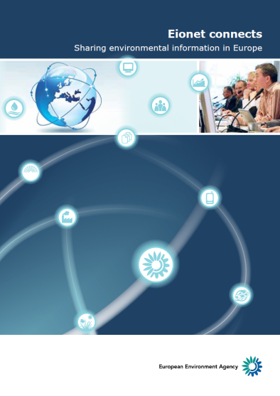
ETCs are part of Eionet (European environment information and observation network)
The European Topic Centre on Inland, Coastal and Marine waters (ETC/ICM) is an international consortium brought together to support the European Environment Agency (EEA) in its mission to deliver timely, targeted, relevant and reliable information to policy-makers and the public for the development and implementation of sound environmental policies in the European Union and other EEA member countries.
The intention is to establish a seamless environmental information system to assist the Commission and EEA member countries in their attempts to improve the environment, move towards sustainability and integrate environmental policies with other sectors such as economic, social, transport, industry, energy and agriculture.

Slide 3
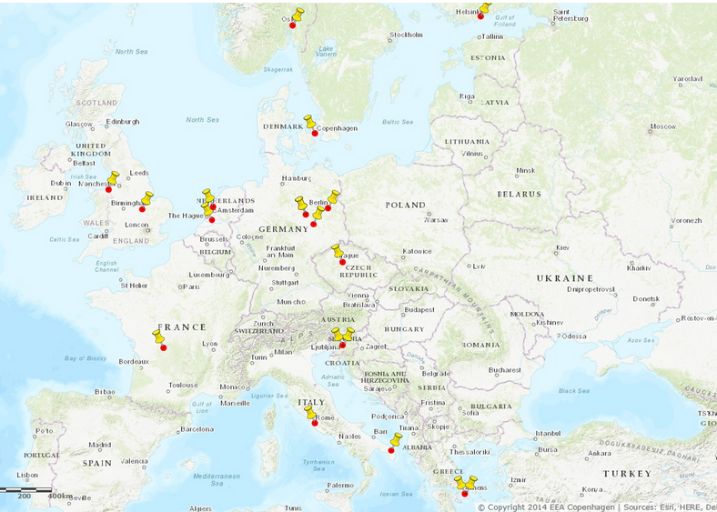
ETC/ICM 2014 - 2018
From 2007 to 2013, Cenia, Czech Environmental Information Agency was leading the European Topic Centre on Water (ETC/W) later called ETC/ICM.
From 2014 to 2018 The Helmholtz Centre for Environmental Research – UFZ is leading the European Topic Centre on Inland, Coastal and Marine waters (ETC/ICM) with a consortium of 18 partners.
UFZ has submitted a proposal for the new ETC/ICM 2019-2021.

Slide 4
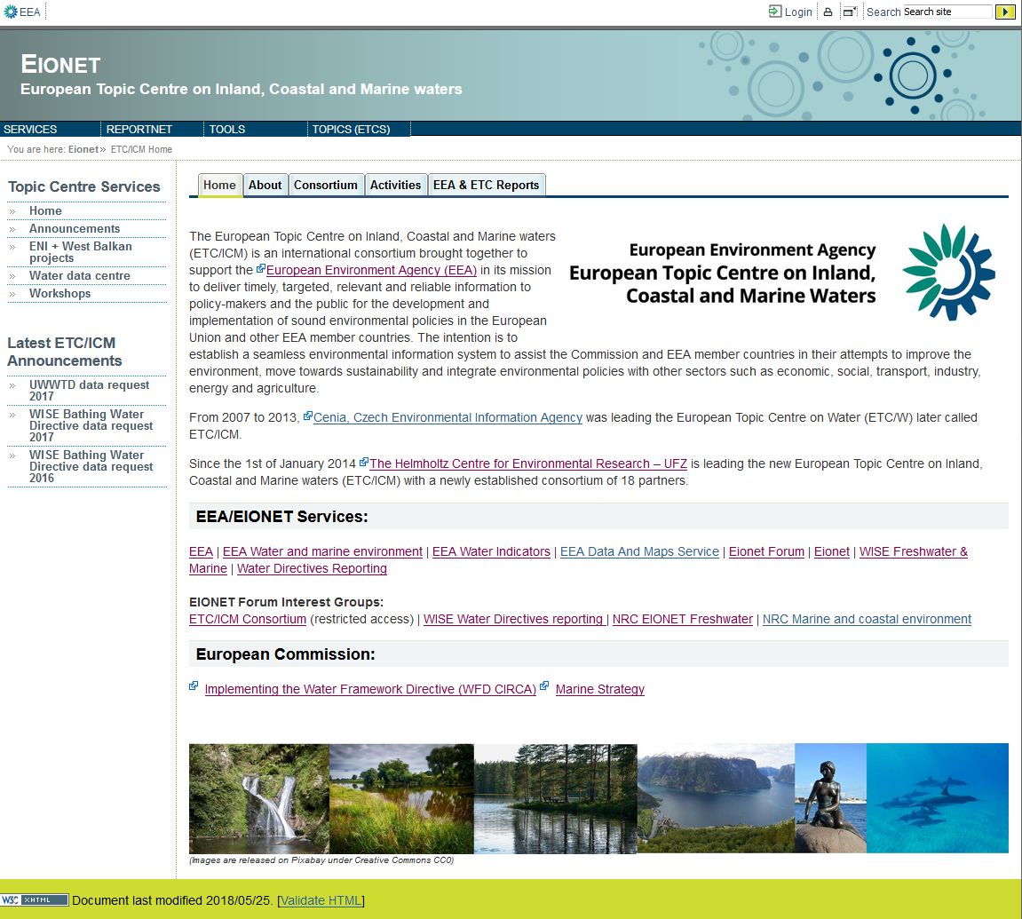
ETC/ICM website: http://icm.eionet.europa.eu/

Slide 5
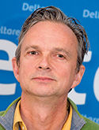
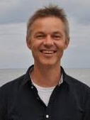








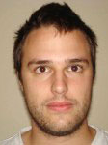

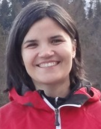
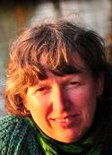
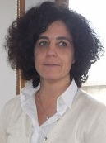
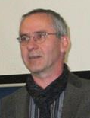

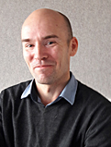

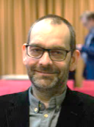
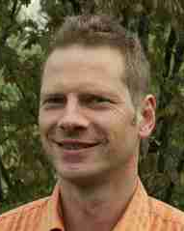

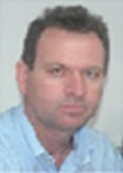
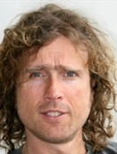
ETC/ICM teams and task leaders 2018
Core team
Joost van den Roovaart
Hans M. Jensen
Jørgen N.
Jensen
Anne Lyche Solheim
Lidija Globevnik
Freshwater
team
Marine
team
Neil
Holdsworth
Kari Austnes
Theo Prins
Ursula Schmedtje
Team lead
UBA Dessau
Team lead
JNCC
Bryoni Meakins
Štefan
Trdan
UFZ:
ETC Manager: Anita Künitzer
ETC Assistant
Financial contact
Scientific key experts
Ursula Schmedtje
David Vaughan
David Vaughan
Ana Frelih-Larsen
Sabrina Agnesi
Volker Mohaupt
Claudette
Spiteri
Samuli Korpinen
Silvie Semerádová
Jesper H. Andersen
Mathias Scholz
Bethany
Stoker
Evangelos Baltas
Gerjan J.
Piet

Slide 6
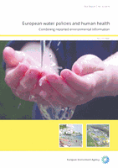
What did we achieve 2014 – 2018 (1)
Revision of the SoE guidance (FW+M), improvements of the SoE datasets, harmonisation with WFD spatial data, migration of all ETC databases into EEA CWS, CSI019, CSI020 (with NRC support)
Annual BWD data request with annual assessment report, map viewer, data viewer, CSI022 (extranet networking)
Biannual UWWTD data request with publication of database, map viewer, data viewer, CSI024 (extranet networking)
Triannual DWD data request with publication in EEA Report No 32/2016 ‘European water policies and human health — Combining reported environmental information’ (extranet networking)
Support to WISE development

Slide 7
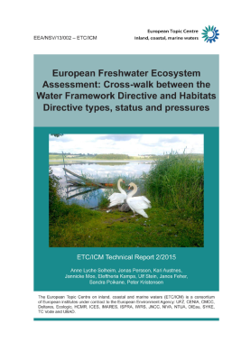
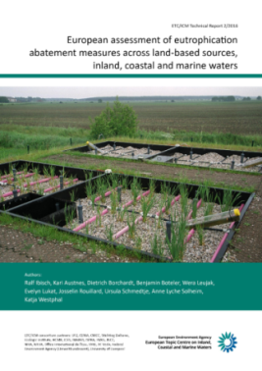
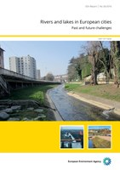
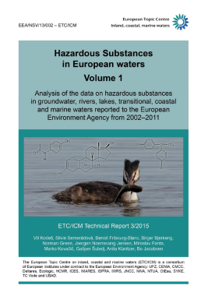
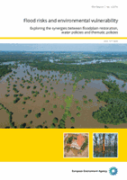
What did we achieve 2014 – 2018 (2)
Assessment of WFD 2016 data to support SoW report
Framework for assessing synergies in the implementation of the WFD and other environmental EU Directives in 2016 (internal paper)
European Freshwater Ecosystem Assessment: Cross-walk between the Water Framework Directive and Habitats Directive types, status and pressures published 2015
European assessment of eutrophication abatement measures in 2015-2016, published
EEA Report on ‘Rivers and lakes in European cities’
Policy-focused assessment report on “Chemicals in Europe’s Surface Waters” nearly finalised, Report ‘Hazardous substances in European waters, published in 2 volumes in 2015
Framing of water & agriculture assessment started
Assessment of floods (EEA publication in 2016) and past floods database.
Report on floodplains and spatial assessment of floodplain ecosystems started 2017

Slide 8
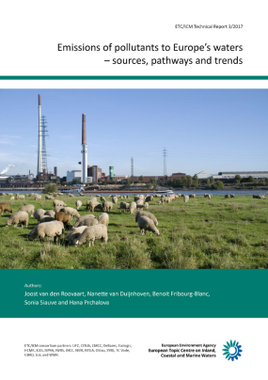
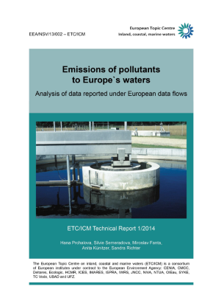
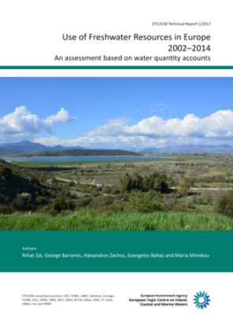
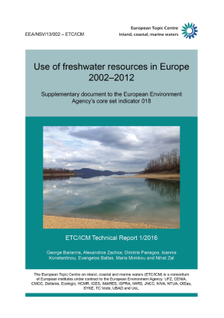
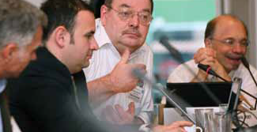
What did we achieve 2014 – 2018 (3)
Emissions of pollutants to Europe’s waters: 2 ETC/ICM Technical Reports published 2017 + 2014
Water quantity data collection, analysis, water accounting, CSI018 ‘use of freshwater resources’ and WAT006 ‘Water intensity of crop production’, 2 ETC/ICM Technical reports published in 2017 + 2016
Water emission and quality (condition) accounts started in 2018
Networking with Eionet: support to NRC workshops, participation in NFP/Eionet meetings (3/y), country visits if requested
Support to other EEA activities than water:
Contribution to the EEA report ‘Climate change adaptation and disaster risk reductions in Europe’ in 2016-2017
Support to the E-PRTR data review in 2018

Slide 9
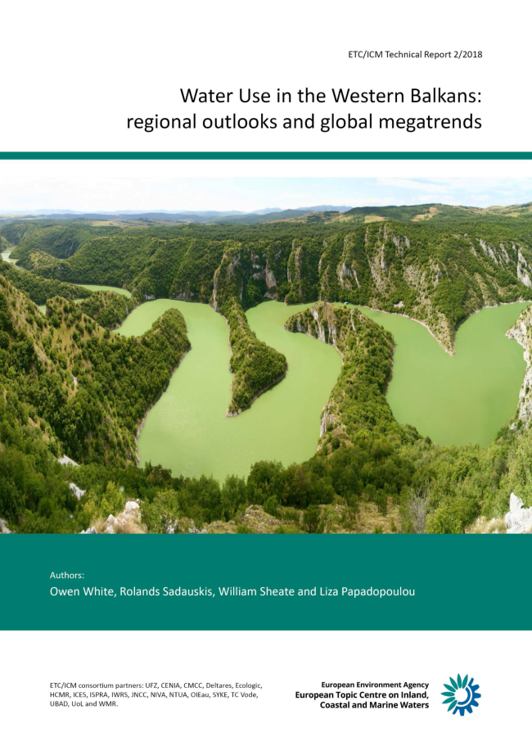
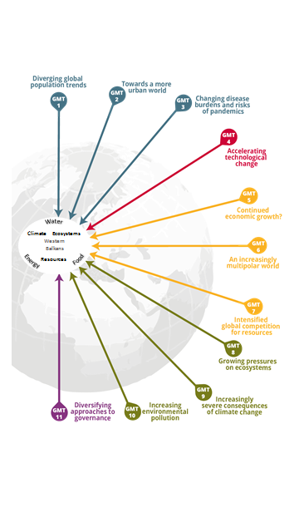
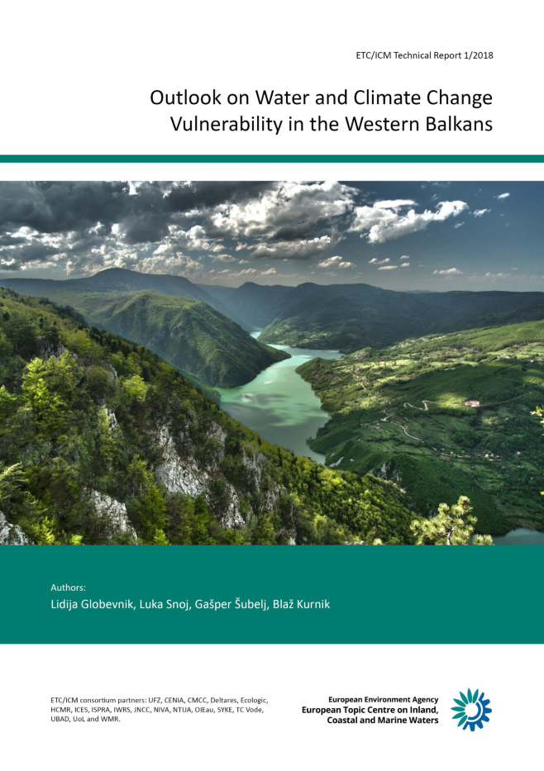
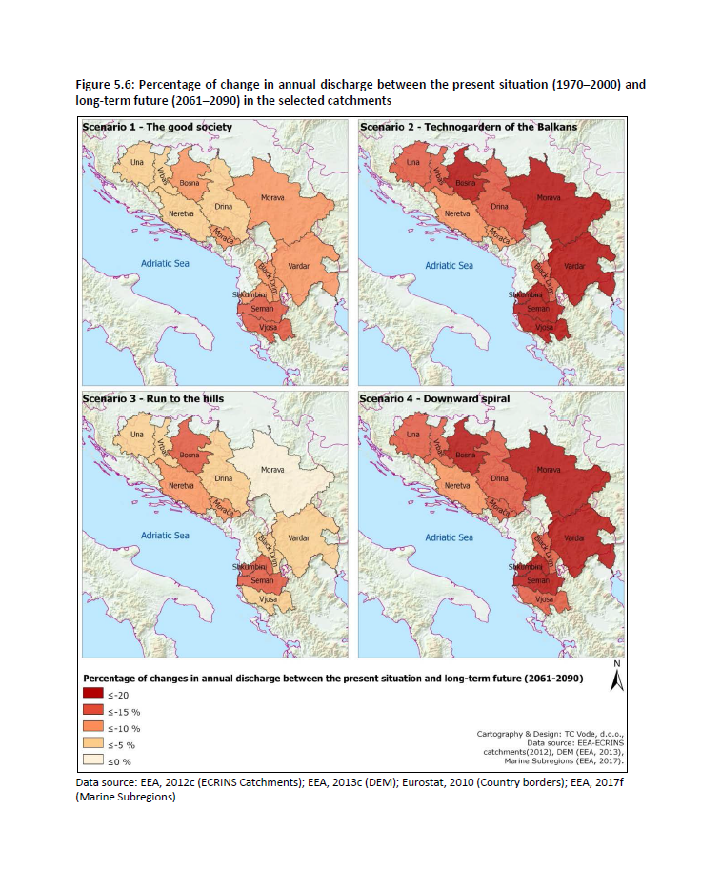
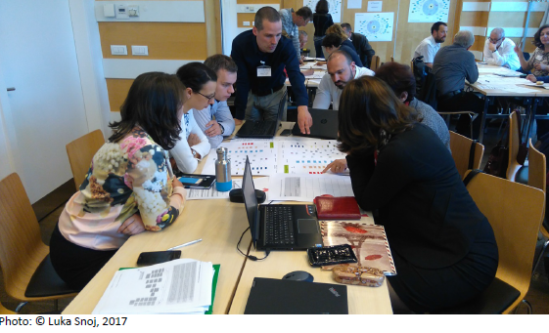
Additional project to support West Balkan countries 2016-2017

Slide 10
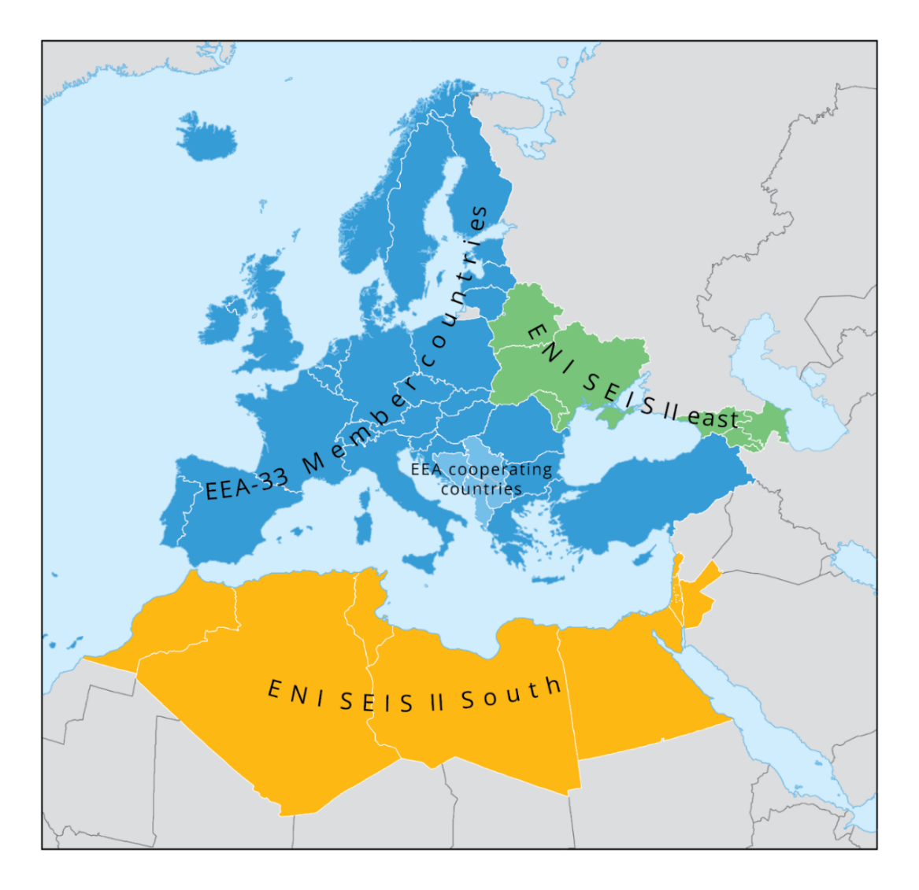
Additional projects to support ENI East/South countries
ENI SEIS II East project (2017 – 2019): Implementation of the Shared Environmental Information System (SEIS) principles and practices in the Eastern Partnership countries
  https://eni-seis.eionet.europa.eu/east/areas-of-work/
ENI SEIS II South project (2017 – 2019): Implementation of the Shared Environmental Information System (SEIS) principles and practices in the ENP South region - SEIS Support Mechanism
  https://eni-seis.eionet.europa.eu/south

