Slide 1
Stéphane Isoard
Water and Marine – Head of Group
Stephane.Isoard@eea.europa.eu
EIONET Freshwater Workshop
14-15 June 2018, EEA, Copenhagen
2018 Freshwater data call

Slide 2
WISE SoE - 2018 Data call
2018
October
Februar
December arch
May
June
July
August
Se
October ptember
em December ber
2018 freshwater data-call (WISE-1, 3, 4 and 5)
2019
Publication of Waterbase
2019 freshwater and marine data-calls (from WISE-1 to WISE-6)

Slide 3
WISE SoE - 2018 Data call
The WISE SoE 2018 Data call covers WISE 1, 3, 4 and 5:
WISE SoE 1: Emissions to water
WISE SoE 3: Water quantity
WISE SoE 4: Water quality in rivers, lakes and groundwater
WISE SoE 5: Spatial data
From 1st October 2018 to 31 December2018
Please refer to previous communication on the WISE-SoE data calls, particularly emails to NRCs and NFPs:
4 October 2017 - Informing about the postponement of the 2017 Freshwater WISE-SoE data calls to October 2018.
21 December 2017 and 3 April 2018 - Informing that 3 indicators (‘Hazardous substances in marine organisms’, ‘Nutrients in TCM waters’ and ‘Chlorophyll in TCM waters’) would now be based on data reported to ICES and data from EMODnet Chemistry in an effort to further streamline reporting at EU level. The marine WISE-SoE data call was therefore postponed to October 2018.
The European datasets from previous submissions will be available at the EEA Water Data Centre.

Slide 4
WISE SoE - 2018 Data call
The Announcement Letter will be sent by EEA to:
Eionet PCPs and NRCs for Water quality and ecological status
Eionet PCPs and NRCs for Water emissions
Eionet PCPs and NRCs Water Quantity
Eionet PCPs and NRCs for Marine, coastal and maritime
Cc: Eionet National Focal Points
Please try to deliver your data early in the data collection period.
Final feedback will be provided on any released envelope during the reporting period (and not after the end of the data collection period). Envelopes released after the end of the data collection period (31 December 2018) run the risk of being harvested and processed as part of the 2019 data call only.

Slide 5
WISE SoE - 2018 Data call
The WISE-1 data collection model is identical to the one used since the 2015 Data Call. However it now includes riverine input loads and direct discharges to the sea, which will be ignored in 2018 since there is no marine data call in 2018.
(The WISE-2 has been revised during 2015 and 2016 and streamlined with the biology data-model in WISE-4.) No marine data call in 2018.
The WISE-3, WISE-4 and WISE-5 data collection models are identical to the ones used since the 2015 Data Call.
The WISE SoE - Spatial Data (WISE-5) data flow includes the spatial reference datasets following the same data models used in the WFD – RBMPs - 2016 spatial data reporting. Data Providers not reporting under the WFD are expected to report information under WISE-5. Data Providers reporting under the WFD (Member States and Norway) may also exceptionally use WISE-5 to provide information on EIONET spatial objects not covered by the WFD reporting.
For marine waters (beyond the scope of the WFD), stations will be reported under the WISE-5 MonitoringSite model, using the marine region or subregion code as feature of interest. This will be ignored in 2018 since there is no marine data call in 2018.
(The WISE-6 data collection model is the new model for water quality in transitional, coastal and marine waters (former WISE-TCM), which has been revised during 2015 and 2016 and streamlined with the water quality data-model in WISE-4. Data coming from reporting to ICES through the Regional Sea Conventions will be collected by the EEA/ETC, and transformed to the WISE-6 (time series) and WISE-5 (monitoring sites) models, so that it can also be published in Waterbase.) No marine data call in 2018.

Slide 6
WISE SoE - 2018 Data call
Please use the Reporting Obligations Database (ROD) to locate the relevant information about:
WISE SoE - Emissions (WISE-1)
WISE SoE - Water Quantity (WISE-3)
WISE SoE - Water Quality (WISE-4)
WISE SoE - Spatial Data (WISE-5)
Reporting process - Guidance documents available at:
WISE SoE - Emissions (WISE-1)
WISE SoE - Water Quantity (WISE-3)
WISE SoE - Water Quality (WISE-4)
WISE SoE - Spatial Data (WISE-5)
Definition of the datasets: http://dd.eionet.europa.eu/datasets
Data files should be uploaded to the Central Data Repository (CDR). The following formats are accepted: Microsoft EXCEL files (XLS or XLSX); XML files; Shapefiles and GML files (WISE-5 only). WISE-SoE CDR help page: http://cdr.eionet.europa.eu/help/WISE_SoE

Slide 7
WISE SoE - 2018 Data call
If your data delivery was released and technically accepted, you may still deliver additional data (or correct the data that was previously delivered) by creating a new envelope.
If your data delivery was released and a correction was requested, you may still submit a revised full delivery in a new envelope.
Please contact wisesoe.helpdesk@eionet.europa.eu if you need EEA's assistance in preparing your data delivery. In case of login problems or any other technical difficulties with Eionet services, please contact Eionet helpdesk: helpdesk@eionet.europa.eu

Slide 8
WISE SoE - 2018 Data call
Please note that the EEA, in accordance with its data policy, publishes all data reported by countries, aggregated and disaggregated.
Planned use of WISE SoE data calls:
The European datasets from previous submissions will be available at the EEA Water Data Centre.
Freshwater quality indicators:
Nutrients in freshwater (CSI 020),
Oxygen consuming substances in rivers - biochemical oxygen demand (BOD) (CSI 019)
Freshwater quantity indicators:
Use of freshwater resources (Water Exploitation Index; WEI+, CSI018)
Possibly the Water intensity of crop production (WAT006), depending on data coverage.
WISE-Freshwater interactive maps providing European overviews.
Assessments (see the Freshwater and Marine Roadmaps 2016-2022)
The following Marine indicators, instead of being based on WISE 6 (formerly known as WISE-TCM; Water quality in transitional, coastal and marine waters), will now be fed with data reported to ICES and data from EMODnet-Chemistry:
Nutrients in TCM waters (MAR 005 / CSI 021)
Chlorophyll in TCM waters (MAR 006 / CSI 023)
Hazardous substances in marine organisms (MAR 001 / CSI 049)
Reduced oxygen content (MAR 012)
WISE 2: Biology in transitional and coastal waters will be called for the 1st time in 2019 in view of developing the related indicators.

Slide 9
Stéphane Isoard
Water and Marine – Head of Group
Stephane.Isoard@eea.europa.eu
Sign up to receive EEA news, reports
and alerts on your areas of interest at
http://eea-subscriptions.eu/subscribe
Thank you for your attention

Slide 10
WISE SoE marine dataflows: changes in the data-models
WISE-6
WISE-TCM
DissagreggatedData
Nutrients in seawater
Hazardous substances in seawater
Hazardous substances in sediment
Hazardous substances in biota
WISE-1
Emissions
Direct discharges
Riverine inputs
Direct discharges
Riverine inputs
Monitoring stations
Flux stations
WISE-5
MonitoringSite
WISE- Biology in TC waters
Other spatial data (RBD, SWB…)
Biology stations
WISE-2
Data by monitoring station
Data by water body
Classification procedure
Data by monitoring site
Data by water body
Classification procedure

Slide 11
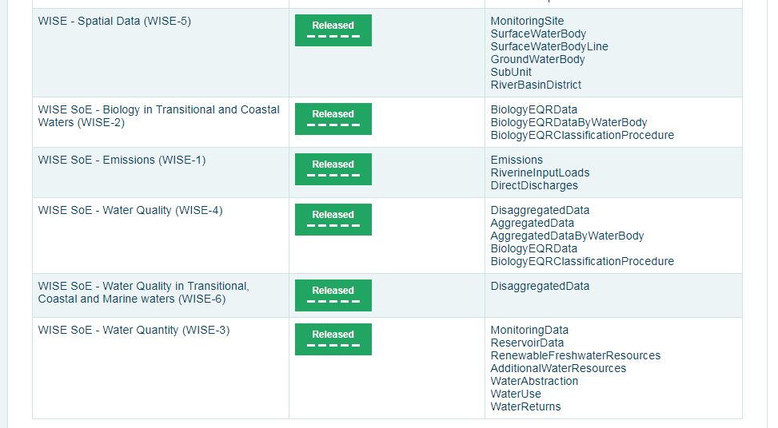
WISE SoE marine dataflows: data dictionary
Definition of the datasets: http://dd.eionet.europa.eu/datasets

