Slide 1

Stéphane Isoard
Water and Marine – Head of Group
Stephane.Isoard@eea.europa.eu
Sebastian Birk (ETC/ICM), Ángel Borja (ETC/ICM)
Freshwater / Biodiversity EIONET Workshop
3-4 June 2019, EEA, Copenhagen
Ecosystem-based management:
a tool to implement EEA’s roadmap on natural capital

Slide 2



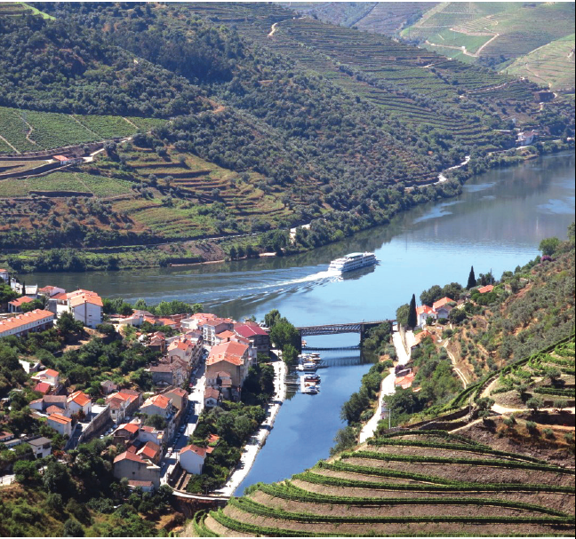




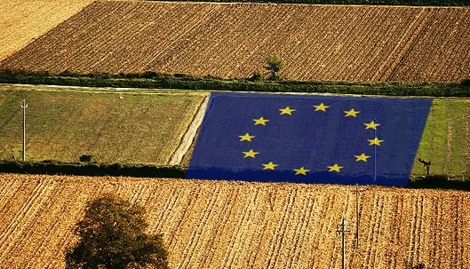




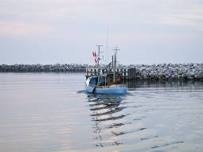

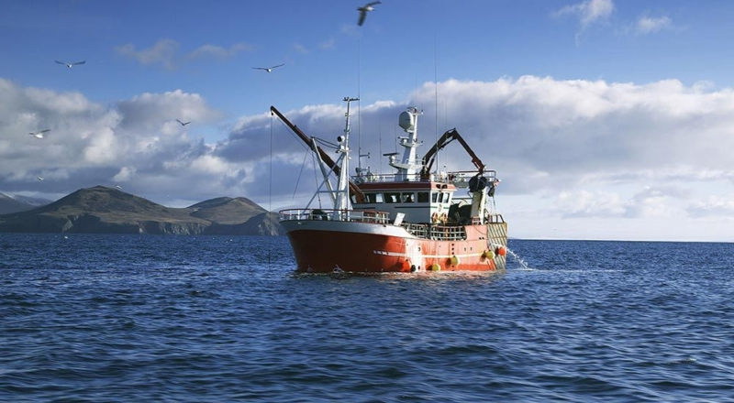
Ecosystem-based management at the core of EU, global and regional policies
Water Framework Directive / Floods Directive / daughters directives (GW, EQS)
Water industry directives
Water scarcity and droughts strategy
Birds Directive
Habitats Directive
Common Agricultural Policy
Nitrates Directive
EU forest strategy
Integrated Maritime Policy
Marine Strategy Framework Directive
Maritime spatial planning Directive
Common Fisheries Policy

Slide 3

Ecosystem-based management at the core of EU, global and regional policies
MSFD
‘The marine strategies shall apply an ecosystem-based approach, which the Marine Strategy Framework Directive broadly defines as management of human activities, ensuring that the collective pressure of such activities is kept within levels compatible with the achievement of good environmental status and that the capacity of marine ecosystems to respond to human-induced changes is not compromised, while enabling the sustainable use of marine goods and services by present and future generations.’
CFP
The Common Fisheries Policy says that the ecosystem-based approach to fisheries management means an integrated approach to managing fisheries within ecologically meaningful boundaries, which seeks to manage the use of natural resources, taking account of fishing and other human activities, while preserving both the biological wealth and the biological processes necessary to safeguard the composition, structure and functioning of the habitats of the ecosystem affected, by taking into account the knowledge and uncertainties regarding biotic, abiotic and human components of ecosystems.
Convention for Biological Diversity
“The ecosystem approach is a strategy for the integrated management of land, water and living resources that promotes conservation and sustainable use in an equitable way.” (Millennium assessment)
https://www.cbd.int/ecosystem/
OSPAR Convention
The ESA is defined as “the comprehensive integrated management of human activities based on the best available scientific knowledge about the ecosystem and its dynamics, in order to identify and take action on influences which are critical to the health of marine ecosystems, thereby achieving sustainable use of ecosystem goods and services and maintenance of ecosystem integrity.”
https://www.ospar.org/about/principles/ecosystem-approach

Slide 4
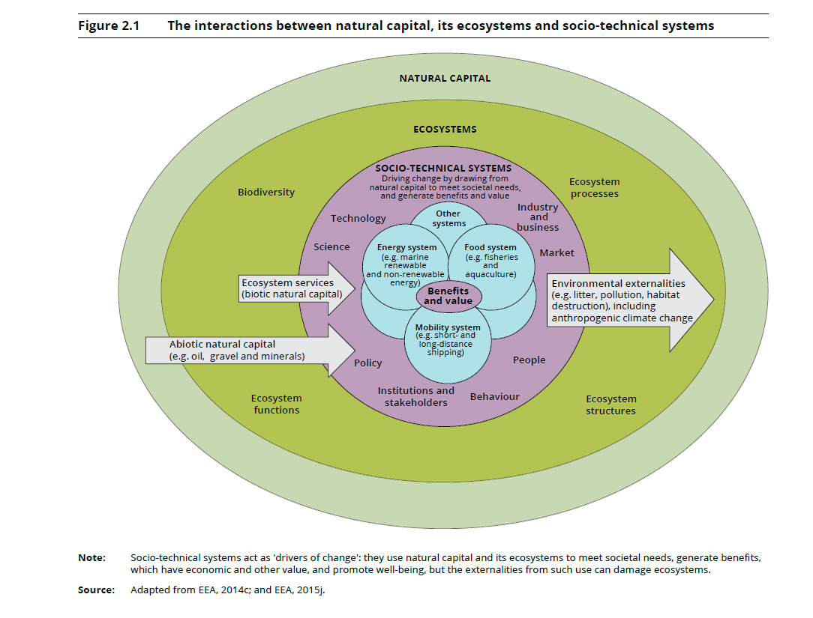
Why is ecosystem-based management at the core of EU policies? Recognising the interactions between natural capital, its ecosystems and socio-technical systems

Slide 5
Capacities of an ecosystem-based management approach
SUSTAINABILITY | EXTERNALITIES | DIALOGUE
Highlight the critical role ecosystems and biodiversity play in sustaining life, human well-being and long-term economic sustainability | Make environmental externalities explicit, and as the basis for the design of policy mechanisms intended to internalise the value of such externalities in market transactions and decision making processes | Promote dialogue between academic disciplines and to improve communication between interest groups, as different as conservationists, farmers, economists, policy-makers and entrepreneurs
CONCEPTUAL BACKGROUND
﻿Jax, K., Barton, D.N., Chan, K.M.A., De Groot, R., Doyle, U., Eser, U. Görg, C., Gómez-Baggethun, E., Griewald, Y., Haber, W., Haines-Young, R., Heink, U., Jahn, T., Joosten, H., Kerschbaumer, L., Korn, H., Luck, G.W., Matzdorf, B., Muraca, B., Neßhöver, C., Norton, B., Ott, K., Potschin, M., Rauschmayer, F., von Haaren, C., Wichmann, S., 2013. Ecosystem services and ethics. Ecol. Econ. 93, 260–268. https://doi.org/10.1016/j.ecolecon.2013.06.008

Slide 6
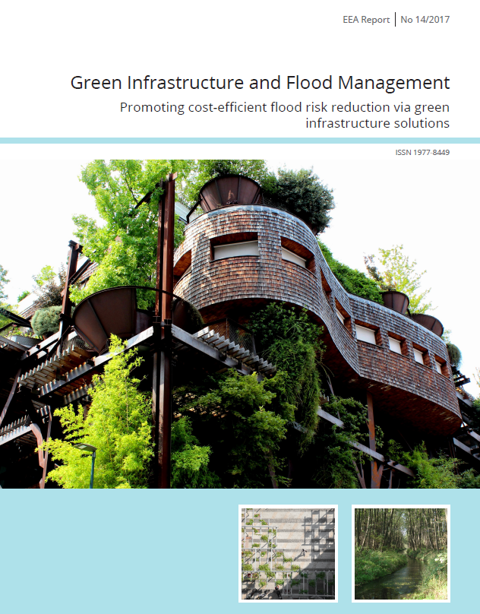
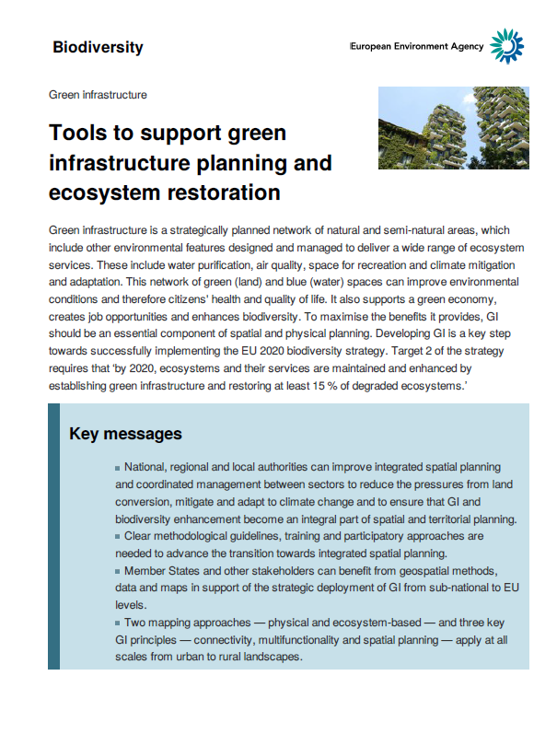
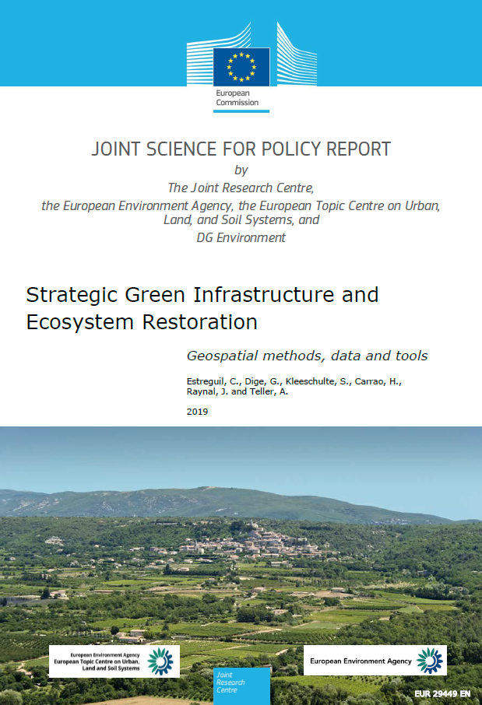
Challenges towards ecosystem-based management
Aim: ‘Preserving the long-term potential or capacity for ecosystems to continue to deliver the services and benefits upon which human societies depend.’
Gap between theory (conceptualization and endorsement by policy makers) and practice (incorporation into actual resources management practice).
Consider ecosystem connections and connections with human activities, address cumulative pressures and impacts (e.g. MSFD Art. 8), together with multiple objective (e.g. GES, FCS, MSY).’
Other closely-related terms
Great expectations
+ Conceptual breadth
+ Rapid developments in research and implementation
= Unspecific and elusive notion of EBM – Definitions vary
Green infrastructure
Nature-based solution
Natural water retention measures
Sustainable management of forest ecosystems

Slide 7
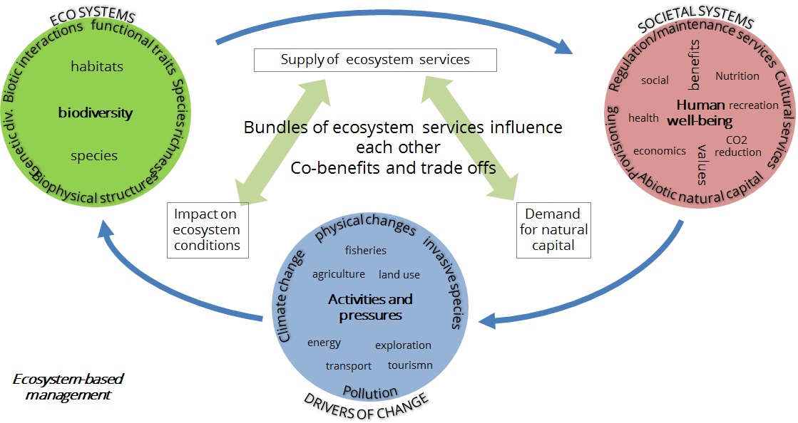
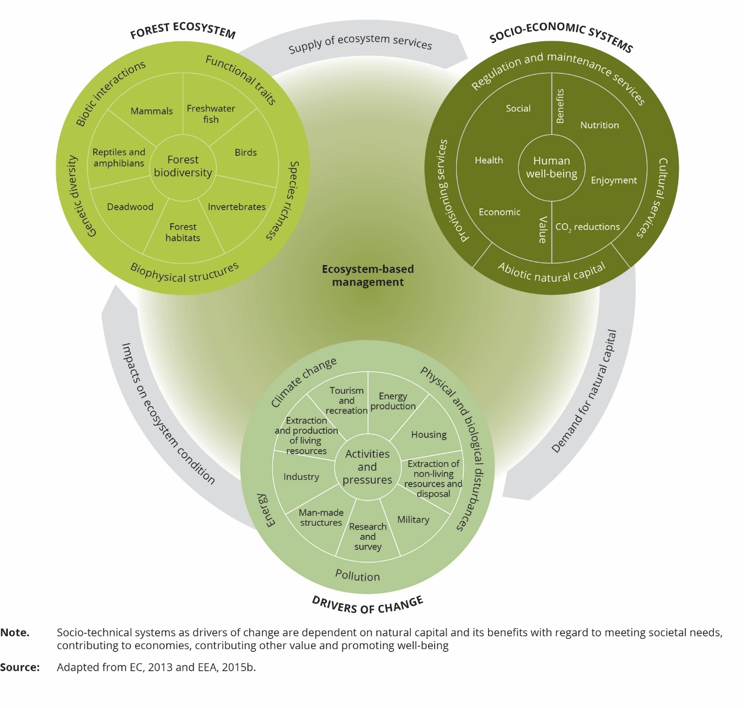
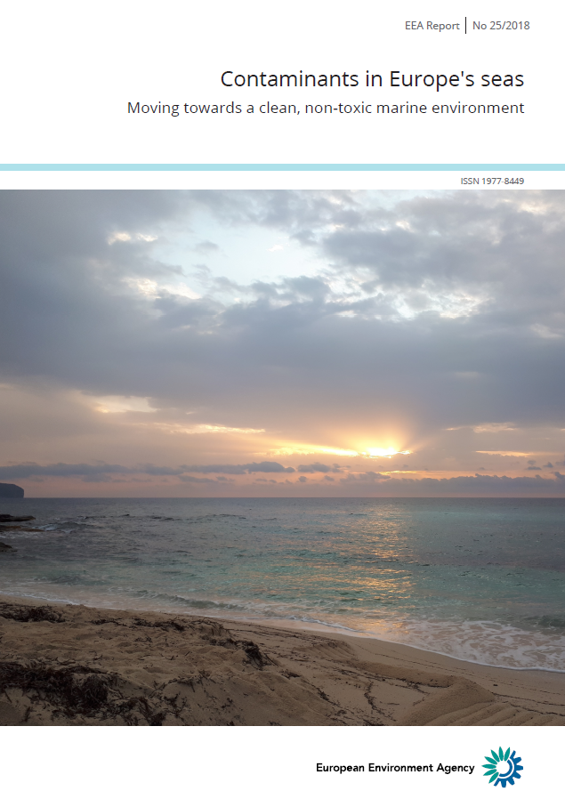
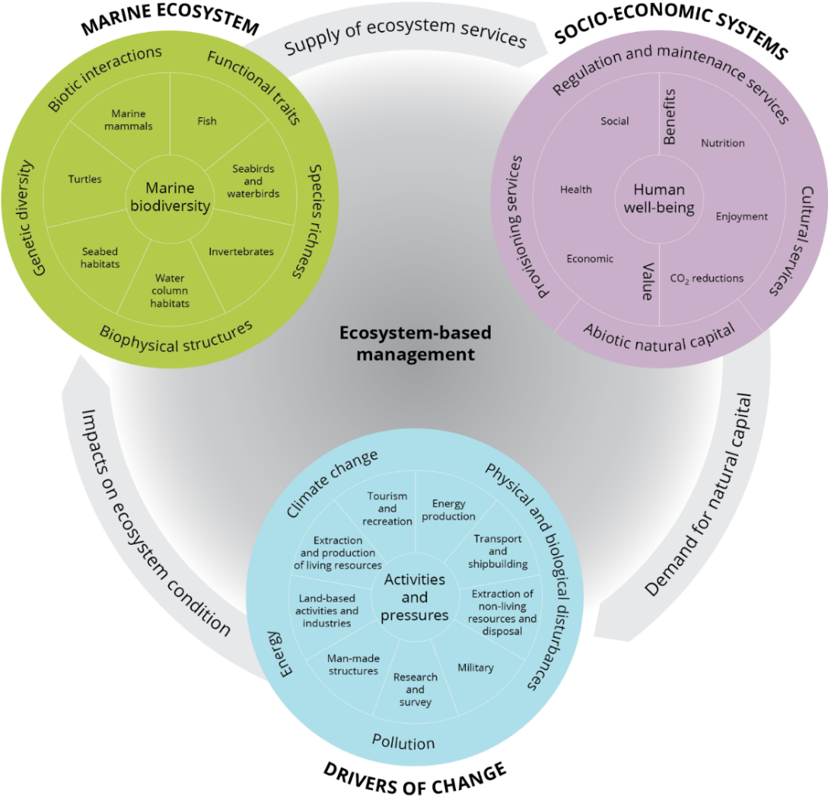
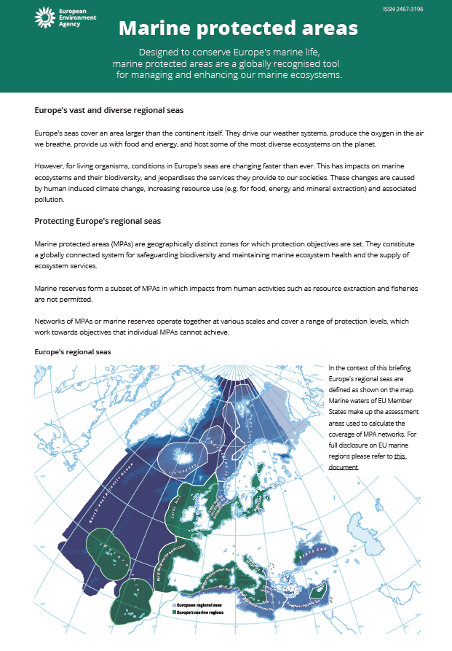

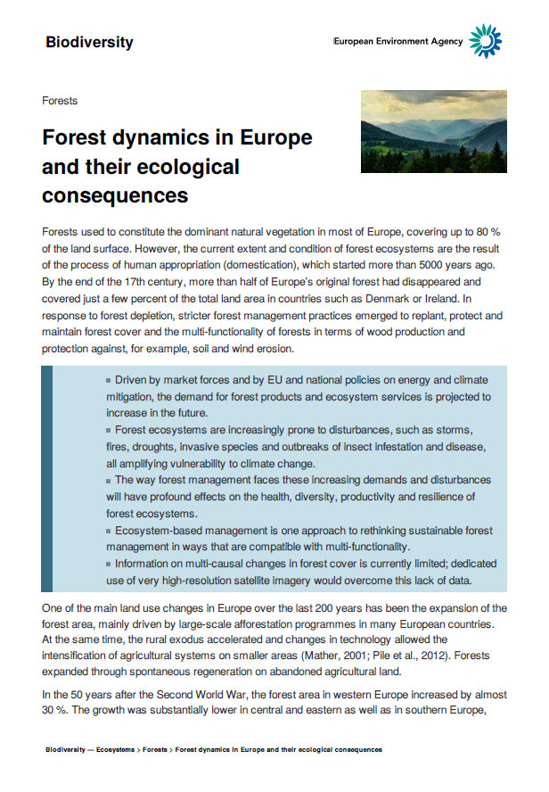
Ecosystem-based management: an analytical tool to inform policies in a coherent and integrated manner – The approach taken at the EEA
Nature directives
2020 Biodiversity Strategy / MAES
Multiple objectives
Spatial approach
Policy developments
Availability of data and information
Analytical and assessment methods
Cumulative impacts
Recognising connections
IMP / MSP
MSFD (Annex 3)
MAES Target 3a, 3b on Agriculture and Forests
Notes:
Central for EEA marine assessments are our conceptual framework. It is built around a holistic understanding of an ecosystem-based approach to management that on one part realise it is a
Spatial approach, 2) its about recognising connections, 3) addressing cumulative impacts and 4) about handling multiple objectives.
Its main building blocks include marine ecosystems, socio-economic system as well as drivers of changes – the individual componets of the circles can be linked directly to EU policy documents and/or key scientific references.
Obviously, MPAs as a measure for halting loss of biodiversity fits nicely within this conceptual framework. It is fully described in the State of Europes seas report.

Slide 8
Ecosystem-based management in a nutshell – Uptake of a guiding and analytical tool
Spatial approach
Multiple objectives
Marine
Ecosystem-based management
Ecosystem-based management is an integrated approach to management that considers the entire ecosystem including humans.
The goal is to maintain ecosystems in a healthy, clean, productive, and resilient condition, so that they can continue to provide humans with the services and benefits upon which we depend.
It is a 1) spatial approach that builds around 2) acknowledging connections, 3) cumulative impacts and 4) multiple objectives rather than traditional approaches that address single concerns e.g. species, sectors, activities or individual national interests.
State of the environment assessments and outlooks to be complemented by temporal trends analysis.
Forests
Freshwater
Wetlands, Peatlands
Land, agriculture
Cumulative impacts
Coastal, Land-Sea continuum
Recognising connections
Climate change adaptation
Interdisciplinary
Holistic
Connective
Flexible
Management oriented
Notes:
Central for EEA marine assessments are our conceptual framework. It is built around a holistic understanding of an ecosystem-based approach to management that on one part realise it is a
Spatial approach, 2) its about recognising connections, 3) addressing cumulative impacts and 4) about handling multiple objectives.
Its main building blocks include marine ecosystems, socio-economic system as well as drivers of changes – the individual componets of the circles can be linked directly to EU policy documents and/or key scientific references.
Obviously, MPAs as a measure for halting loss of biodiversity fits nicely within this conceptual framework. It is fully described in the State of Europes seas report.

Slide 9
Guiding questions for the break-out sessions
Can you give specific country level of examples of good practice (e.g. coordination of management, both inside and outside protected areas), in terms of actual ecosystem-based management, and ecosystem-based approach (integrative of stakeholders) and policy integration (or trade-offs, for example where policy delivery produces poor results for one or another sector).
What do you think are the specific issues in relation to the delivery of ecosystem-based management and policy streamlining.
Is there institutional cooperation in relation to delivery of EBM and if so/in addition what you think are the key issues and opportunities in relation to its delivery?
Key learning points/messages for the EEA.
Notes:
Central for EEA marine assessments are our conceptual framework. It is built around a holistic understanding of an ecosystem-based approach to management that on one part realise it is a
Spatial approach, 2) its about recognising connections, 3) addressing cumulative impacts and 4) about handling multiple objectives.
Its main building blocks include marine ecosystems, socio-economic system as well as drivers of changes – the individual componets of the circles can be linked directly to EU policy documents and/or key scientific references.
Obviously, MPAs as a measure for halting loss of biodiversity fits nicely within this conceptual framework. It is fully described in the State of Europes seas report.

Slide 10
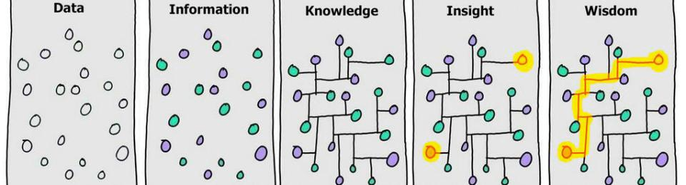
Stéphane Isoard
Water and Marine – Head of Group
Stephane.Isoard@eea.europa.eu
Sign up to receive EEA news, reports
and alerts on your areas of interest at
http://eea-subscriptions.eu/subscribe
Thank you for your attention

Slide 11
Ecosystem-Based Management (EBM)
AQUACROSS principles, plus:
Policy coordination
Ecosystem resilience
Ecosystem services
15 key principles of EBM
listed in increasing frequency of importance according to the literature
﻿Long et al., 2015. Key principles of marine ecosystem-based management. Mar. Policy 57, 53–60.

