Slide 1
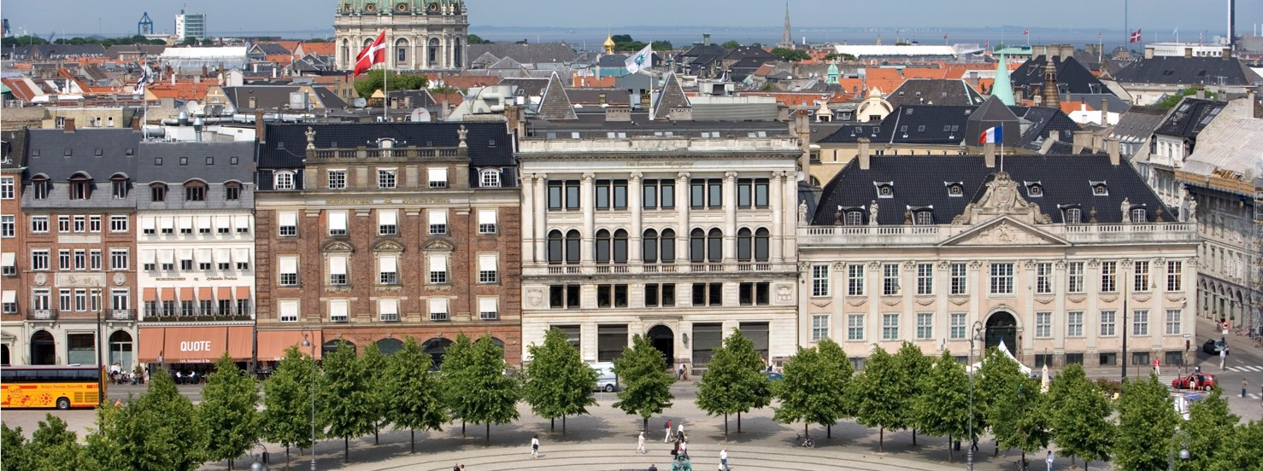
Floodplains: important ecosystems and mitigators of flood risks
Trine Christiansen, Muhammet Azlak and Sebastian Birk
Eionet workshop, Copenhagen, 3 June 2019
Contact: trine.christiansen@eea.europa.eu

Slide 2
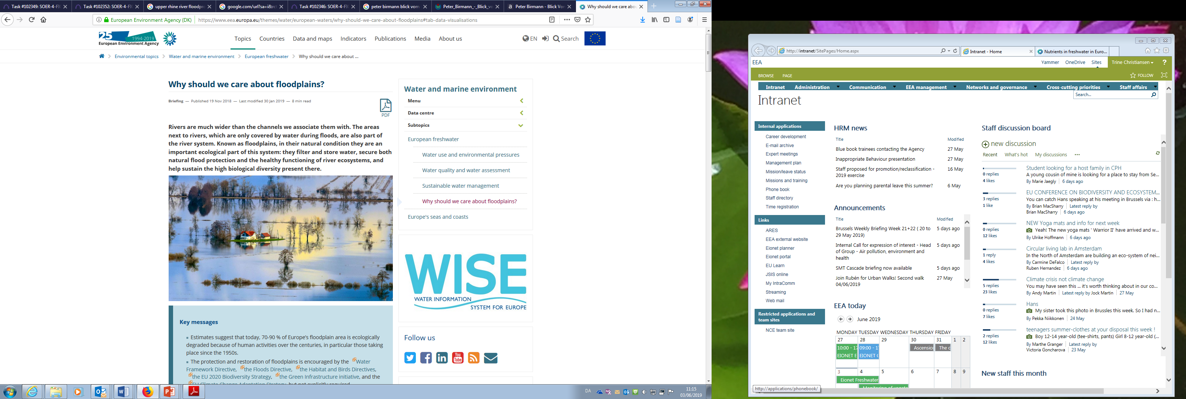
EEA Context: Briefing and report
Briefing published in 2018: https://www.eea.europa.eu/themes/water/european-waters/why-should-we-care-about-floodplains
Forthcoming Report: Floodplains: mitigators of flood risks and important ecosystems
Consultation: 6-8 weeks over summer
Publication: Q4 2019

Slide 3
EEA Freshwater context
1. Water and waterways have many uses – not all are sustainable
2. Water supports ecosystems and is an ecosystem in its own right
3. Clean water is essential for human health, our production systems and for ecosystems
4. Water is an essential and valuable resource, influenced by a changing climate
5. Water policies are needed to secure progress towards sustainability
Floodplains: important ecosystems and flood risk
SoER 2020
SoER 2025
2019
2020
2021
2022-2024
2025

Slide 4
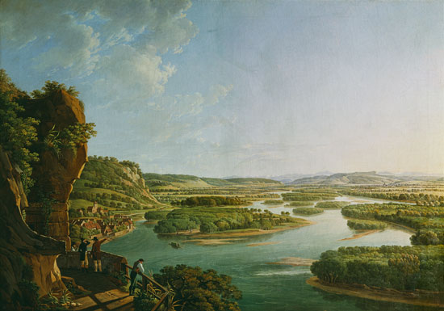
What has changed?
EEA has developed the water exploitation index (WEI+) to
Peter Birmann: View from the Isteiner Klotz (Rhein in 1830 )
View of the Rhein today

Slide 5
Our policy context around floodplains
Climate change, economic, market and other drivers of landuse
Nature Directives
Water Framework & Floods Directives
National implementation
not site specific
Protect valuable species and habitats
Favourable conservation status
Pressures and treats
Management plans
Common issues
Freshwater, small water body, wetland, and floodplain
habitats
Achieving good status
Same pressures identified
Co-benefits of water
management measures
River basin implementation
Water body specific
Achieving good ecological and chemical status
Maps significant pressures
River Basin Management Plans including measures
Solutions
Nitrates Directive
Green infrastructure
Sustainable finance

Slide 6
In their natural state (where flooding occurs), flood plains provide many ecosystem services – many of them support environmental policy objectives
Clean water / surface and groundwater for drinking
Food production: fish
Food production: agricultural plant production / cultivated plant production
Food production: Agricultural animal production / animals reared to provide nutrition
Flood control
Hydrological cycle and water flow regulation: Groundwater recharge and water storage.
Erosion control and prevention
Bio-remediation by micro-organisms, algae,plants, and animals: Water purification
Filtration/sequestration/storage/accumulation by micro-organisms, algae, plants, and animals: Carbon sequestration
Soil conservation, formation & composition: decomposition and fixing processes and their effect on soil quality
Seed dispersal
Conservation of biodiversity: maintaining nursery populations and habitats (Including gene pool protection)
Recreation

Slide 7
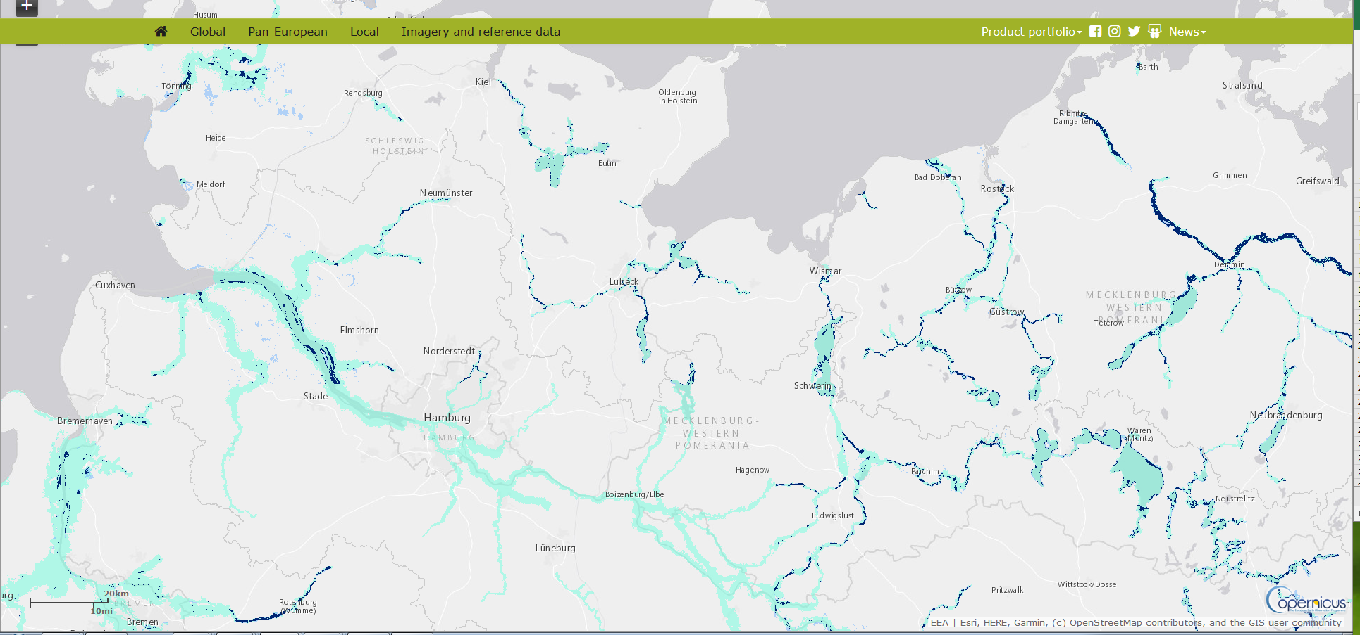
Copernicus Riparian Zone layer
EEA has developed the water exploitation index (WEI+) to
https://land.copernicus.eu/local/riparian-zones/riparian-zones-delineation

Slide 8
Status today
EEA has developed the water exploitation index (WEI+) to
Note: Malta, Cyprus and Lichtenstein have very small or no floodplains

Slide 9
Status today

Slide 10
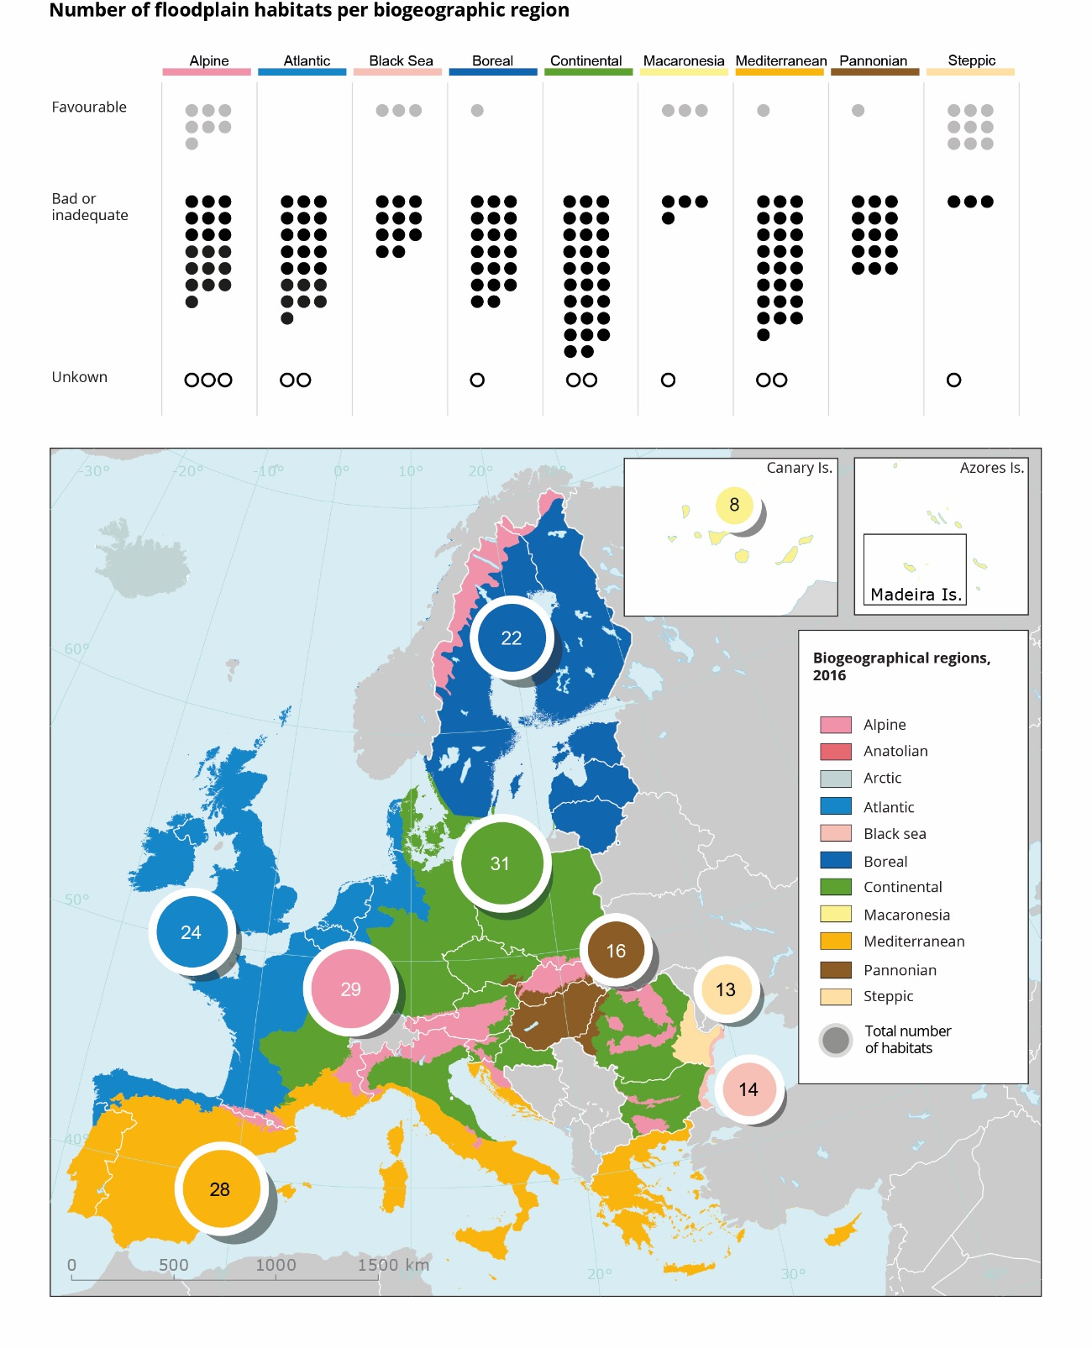
Status today
EEA has developed the water exploitation index (WEI+) to

Slide 11
The need for flood protection
EEA clim indicator 0039
EEA has developed the water exploitation index (WEI+) to

Slide 12
Hydromorphological pressures
EEA has developed the water exploitation index (WEI+) to

Slide 13
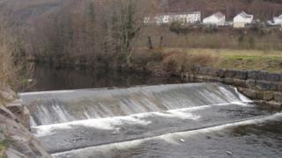
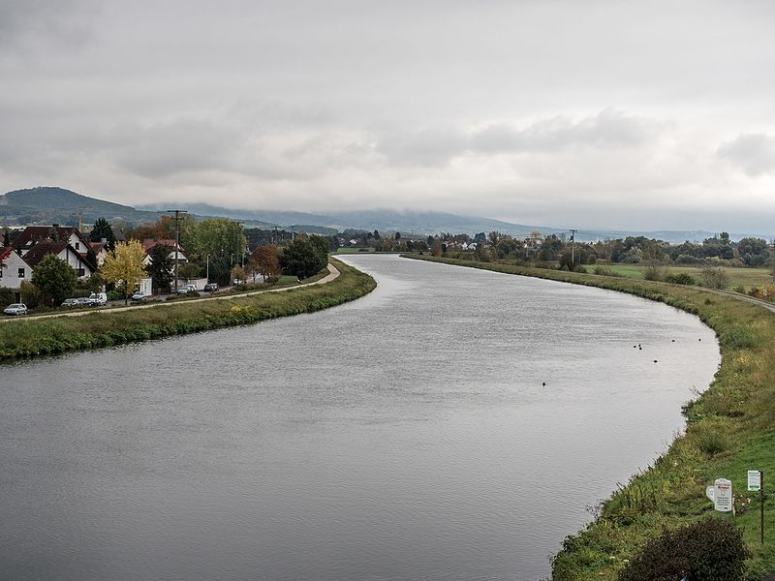
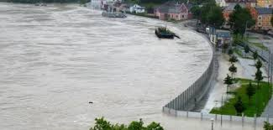
Hydromorphological pressures
EEA has developed the water exploitation index (WEI+) to

Slide 14
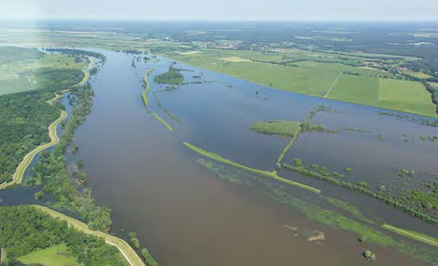
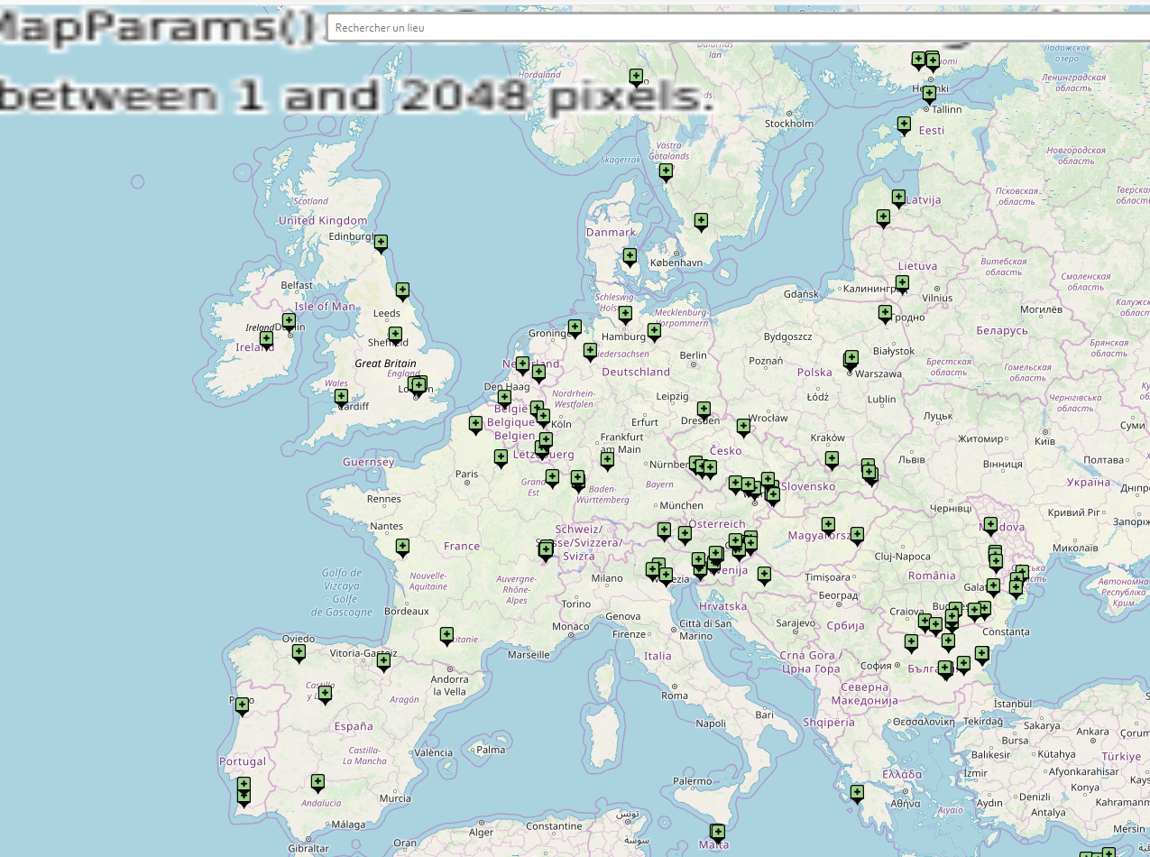
Restoration : River restoration is the process of managing rivers to reinstate natural processes to restore biodiversity, providing benefits to both people and wildlife.
EEA has developed the water exploitation index (WEI+) to
Case studies available in: http://nwrm.eu/
Dike relocation – Lenzen, Germany

Slide 15
Biophysical structure
Floodplain and river system
Functions
Regulation of soil quality
Services
High quality soils
Benefits
Value
Agricultural food production
Value of food
The potential of ecosystem services
Evironment and ecosystem service supplies
Social system benefits demands
Policy regulation:
Nitrates Directive
Water Framework Directive
Multiple ecosystem pressures:
Nutrient and chemical pollution
Reduced water retention due to drainage
Hydromorphological pressures linked to increased water storage

Slide 16
The potential of ecosystem services and ecosystem based management: balancing priorities over time
Service provided
Regulating services
Provisioning services
Cultural services
From Gilvear et al, 2013

Slide 17
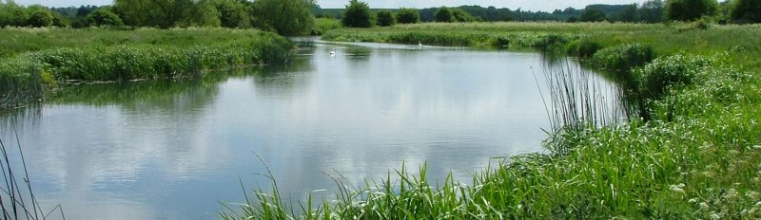
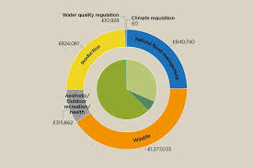
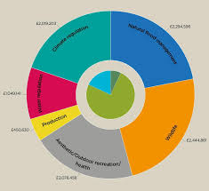
An example from Chimney Meadows, UK
Services provided before restoration
Services provided after restoration
Clare Lawson, Emma Rothero, David Gowing (Open University) Tom Nisbet, Nadia Barsoum, Samantha Broadmeadow (Forest Research) Ann Skinner (River Restoration Centre)

Slide 18
Our policy context around floodplains
Climate change, economic, market and other drivers of landuse
Nature Directives
Water Framework & Floods Directives
National implementation
not site specific
Protect valuable species and habitats
Favourable conservation status
Pressures and treats
Management plans
Common issues
Freshwater, small water body, wetland, and floodplain
habitats
Achieving good status
Same pressures identified
Co-benefits of water
management measures
River basin implementation
Water body specific
Achieving good ecological and chemical status
Maps significant pressures
River Basin Management Plans including measures
Solutions
Nitrates Directive
Green infrastructure
Sustainable finance

Slide 19
Can ecosystem based management help bring management needs under different policies together?

