Slide 1
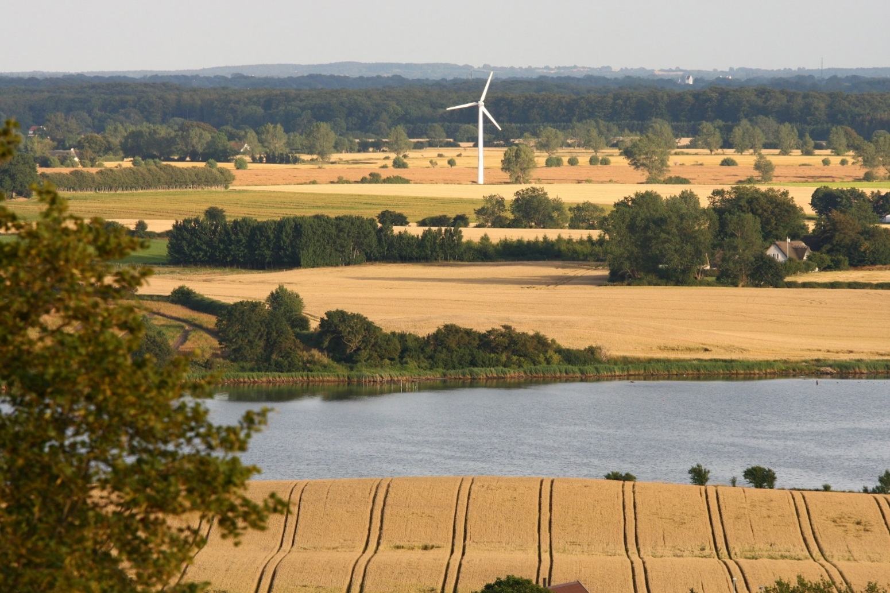

MAES and Accounting support to BD 2020 evaluation
2019 Joint Eionet Workshop - NRCs Biodiversity and Freshwater
‘Synergies between biodiversity and water quality with special focus on assessments’
Copenhagen 03-04. June 2019
Markus Erhard, Nihat Zal, Jan-Erik Petersen, EEA
markus.erhard@eea.europa.eu

Slide 2
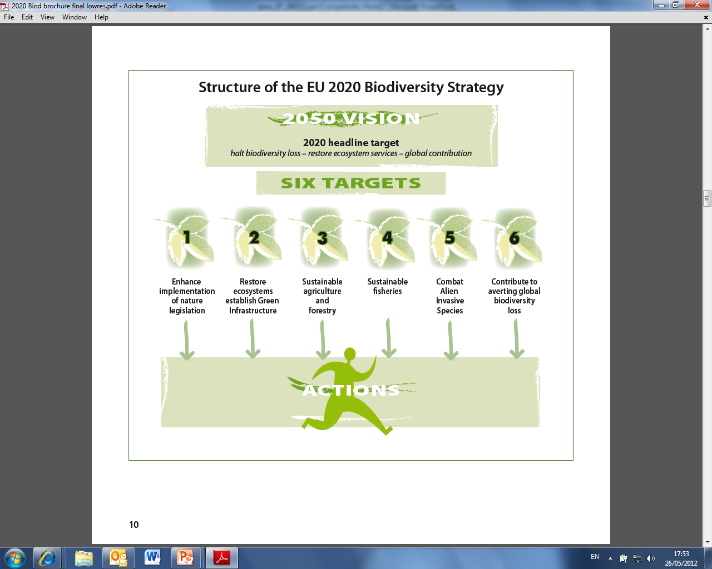
EU Biodiversity Strategy to 2020

Slide 3
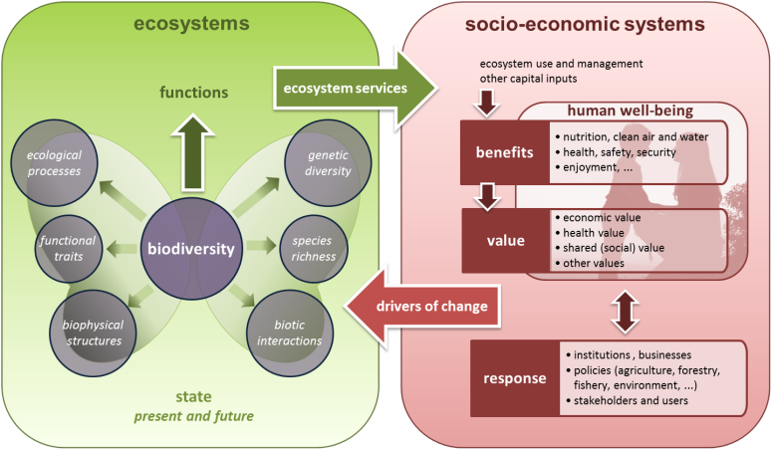
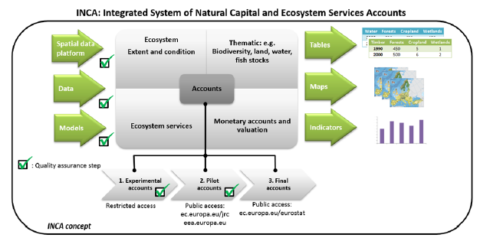
MAES and Natural Capital Accounting
Action 5 of EU Biodiversity Strategy: Improve the knowledge of ecosystems and their services in the EU
“Member States, with the assistance of the Commission, to map and assess the state of ecosystems and their services in their national territory by 2014, assess the economic value of such services, and promote the integration of these values into accounting and reporting systems at EU and national level by 2020”
Working group on Mapping and Assessment of Ecosystems and their Services (MAES)
Knowledge Innovation Project on Integrated System of Natural Capital and Ecosystem Services Accounts (KIP INCA)
L

Slide 4
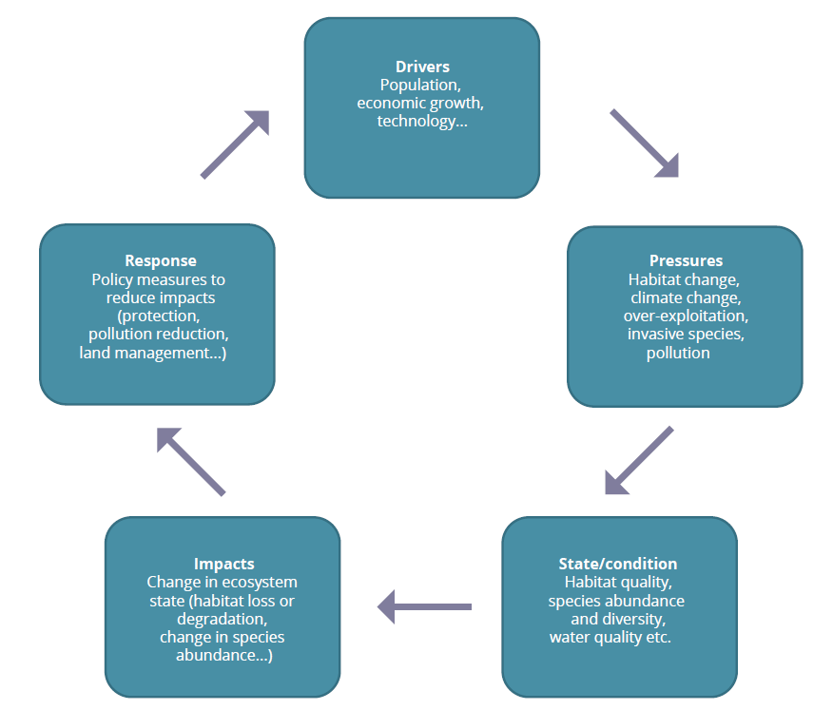
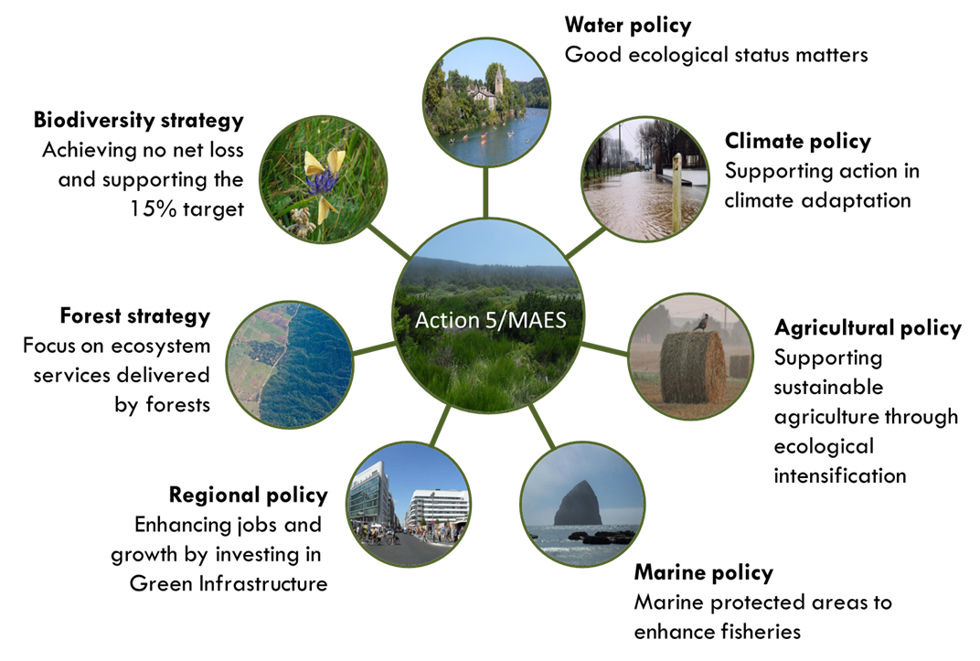
EU Biodiversity Strategy to 2020 - Action 5 MAES:
Mapping and Assessment of Ecosystems and their Services
Assessment framework
DPSIR approach
Policy integration
Change
of our Natural Capital
Ecosystem
Mapping
Condition
assessment
Service
assessment
Integration
http://ec.europa.eu/environment/nature/knowledge/ecosystem_assessment/pdf/Brochure%20MAES.pdf

Slide 5
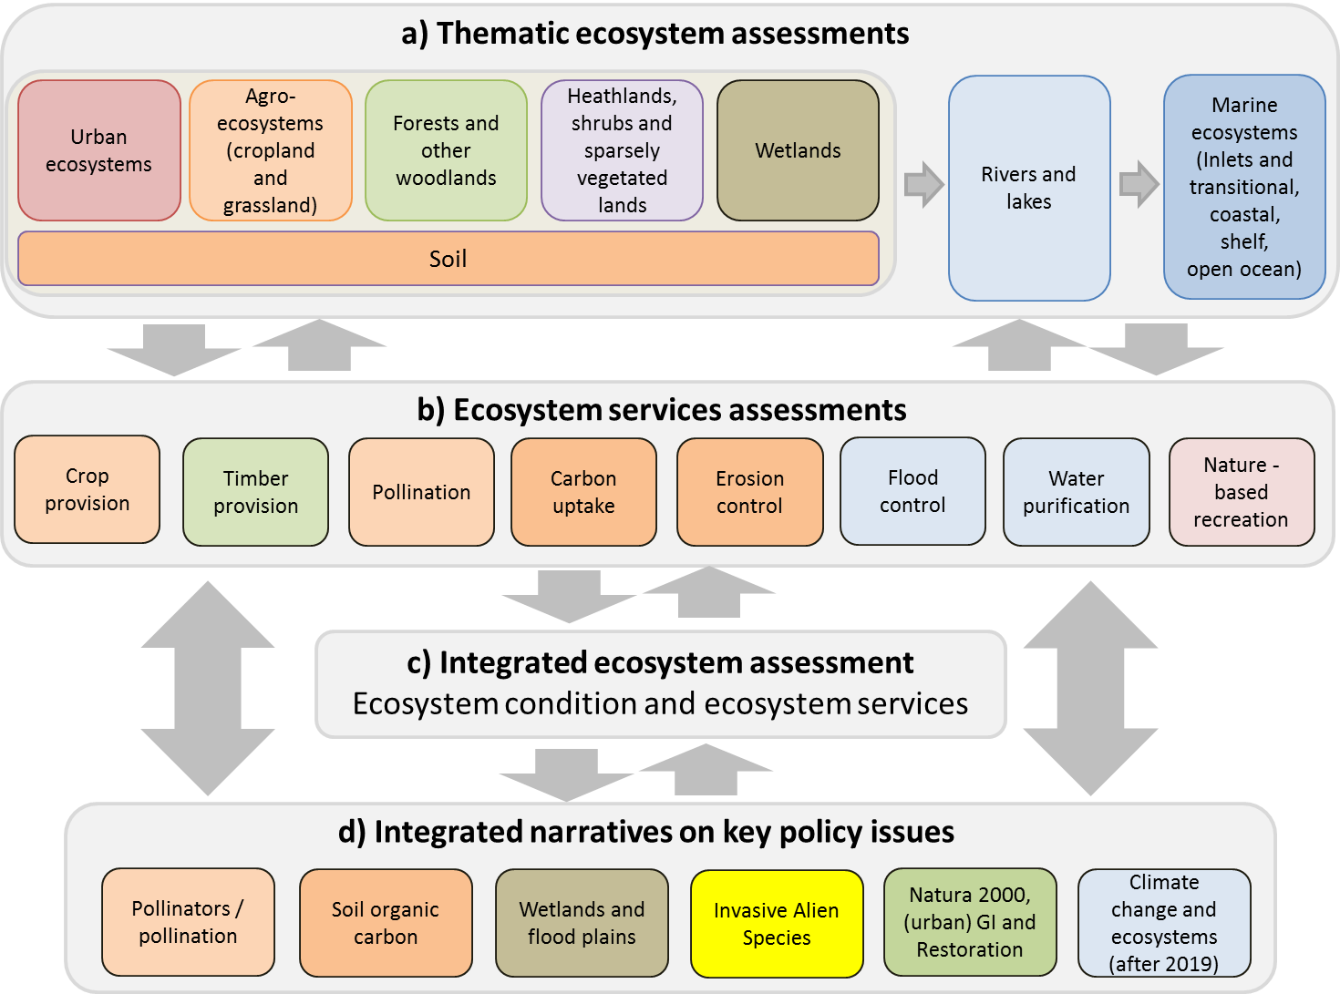
MAES assessments
5th MAES report
Scoping paper

Slide 6
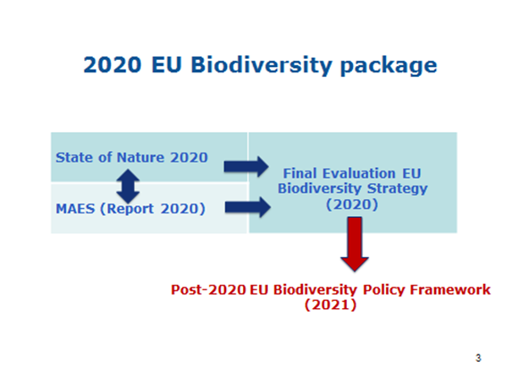
Towards BD 2020
State of Nature (SoN) and MAES reports as communication package in beginning Q4 2020
Material from SoN and MAES to go online on BISE (with publication) internal availability end 2019 to support BD 2020 evaluation

Slide 7
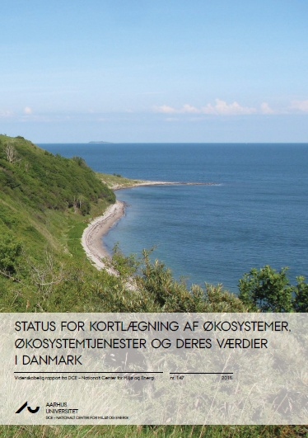
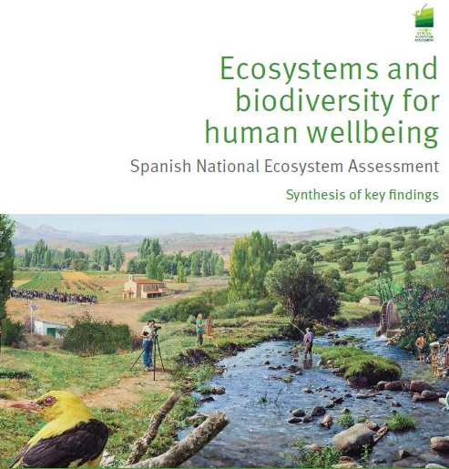

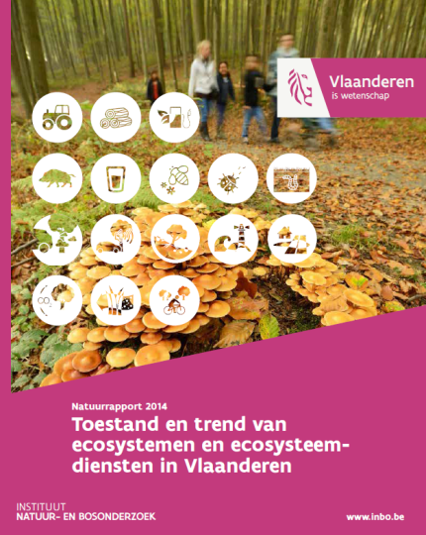
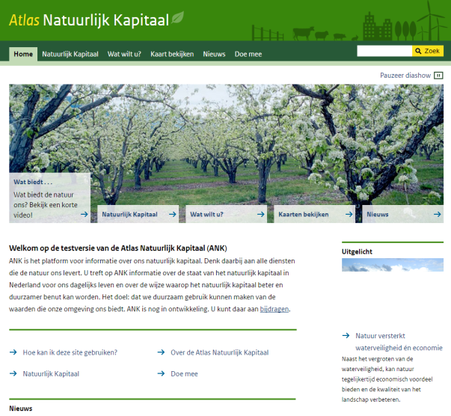
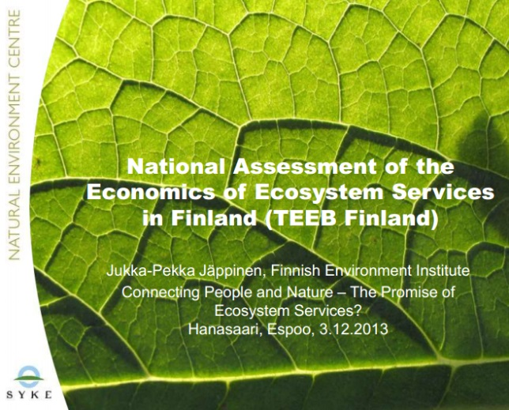
Ecosystem / Ecosystem Service Assessments in Member States
Available on BISE
https://biodiversity.europa.eu/countries

Slide 8
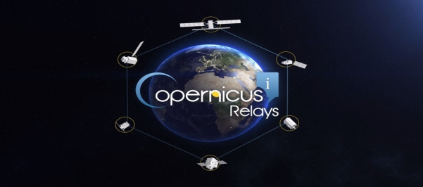
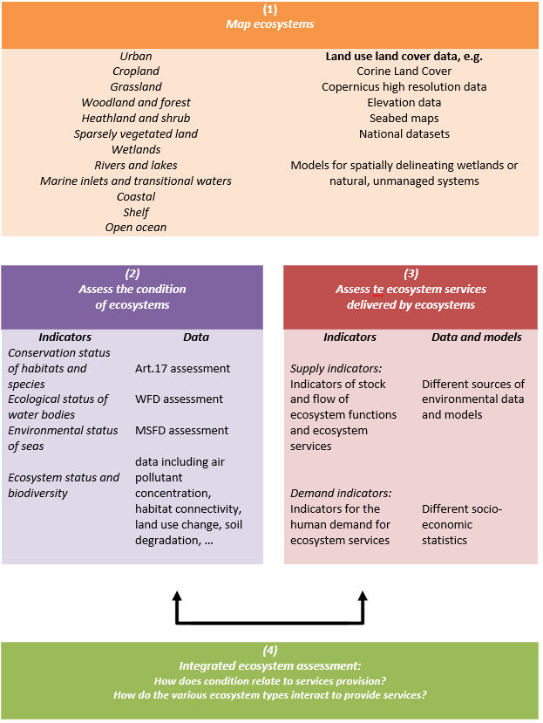
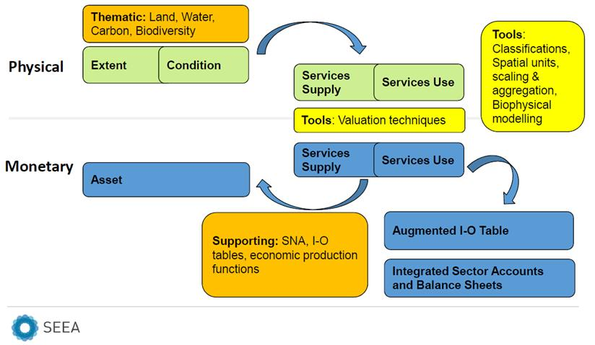
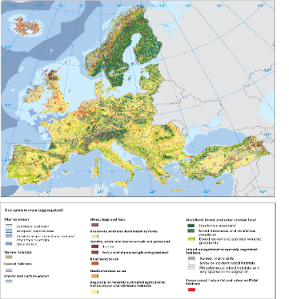
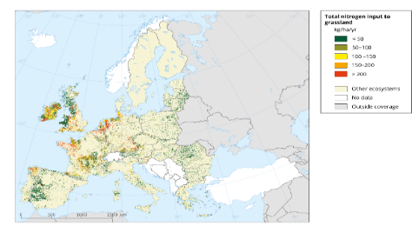
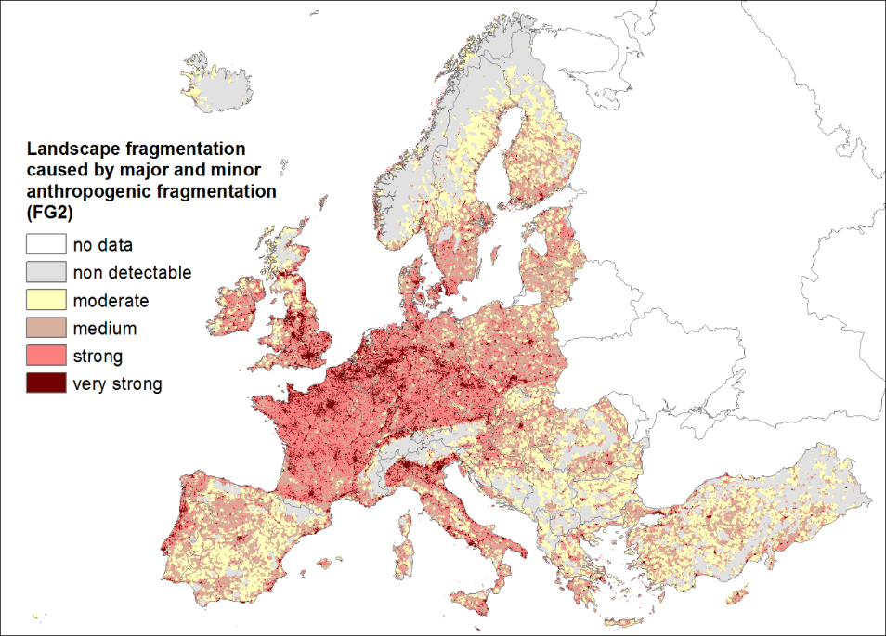
Mapping - Assessment - Accounting
Ecosystem Assessment and Green Infrastructure
Components of SEEA-EEA to be developed under KIP-INCA
Accounting
Spatial data
Ecosystem
Mapping
Condition assessment
Service assessment
Integration
Maes et al., 2014
KIP-INCA, 2015

Slide 9
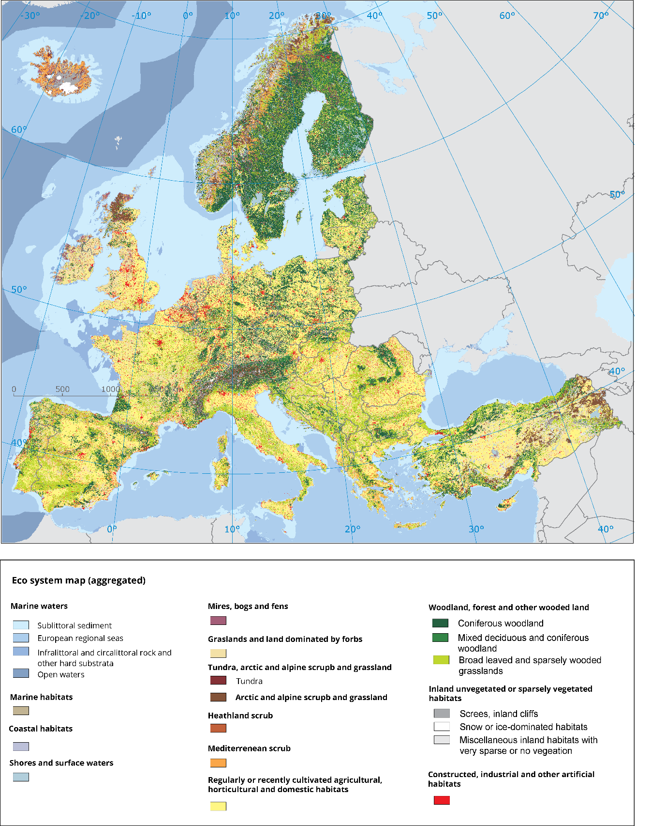
KIP INCA: Accounting for natural capital + ecosystem services
Aim of KIP INCA on natural capital accounting:
Partnership of ESTAT, ENV, JRC, EEA, RTD
Implements and tests UN guidance on ecosystem accounting at EU level
Coordinated by Eurostat, feeds into MAES and international accounting discussions
Planned outputs:
Accounts on ecosystem extent and ecosystem condition (EEA)
Accounts on ecosystem services (JRC)
Valuation of natural capital & ESS (JRC + ENV)
Geo-spatial data platform (EEA + all)
Proposal for regular EU ecosystem accounting system (by end 2020)

Slide 10
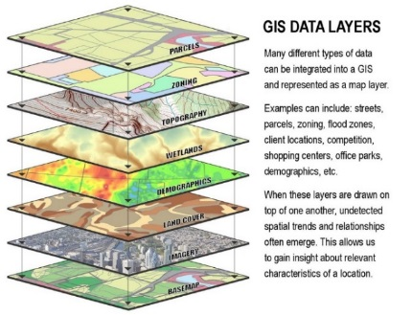
Building a geo-spatial platform for multiple uses
Geo-spatial platform
Ecosystem extent accounts
Ecosystem assessment
Ecosystem accounting
Policy analysis
Integrated assessment
Sectoral analysis etc.
Ecosystem extent accounts
Other analytical uses
Ecosystem service accounts
Ecosystem condition accounts
Ecosystem extent accounts

Slide 11
Land cover change in / outside Natura 2000 areas
Notes:
Reductions in extent of cropland, grassland, heathland and shrub, sparsely vegetated land and inland wetland ecosystems are lower in areas with high Natura 2000 site coverage.
Nonetheless, the extent of all these ecosystems has still declined, accompanied by an increase in the extent of urban and river and lakes ecosystems.

Slide 12
Ecosystem pressure and condition accounts
Biodiversity accounts – based on Nature reporting and national bird surveys (with ENV INCA contractors)
Spatial nutrient accounts (in cooperation with JRC)
Revision of JRC/EEA estimate of HNV farmland (input to MAES ecosystem assessment & spatial land use data)
CAP impact indicator on pressure of agriculture on water resources
Freshwater condition accounts based on WFD data

Slide 13
Integrated analysis based on accounts for freshwater system
Economic users
Environmental account, SEEA-CF
Ecosystem condition account
Ecosystem service accounts
Economic users
Agriculture
Physical water
asset accounts
Water flow accounts
Water emission accounts
Freshwater
quality account
Species accounts
Nutrient accounts
Other condition accounts
Fish & shellfish
Agriculture
Manu-facturing
Water purification
Manu-facturing
Energy
Flood protection
House-holds
House-holds
Recreation
Tourism
Other
Others
Others
Pressures from land use / management, (water) resource consumption, change in
land cover/infrastructure,
other human activities, etc.
Notes:
Figure 6.2 Analysing environment-economy interactions for fresh water ecosystems
Provide source ?

Slide 14
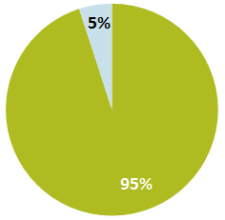
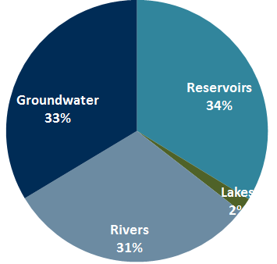
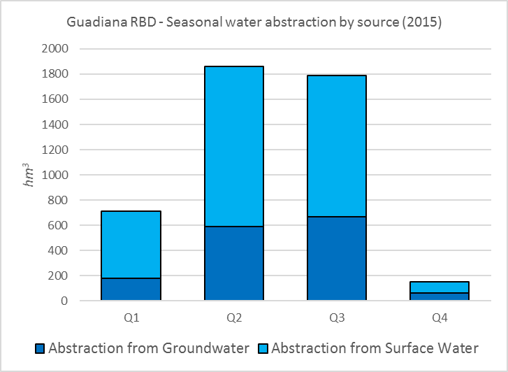

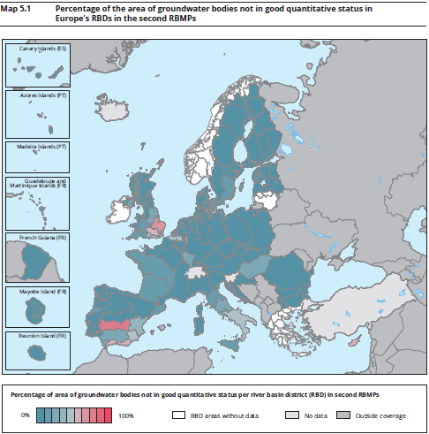
A tool for integrated assessment
Guadiana RBD - Water abstraction by sector (2015)
Guadiana RBD - Water abstraction for agricultural by source (2015)
Guadiana RBD, 55 % of Groundwater Bodies are in poor quantitative status, while water abstraction has been reported as significant pressure.
Quantifying the level and magnitude of economic pressures on water resources – Agriculture pressure on water resources in Guadiana basin (2015)

Slide 15
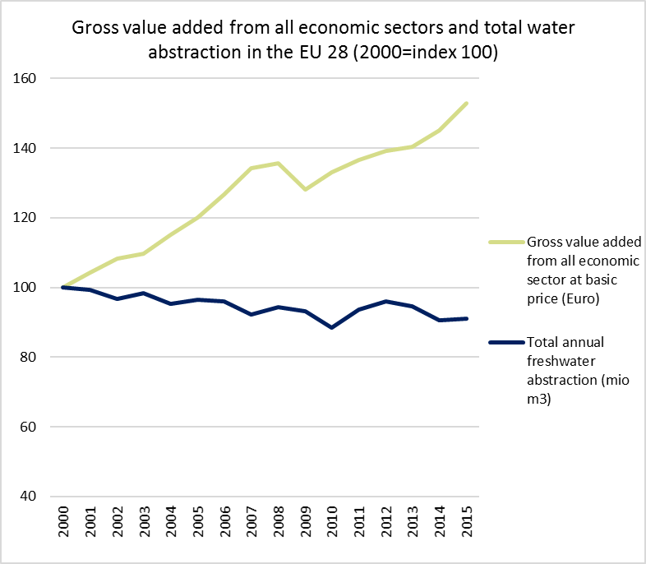
Linking environmental and economic information
Economic significance of current water use
(WFD Article 5- Economic characterisation of river basins)

Slide 16

Thank you very much for your attention
Useful links:
Ecosystem assessment:
BISE: http://biodiversity.europa.eu/
MAES: http://biodiversity.europa.eu/maes/
Natural capital accounting
KIP INCA: http://ec.europa.eu/environment/nature/capital_accounting/index_en.htm
EEA report: https://www.eea.europa.eu/publications/natural-capital-accounting-in-support
Water accounts
CSI 018 Use of freshwater resources:
https://www.eea.europa.eu/data-and-maps/indicators/economic-water-productivity-of-irrigated-1/csi-018-use-of-freshwater-resources
WAT 006 Water intensity of crop production
https://www.eea.europa.eu/data-and-maps/indicators/economic-water-productivity-of-irrigated-1/assessment
Ecosystem services:
Ecosystem services accounting:
http://publications.jrc.ec.europa.eu/repository/handle/JRC110321
https://ec.europa.eu/jrc/en/publication/ecosystem-services-accounting-part-ii-pilot-accounts-crop-and-timber-provision-global-climate
Ecosystem Service Classification: www.cices.eu
The Ecosystem Services Partnership: http://www.es-partnership.org/esp
OPPLA platform: http://oppla.eu/
UNSD-SEEA: http://unstats.un.org/unsd/envaccounting/seea.asp

