Slide 1


WISE‑SoE data flows
Session 3a: Consultation on quality fact sheets
Peter Kristensen
Project manager Integrated Water Assessments,
European Environment Agency (EEA)
Eionet NRC Freshwater meeting, 18-19 June 2015

Slide 2
Consultation on quality fact sheets
During the many years of reporting, some inconsistencies and errors have been introduced and persist in the Waterbase data sets.
EEA needed to consult with countries, clarify the issues detected on already reported data and solve such errors that may exist.
The main objective of the quality fact sheets has been to correct any errors in the data.
An additional objective was to improve the spatial and temporal coverage and to ensure that the relevant parameters are reported.
The background report presents an overview and a summary of the consultation of the quality fact sheets (QFSs). Available at http://forum.eionet.europa.eu/nrc-eionet-freshwater/library/copenhagen-freshwater-eionet-workshop-2015/copenhagen-freshwater-eionet-workshop-2015/background-documents/3a_summary_of_consultation_of_quality_fact_sheets_final

Slide 3
Why do we need the check of the data?
Clarification on shift in determinands;
Broken time series;
Some countries with few time series, other countries with many time series;
Gap filling to ensure consistent time series
Data not covering all river basin districts

Slide 4
Broken time series
Similar station names but two different station IDs
Total ammonium – ammonium
Heavy metal (total or dissolved)
Annual average
Growing season
More time series for trend graphs
Better quality checks
Repair of broken time series

Slide 5
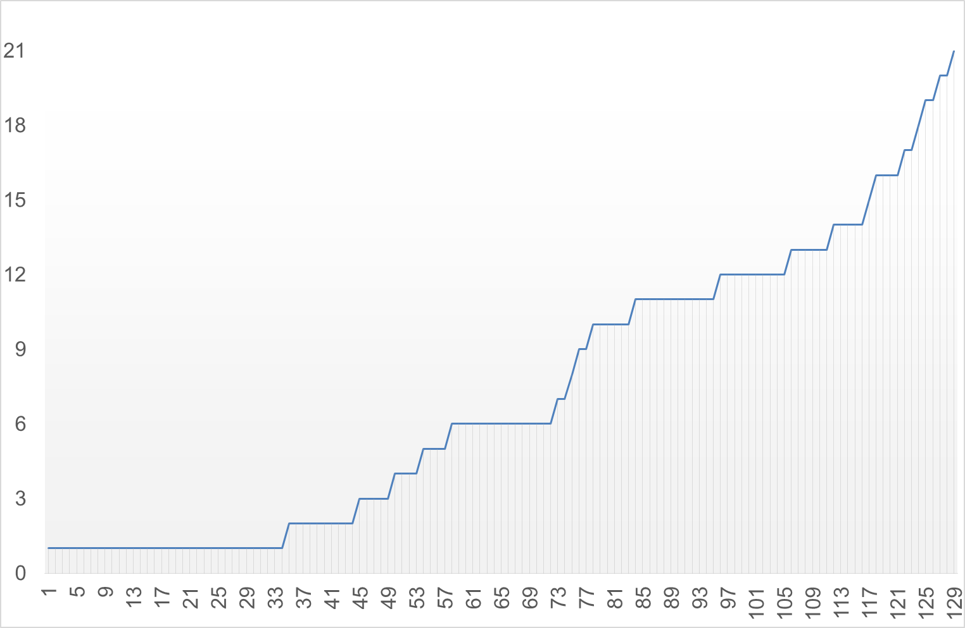
Some countries with few time series
Example data set 129 stations (rows) – 1992-2012 (columns)
Many stations with few years of observations
Few stations with long time series
Broken time series
- Stations that have only have observations from the last six years
- Stations that have observations from mid-1990s to 2007
- Can the red and blue stations be matched?
Few stations with long time series
Gap filling necessary

Slide 6
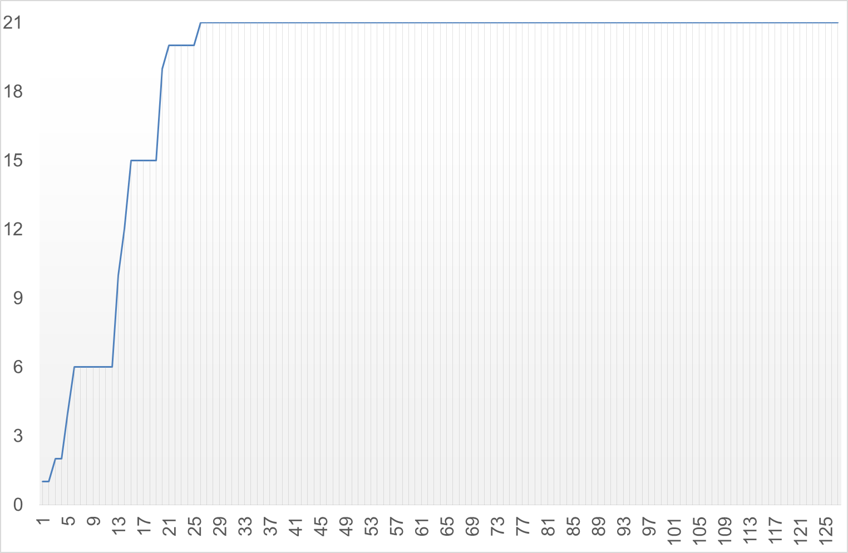
Other countries with many time series
Example data set 126 stations (rows) – 1992-2012 (columns)
Few stations with few years of observations
Many stations with long time series
Broken time series
- Stations that have only have observations from the last six years
- Stations that have observations from mid-1990s to 2007
- Can the red and blue stations be matched?
Many stations with long time series
Limited gap filling

Slide 7
Gap filling of time series - Inter/extrapolation and consistent time series
For time series and trend analyses, only series that are complete after inter/extrapolation (i.e. no missing values in the station data series) are used.
This is to ensure that the aggregated data series are consistent, i.e. including the same stations throughout the time series.
In this way assessments are based on actual changes in concentration, and not changes in the number of stations.
Gap filling increases the number of stations that can be included in the time series/trend analysis.
EEA procedures allows for gaps of up to three years, both at the ends and in the middle of the time series.
Gaps up to three years are filled
Gaps set equal to first or last observation
Gaps filled by interpolation
2000-2012 time series used

Slide 8
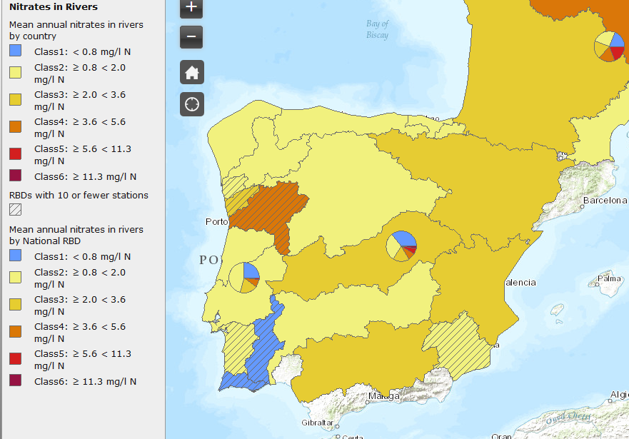
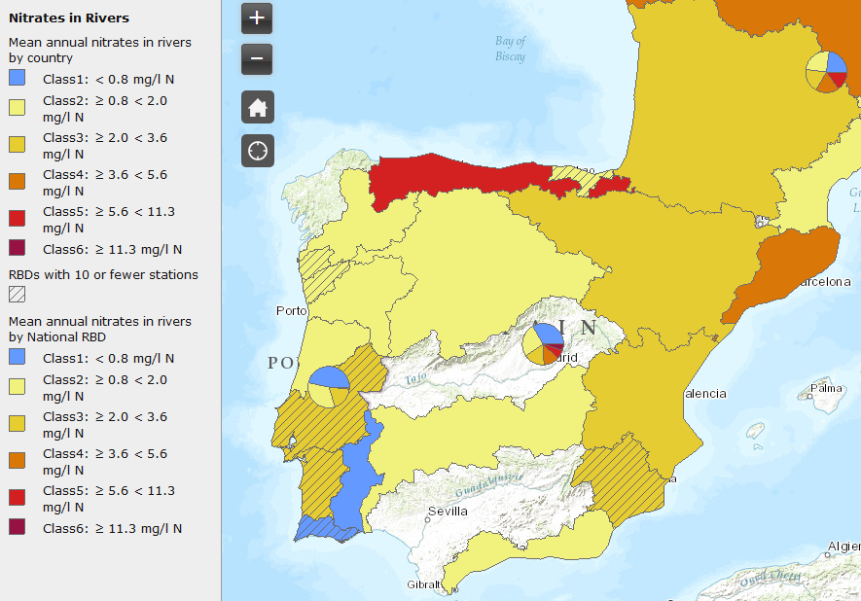
Data not covering all river basin districts
2007
2012
Missing Spanish data from some of the RBDs
Less than 10 stations in some of the RBD
Missing Spanish data from Tajo RBD, Galicia RBD, Guadalquivir RBD
Less than 10 stations in some of the RBDs

Slide 9
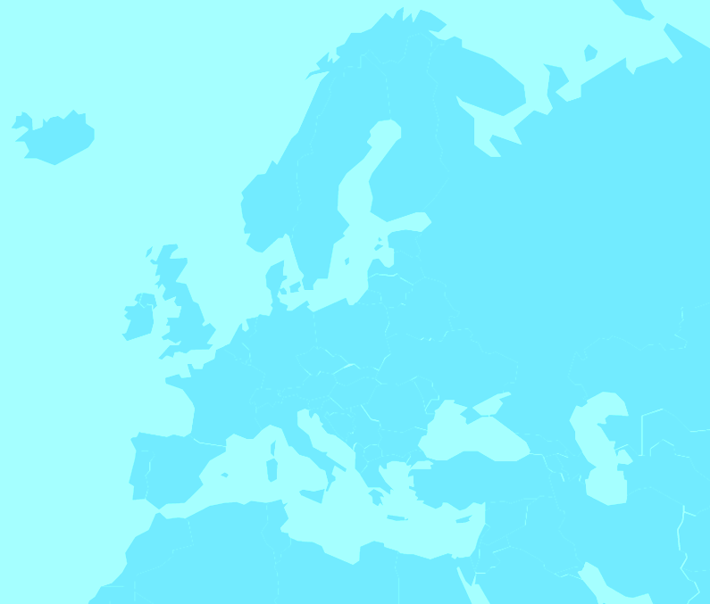
Consultation on Quality Fact Sheets (QFS)
Outcome of EIONET Freshwater workshop 26-27 June
Suspension of the 2014 freshwater data request (WISE-SoE groundwater, rivers, lakes, emissions and water quantity);
Consultation with countries/Eionet on country data quality factsheets, to clarify issues related to
  the data that has already been reported, and
  to improve its temporal and spatial coverage;
Quality Fact Sheets sent for consultation
  Part 1: 15/12-15/2
  Part 2: 15/1-15/3

Slide 10


Main results of consultation of QFS (1)
Countries provided an impressive number of replies on the questions asked in the Quality Fact Sheets.
In total, there were more than 2100 comments/answers provided.
Many good and valuable comments, answers and clarifications were received, and based on the comments the quality of the different databases will be improved.
Of 39 EEA member countries 32 countries provided comments on the questions asked in the QFS.
No comments from Bosnia-Herzegovina (BA), Spain (ES), Greece (GR), Liechtenstein (LI); Luxembourg (LU), Montenegro (ME), Malta (MT).
Water management, resources and ecosystems

Slide 11
Main results of consultation of QFS (2)
Of the countries providing comments most of them (26 countries) provided comments on 10 (or 9) of the data flows.
On average there were more than seven comments provided per country and dataflow.
Nine out of the ten data flows had replies from around 30 countries; while 25 countries replied on the data flow on hazardous substances in groundwater.
The answers will help in the clean-up and error correction in the data member countries now have reported for last 20 years.
Water management, resources and ecosystems

Slide 12
Clarifications and corrections of legacy data
The countries clarified many of the asked issues (determinands, station coding, aggregation of data and others) in the different data flows.
  Countries clarified that ammonium and total ammonium is the same determinand. Also clarifying questions on COD, BOD or TOC/DOC were answered.
  The countries further clarified questions to the aggregation period, e.g. for some countries the years reported as seasonal data can be considered as annual data.
  Regarding differences in station coding countries clarified this question. Some countries can provide additional recodification mapping tables with the next reporting.
These clarifications help to improve the quality of the data available in Waterbase.

Slide 13
Improving the coverage of determinands, temporal and spatial coverage
Several countries indicated that they during the next reporting cycle will report more stations, missing determinands and additional years to complete the time series.
Some countries indicated that they will resubmit all their data to ensure consistency with the national data set and to correct errors.
Other countries clarified that it was not possible to report more data because the national database does not have a better time coverage or more stations;
Some countries described planned improvements in their monitoring network and therefore in the future ability to report more stations and more complete data sets.
For some data flows (e.g. biology) and some countries it is not possible to deliver more data for additional stations what is typically caused by resource limitations (lack of human and financial capacity)
The request for additional or corrected data for improving the coverage of determinands, time series and stations will be added with the next data call.

Slide 14
Conclusions and the way forward
All comments of the quality fact sheets were carefully read and will be processed and regarded for their integration into Waterbase. In general, three main steps will be performed during this integration:
Based on the comments and clarifications the legacy data will be corrected and updated in the existing Waterbase
Additional data and stations that supplement the existing data set will be reported together with the 2013 and 2014 data during the next data call
The revised data model and established quality checks aim to ensure better data quality
Water management, resources and ecosystems

Slide 15

Thank you
eea.europa.eu

