Slide 1


The 2015-18 EEAs assessment of the status of Europe’s waters
Session 4
Peter Kristensen
Project manager Integrated Water Assessment,
European Environment Agency (EEA)
Eionet NRC Freshwater meeting, 18-19 June 2015

Slide 2
Water Framework Directive
… obligations for MS, COM and EEA
Article 18 Commission report
1. The Commission shall publish a report on the implementation of this Directive at the latest 12 years after the date of entry into force of this Directive and every six years thereafter (2018), and shall submit it to the European Parliament and to the Council.
2. The report shall include the following:
  (a) a review of progress in the implementation of the Directive;
  (b) a review of the status of surface water and groundwater in the Community undertaken in coordination with the European Environment Agency;
  (c) a survey of the river basin management plans submitted in accordance with Article 15, including suggestions for the improvement of future plans;
Notes:
Drivers EU water (environmental) policies (Blueprint, 7th Environmental Action Program, WFD, other directives, CAP, rural development policies, biodiversity strategy)
Products/assessments linked to policy processes
2016-2018 reporting of results from 2nd RBMPs and potential revision/update of WFD
Better implementation of legislation
Better WFD/RBMP reporting (2016 WFD reporting guidance)
Illustrate progress/changes (status, and pressures)
Integrated assessment of pressures, status and progress in implementing measures
Linking WISE-SoE data to WISE-WFD

Slide 3
The 2017 State of Water Assessment (report/portal) should cover
Overview of status, pressures and impacts (update of baseline – state 2012-2015)
Change in status and pressures from 1st to 2nd RBMPs
Relationship between pressure and status (what is causing less than good status) –pressures-driving force relationship.
Effect of measures (focused on measures implemented during the first RBMP planning period).
Policy relevanse 7th Environmental action Program, Natural Capital, Blue Print etc.
“Most of the general analyses and diagrams of the 2012 assessment can be repeated in the 2017 assessment, i.e. updated with the 2016 reported data.
However, there is a range of possible additional analyses.
A major task will thus be to select focus and prioritise.
Generally, the number of potential analyses and diagrams is higher in the 2017 assessment.”
Notes:
State of water (SoW) assessment should quantify and identify the current state of, and impacts on, water environment, how these are changing in time and if the measures that are taken at different levels prove effective.

Slide 4
Tentative planning and time table
Notes:
During 2015 EEA) is producing a WFD assessment framework. The WFD Assessment Framework will provide a common understanding and planning of the State of Water assessment.
During 2016 and 2017 the main activity on the 2017 State of Water assessment is happening:
A draft outline of the 2017 State of Water assessment will be available as outcome of the above WFD assessment framework.
This activity will also result in some preparatory activities, for example, testing different methods for presenting change between 1st and 2nd RBMP period, inventories of additional information, and analytic methods.
The main activity on analysing, producing results and assessments are concentrated in a three month period in the autumn 2016.
Thereafter there are a CIS and Eionet consultation period (first half of 2017).
During the summer 2017 the draft results and assessment are updated including late data deliveries and taking into account comments received on the draft.
The final 2017 State of Water assessment report and portal will be ready ultimo 2017.
The Eionet Freshwater NRCs and the relevant Common Implementation Strategy (CIS) Working Groups will during the process be consulted on structure of the assessment, on draft results and on the draft assessment.

Slide 5
How to include countries not covered by WFD?
It is important that the next State of Water report also include results from the EEA member countries and collaborating countries not implementing the WFD.
EEA will together with the relevant NRCs explore the different options to include results from these countries.

Slide 6
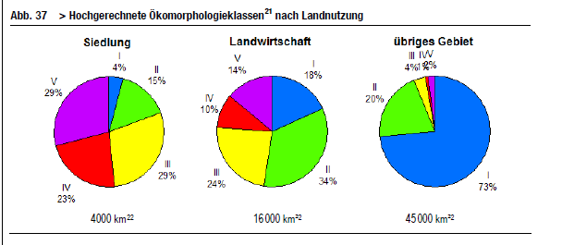
Strukturen der Fliessgewässer in der Schweiz
Source: http://www.bafu.admin.ch/publikationen/publikation/01075/index.html?lang=de

Slide 7
Challenges
Overview of status, pressures and impacts (update of baseline – state 2012-2015)
Change in status and pressures from 1st to 2nd RBMPs
Relationship between pressure and status (what is causing less than good status) –pressures-driving force relationship.
Effect of measures (focused on measures implemented during the first RBMP planning period).

Slide 8
Overview of status (update of baseline = status 2012-2015)
Is the status good or bad?
Physico-chemical
Biological
Chemical

Slide 9
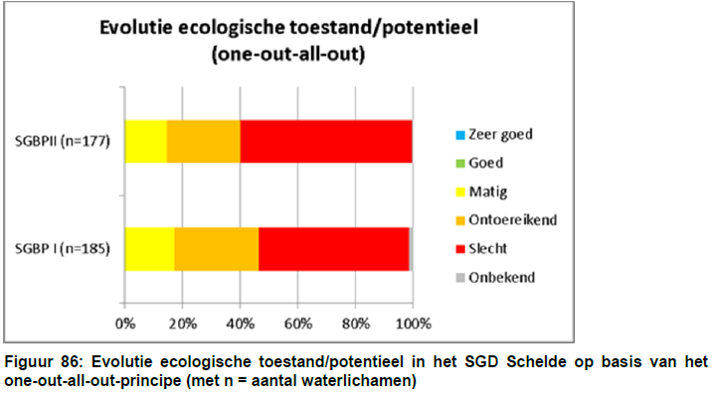
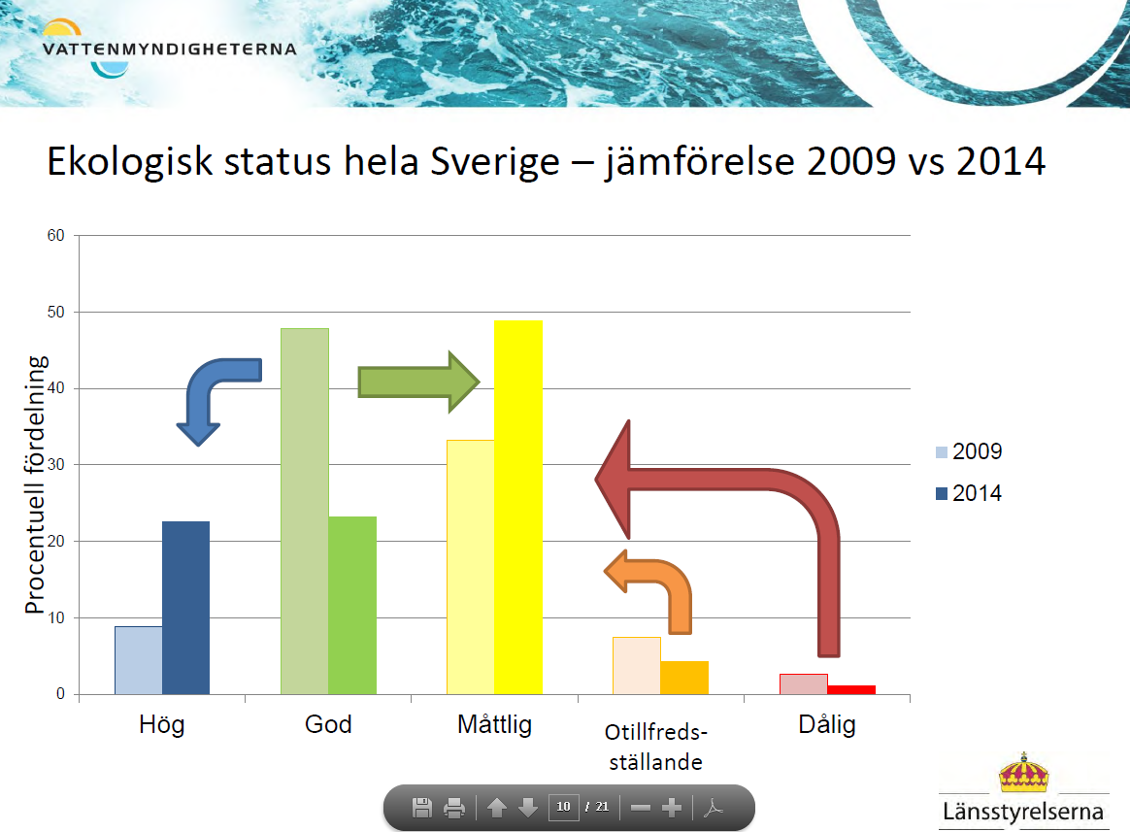
Change in status
2nd RBMP
1st RBMP
The river basin district of the Scheldt none of the 177 water bodies achieves good ecological status or ecological potential, based on the 'one-out-all-out' principle.
There is little evolution of the final assessment based on the one-out-all-out principle for all water bodies in the river basin district of the Scheldt (see Figure 86).
<google translation>
More high
Less good
Less good, poor or bad
More moderate
Source Scheldt dRBMP Link and Sweden Link

Slide 10
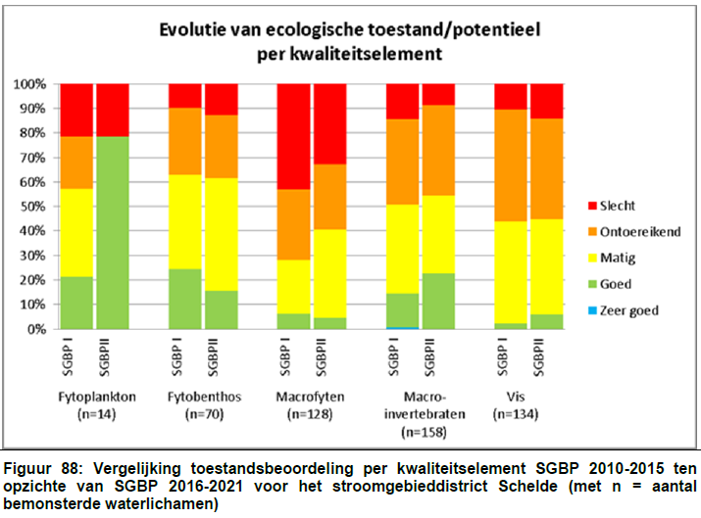
Change in status by quality elements
Phytoplankton
Phytobenthos
Macrophytes
Macroinverte- brates
Fish

Slide 11
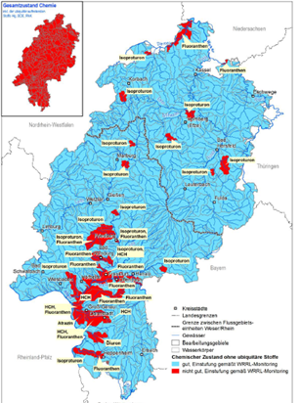
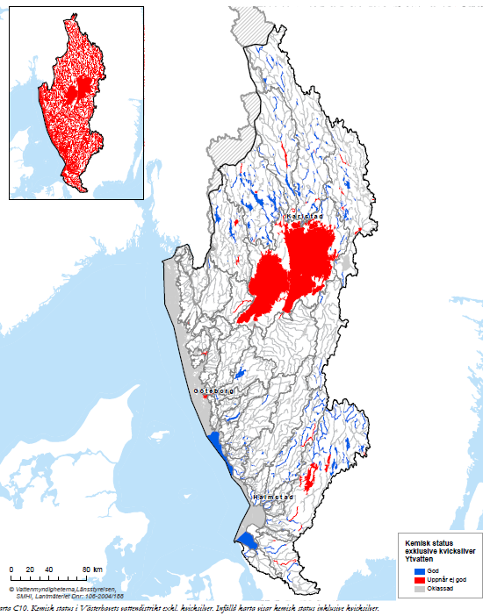
Baseline – overview of chemical status
Chemical status (with and without ubiquitous substances)
Sweden SE5 – with or without mercury
Source: Hessia (Germany) - chemical pressures

Slide 12
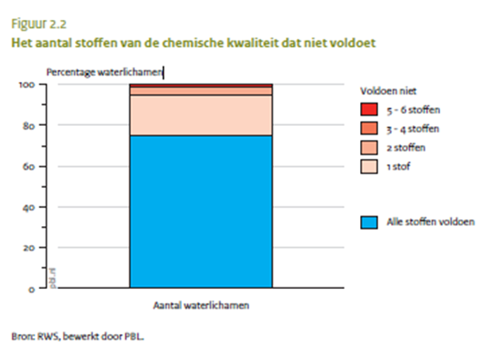
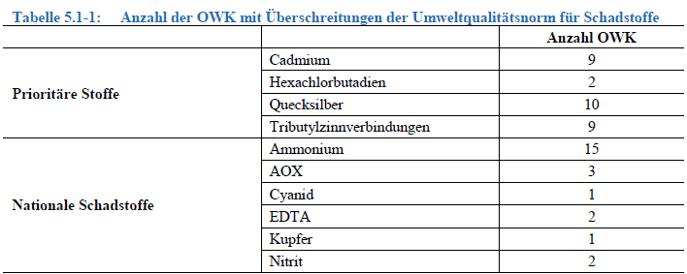
Which pollutant is causing poor chemical status?
More than one substance causing poor chemical status (The Netherlands – 2009)
Substance (priority or River Basin Specific) exceeding Environmental Quality Standards (Austria 2014)
Source: NL (see next slide) & Austria 2nd dRBMP Link

Slide 13
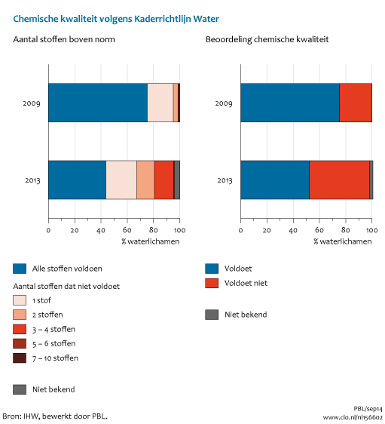
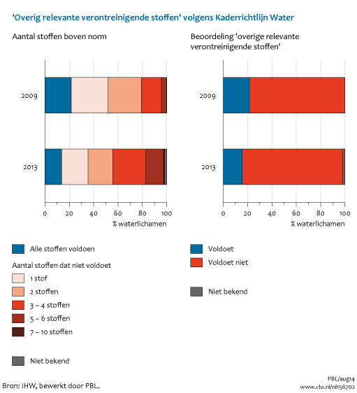
Change in chemical status due to stricter standards and more monitoring
Chemical status – The Netherlands
River Basin Specific Pollutants– The Netherlands
2009
2013
CBS, PBL, Wageningen UR (2014). Chemische kwaliteit volgens KRW, 2013 (indicator 1566, versie 02, 9 september 2014) & 2014). Kwaliteit overig relevante verontreinigende stoffen volgens KRW, 2013 (indicator 1567) www.compendiumvoordeleefomgeving.nl . CBS, Den Haag; Planbureau voor de Leefomgeving, Den Haag/Bilthoven en Wageningen UR, Wageningen.

Slide 14
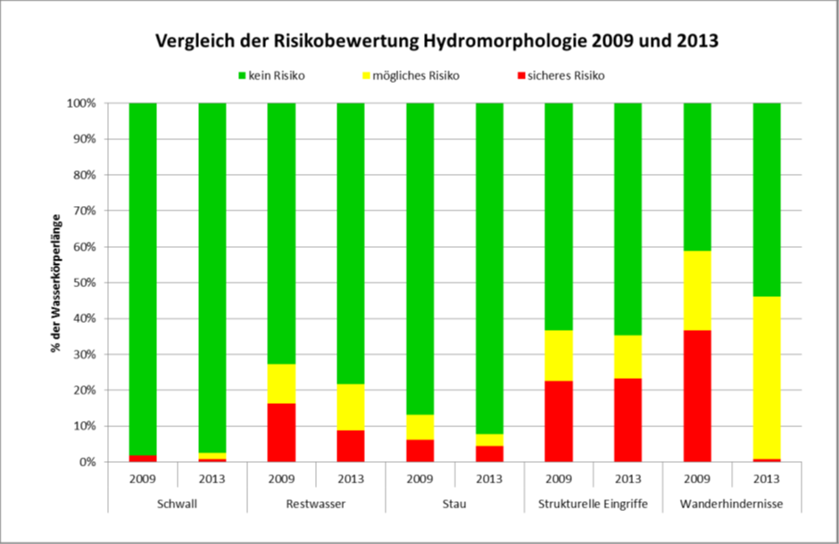
Austria – Hydromorpholgical pressures 2009/2013
Not at risk
Possible
at risk
At risk
2009
2013
2009
2013
Hydro-peaking
Storage reservoirs
Transverse structures
Dry river stretches
Structural changes
7000 river water bodies
Source:Bundesministerium Für Land- Und Forstwirtschaft, Umwelt Und Wasserwirtschaft 2014: EU Wasserrahmenrichtlinie 2000/60/EG Österreichischer Bericht der Ist-Bestandsanalyse 2013
Notes:
Schwall/Hydro-peaking – Restwasser/dry river stretches – Stau/Storage reservoirs – Structural changes – Transverse structures

Slide 15
Blue high degree of waste water treatment, Green biological treatment, Red wastewater discharged without treatment
2005/2006
UWWT baseline scenario 2015
What is the effect on ecological status, quality elements etc. ?

Slide 16
Can we achieve good status with the current measures?
GAP to achive good status
Supplementary measures
Business as usual
‘what is in place and/or in the pipeline already’ and
‘what is feasible

Slide 17
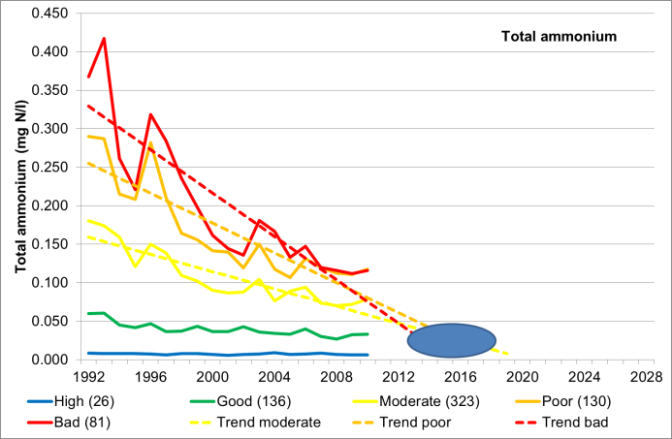
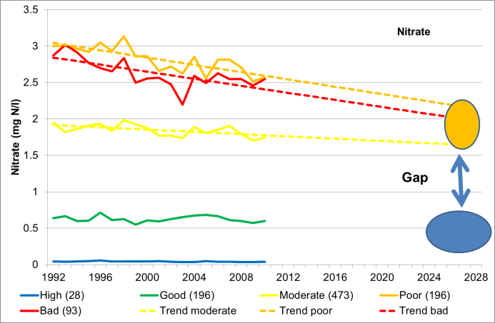
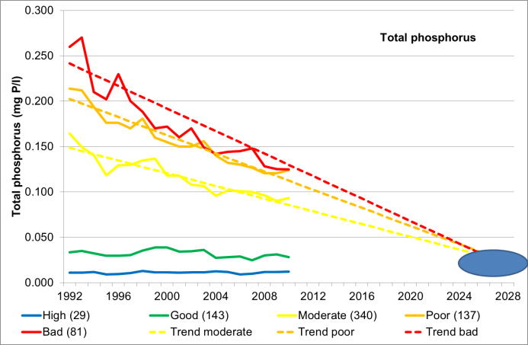
Linking WISE-SoE data to WISE-WFD

Slide 18
Tentative planning and time table
Notes:
During 2016 and 2017 the main activity on the 2017 State of Water assessment is happening:
A draft outline of the 2017 State of Water assessment will be available as outcome of the above WFD assessment framework.
This activity will also result in some preparatory activities, for example, testing different methods for presenting change between 1st and 2nd RBMP period, inventories of additional information, and analytic methods.
The main activity on analysing, producing results and assessments are concentrated in a three month period in the autumn 2016.
Thereafter there are a CIS and Eionet consultation period (first half of 2017).
During the summer 2017 the draft results and assessment are updated including late data deliveries and taking into account comments received on the draft.
The final 2017 State of Water assessment report and portal will be ready ultimo 2017.
The Eionet Freshwater NRCs and the relevant Common Implementation Strategy (CIS) Working Groups will during the process be consulted on structure of the assessment, on draft results and on the draft assessment.

Slide 19

Thank you, and looking forward co-operating with you on the next state of water assessment
eea.europa.eu

Slide 20
The 2015-18 EEAs assessment of the status of Europe’s waters – Floods Directive
Session 4
Wouter Vanneuville
Project manager Water and Vulnerability,
European Environment Agency (EEA)
Eionet NRC Freshwater meeting, 18-19 June 2015

Slide 21
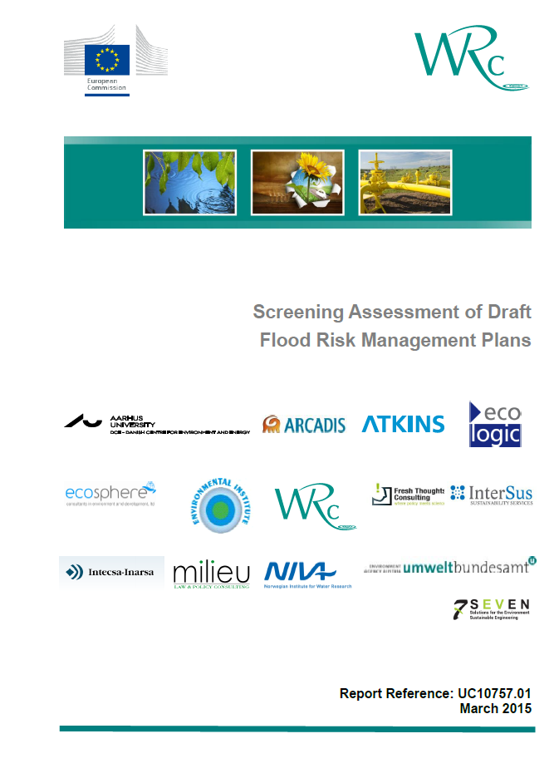
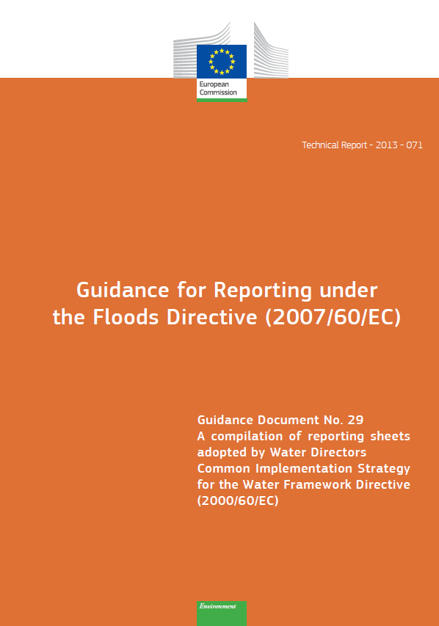
Floods Directive
Flood Risk Management Plans (FRMPs) shall include:
Conclusions of the PFRA […] delineating the APSFR;
FHRMs;
Description of the objectives;
Summary of the measures (and prioritization), including those taken under other community acts […];
How the implementation will be monitored;
Summary of public information and consultation;
List of CA;
The coordination process in international RBDs / other UoMs; and
The coordination process with the WFD.
Notes:
Drivers EU water (environmental) policies (Blueprint, 7th Environmental Action Program, WFD, other directives, CAP, rural development policies, biodiversity strategy)
Products/assessments linked to policy processes
2016-2018 reporting of results from 2nd RBMPs and potential revision/update of WFD
Better implementation of legislation
Better WFD/RBMP reporting (2016 WFD reporting guidance)
Illustrate progress/changes (status, and pressures)
Integrated assessment of pressures, status and progress in implementing measures
Linking WISE-SoE data to WISE-WFD

Slide 22
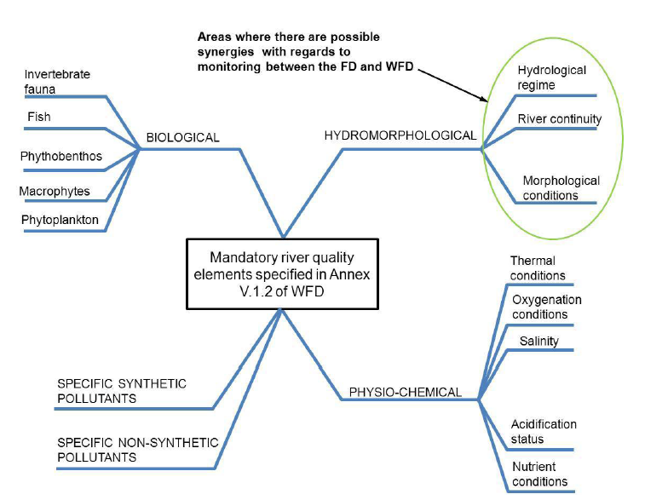
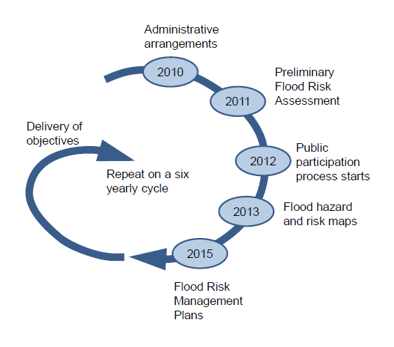
FRMPs
Are the last step in the first cycle of the implementation of the floods directive
Schema for FRMPs are only text fields
  Structured information is in PFRAs (reported 22/03/2012)and FHRMs (reported 22/03/2014)
Synergies with WFD:
  Monitoring (HYMO, WQ)
  Measures (NWRM and beyond)
  (Objectives)
  …

Slide 23
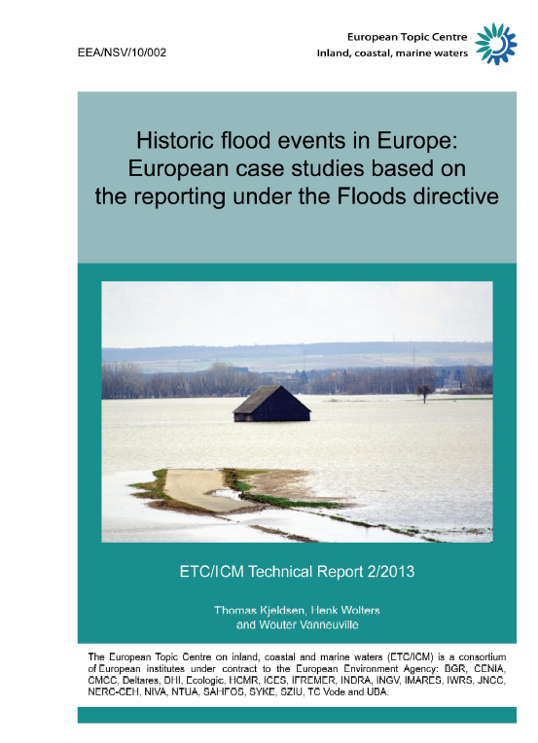
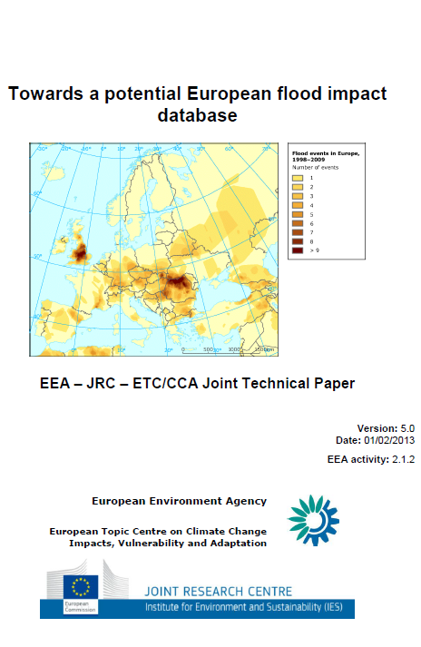
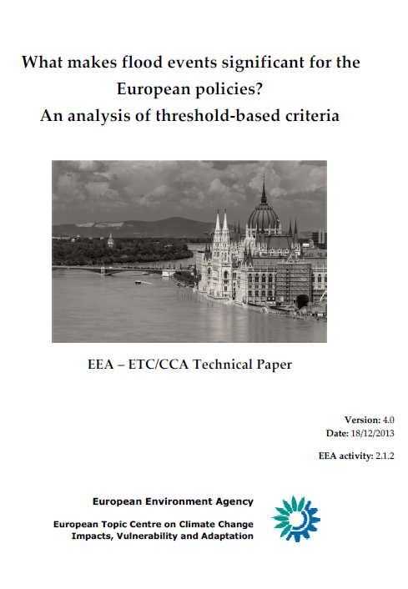
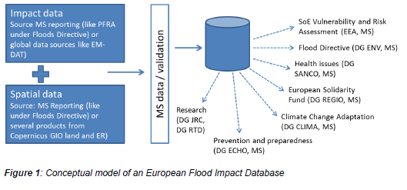
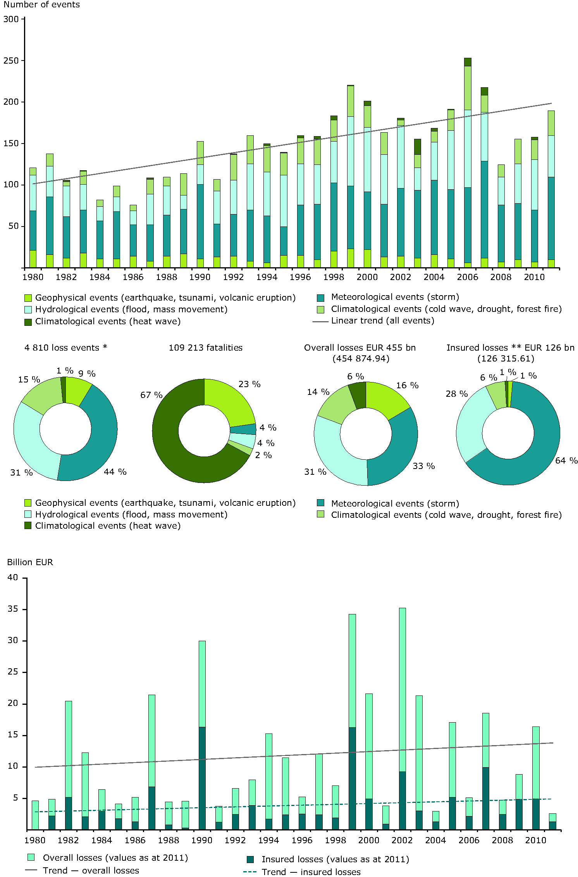
PFRA – past floods

Slide 24
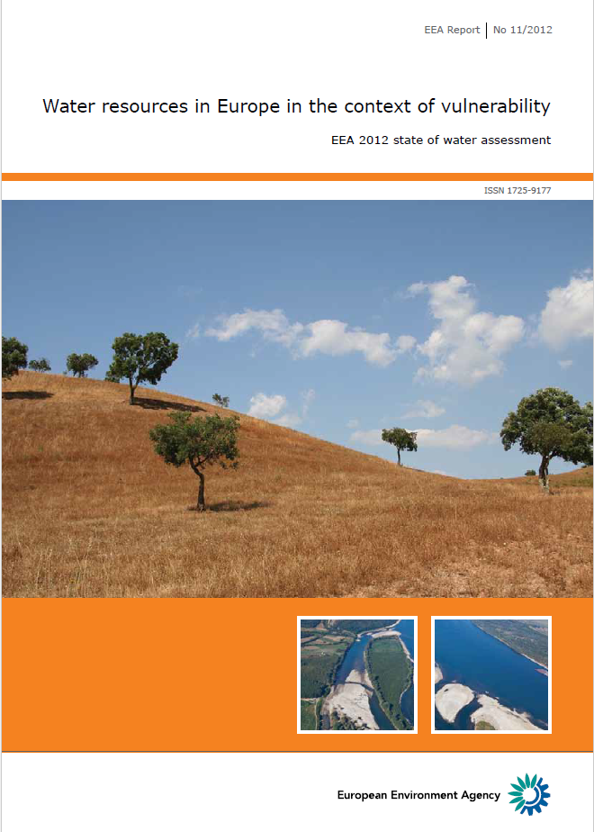
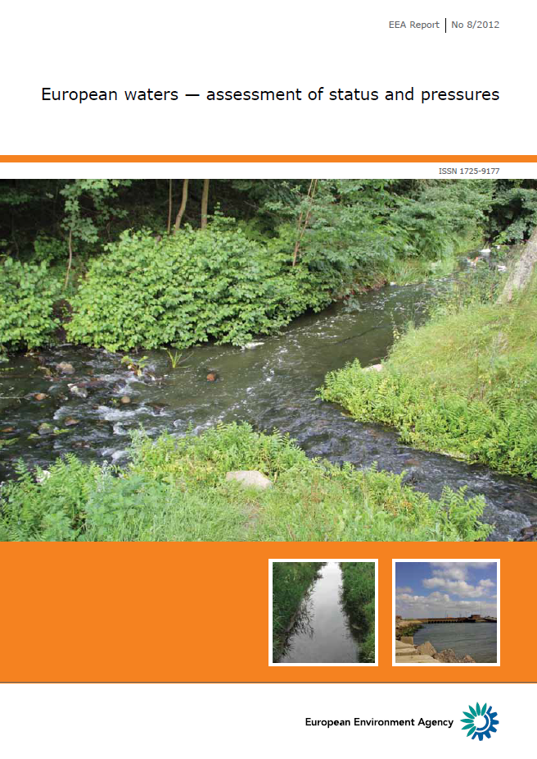
State of Europe’s water assessment
Focus on aspects linking FD and WFD
  So more on environment than e.g. cultural heritage
DPSIR
Link with other policy domains (thematic aspects
  LU of floodplains
  Water level variations
  Connectivity
  Water quality
Consultation foreseen September-October
  Eionet Water NRC
  CIS WFD-FD WG (F)
  Experts
  …
2015
2016-2018
EEA report on floods, floodplains, vulnerability and flood risk

Slide 25
Thank you, and looking forward co-operating with you on the next state of water assessment(s)
eea.europa.eu

