Slide 1
Session 2: SoE content review
* Content review of the WISE SoE data flows
- Determinants for describing pollution from hazardous substances and emerging chemicals
Freshwater Eionet Workshop, 18-19 June 2015
Benoît Fribourg-blanc, Office International de l’Eau, Limoges, France

Slide 2
Goals of the review
Merging reporting of all water categories (RW, LW, GW, TCM)
Structure the knowledge
Remove redundant parameters and clarify priorities to reduce reporting burden
Support planned EEA’s environmental assessments for the 2016-2018 period
Prefill Eurostat/OECD JQ IWA (rivers, lakes)

Slide 3
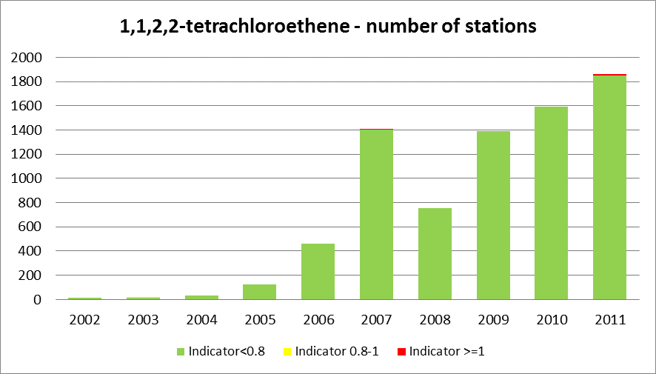
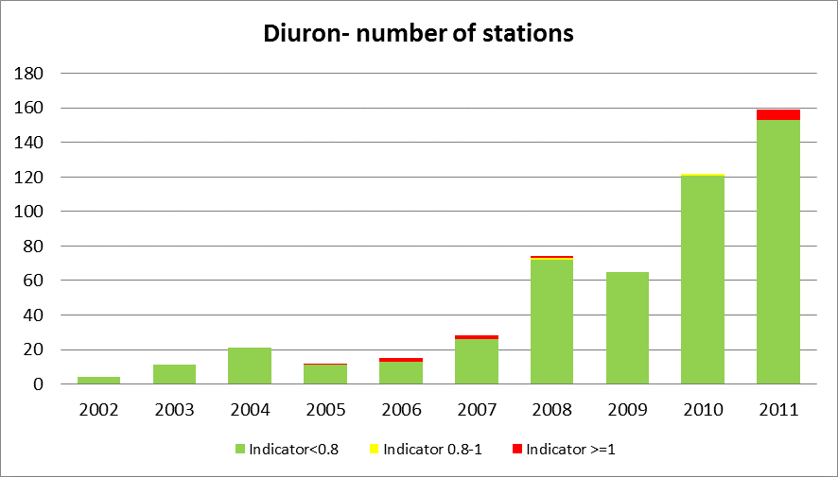
Current status
SoE reporting temporal scales
An increase in reported data: more substances, more analyses, more quantified values (>50% of all analyses in most recent years)

Slide 4
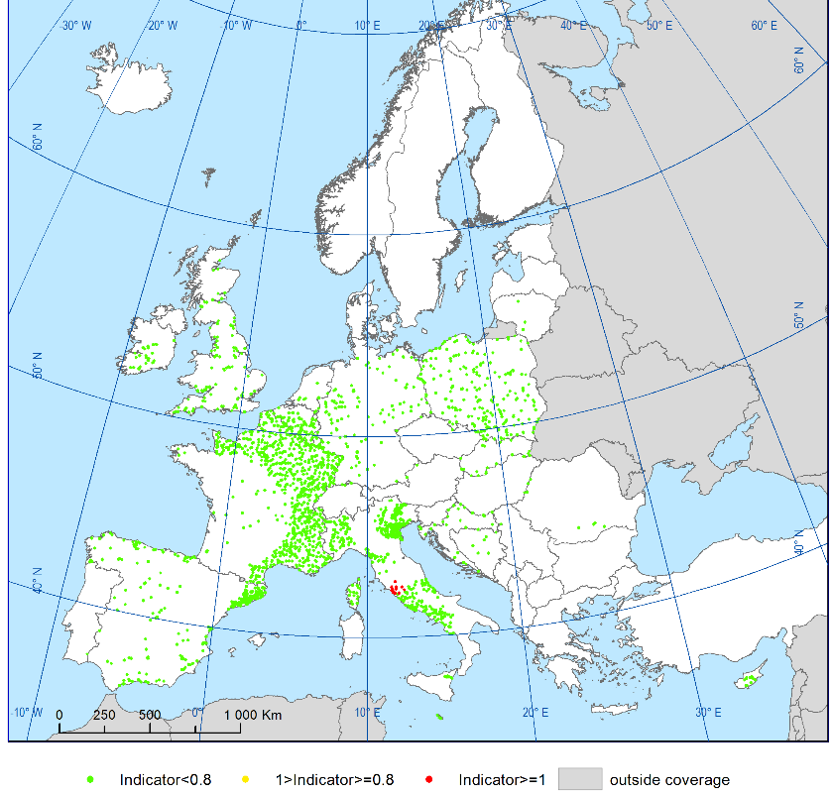
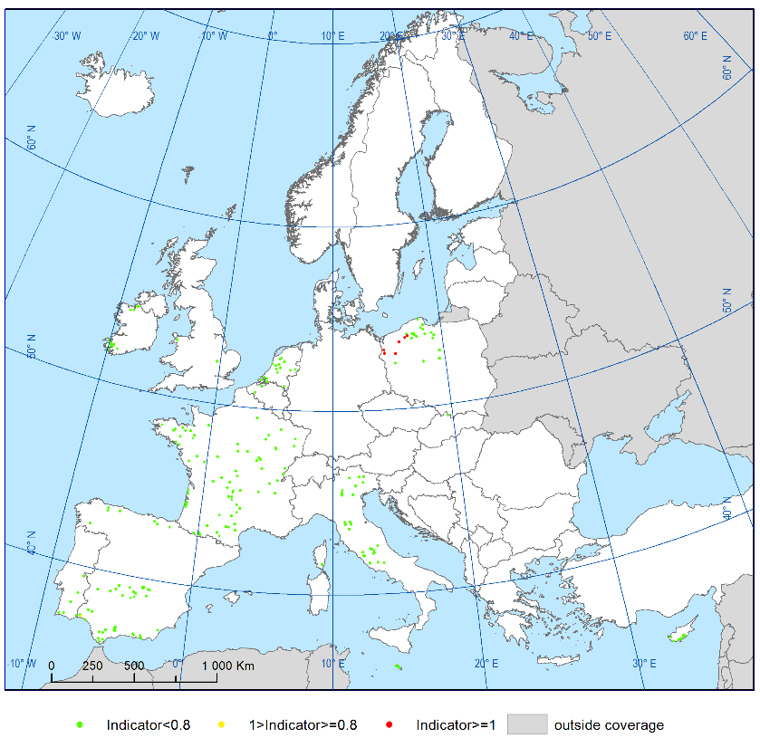
Current status
SoE reporting spatial scales
But: uneven spatial distribution
1,1,2,2-tetrachloroethene in rivers
diuron in lakes

Slide 5
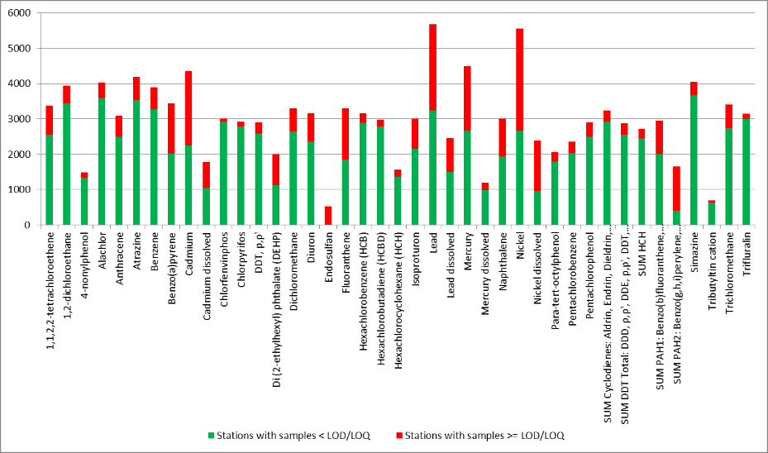
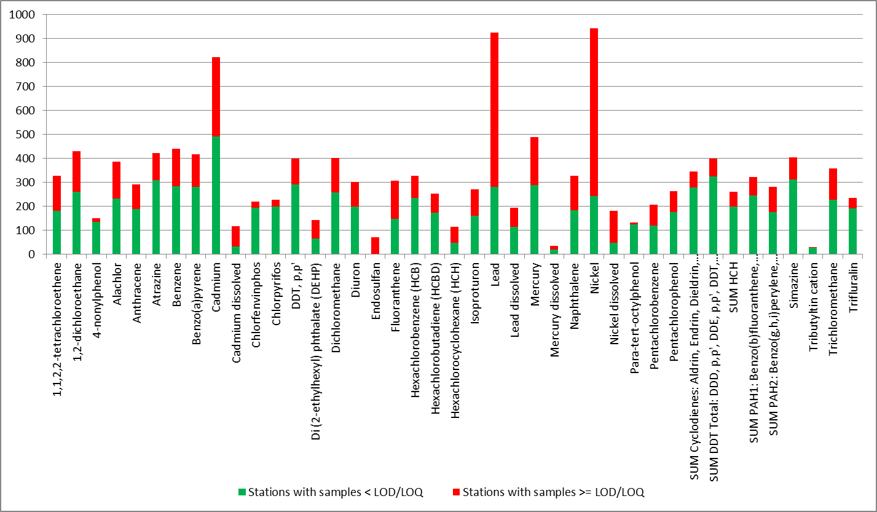
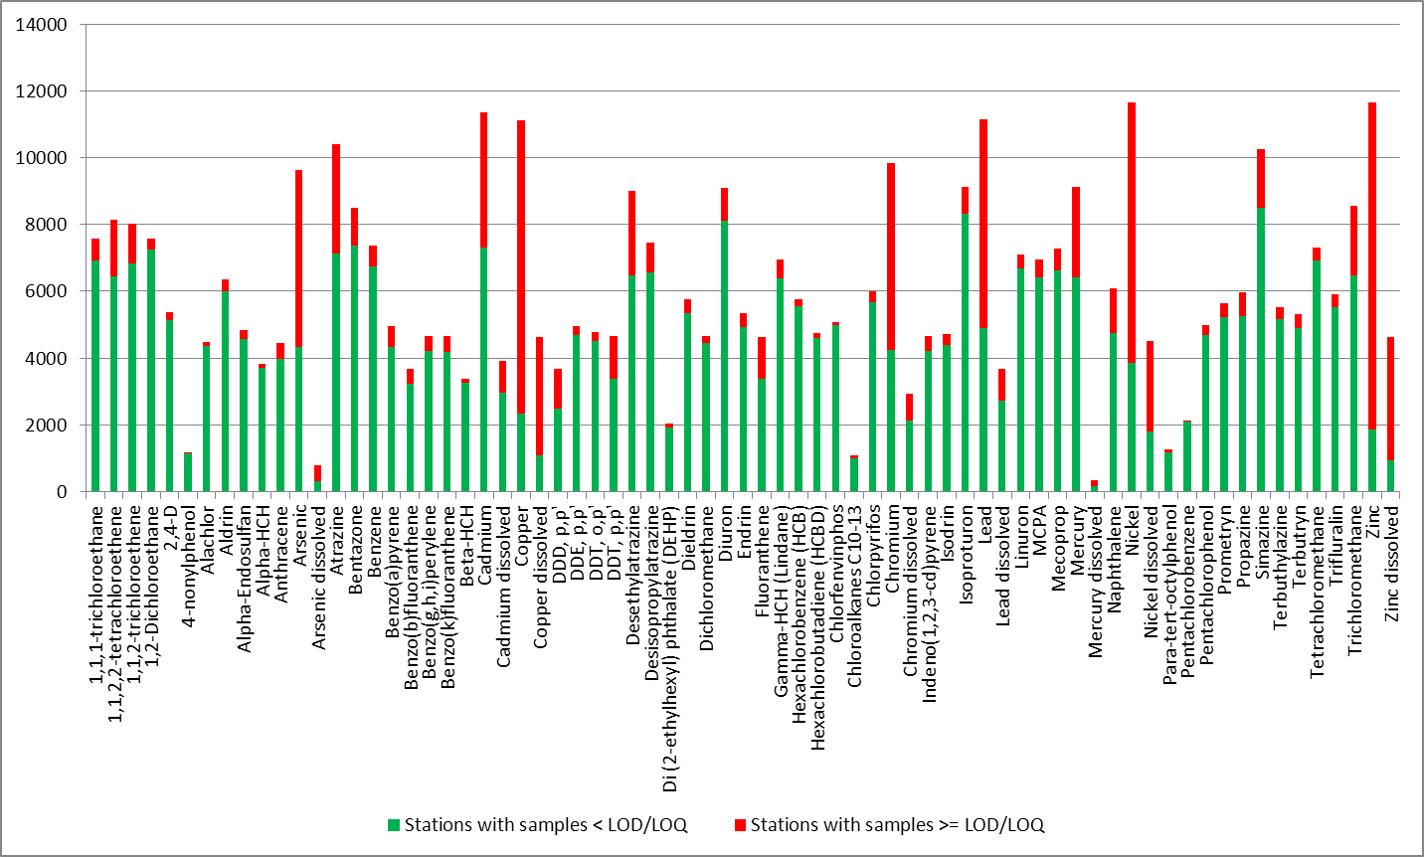
Current status
SoE reporting waterbody categories
uneven waterbody categories distribution
Number of stations for some substances (HS report 2015)
in rivers
in lakes
in groundwater

Slide 6
Proposed changes
chemical substances, a specific case:
  20,000 to 70,000 different chemicals on the market
  Not all substances are dangerous or relevant for water
  Assessments can be made on groups
  Collected data can be used by others (JRC for prioritisation, IPChem, EU projects…)
A unique list of relevant chemical substances with
  Single code per determinand
  4 grouping criteria applied
  For each substance identification of groups it belongs to

Slide 7
Proposed changes
4 grouping criteria:
  chemical families,
  uses,
  European legislation
  properties
6 groups of substances defined (criteria combination)

Slide 8
Conclusions
Increasing trend in reporting participation
Grouping allow clarification on objectives for data collection: each substance identified with its priority
in rivers and lakes
in groundwater

Slide 9
Determinants for pollution from other pressures
-> see presentation on pollution from other pressures

