Slide 1
Miroslav Fanta
5th April 2022
12th reporting call under the UWWTD
- Reporting process

Slide 2
CDR help pages - overview
CDR help pages for Art.15 and Art. 17
http://cdr.eionet.europa.eu/help/UWWTD/UWWTD_613
http://cdr.eionet.europa.eu/help/UWWTD/UWWTD_524
Data Dictionary instructions
New: How to use Reportnet 3 for UWWTD reporting
2021 xls (xsd) templates
2021 update of QA rules
-> fill the templates for both articles with your data

Slide 3
CDR help pages

Slide 4
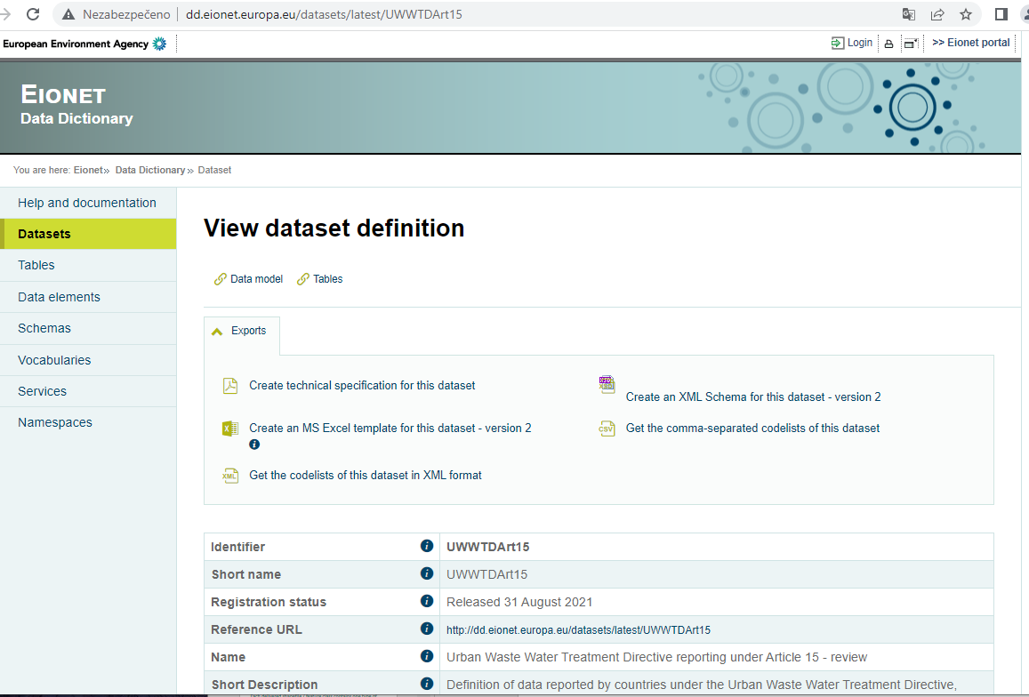
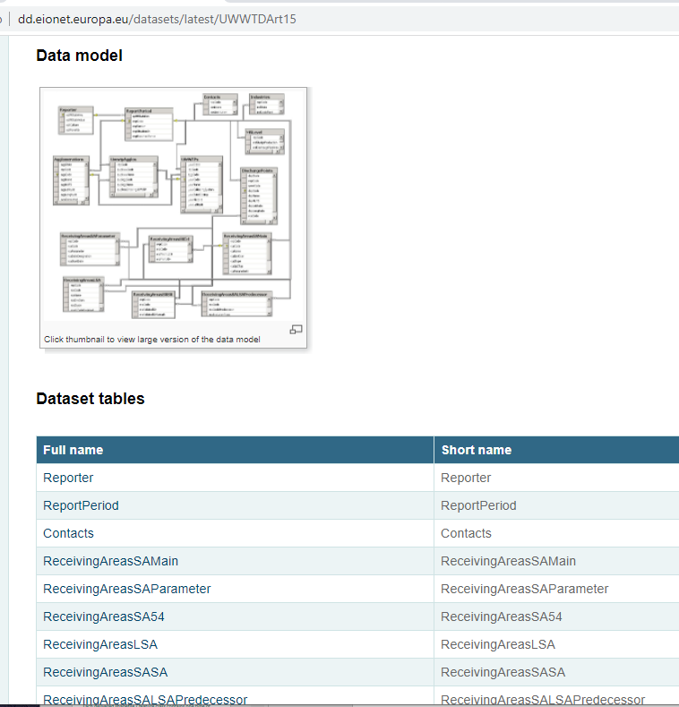
Data dictionary

Slide 5
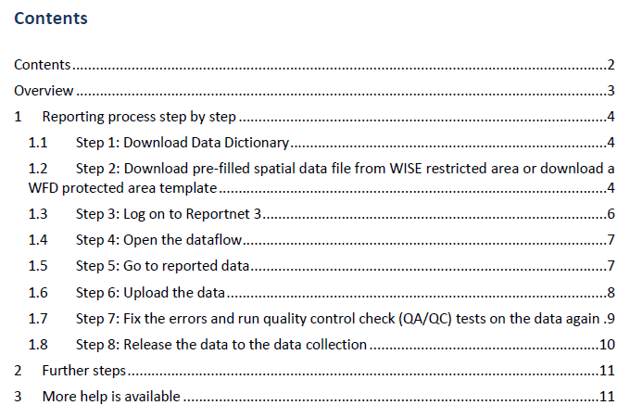
New document: How to use Reportnet 3 for UWWTD ...

Slide 6
Tabular data templates
Use current reporting period templates !!!
Tabular data:
templates available for download on CDR helpdesk or on Data Dictionary web page
few new elements (fields) added to (removed from) data structure in comparison to the previous reporting period

Slide 7
Spatial data templates
WFD-like spatial data structure is accepted only
contains shapefiles: ProtectedArea (polygon data)
ProtectedAreaLine (line data)
(ProtectedAreaPoint)
Do not use pre-existing UWWTD spatial data structure anymore !
In this data structure, each delivered shapefile / feature class contained one type of sensitive area / less sensitive area
catchment (polygons)
coast area (polygons)
coastline (lines)
…

Slide 8
Spatial data templates
Download current template from EIONET Forum interest group:
Reporting under the WISE Water Directives and WISE SoE
-> folder WISE restricted access area
-> country folder, file UWWTD_ProtectedArea_{CC}.zip
https://forum.eionet.europa.eu/x_wise-reporting/library/restricted_distribution/{CC}/uwwtd_protectedarea_{CC}
Focus on the wEvolution and versionId attributes in the template
wEvolution: „creation“ should be changed to „noChange“ if object has been reported before
versionId: should be filled (e.g. YYYY-MM-DD )
ask UWWTD helpdesk for support if necessary

Slide 9
Data preparation
Linking between Art. 15 and Art.17 data
any object (agglomeration, treatment plant) used in Art.17 should be used in Art.15 as well
Linking between Art.15 tabular and spatial data
Any receiving area reported in Art.15 tabular data in the ReceivingAreas_SAMain table should be reported in spatial data
(and vice versa)

Slide 10
Reportnet 3 - overview
https://reportnet.europa.eu
Login (reportnet 3 login) – upper right corner
Data upload under 2 data flows (art. 15 including spatial data as a part of it, art 17)
Data validation
Release

Slide 11
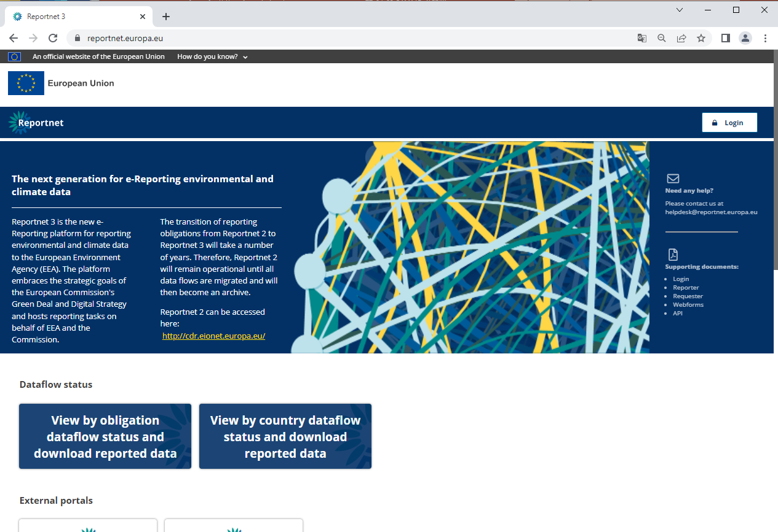

Slide 12
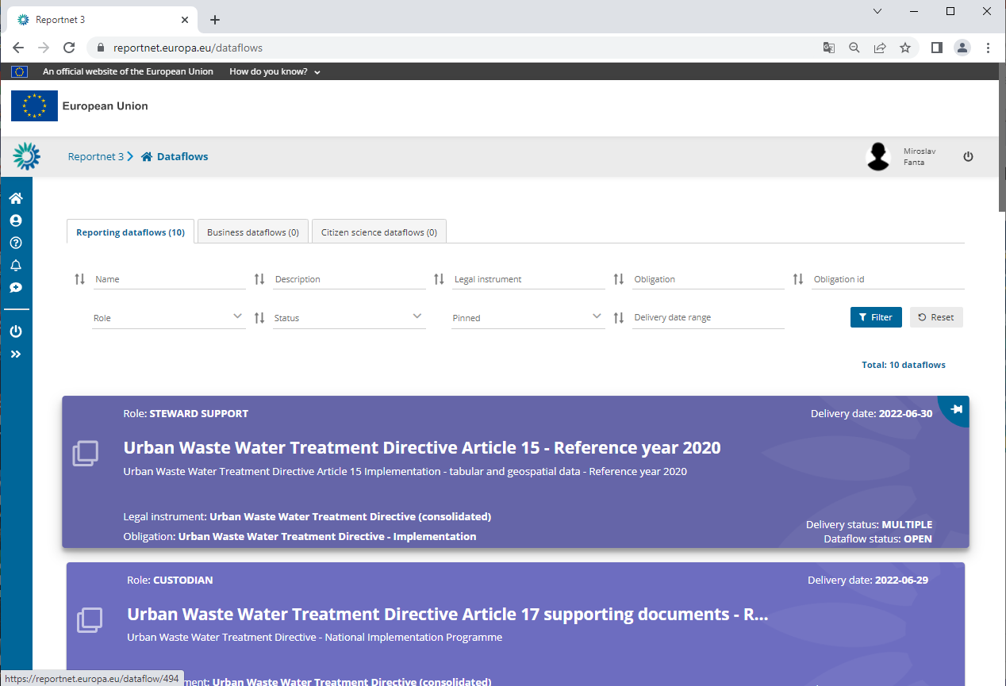

Slide 13
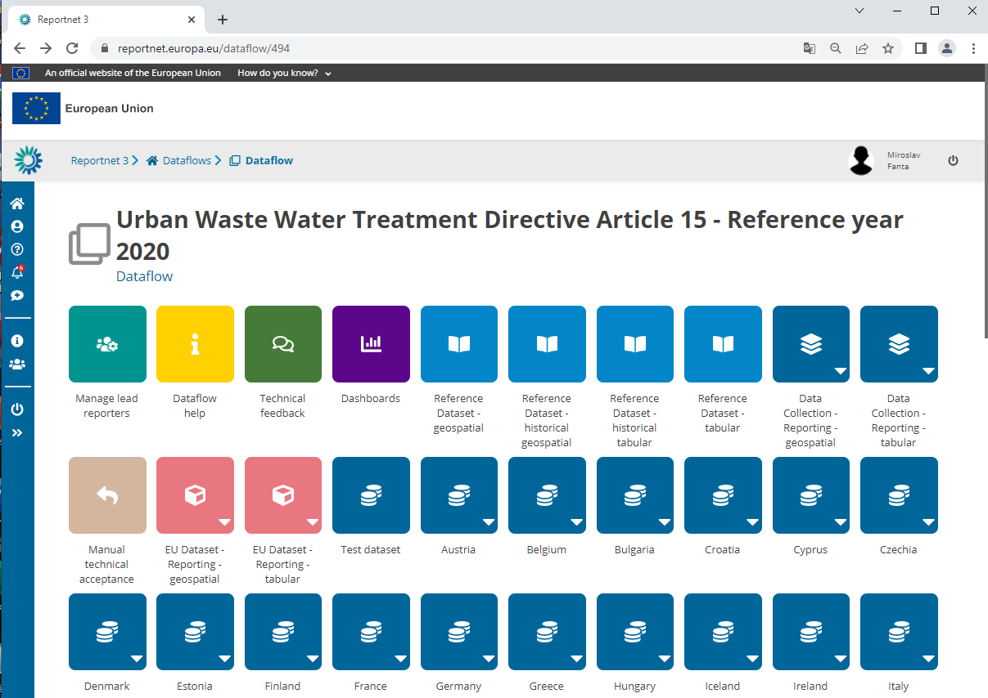

Slide 14
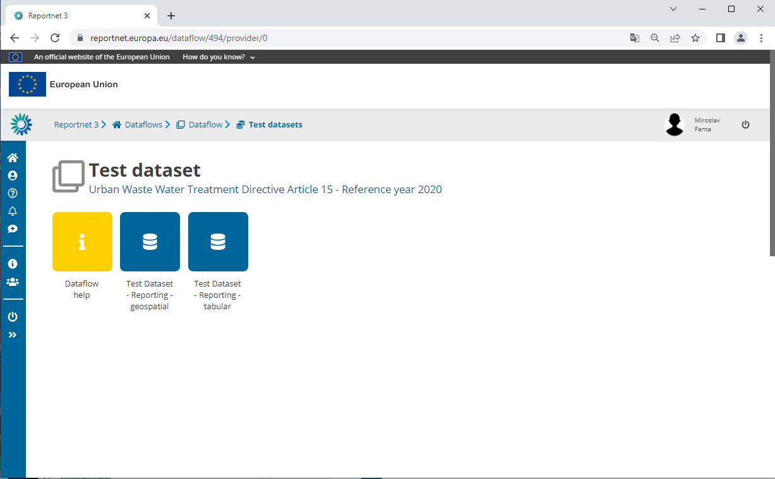

Slide 15
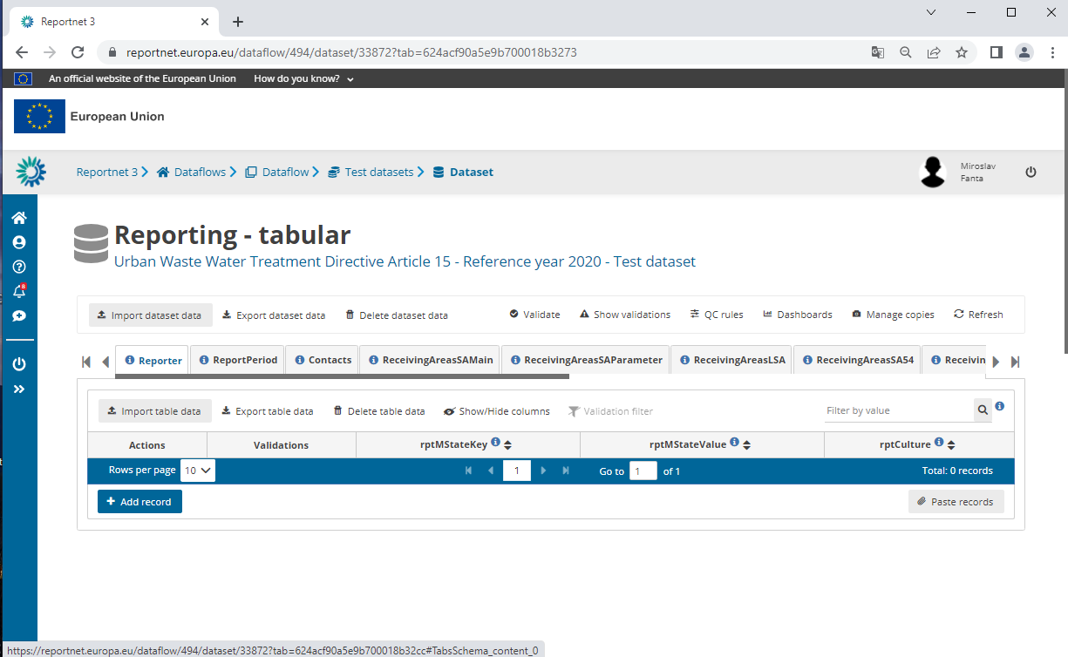

Slide 16
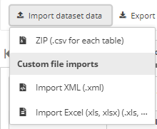
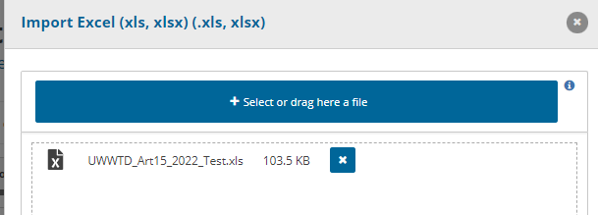
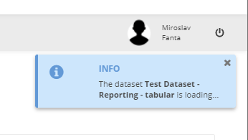
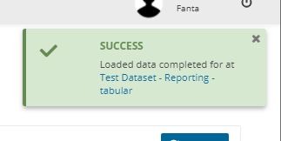
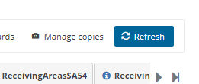
Import dataset data

Slide 17
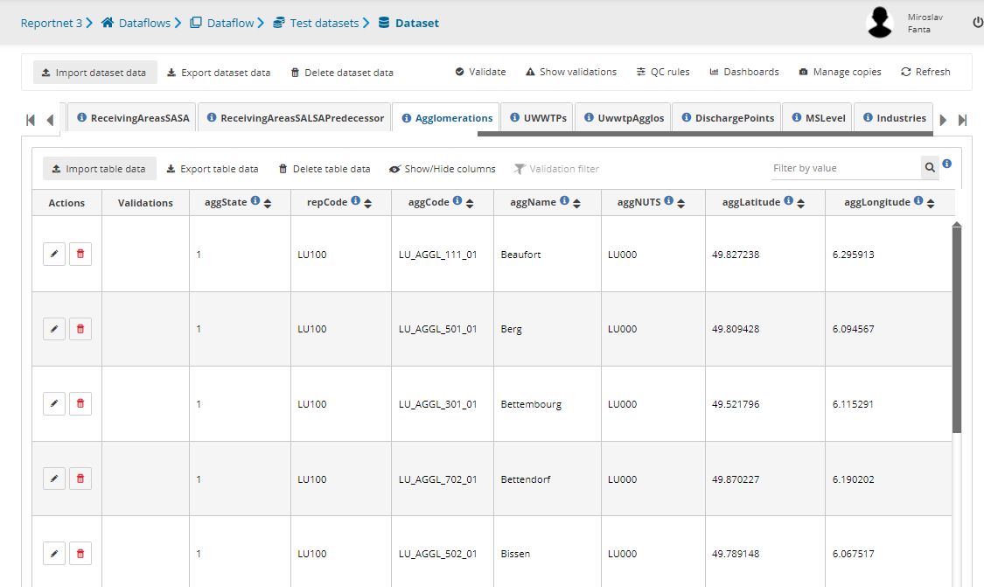
Data loaded

Slide 18
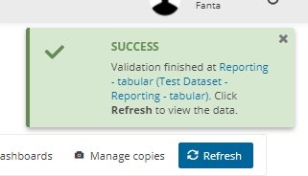
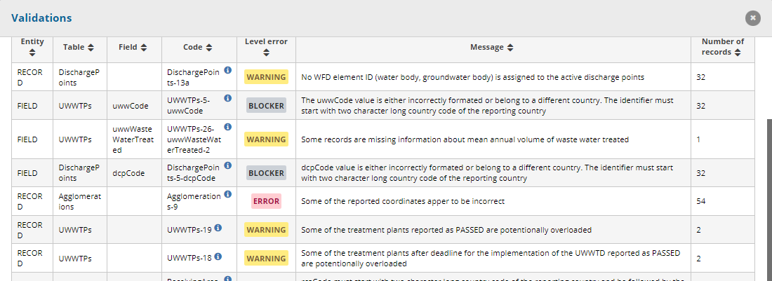
Validation

Slide 19
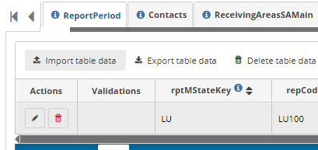
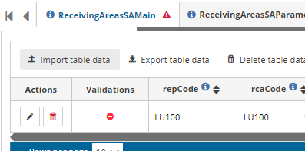
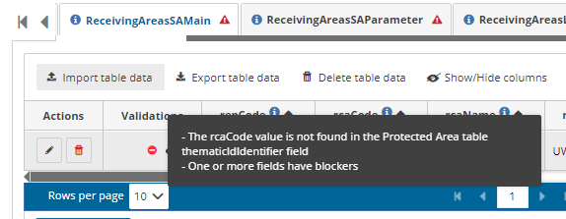
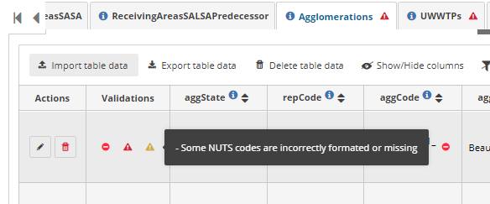
Validation results

Slide 20
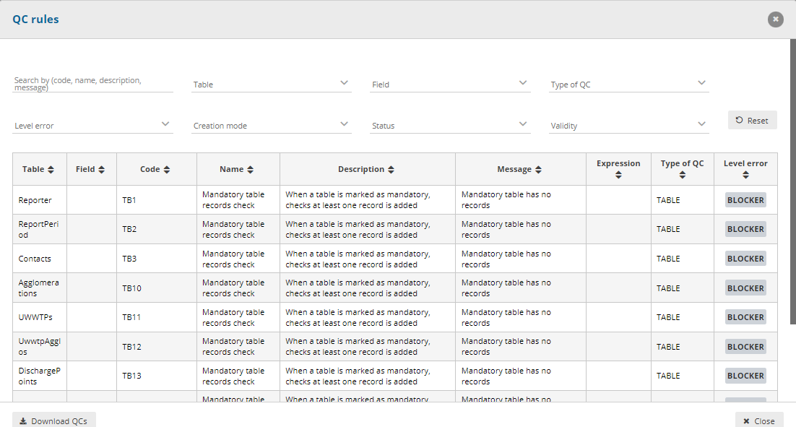
QC rules

Slide 21
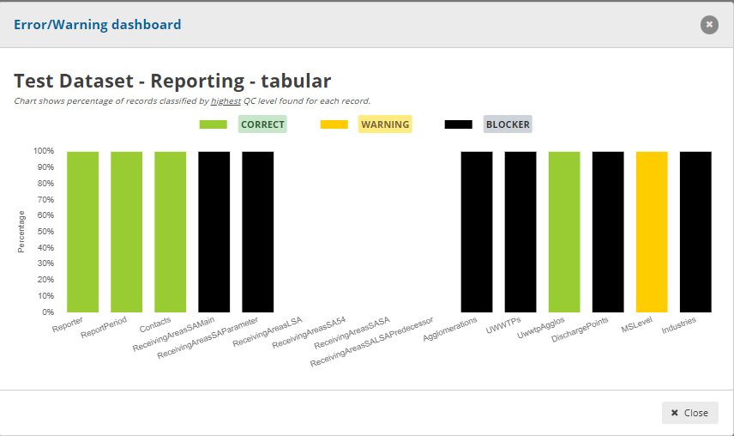
Dashboards

Slide 22
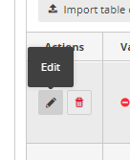
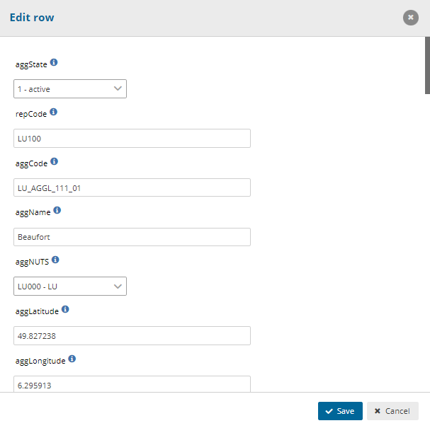
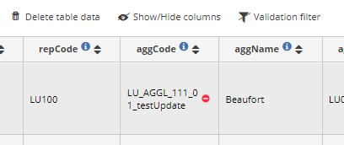
Editing of the record

Slide 23
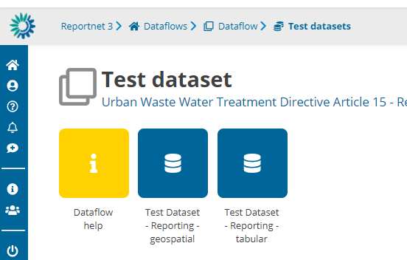
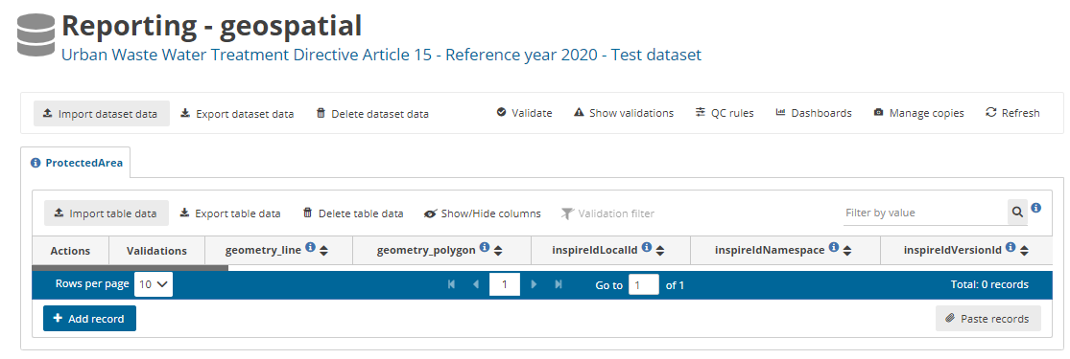
Spatial data reporting

Slide 24
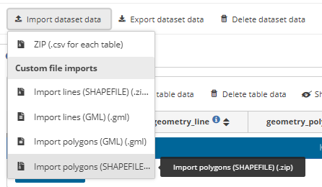
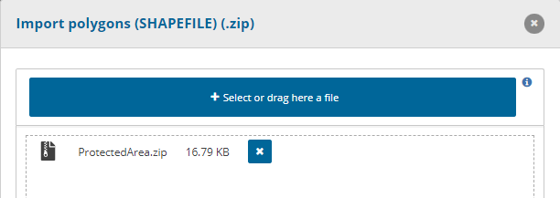
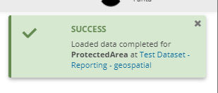
Spatial data upload

Slide 25
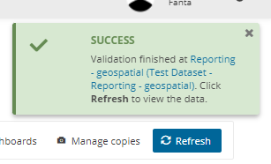
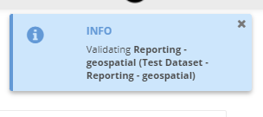
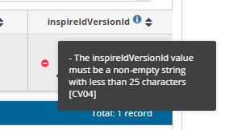
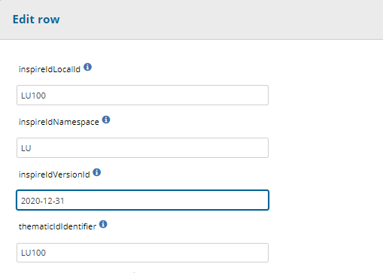
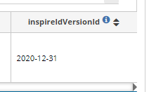
Spatial data validation

Slide 26
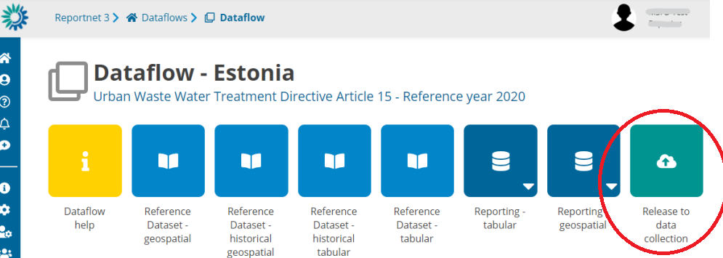
Reporting process – final step
No blockers (if possible, no errors as well) -> Release the data collection
Contact UWWTD helpdesk in case of any problems (uwwtd.helpdesk@eionet.europa.eu – afterwards, the issue is managed through OTRS system)
EIONET helpdesk also available (e.g. EIONET account problems - helpdesk@eionet.europa.eu)

Slide 27
Thank for your attention
Caroline Whalley (EEA)
Silvie Semeradova, Miroslav Fanta (ETC/ICM)
miroslav.fanta@cenia.cz
silvie.semeradova@vuv.cz
caroline.whalley@eea.europa.eu

