Slide 1
Welcome to the UWWTD Reporter Webinar
30th October 2023
This meeting will be recorded so that reporters can access after the meeting.
You are welcome to ask questions. Please write questions in the chat. If you prefer to speak, then put “Question” or “Comment” in the chat and we will call on you.
Otherwise, please mute your microphone.

Slide 2
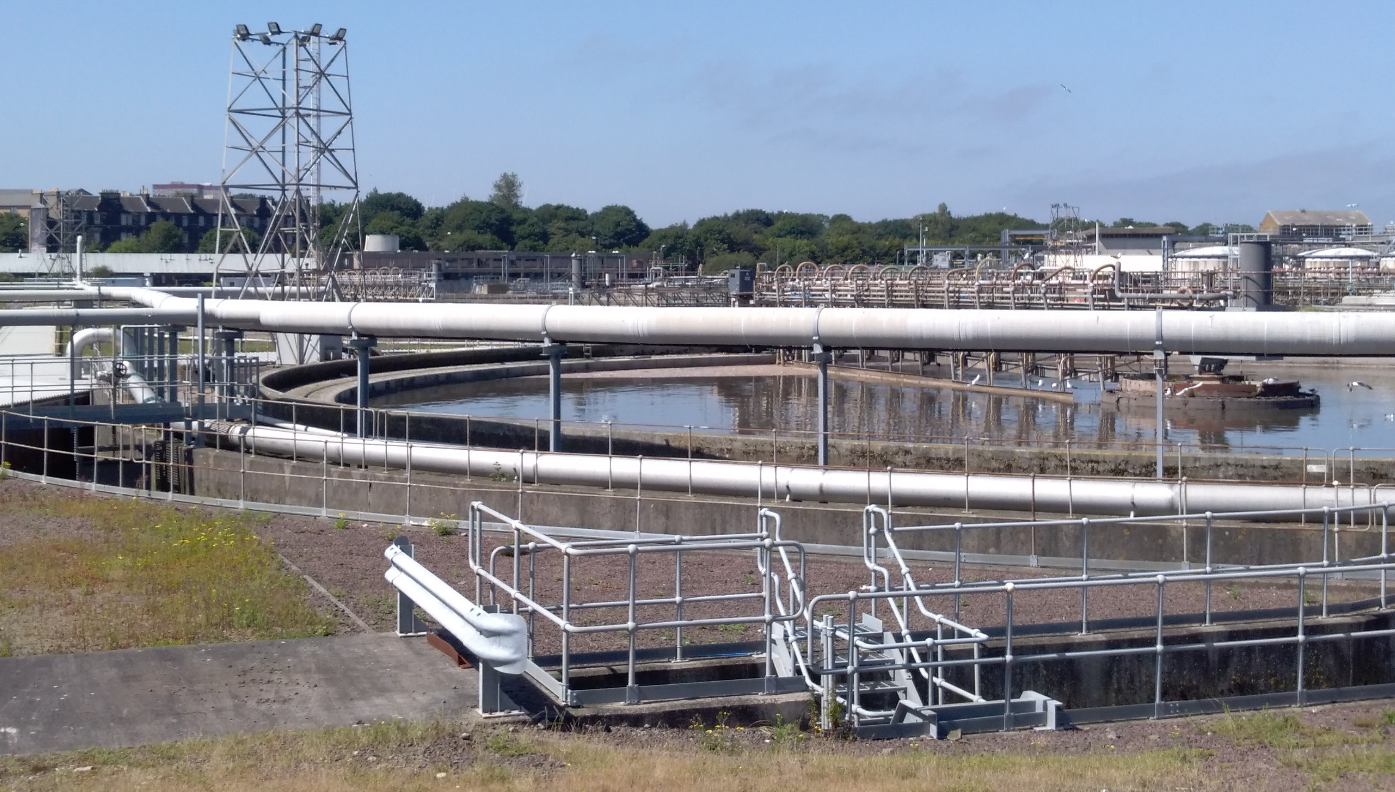
UWWTD Reporter webinar
© caroline whalley
Caroline Whalley / 30th October 2023
Notes:
OPENING SLIDE – dark background and white logo

Slide 3
Meeting Agenda
Introduction – Caroline
Overview of the data flow and its changes - Silvie
How to report? Online presentation - Miroslav

Slide 4
Proposed revisions to UWWTD legislation
Commission proposals to revise UWWTD and Industrial Emissions Directive
Negotiations on-going
Greater clarity in spring 2024 as to UWWTD reporting after 2025

Slide 5
UWWTD compliance calculations
Compliance calculations previously were carried out by European Commission’s consultants (“SIIF”)
EEA, EC, EC’s consultants and EEA IT consultants have been scripting compliance calculations into EEA systems, with 2023 as a transition year.
From 2024, compliance calculations will be done at EEA after June 30th. Assessment of the data will be carried out by EC’s consultants

Slide 7
Timeline
Testing of the dataflow – November
Launch of the datacall – end December
Reporter webinar March-April 2024
Deadline of 13th datacall - 30th June 2024
Presentations and recording will be uploaded here
Any questions – uwwtd.helpdesk@eionet.Europa.eu

Slide 8
Thank you
© caroline whalley
Silvie Semerádová, Miroslav Fanta, Herdis Gudbrandsdottir, Jon Maidens, Caroline Whalley
Notes:
Closing slide: you may want to use the same image as in the opening slide and thank your listeners.

