Slide 1
Miroslav Fanta
30th October 2023
UWWTD reporting
13th reporting call under the UWWTD:
data preparation and reporting process
using of Reportnet 3

Slide 2
Data preparation
CDR help pages for Art.15 and Art. 17
http://cdr.eionet.europa.eu/help/UWWTD/UWWTD_613
http://cdr.eionet.europa.eu/help/UWWTD/UWWTD_524
Data Dictionary instructions
Use 2023 xls (xsd) templates
2023 update of QA rules
Other documents
-> fill the templates for both articles with your data
Download prefilled spatial data template, update when necessary

Slide 3
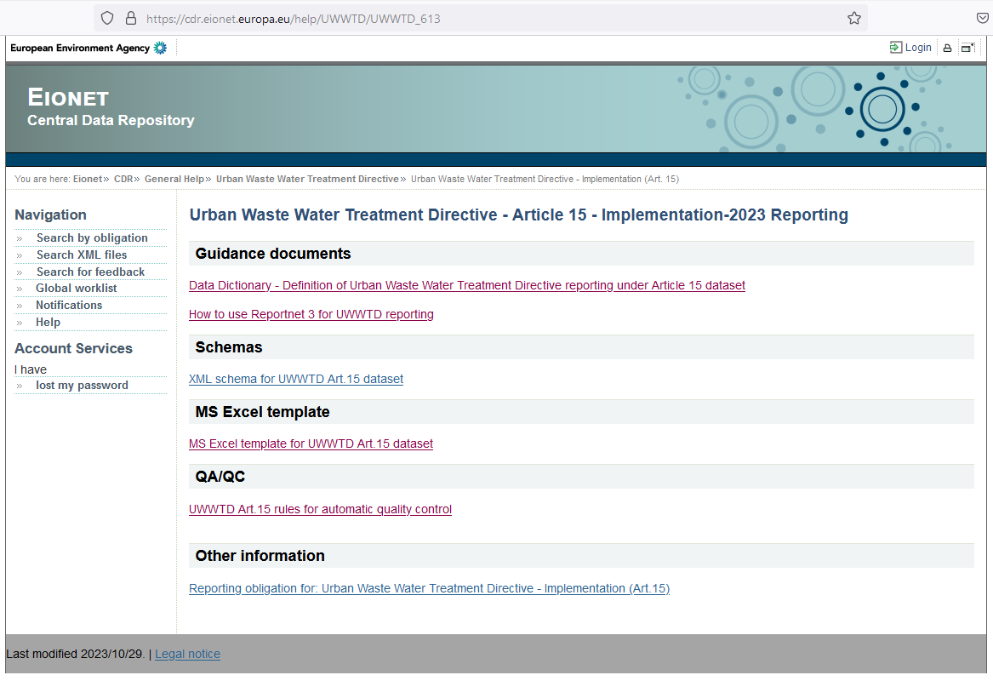
CDR help pages

Slide 4
Reporting process – spatial data – use of the template
Update previous reporting period spatial data when necessary
Ensure consistency of identifiers of spatial objects (receiving / sensitive areas) available in spatial and tabular data
Keep proper data specification (spZoneType: rivers / lakes / TW / coastL / coastA / catchments / …) and data type (lines / polygons) as requested
Requested spatial data structure: follow the the WFD-like template and shapefile names

Slide 5
Reporting process – spatial data – WFD-like structure
WFD-like template „UWWTD_ProtectedArea_{CC}.zip“
contains shapefiles: ProtectedArea (polygon data)
ProtectedAreaLine (line data)
(ProtectedAreaPoint)
attributes important for data selection in these shapefiles:
spZoneType
polygons: catchmentOfSensitiveArea, lakeSensitiveArea, coastalSensitiveArea,
transitionalSensitiveArea, lessSensitiveArea, (riverSensitiveArea)
lines: riverSensitiveArea, coastalSensitiveArea, lessSensitiveArea
statusCode
selection of currently valid data:
statusCode in ('valid', 'stable', 'experimental’)
resp.
(statusCode = 'valid’ OR statusCode = 'stable’ OR statusCode = ‘experimental’)

Slide 6
Prefilled templates – WFD-like (INSPIRE) data structure

Slide 7
Reporting process – Reportnet 3
reportnet.europa.eu
Login (upper right corner)
-> Art. 15: Urban Waste Water Treatment Directive 91/271/EEC –
Implementation
-> Art. 17: Urban Waste Water Treatment Directive 91/271/EEC –
National Implementation Programme
-> Art. 15: Urban Waste Water Treatment Directive 91/271/EEC –
Implementation – Spatial data

Slide 8
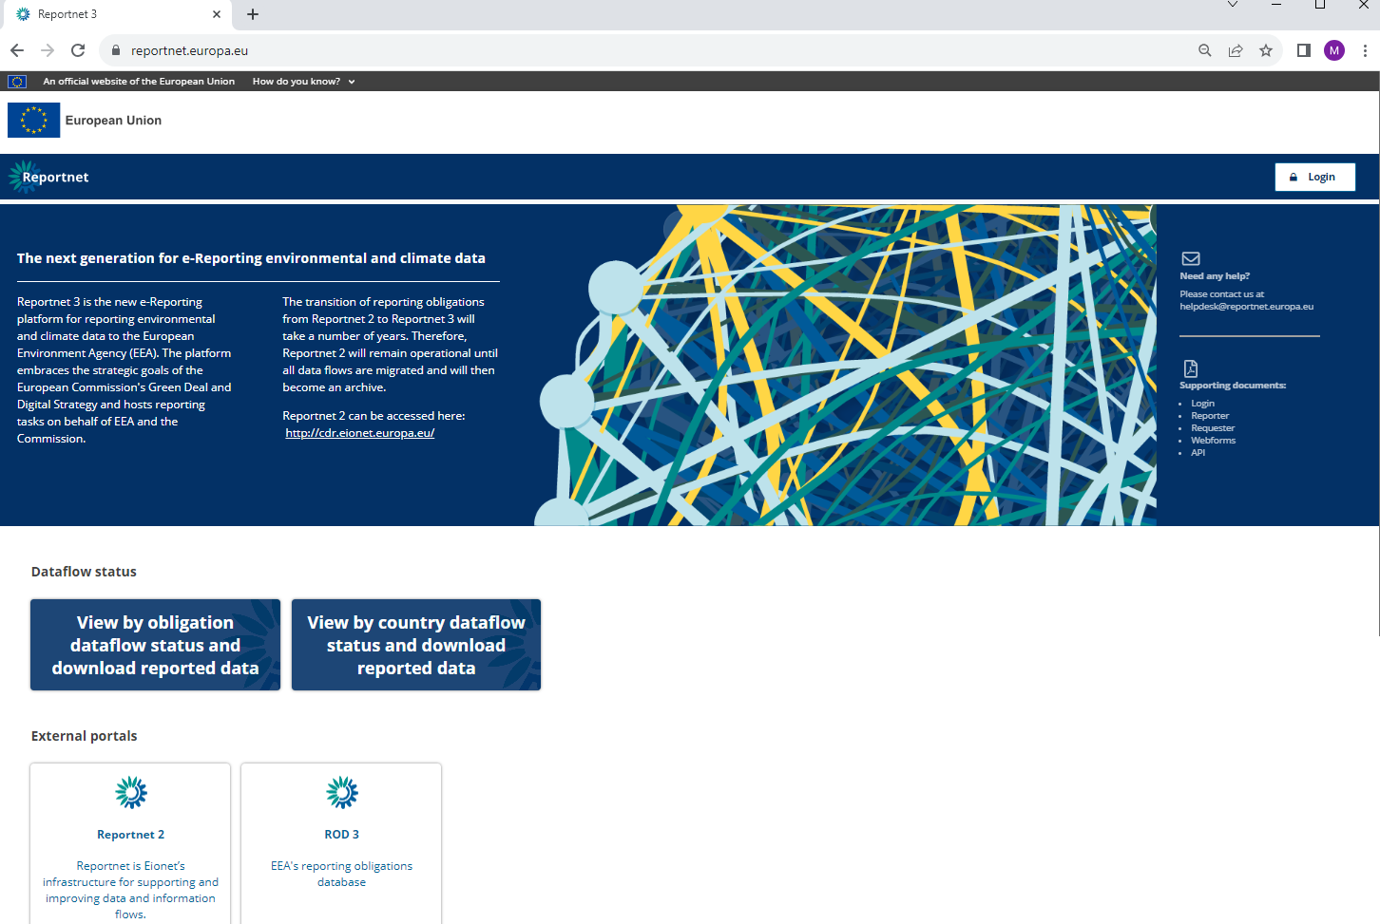

Slide 9
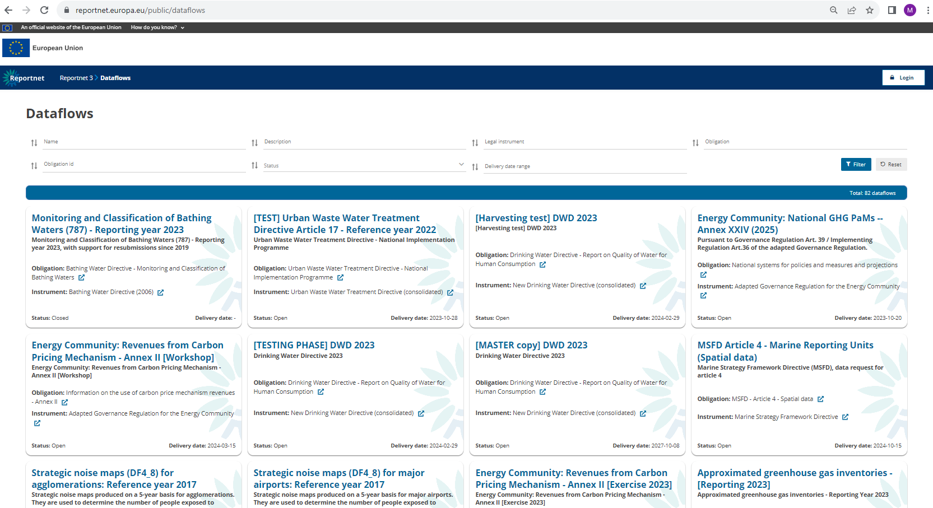

Slide 10
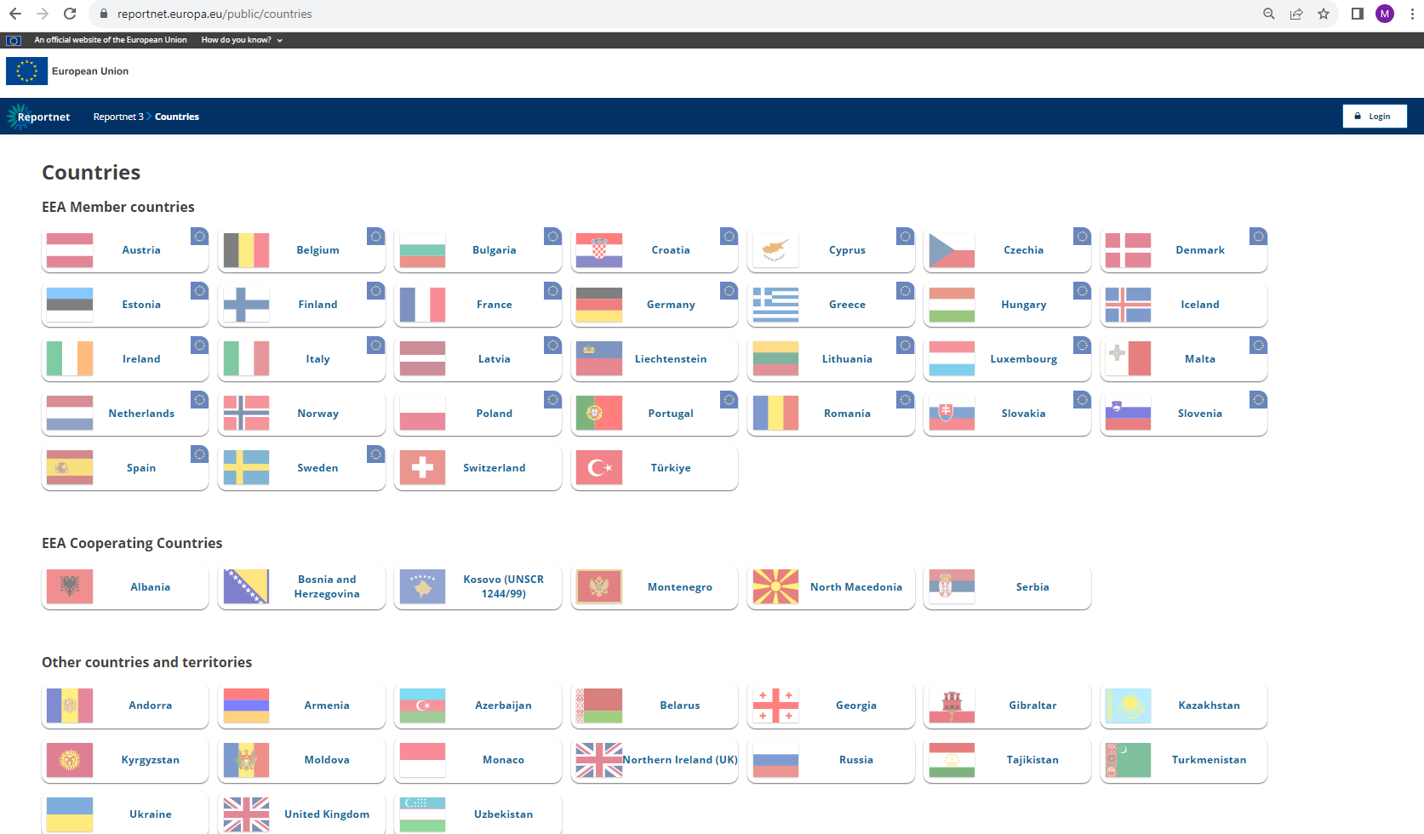

Slide 11
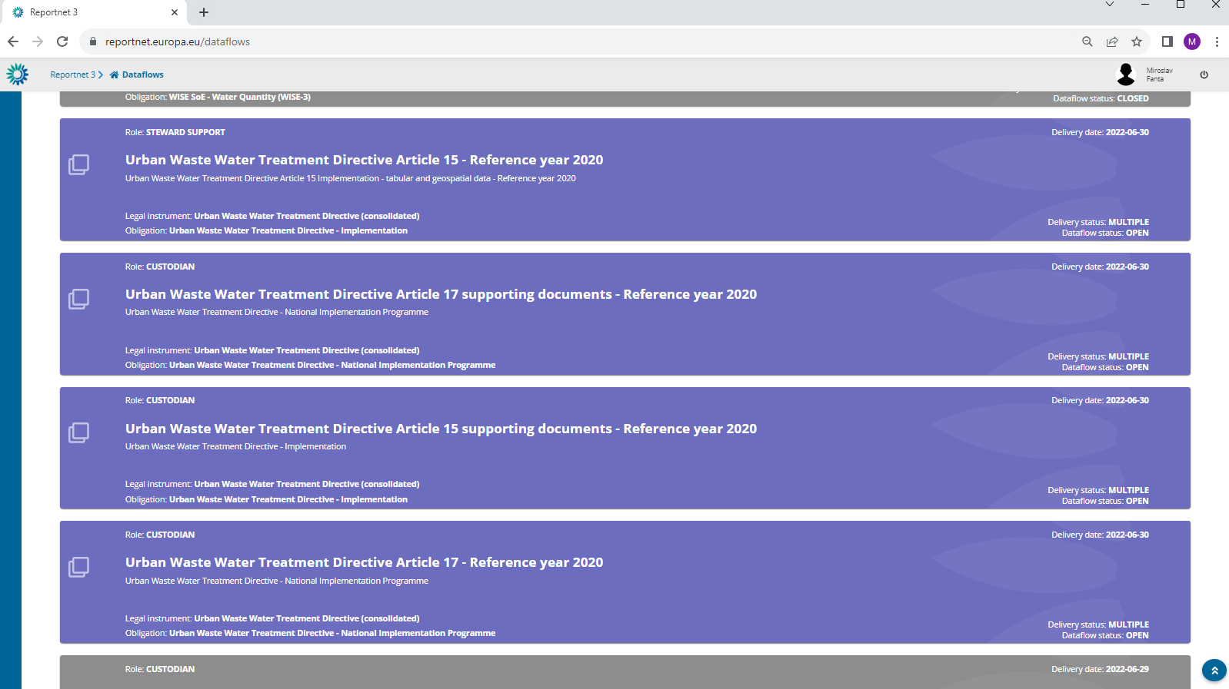

Slide 12
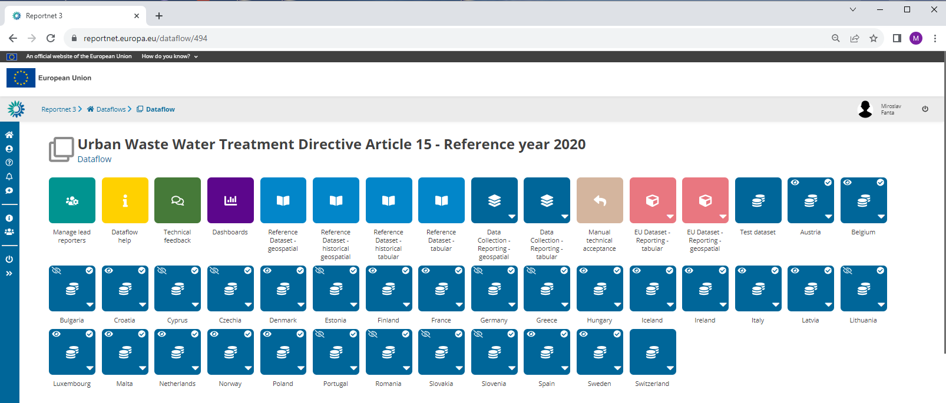
Dataflow UWWTD Art. 15 ref. year 2020 – all countries

Slide 13
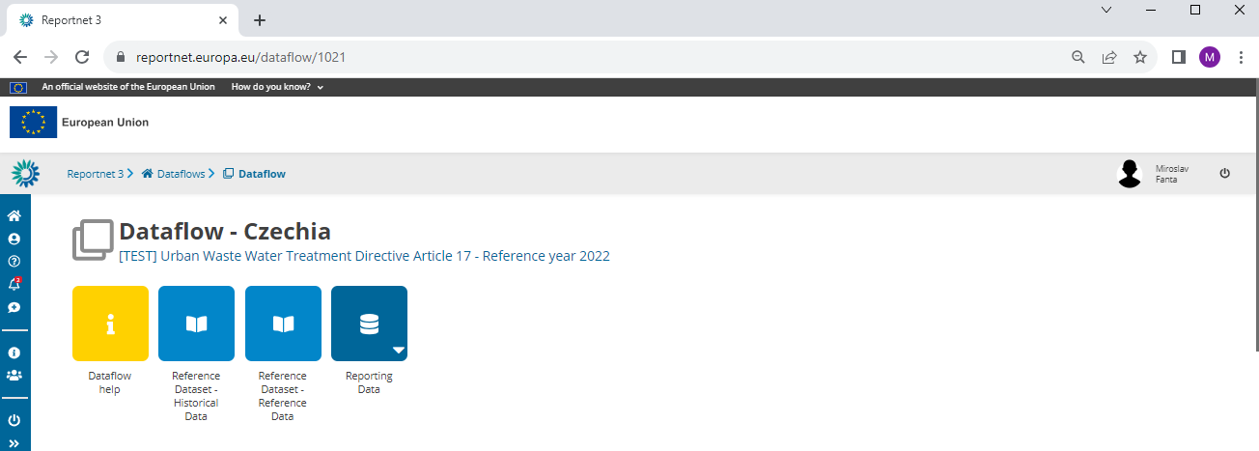

Slide 14
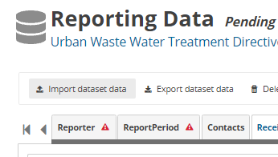
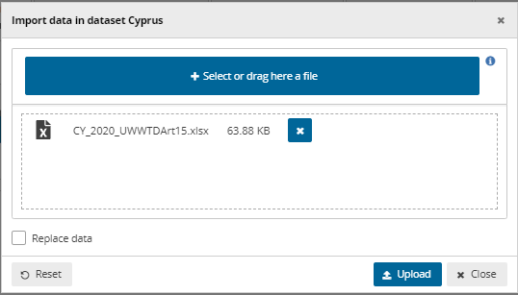
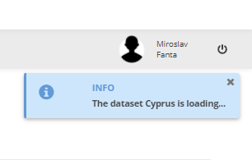
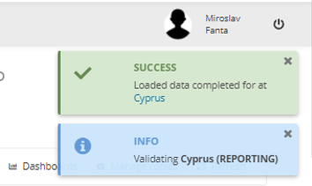
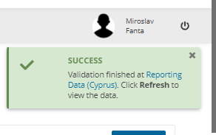
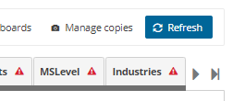

Slide 15
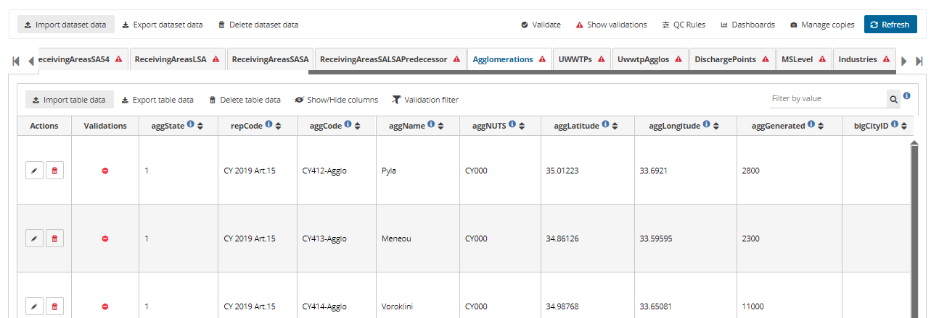

Slide 16
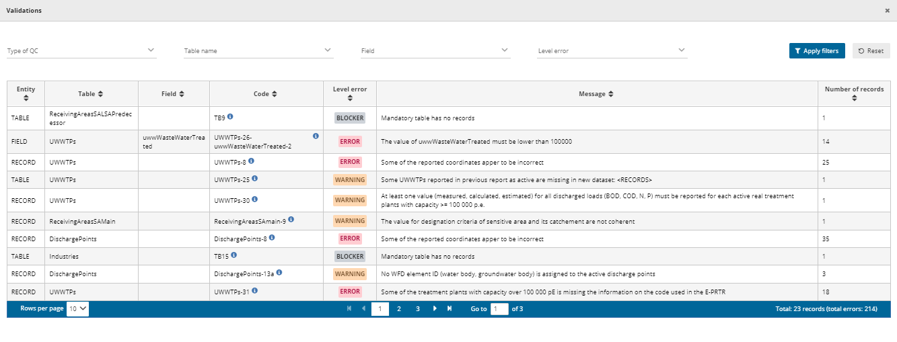
Validation results

Slide 17
Reporting process – final step
No blockers (if possible, no errors as well) -> Release the data delivery
Contact UWWTD helpdesk in case of any problems (uwwtd.helpdesk@eionet.europa.eu – afterwards, the issue is managed through OTRS system)
EIONET helpdesk also available (e.g. EIONET account problems - helpdesk@eionet.europa.eu)

Slide 18
Thank for your attention
Caroline Whalley (EEA)
Silvie Semeradova, Miroslav Fanta (ETC-BE)
caroline.whalley@eea.europa.eu
silvie.semeradova@vuv.cz
miroslav.fanta@cenia.cz

