Slide 1
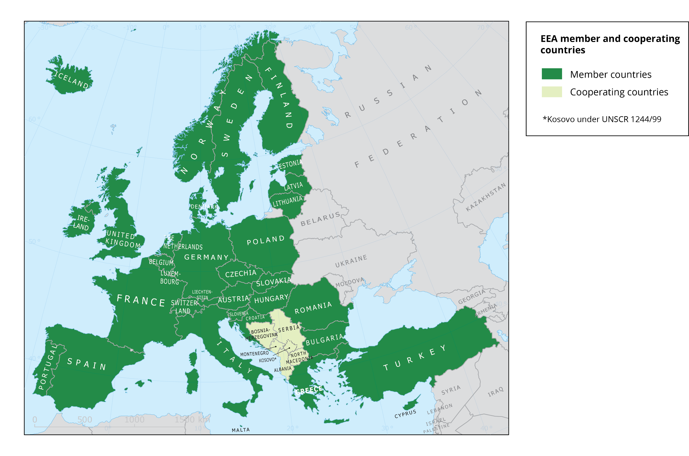
Wednesday 18th September 2019
WISE-1 (Emissions) webinar
Introduction
Caroline Whalley (EEA)
Hana Prchalová (ETC-ICM)
Silvie Semerádová (ETC-ICM)

Slide 2
Skype for Business – practical tips
Camera off
Mute – please use “conversation” IM to ask questions
Recording the skype – any concerns?
Links to documents are in the presentation

Slide 3
Introduction
Welcome – and thanks!
Purpose of webinar
lumaxart/2137737248

Slide 4
Agenda for the meeting
1) Introductions and technical instructions - Caroline
2) Uses of the WISE-1 data - Caroline
3) Feedback on the 2018 WISE-1 datacall - Caroline
4) 2019 WISE-1 datacall and E-PRTR proposal – Hana
5) Reporting process - Silvie
6) Discussion

Slide 5
Uses of the WISE-1 data
https://www.eionet.europa.eu/etcs/etc-icm/products/etc-icm-reports/emissions-of-pollutants-to-europe2019s-waters-2013-analysis-of-data-reported-under-european-data-flows

Slide 6
Reported WISE-1 point source emissions at River Basin District level
https://www.eionet.europa.eu/etcs/etc-icm/products/etc-icm-reports/emissions-of-pollutants-to-europe2019s-waters-2013-analysis-of-data-reported-under-european-data-flows

Slide 7
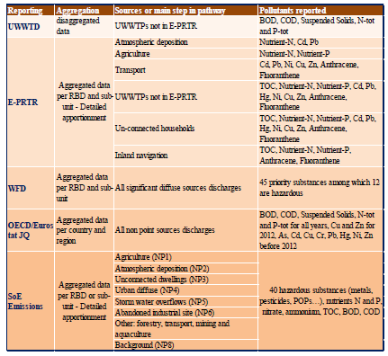
Diffuse emission reports, aggregation level and sources, pathways and pollutants
WISE-SoE Emissions data with specific classification of diffuse sources
https://www.eionet.europa.eu/etcs/etc-icm/products/etc-icm-reports/emissions-of-pollutants-to-europes-waters-sources-pathways-and-trends

Slide 8
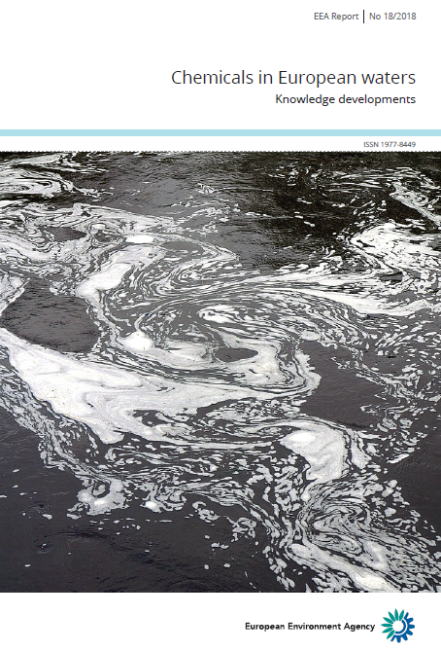
Focusing on “top 15” priority substances - I
Nonylphenol (t / a)
Loads given in these figures cannot be summed, as there may be double counting
https://www.eea.europa.eu/publications/chemicals-in-european-waters

Slide 9
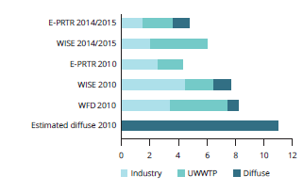
Focusing on “top 15” priority substances - II
Nickel (t / a)
Mercury (t / a)
Loads given in these figures cannot be summed, as there may be double counting
https://www.eea.europa.eu/publications/chemicals-in-european-waters

Slide 10
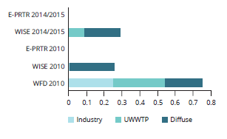
Focusing on “top 15” priority substances - III
Isoproturon (t / a)
Benzo(a)pyrene (t / a)
Loads given in these figures cannot be summed, as there may be double counting.
CAUTION — low confidence in data, as there has been limited reporting of these substances.
https://www.eea.europa.eu/publications/chemicals-in-european-waters

Slide 11
No. Member States with emissions data for the 15 priority substances most frequently causing failure to achieve good chemical status under WFD
https://www.eea.europa.eu/publications/chemicals-in-european-waters

Slide 12
Effectiveness of point source control
https://www.eea.europa.eu/publications/chemicals-in-european-waters

Slide 13
Findings on emissions reporting
Little reporting on diffuse sources;
Limited reporting on urban wastewater treatment plant (UWWTP) effluents (not all UWWTPs, not all relevant pollutants);
Unclear quality of emission data from industrial sources (not all facilities, not all relevant pollutants);
Inconsistent reporting in time and space (no comparable and consistent time ranges and not all river basin districts reported);
Double reporting or reporting gaps (WFD, European Pollutant Release and Transfer Register/E-PRTR, WISE-SoE, UWWTD).

Slide 14
ETC-ICM task 2019-
Provide an analysis with options for harmonisation of the reporting of emissions to water in E-PRTR, UWWTD, WFD and WISE SoE;
Run a process for exchange of information on methods of quantifying diffuse sources;
Produce a paper with proposals for harmonisation

Slide 15
Opportunities and solutions to challenges for UWWTPs
https://forum.eionet.europa.eu/nrc-eionet-freshwater/library/urban-waste-water-treatment/urban-waste-water-treatment-challenges-and-opportunities

Slide 16
Diffuse pollution from non-connected dwellings
Ricardo/EEA, In preparation

Slide 17
Questions?
Thanks to: Reporters; Joost van den Roovaart, Nanette van Dujnhoven, Hana Prchalová, Silvie Semerádová, Miroslav Fanta (ETC-ICM); Marek Staron, Fernanda Nery, Peter Kristensen (EEA).

Slide 18
WISE-1 datacall
picture=feedback

Slide 19
WISE-1 reporting summary statistics
25 countries delivered data in 2017, 14 in 2018
Data available in range from 1985 - 2017
2018 collection closed 21st January 2019
Waterbase published 10th April. (Update expected summer 2019 was not possible.)

Slide 20
WISE-1 reporting summary statistics
E-PRTR data (“yes“) – delivered in 2017 and 2018
Year | No. countries reporting | No. records | No. records not passing QA | No. countries with records not passing QA
2015 | 11 | 2660 | 79 | 2
2016 | 11 | 1050 | 57 | 2
2017 | 7 | 397 | 47 | 1

Slide 21
Reporter view – WISE 1
Lacks data. Few countries report diffuse sources with long time series.
Point sources, many countries only report E-PRTR data (or EEA import the E-PRTR data). Point sources reporting could be improved
0 – values are not allowed
Data removal is only possible by special request
Diffuse sources are a big gap

Slide 22
Questions?
wisesoe.helpdesk@eionet.europa.eu
Caroline.whalley@eea.europa.eu

