Slide 1
Kari Austnes, Lidija Globevnik, Gašper Šubelj, Anne Lyche Solheim, Webinar on WISE-6, 29.09.2022
Nutrients and oxygen consuming substances in freshwater in Europe

Slide 2
Overview
Indicators CSI019 and CSI020
New format and latest update
Technical issues
WISE-6 biological data

Slide 3
The CSI019 and 020 indicators
CSI019: Oxygen consuming substances in European rivers
CSI020: Nutrients in freshwater in Europe
Large inputs of nutrients or organic pollutants can lead to eutrophication or de-oxygenation
Negative ecological impacts: Changes in species composition, species loss
Negative impacts on the use of water: Drinking, bathing, recreation
Main sources: Waste water and agriculture
Objective of several directives: WFD, UWWTD, DWD, ND
Trends: Are conditions improving?
Current status: Where do we see the largest problems now?

Slide 4
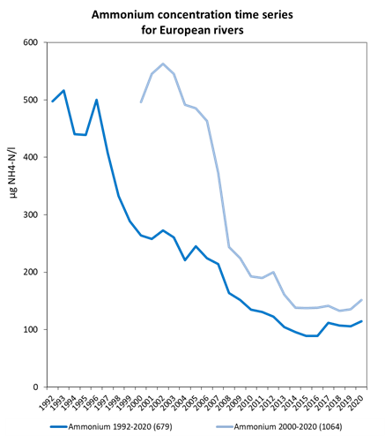
Time series: oxygen consuming substances
All sites with time series from 1992 or 2000 and gaps < 3 years
Notes:
Marked decrease, then apparent stabilisation

Slide 5
Time series: nutrients
Notes:
SW: Apparent stabilisation in recent years, especially for rivers
GW: Similar numbers of increasing and decreasing trends. 2018 peak due to FR

Slide 6
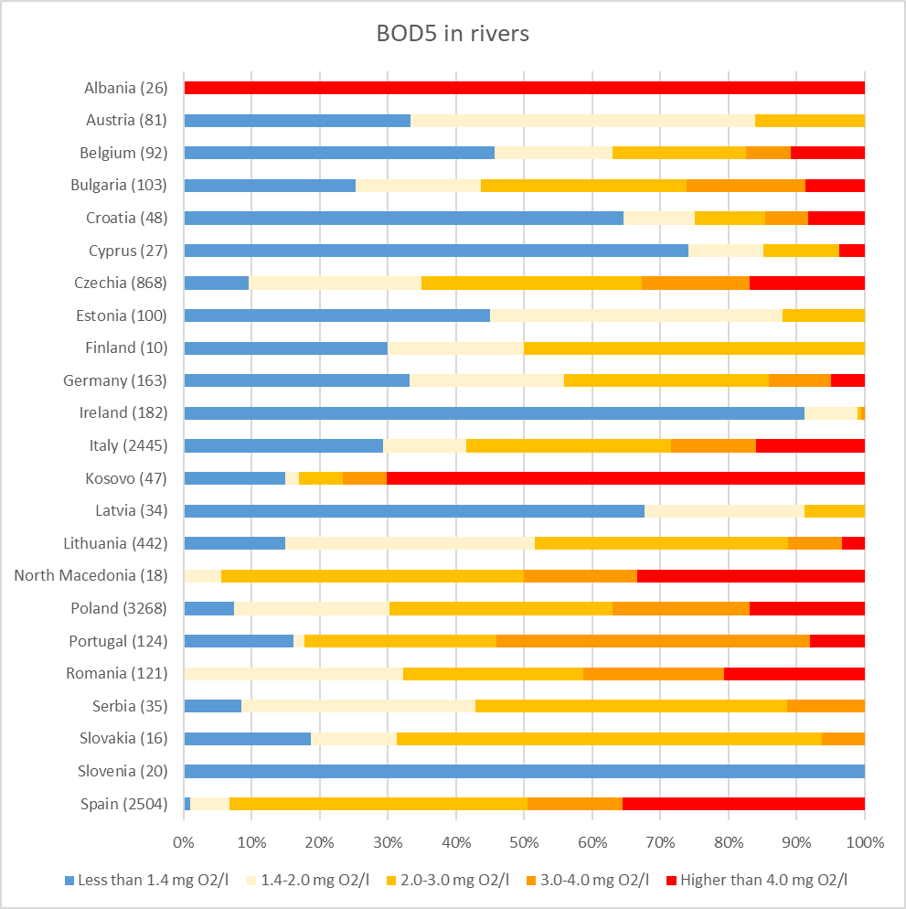
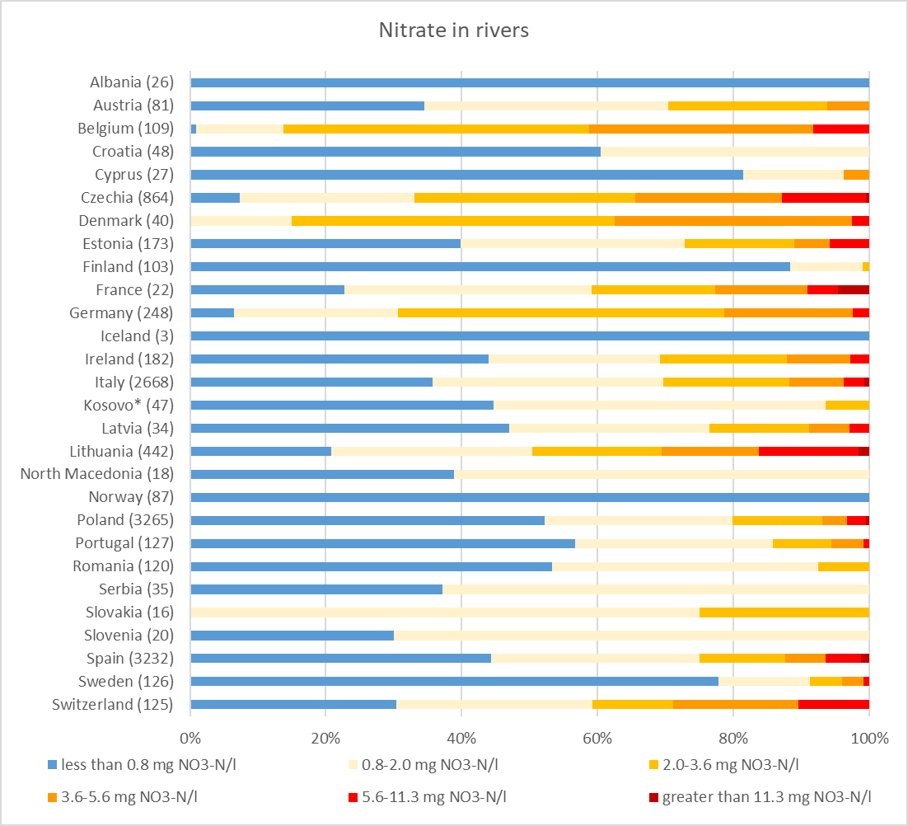
Current status
All sites with data in 2018-2020: Far more sites than for time series
Concentration classes not mainly linked to policies: Objective to show distribution and compare
Notes:
3 mg O2/l: Fish Directive
11.3 mg NO3-N/l: ND/DWD – corresponds to 50 mg NO3/l

Slide 7
New format EEA indicators
Short and concise
Two plots: Aggregated (Europe) and disaggregated (country)
Brief descriptive text and supplementary information
No possibility to show country time series
First version 2022
Time series for all determinands
Current status plot only for one determinand
Limited information on trend statistics
Notes:
https://www.eea.europa.eu/ims/nutrients-in-freshwater-in-europe
https://www.eea.europa.eu/ims/oxygen-consuming-substances-in-european-rivers

Slide 8
Further improvements
Technical improvements to existing indicator
Links to current status plots for the other determinands
Links to statistical tables
Separate document with more detailed methodology descriptions
Notes:
Depending on further developments

Slide 9
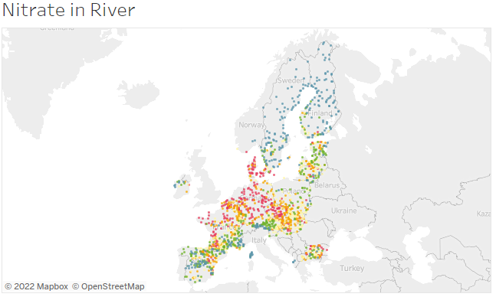
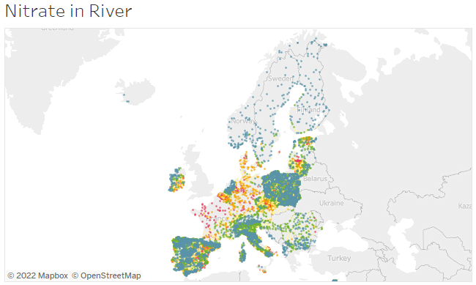
Further improvements
Improved analyses
More advanced statistical treatment of time series data
Make full use of the reported data – far better spatial coverage
Concentration classes in current status plots based purely on distribution (e.g. quintiles)
Avoid misinterpretation
1992
2020
Notes:
The intention is to work on this in 2023

Slide 10
Further sources of information
The longer (old) indicator versions have also been updated
Aim to make them available in WISE freshwater
Dashboards provide further possibilities for data exploration and quality control
Aim to publish selected dashboards

Slide 11
Data – quality control – what we do
Both automatic and manual quality control (QC)
Flagged records frequently excluded from analyses (depending on the flag)
Dataset should be as correct but also as extensive as possible
QC issues discovered and summarised per country
Will get back to you with specific questions as far as time allows
Manual QC mainly focused on the near-complete time series
If we start to include all sites in the time series analysis, detailed data examination will be difficult
Your help in improving the data quality is (as always) very valuable

Slide 12
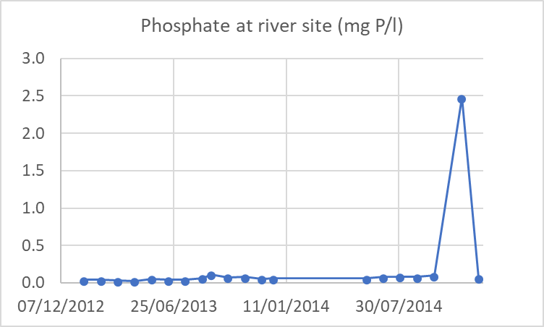
Data – quality control – how you can help
Reported data are available through discodata or direct download
Please check
Metadata statements: QC flags with explanation
Flagged records can be re-submitted as corrected (new values) or confirmed (resultObservationStatus = ‘A’) (Use the 'A' observation status flag to confirm that the given record is correct. The flag should not be applied to all valid records. It is intended for confirmation of extremely high or low values or for other special cases where confirmation is needed or is relevant)
monitoringSiteIdentifier | parameterWaterBodyCategory | observedPropertyDeterminandLabel | resultUom | phenomenonTimeSamplingDate | resultObservedValue | resultObservationStatus | metadata_statements
 | RW | Phosphate | mg{P}/L | 20141119 | 2.479 |  | QC_OUTLIER_STDEV: Possible outlier - fails in the standard deviation limit test
Notes:
Discodata: https://discodata.eea.europa.eu/#
Downloading waterbase: https://www.eea.europa.eu/data-and-maps/data/waterbase-water-quality-icm-2

Slide 13
Data – quality control – how you can help
Please check
Site list:
Changes in site codes over time? Data from the same site are registered to different sites – loss of long time series (e.g. many time series from a country end in 2012 while others start in 2013)
Some countries have reported a large number of sites with very few years of data in the past – should these sites be part of our new time series analysis?
Unit errors: Mix-up of NO₃-N and NO₃ or NH₄-N and NH₄
Seen as break-points in time series across all/most sites from a country
If discovered records will have the flag QC_OUTLIER_EXPERT_YEAR

Slide 14
Data - LOQ
Observed values not used when reported as below LOQ
Currently replaced by LOQ value in analyses
Changes in data dictionary: No need to report observed value when <LOQ
Important that LOQ value is reported and correct
New QC test on max LOQ in CDR
Feedback welcome
Older data with unreasonably high LOQ will be flagged and excluded
Flagged records can be checked and corrected
Sometimes both the LOQ value and the <LOQ reporting seem wrong (i.e. reported observed value seems reasonable)
observedPropertyDeterminandCode | observedPropertyLabel | resultUom | maxLOQ
CAS_14798-03-9 | Ammonium | mg{NH4}/L | 0.064
EEA_3133-01-5 | BOD5 | mg{O2}/L | 1.2
EEA_3133-02-6 | BOD7 | mg{O2}/L | 1.2
EEA_3164-01-0 | Chlorophyll a | ug/L | 2
EEA_3133-05-9 | Dissolved organic carbon (DOC) | mg{C}/L | 1
CAS_14797-55-8 | Nitrate | mg{NO3}/L | 0.89
CAS_14797-65-0 | Nitrite | mg{NO2}/L | 0.066
CAS_14265-44-2 | Phosphate | mg{P}/L | 0.02
EEA_3133-06-0 | Total organic carbon (TOC) | mg{C}/L | 1
EEA_3161-02-2 | Total oxidised nitrogen | mg{N}/L | 0.2
CAS_7723-14-0 | Total phosphorus | mg{P}/L | 0.03

Slide 15
Data – fraction
Please report the correct fraction
Fraction is part of the criteria when we select data to use
Several examples of impossible reporting
e.g. BOD5 in spm fraction or total organic carbon in dissolved

Slide 16
Data – and finally..
Please report disaggregated data when available

Slide 17
WISE-6 biological data
WISE data used also to study biological responses
Essential for evaluating responses to measures
How can we study this?
Linking pressure-state-impact data
Data sources:
WISE-6 biology: Chlorophyll a, Cyanobacteria biomass and percentage, Total phytoplankton biomass (and Secchi depth)
WISE-2 EQR (Ecological Quality ratio) of different biological quality elements
WFD ecological status of different biological quality elements
WFD pressures and WISE-1 emissions
New biological indicators under development

Slide 18
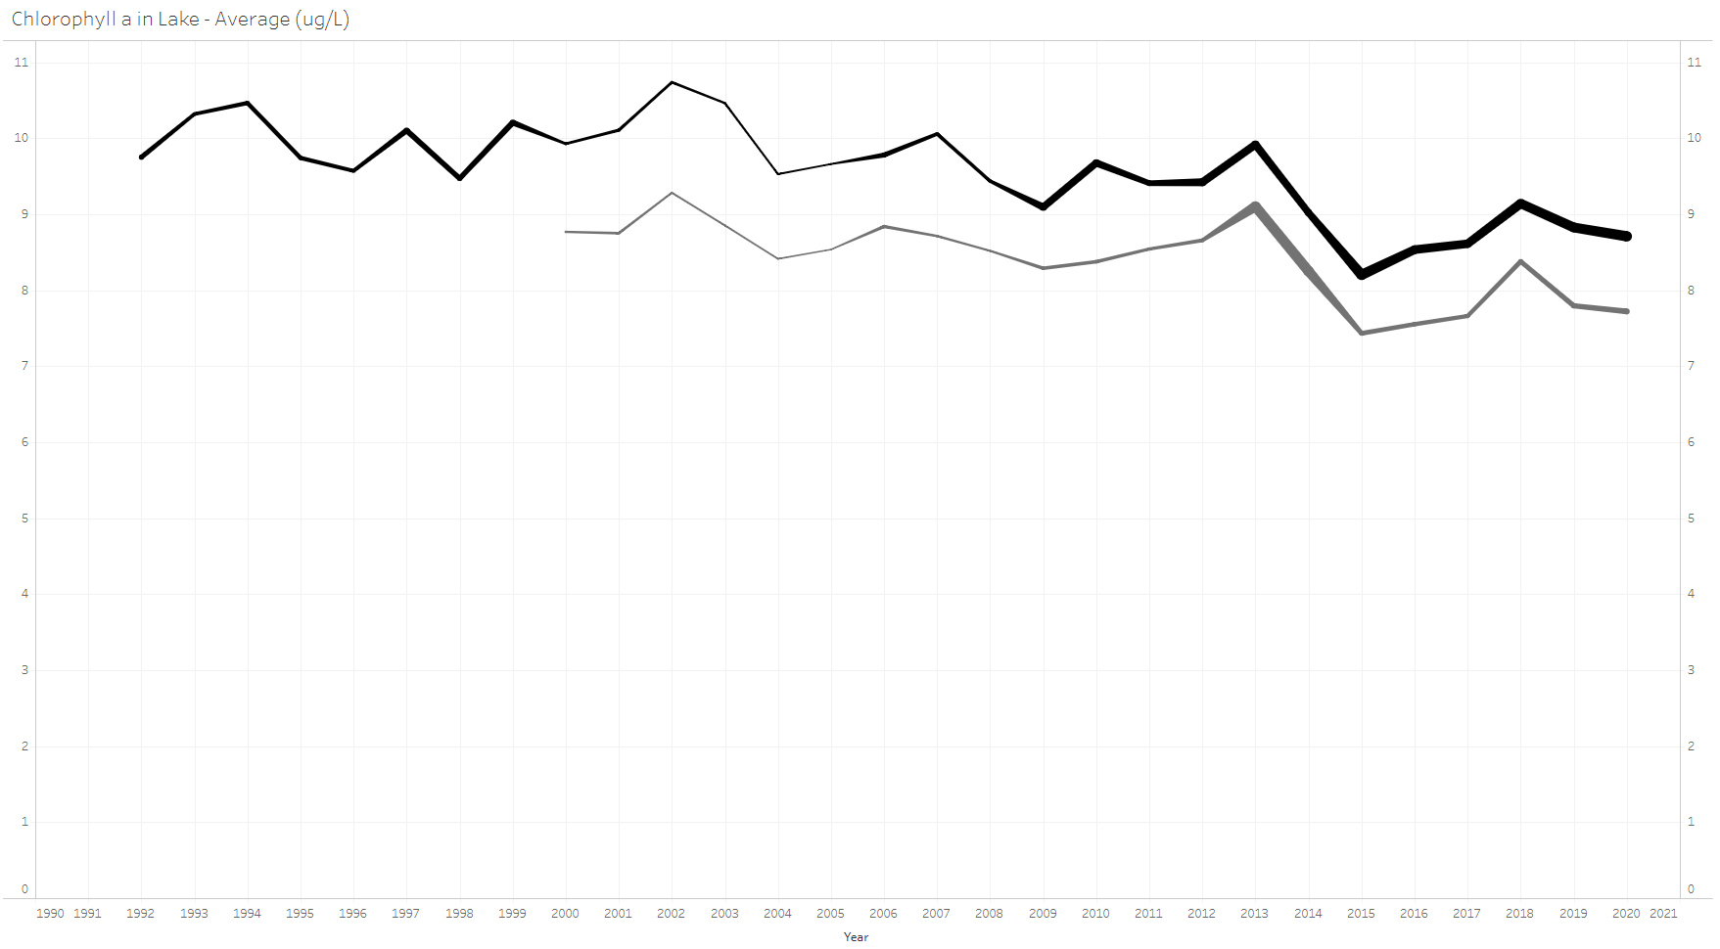
Chlorophyll a time series
Many complete time series available for lakes
More data in the full dataset
Reporting steadily increasing in some countries
Dataset dominated by some countries
Increased reporting would improve representativity
Chlorophyll a in lakes (µg/l)
10
156
8
285
6
4
2
1990
2000
2010
2020

Slide 19
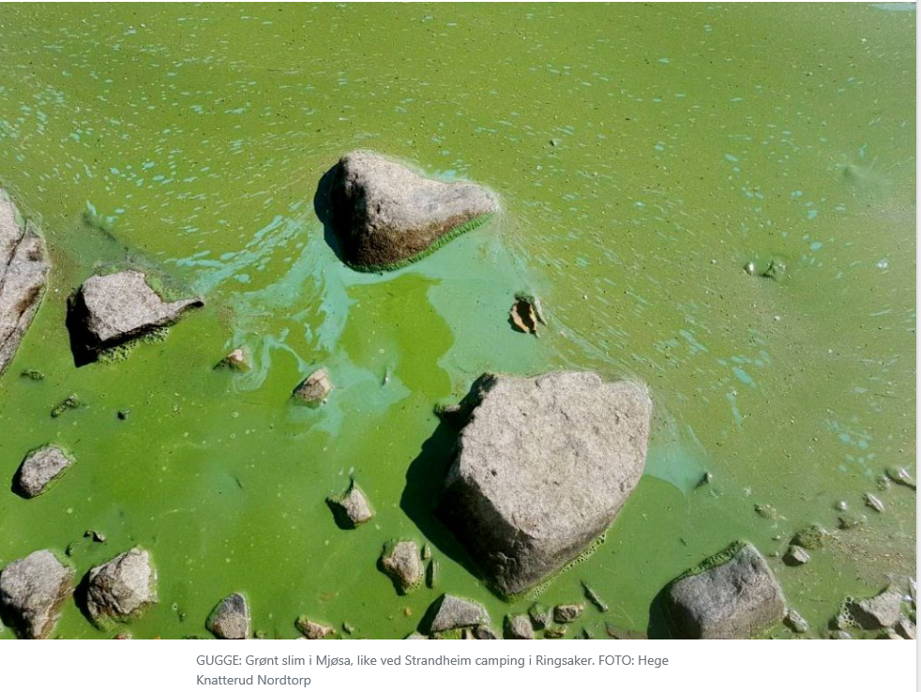
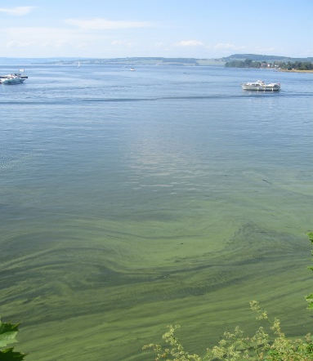
Impact of eutrophication and CC on human health
Cyanobacteria:
Cyanobacteria are a threat to many ecosystem services and seems to increase with climate change
Warming – more rapid growth
Higher frequency of extreme rain events - more nutrient run-off from agricultural land and wastewater overflows
How are the cyanobacterial blooms developing in Europe?
Highly relevant topic, but currently too few countries report data to allow a representative picture, and time series are short
What are the bottlenecks to reporting? Feedback very welcome
Cyanobloom in Norway’s largest lake Mjøsa in 2019, the same happened in 2021

Slide 20
Globevnik Lidija, Kari Austnes, 15.10.2021
For reporting!!

