Slide 1
WISE-2: Biology data reporting to EEA Current content, data dictionary, reporting tools, challenges and solutions
Jannicke Moe (NIVA, ETC/ICM)
WISE-2 Webinar 12.10.2021
Notes:
https://www.freshwaterecology.info/index.php

Slide 2
Outline
WISE-2 data flow - brief introduction
WISE-2 content - overview
WISE-2 data for indicator assessment - examples
WISE-2 reporting and data dictionary - overview
WISE-2 quality issues and solutions

Slide 3
WISE-2 data flow – brief introduction

Slide 4
Added values of the biology data flow
Can show trends in ecological status at the European scale
Biology is more important for than abiotic elements, per definition
Recovery of biological elements can take longer time than abiotic elements
Higher resolution than the WFD ecological status class:
Ecological status as continuous values (scale 0-1)
Ecological Quality Ratios (EQR) can detect trends within status classes
Normalised EQR values (nEQR) are comparable across countries
Conversion from EQR to nEQR is done by EEA/ETC (or by reporters)
Information on national classification systems is requested
Notes:
- Anne probably talked about this already – I can refer to her

Slide 5
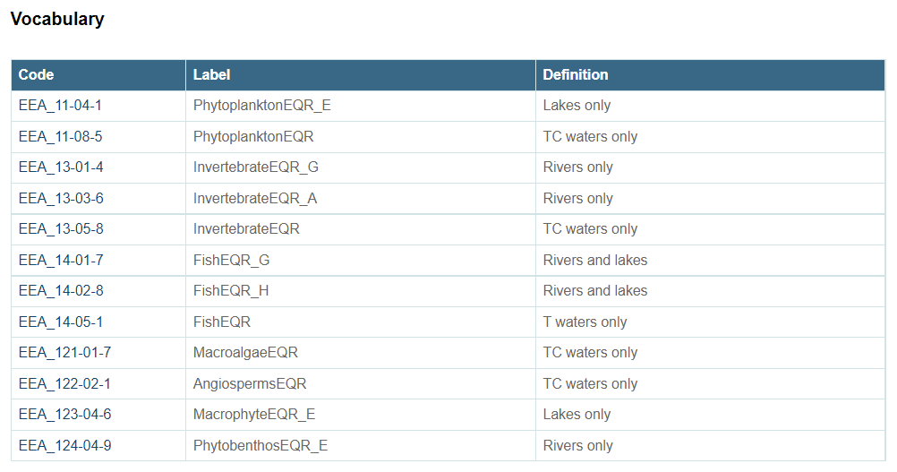
Valid biology determinands & water categories
A = Acidification, E = Eutrophication, G = General degration, H = hydromorphologic
http://dd.eionet.europa.eu/dataelements/latest/observedPropertyDeterminandBiologyEQRCode
Notes:
If you try to report some a wrong combination of determinand & water category, will get error message (blocker?)
(Will get back to this towards the end)
Suffices – historical reasons (FW vs. marine diverged and were later merged...)
@Marek: suffices are not explained anywhere in DD? (_E)

Slide 6
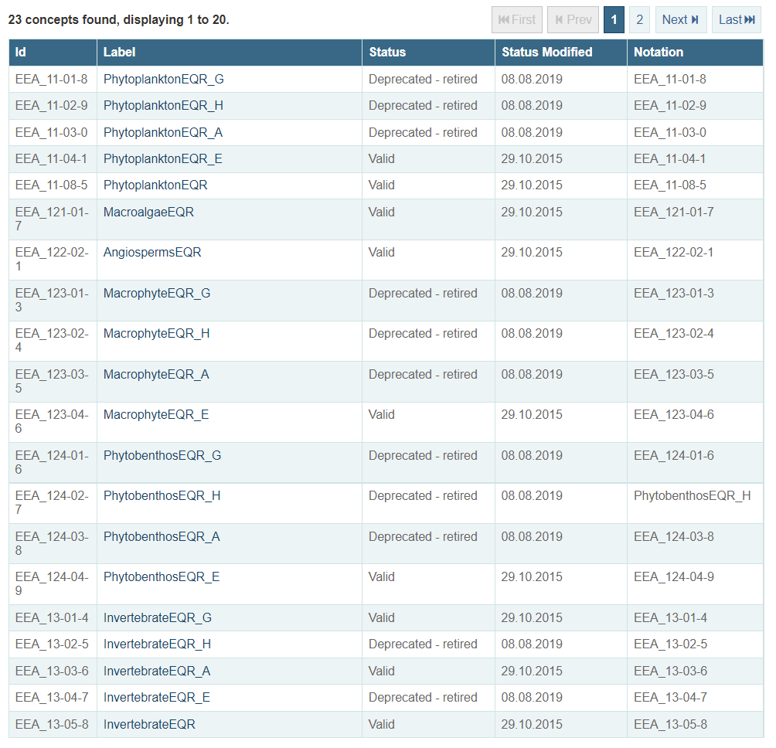
Some biology determinands have been retired
Existing data: some of the retired determinands are still used in indicator tables (e.g. both PhytoplanktonEQR_G + PhytoplanktonEQR_E)
New data: only valid determinands will be accepted (e.g. PhytoplanktonEQR_E)
https://dd.eionet.europa.eu/vocabulary/wise/ObservedPropertyBiologyEQR

Slide 7
Why WISE-2? National vs. normalised EQRs
Calculation of nEQR requires EQR-scale class boundaries specific for each
country
water category
determinand (BQE, impact type)
waterbody type
natural/AWB/HMWB
Notes:
What is special for biology data – compared to e.g. water chemistry (WISE-6):
Chemistry reported as metrics – no conversion

Slide 8
Why WISE-2? National vs. normalised EQRs
Calculation of nEQR requires EQR-scale class boundaries specific for each
country
water category
determinand (BQE, impact type)
waterbody type
natural/AWB/HMWB

Slide 9
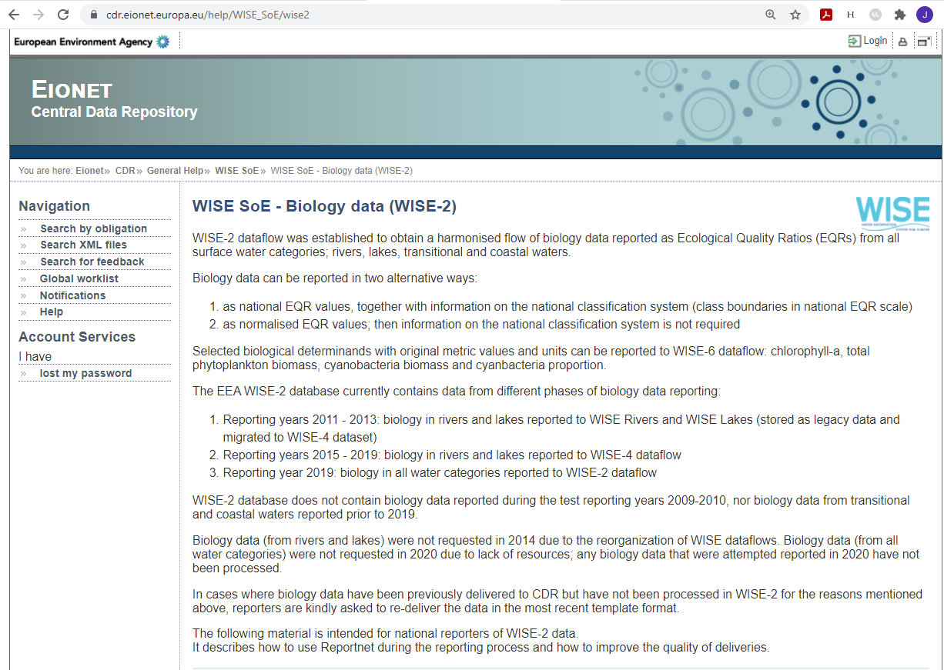
General information: Central Data Repository
Notes:
Anne probably talked about this already – I can refer to her
Mention WISE-6 webinar for more info

Slide 10
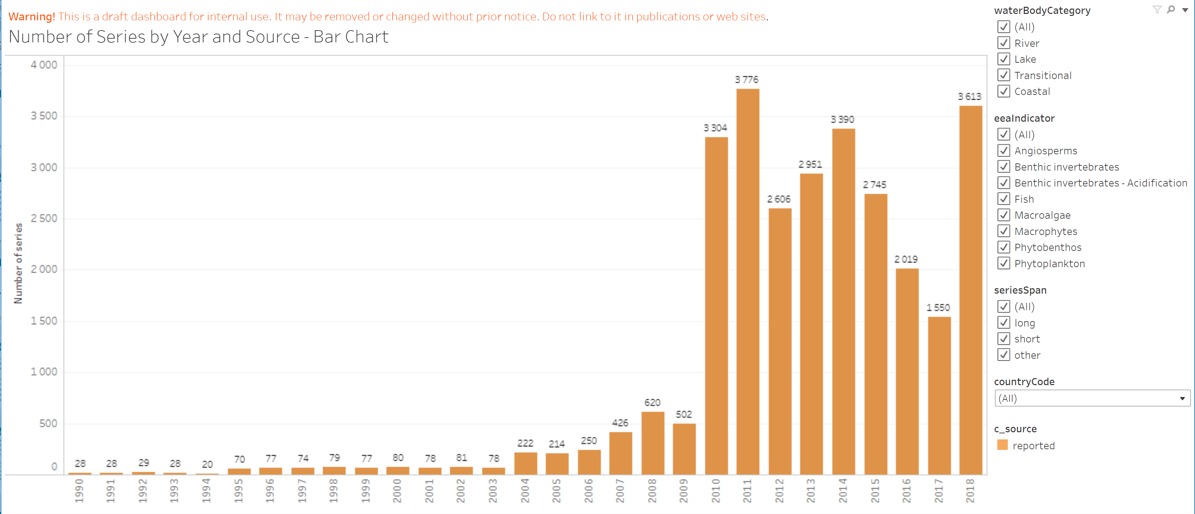
????
The main phases of biology data reporting
Number of biology indicator values by year
NB: Reporting year ≥ Monitoring year +1
WISE-SOE reorganisation in 2014 ➔ reporting decreased
WISE-2 webinar in 2019 ➔ reporting doubled
WISE-2 webinar in 2021 ➔ ???
2019
2020
Monitoring year
Reporting of older data
Reorganisation of WISE-SOE 2014
WISE-2 webinar 2021
Reporting 2011-2013
WISE-2 webinar 2019
Reporting 2015-2019
Test reporting 2009-10
Suspension 2020
Notes:
Reorganisation not a problem in itself, but drained much resources – none for indicator work. Also less motivation because data were not used?
Catch 22: not used because not representative...
Indicators: anything that can be used - w/wo EQR

Slide 11
Old work flow (- 2019)
Polish this slide
NFP
EEA
@Nery/Marek: What is the best label for this DB?
Automatic QC
Monitoring data
Class boundaries
Status classes
EQR
(nEQR)
Class boundaries
Status classes
EQR
nEQR
Central Data Repository
WISE-2 Production
Class boundaries
Status classes
EQR
nEQR
Publication
Waterbase
Delivery to CDR
WISE maps
Biology in rivers and lakes
Download files from each country folder
Upload to EEA
Final QC
ETC/ICM (J. Moe)
Class boundaries
Status classes
EQR
nEQR
Class boundaries
Status classes
EQR
nEQR
Local working DB
Local delivery DB
Clean
Communication with reporters
Content-based quality check
Supporting data call preparation
Calculate nEQR
Interpolation of time series
Aggregation to indicator level
Other data processing
Overviews
Trend
analyses
Maps
Reports
Notes:
Products from local working DB: static products

Slide 12
New work flow for WISE-2 (2020 - )
Waterbody info from WFD
Calculation of nEQR
Interpolation of time series
Aggregation to indicator level
Other data processing
EEA
NFP
Automatic QC
Class boundaries
Status classes
EQR
(nEQR)
Class boundaries
Status classes
EQR
nEQR
Central Data Repository
Harvest
Production
Class boundaries
Status classes
EQR
nEQR
Publication
Waterbase
Monitoring data
Delivery to CDR
ETC/ICM
Communication with reporters via EIONET Helpdesk
Content-based quality check
Supporting data call preparation
Further development of biology indicator
Reports
Overviews
Trend
analyses
Maps
Dynamic dashboards – work in progress
Notes:
Discussion with EEA about use of blocker vs. error vs. warning
Stricter response -> more efficient for both reporters and EEA/ETC

Slide 13
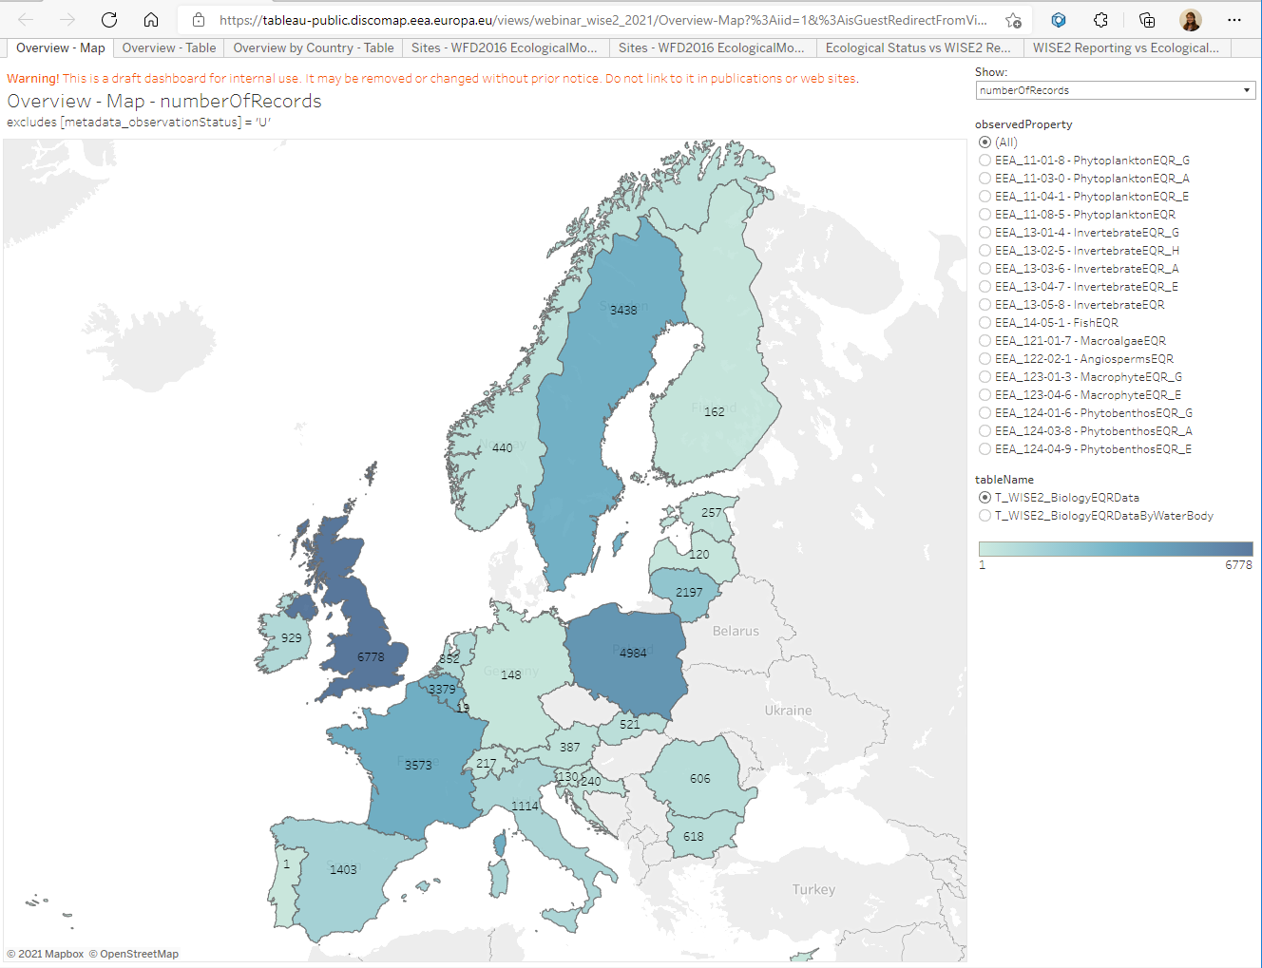
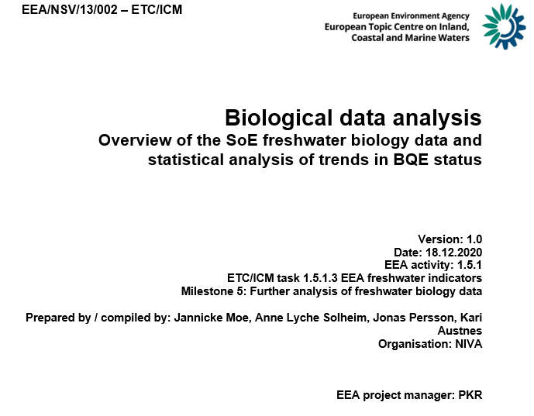
Visualisation of content: old vs. new work flow
Static:
Internal report to EEA, December 2020
Rivers & Lakes only
Dynamic:
Online dashboards based on updated WISE tables, work in progress All water categories
Notes:
Notes:
NB: dashboards are still under development
Based on WISE-6 (water quality) – but needs more adaptation to WISE-2
NB: should ignore years <2010
Welcome to put comment in chat, or in email to me? (What does Nery prefer?)

Slide 14
2. WISE-2 content - overview

Slide 15
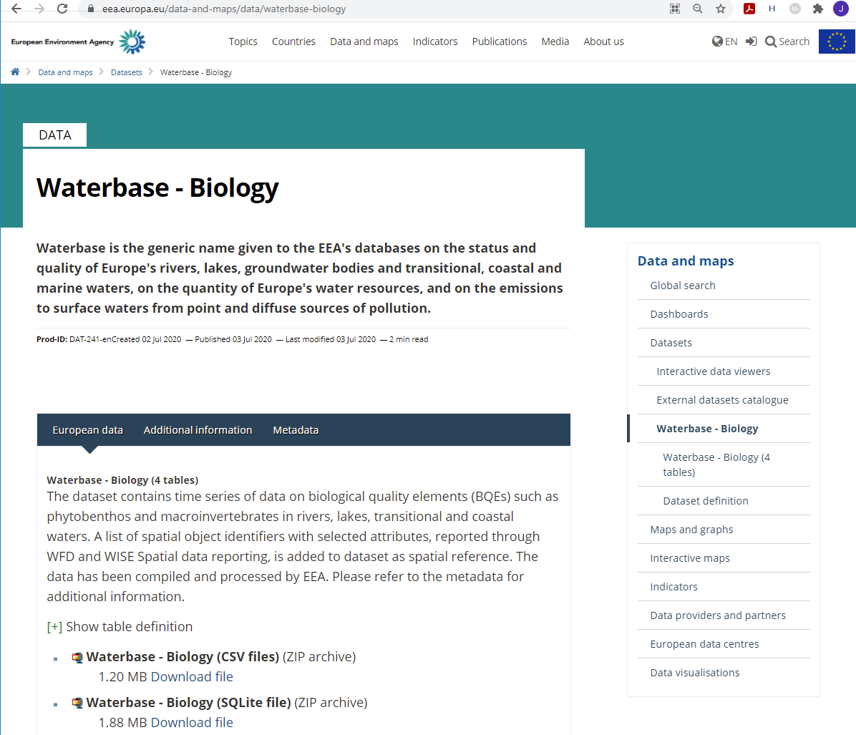
EQR data published in Waterbase - Biology
Last published in July 2020
Monitoring year until 2018
4 tables:
BiologyEQRData (nEQR)
BiologyEQRDataByWaterBody
BiologyEQRClassificationProcedure
SpatialObject_DerivedData (Latitude, longitude, etc.)
(Chl-a and cyanobacteria data: in Waterbase – Water Quality ICM)
Notes:
From Waterbase you get everything in one file...

Slide 16
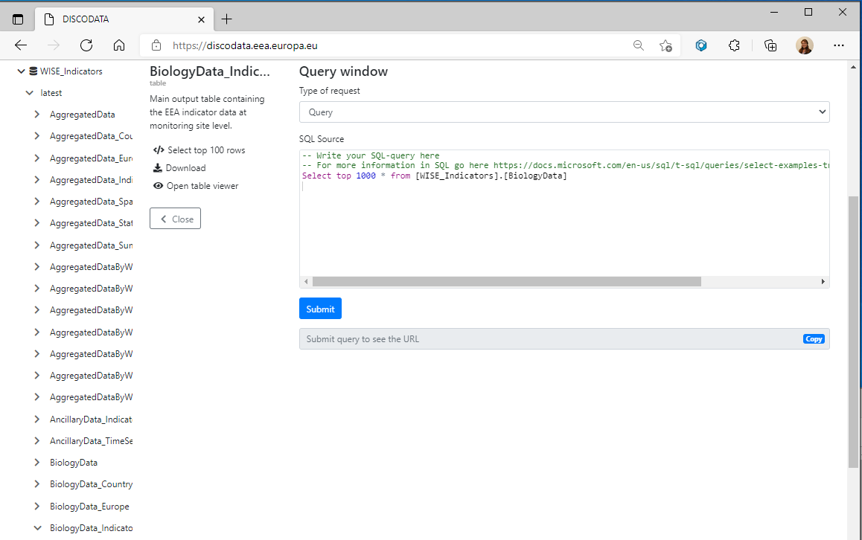
WISE indicator tables can also be accessed from Discodata
Indicator tables: nEQR values aggregated to Waterbody level
More user-friendly format than raw data from Waterbase
Notes:
Raw waterbase data will be accessible from Discodata later
Discodata purpose - serve other computers (API), not humans

Slide 17
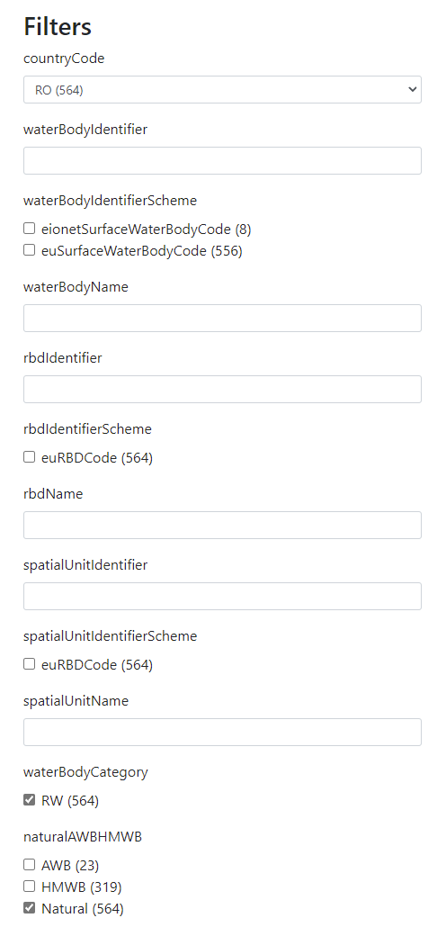
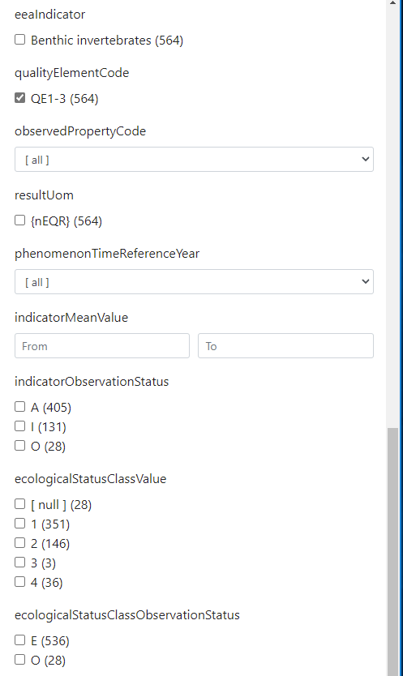
WISE indicator tables can also be accessed from Discodata
Many options for filtering data
Country
Water category
Biological quality element
Year
etc.

Slide 18
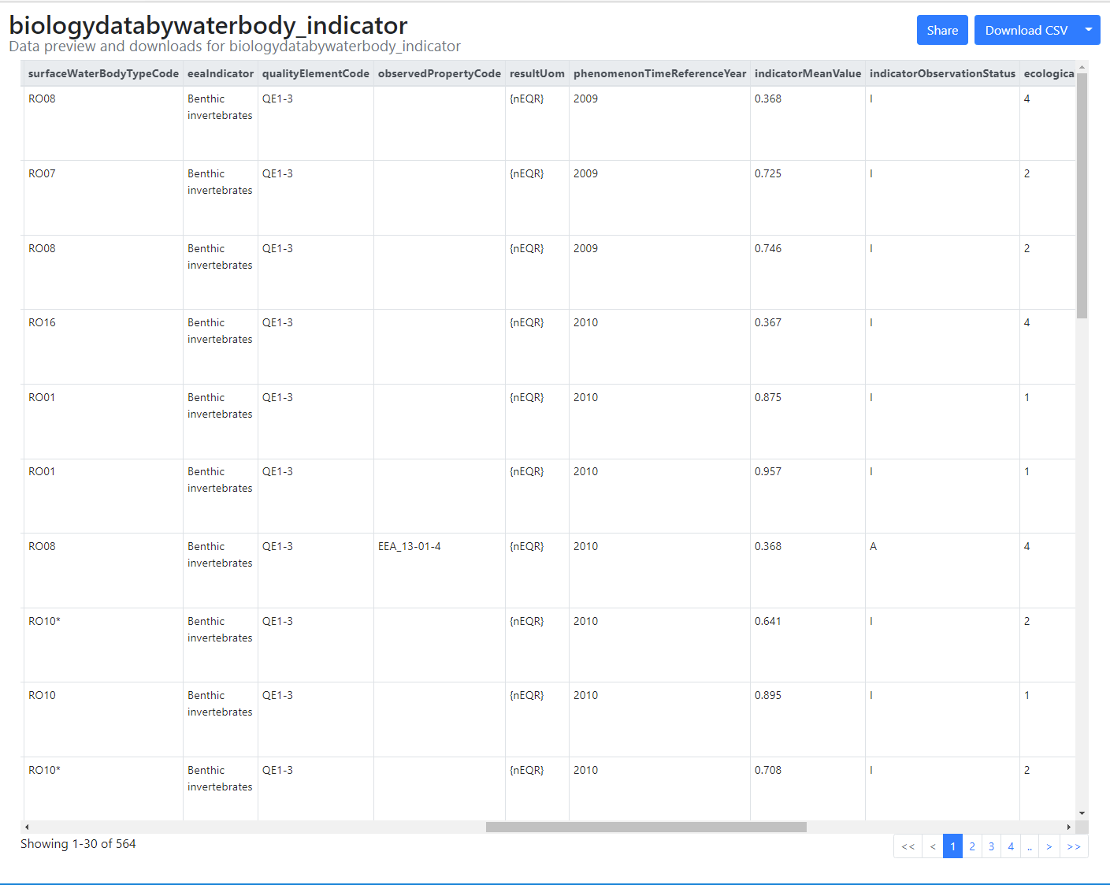
WISE indicator tables can also be accessed from Discodata
Example: filtered indicator table can be downloaded from Discodata
Main output:
IndicatorMeanValue = normalised EQR
Ecological status class

Slide 19
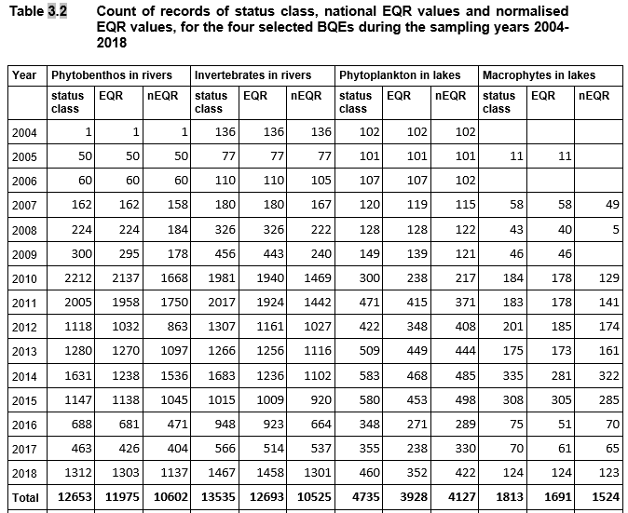
Data reported per year & BQE: RW & LW
Notes:
Notes:
- Showing data for freswhater only.
Records are aggregated to waterbody level.
Not included: 230 records of FishEQR in RW and LW from NL. Records from TW and CW. One series of phytobenthos values 1992-2003, 3 values of macrophytes 2003.
EQR is reported
nEQR is used in assessments
Status class alone can also be used e.g. for maps, but not for trends
Mention fish...

Slide 20
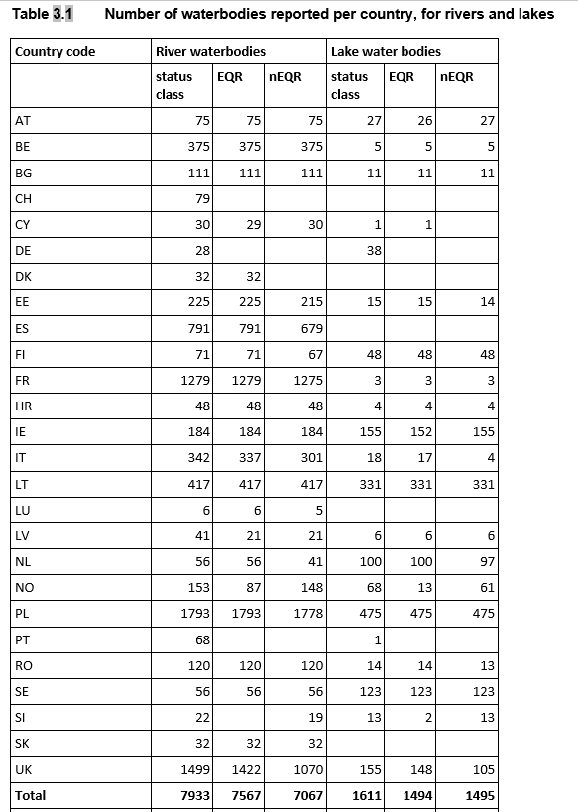
Data reported per country and water category: RW & LW
Notes:
Notes:
Here: latest reported value!
Many countreies have reported many WBs!!
But not every year
and some still missing

Slide 21
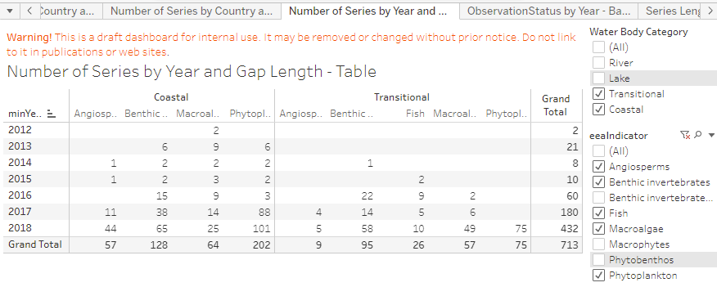
Data reported per year & BQE: TW & CW
Number of "indicator values" =
yearly aggregated
nEQR values (BQE x waterbody)
(NB: some data may still be excluded due to quality issues)
Number of biology indicator values by year - Table
Notes:
Notes:
- Showing data for freswhater only.
Records are aggregated to waterbody level.
Not included: 230 records of FishEQR in RW and LW from NL. Records from TW and CW. One series of phytobenthos values 1992-2003, 3 values of macrophytes 2003.

Slide 22
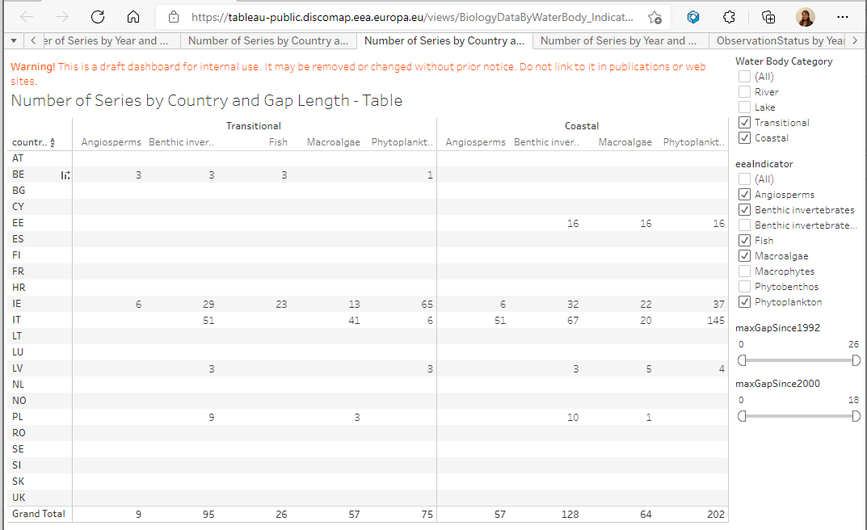
Data reported per country and water category: TW & CW
Number of biology indicator values by country - Table
Number of "indicator values" =
yearly aggregated
nEQR values (BQE x waterbody)
(NB: some data may still be excluded due to quality issues)
Notes:
Notes:
black = nEQR not available
brown = moderate or worse (for AWB or HMWB)

Slide 23
3. WISE-2 data for indicator assessment - examples

Slide 24
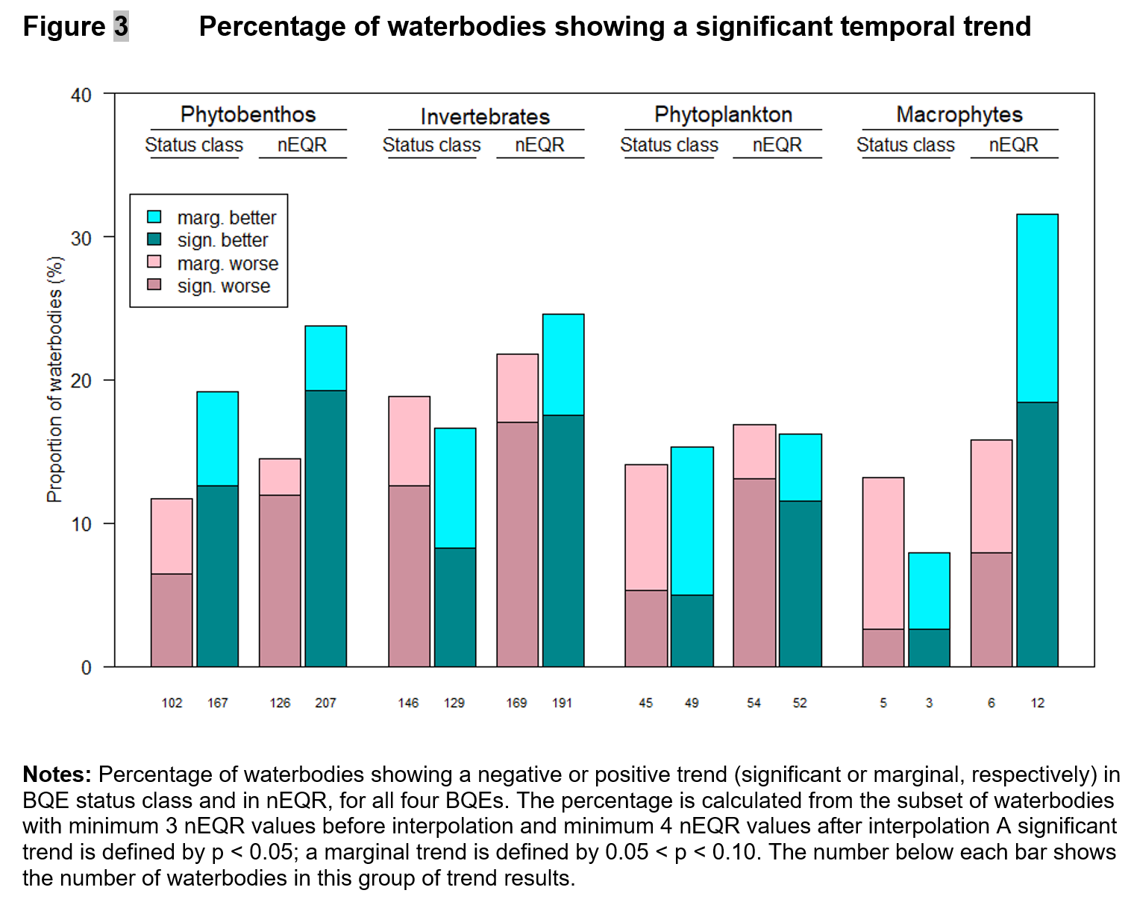
Trends in ecological status: nEQR vs. status class
Method: non-parametric trend test (Mann-Kendall)
Water bodies with data from ≥4 years (after interpolation)
Probability of detecting a significant trend in a series increases with
the number of values (years)
the number of monotonously increasing or decreasing steps
Analysis of nEQR values reveals more significant trends than analysis of status class
Notes:
Notes:
NB: Status class instead of nEQR
Graphs with time series: showing examples of different
(1) number of years (➔ more sign. trend)
(2) duration / frequency (➔ must be considered when aggregating time series from different stations by average)
(3) temporal variability (➔ less sign. trend)

Slide 25
Trends in ecological status: nEQR vs. status class
Examples of individual series with inconsistent trend in nEQR vs. status class
Trend detected in nEQR, but not in status class (99 water bodies, until 2017)
Trend detected in status class, but not in nEQR (25 water bodies, until 2017)
Notes:
Notes:
Graphs with time series: showing examples of different
(1) number of years (➔ more sign. trend)
(2) duration / frequency (➔ must be considered when aggregating time series from different stations by average)
(3) temporal variability (➔ less sign. trend)

Slide 26
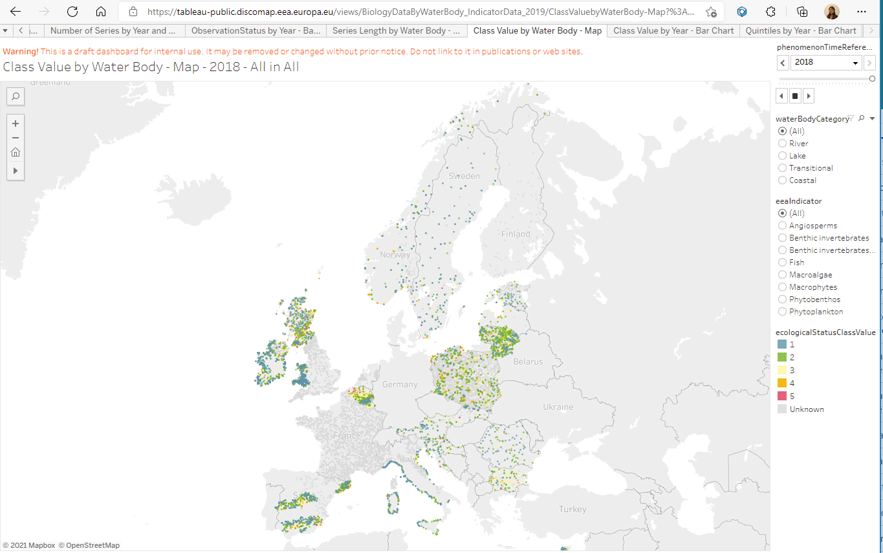
Dynamic maps
User can select:
year
water category
BQE
status class
scale
Grey dots: station with data from other years
(NB: some data may still be excluded due to quality issues)
Notes:
Notes:
black = nEQR not available
brown = moderate or worse (for AWB or HMWB)

Slide 27
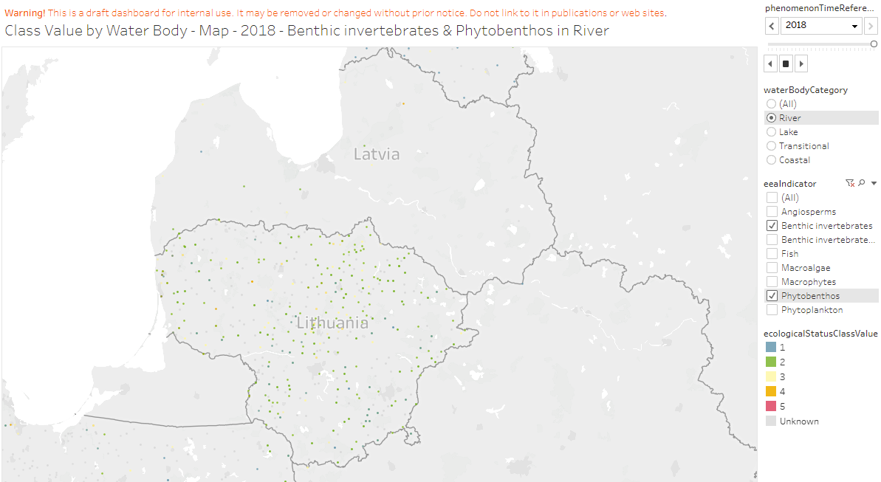
Dynamic maps - dashboards
User can select:
year
water category
BQE
status class
scale
Grey dots: station with data from other years
Pop-up windows with more information for each waterbody
(NB: some data may still be excluded due to quality issues)
Notes:
Notes:

Slide 28
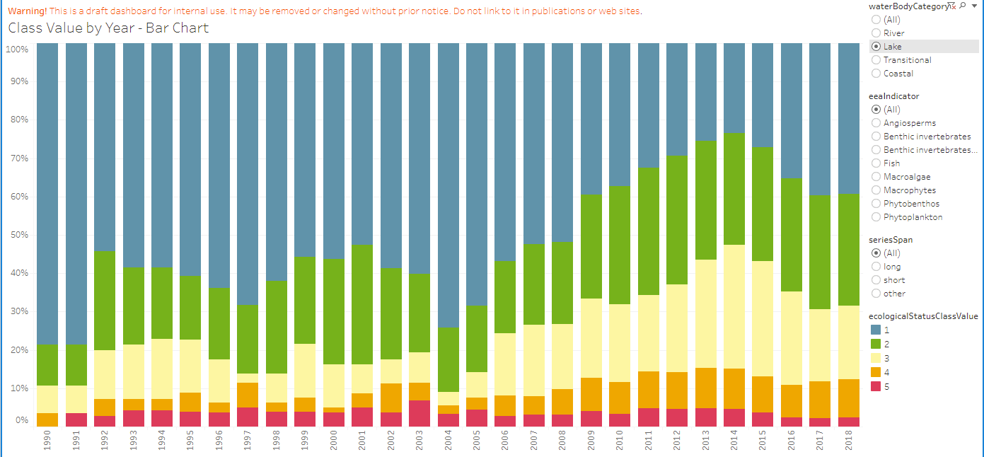
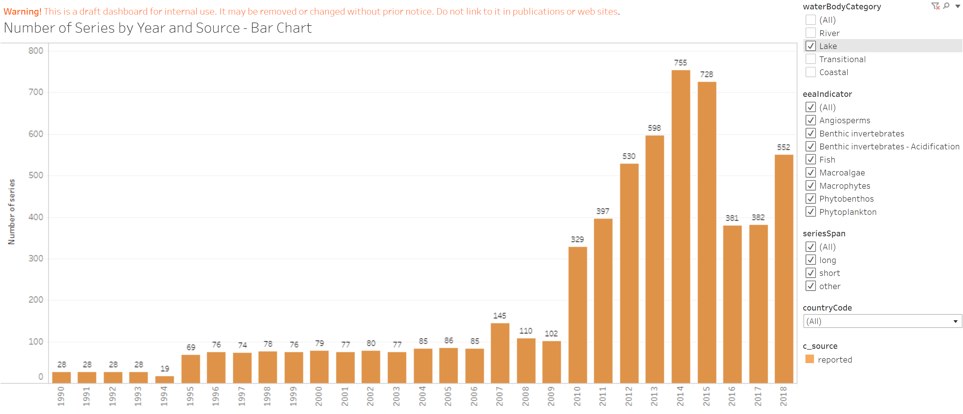
Dynamic bar charts
User can select:
water category
BQE
status class
span of time series [work in progress]
Total number of waterbodies should be taken into account for interpretation
Notes:
Notes:
NB: Purpose is to display & insect all data that have been reported

Slide 29
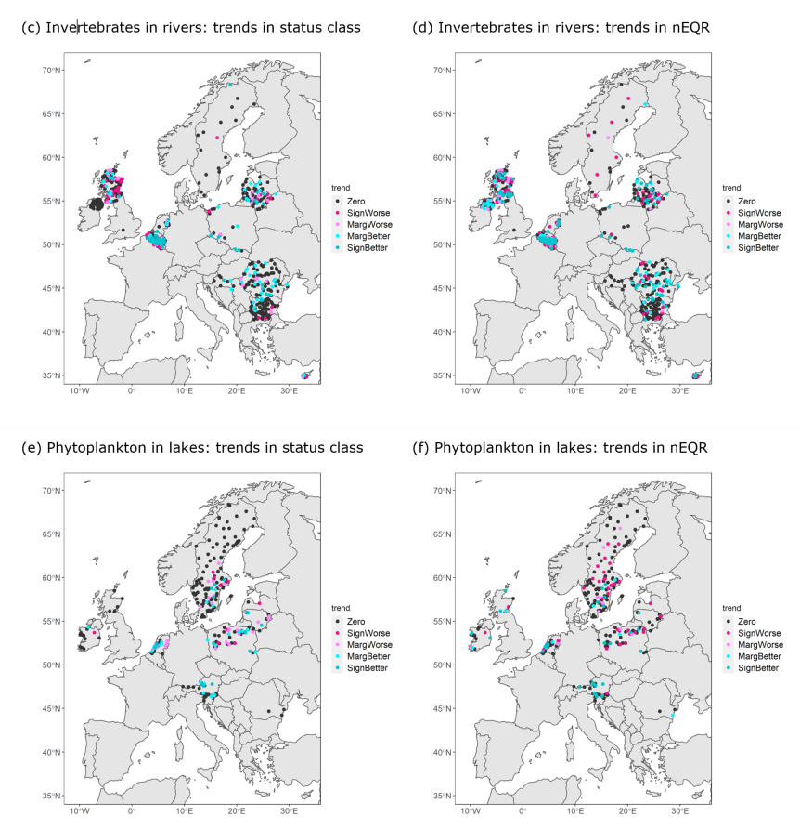
Geographic distribution of temporal trends
Example: trend analysis for
invertebrates in rivers
phytoplankton in lakes
Analysis of nEQR values reveal more significant trends than status class
Most waterbodies with ≥ 4 years show no significant trend (yet)
Planned for 2022: transfer trend analysis to common workspace ➔ can display in dynamic maps
Notes:
Notes:
Graphs with time series: showing examples of different
(1) number of years (➔ more sign. trend)
(2) duration / frequency (➔ must be considered when aggregating time series from different stations by average)
(3) temporal variability (➔ less sign. trend)

Slide 30
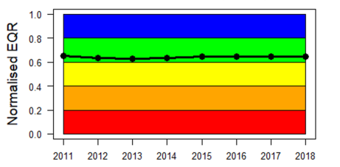
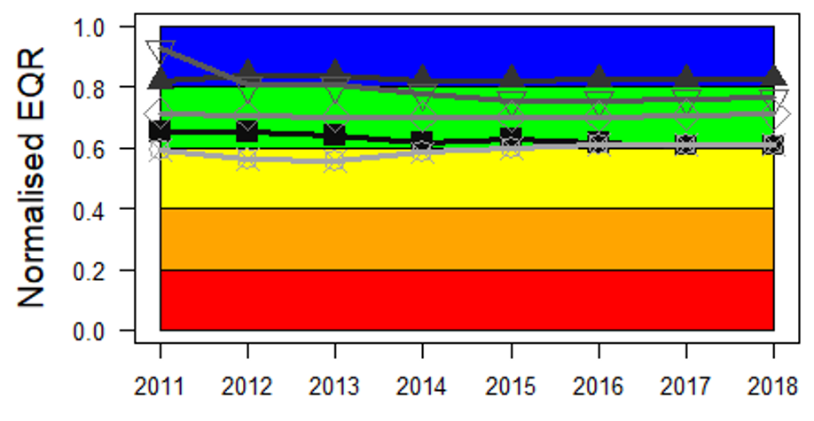
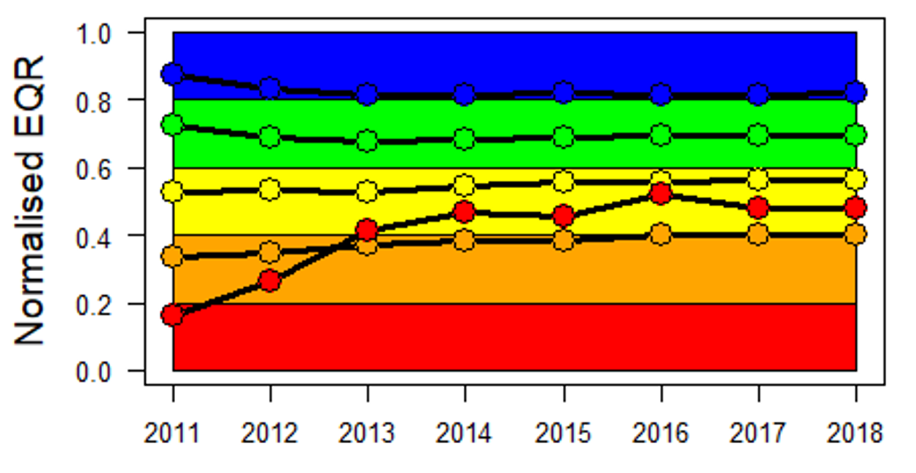
Time series aggregated to European level
Example: invertebrates in rivers – general degradation
Inter/extrapolation of 1-3 missing years
Complete series for 2011-2018:
RW: phytobenthos 474; invertebrates 450
LW: phytoplankton 248; macrophytes 20
Temporal patterns for invertebrates:
Europe: no clear tendency
Regions: nEQR slightly decreased in East (n = 70) and South (but n = 3)
Initial status class: nEQR slightly decreased for High (n = 326) and Good (n = 175); strongly increased for Bad (but n = 6)
Waterbodies in high and good status are over-represented?!
European level
n = 450
Aggregated by region
n = 70
n = 13
n = 3
n = 43
n = 221
Aggregated by initial status class
High: n = 91
Good: n = 175
Moderate: n = 136
Poor: n = 42
Bad: n = 6
Notes:
Time series aggregated:
1) Selected only «valid determinands» (e.g. only eutrophication metrics for botanical elements)
2) interpolation (max 2 year) & extrapolation (max 3 years)
3) Select only complete series from years 2010-2017 (8 years)
4) Group by European level, Georegion, or Initial status class
5) Aggregate by average

Slide 31
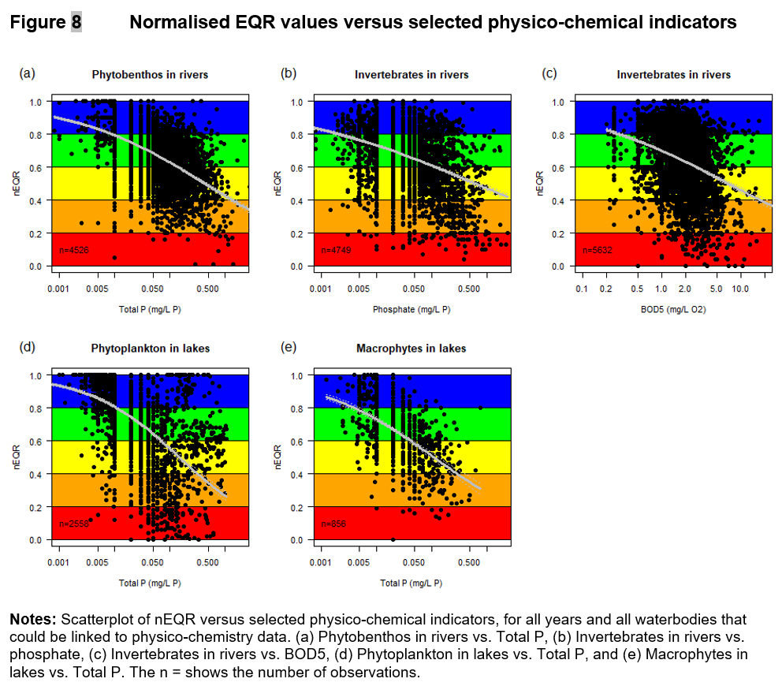
Time series aggregated to European level
Predictor variables: indicator values from WISE-6
Analysis will be refined by e.g. hierachical regression methods
Group by year
Group by region
Group by water body types (broad)
Notes:
Time series aggregated:
1) Selected only «valid determinands» (e.g. only eutrophication metrics for botanical elements)
2) interpolation (max 2 year) & extrapolation (max 3 years)
3) Select only complete series from years 2010-2017 (8 years)
4) Group by European level, Georegion, or Initial status class
5) Aggregate by average

Slide 32
4. WISE-2 reporting and data dictionary - overview

Slide 33
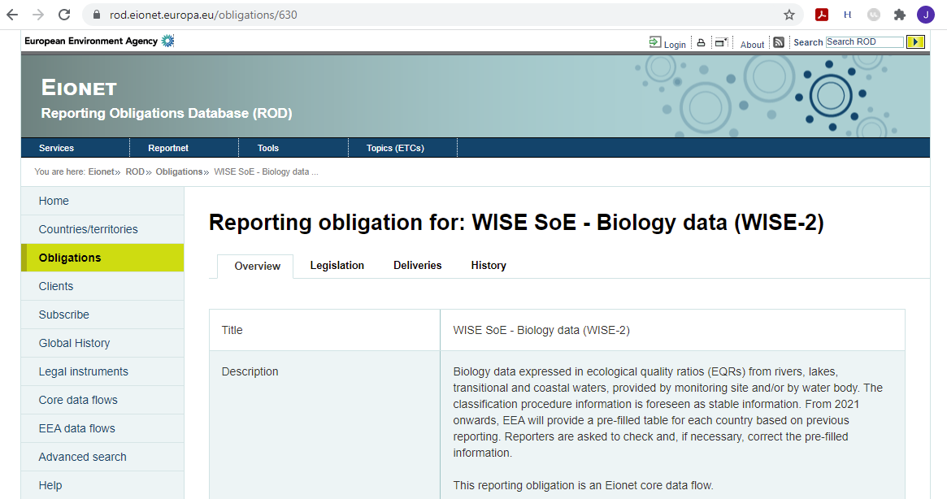
Reporting Obligation Database
NEW: pre-filled classification tables
Notes:
Starting in 2021 after a pause in 2020
Current RO is described in the ROD
new also for experienced reporters: pre-filled classification tables

Slide 34
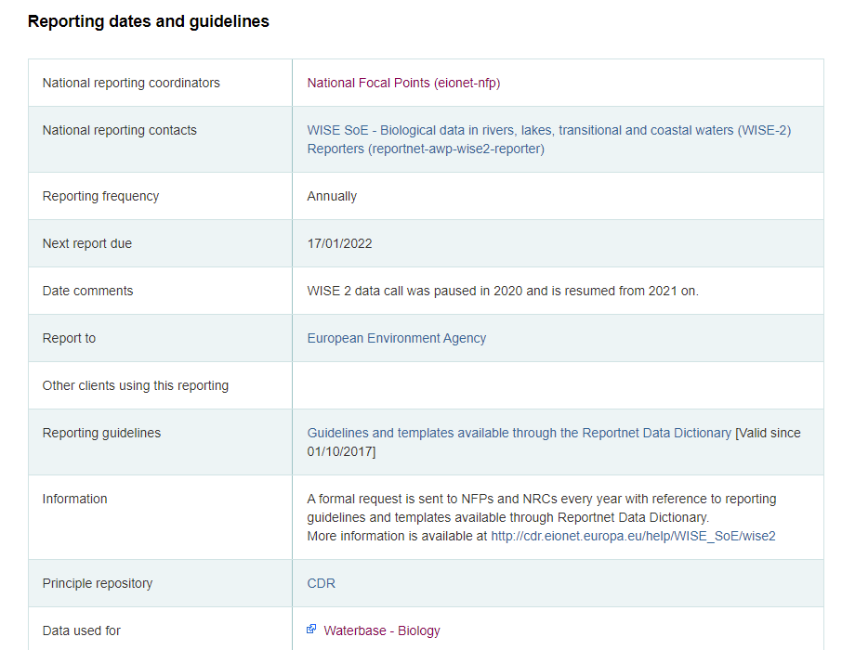
ROD info
Reporting starts: 28/10/2021
Notes:
Starting date: to be confirmed?

Slide 35
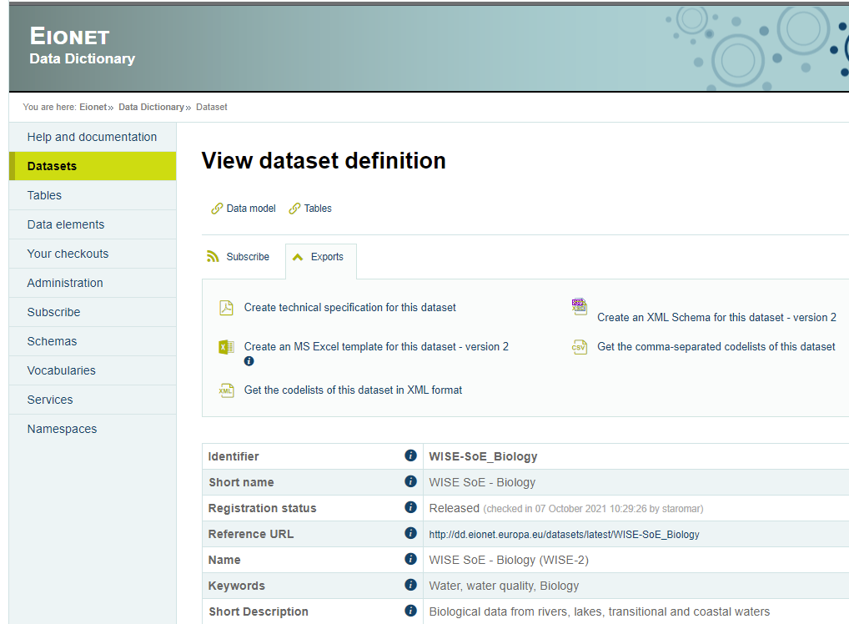
Data Dictionary
Minor changes to DD since 2019
Element [parameterWFDIntercalibration-WaterBodyType] removed, to avoid duplicates in the Classification table
New template must still be downloaded and used
Please wait until new DD is formally released and reporters are notified
Notes:
DD: trying to keep it stable!
Also shows the data model

Slide 36
WISE-2 data model
Report EQR values on waterbody level OR monitoring site level
(preferably not both)
Report national EQR values + classification system AND/OR normalised EQR values
(preferably both, for QC)
https://dd.eionet.europa.eu/visuals/diagram_biology2.jpg
Notes:
Looks a bit complicated, but two parallel chains – alternative structures
Data reported at monitoring site will be aggregated to waterbody site

Slide 37
5. WISE-2 quality issues and solutions

Slide 38
Why WISE-2? National vs. normalised EQRs
Calculation of nEQR requires EQR-scale class boundaries specific for each
country
water category
determinand (BQE, impact type)
waterbody type
natural/AWB/HMWB

Slide 39
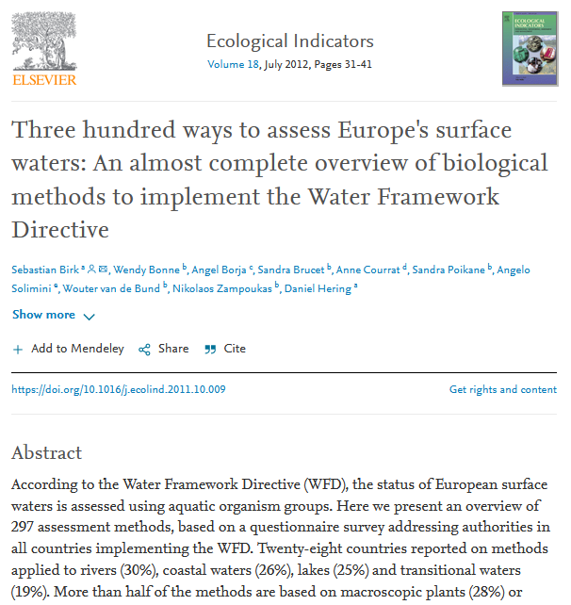
The diversity of national classification systems
National classification systems are based on >300 different assessment methods (metrics)
Most common QC problems are related to the classification tables

Slide 40
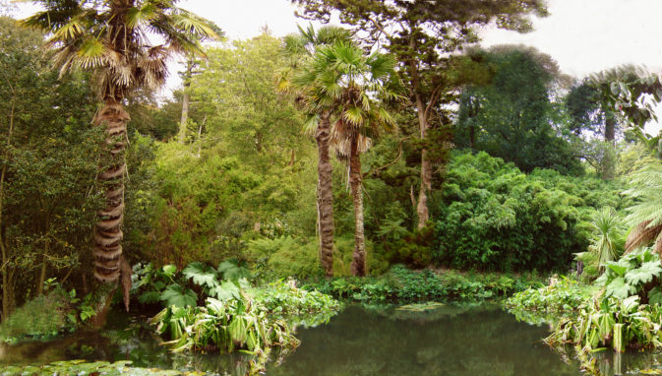
Why so many quality issues for biology data?
National classification systems
BiologyEQRClassificationProcedure
Reporting
QC
Notes:
Problem: there is a jungle of assessment methods – we try to squeeze it into one table and connect with with several other tables
https://www.mn.uio.no/ibv/tjenester/kunnskap/plantefys/leksikon/j/juletre.html
https://innkjopskontoret.no/velkommen-til-jungelen/

Slide 41
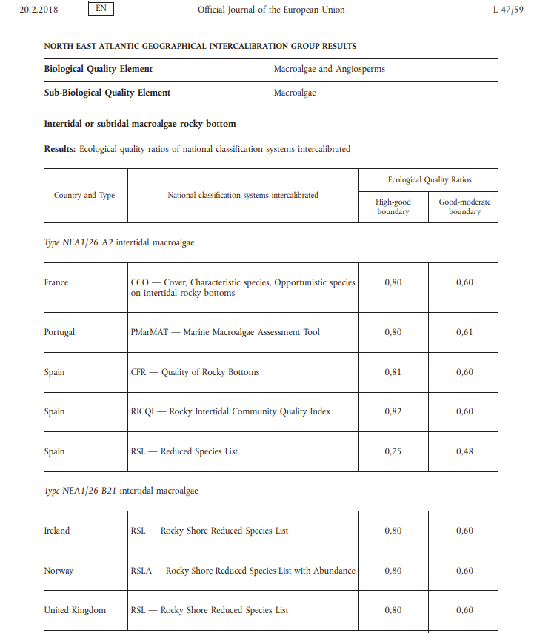
The diversity of national classification systems
Examples:
Water category: Transitional
BQE: Macroalgae and Angiosperms
Sub-BQE: Macroalgae
Sub-BQE: Angiosperms
Waterbody type: NEA1/26
Sub-type: A2 intertidal macroalgae
Sub-type: B21 intertidal macroalgae
...

Slide 42
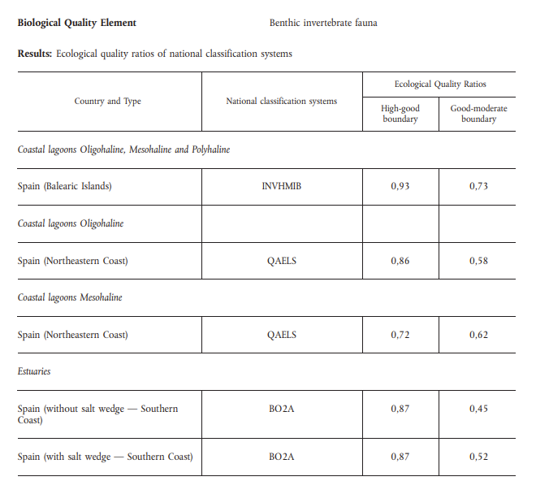
The diversity of national classification systems
Examples:
Water category: Transitional
BQE: Benthic invertebrates
Country: Spain
Method: BO2A
Waterbody type: Estuaries
Sub-type: without salt wedge
Sub-type: with salt wedge

Slide 43
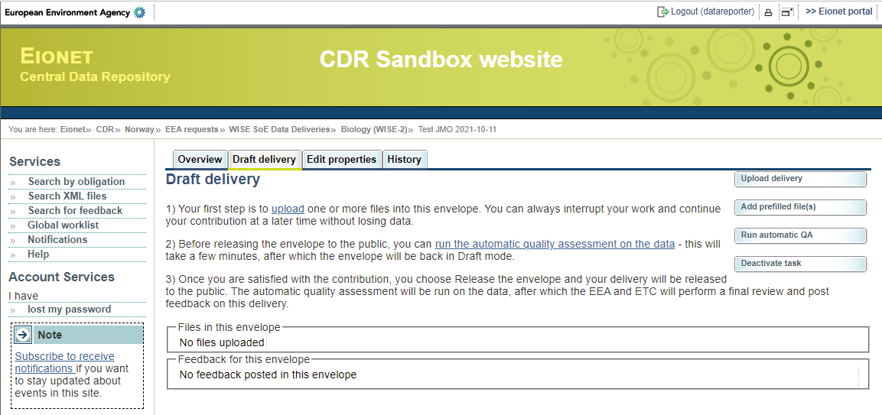
NEW: prefilled classification table

Slide 44
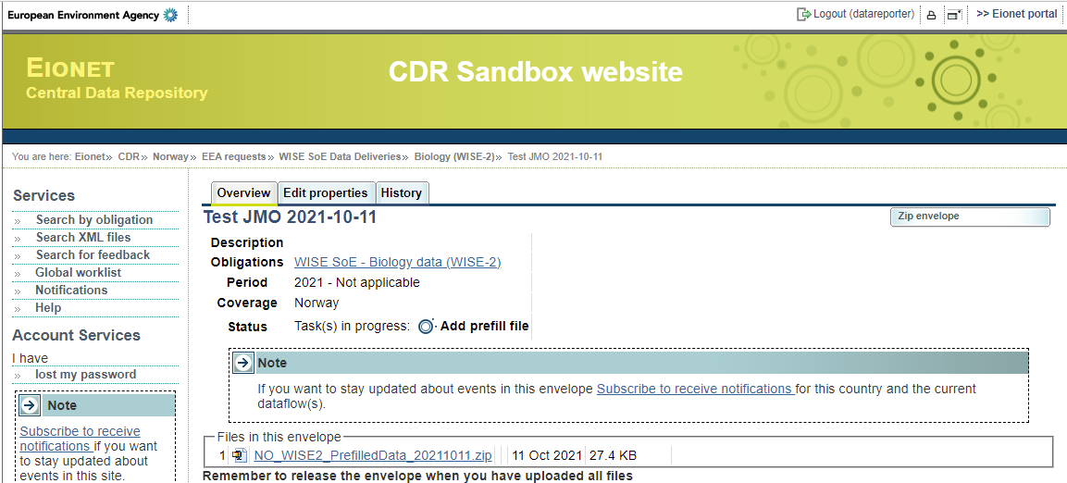
NEW: prefilled classification table

Slide 45
NEW: prefilled classification table
Reporters should check and revise the information
If class boundaries are changed, the previously stored nEQR records will be also recalculated and replace the original nEQR values
Notes:
Example of prefilled table

Slide 46
Some common errors, possible reasons and solutions
Reported EQR record is not valid
Reason: the combination of BQE and water category is not requested (e.g. phytoplankton in rivers)
Solution: don’t report the record
Duplicate records in classification table
Reason: national classification system has higher resolution than the WISE-2 data model E.g. Phytoplankton - Norway: combining nEQR values from 3 different metrics into one nEQR
Solution: calculate and report only the final nEQR values, not the national EQRs + classification system
Reported status class is changed by EEA
Reason: rounding error (e.g. nEQR = 0.6; status class = Good (should be Moderate))
Solution: follow EEA’s instruction for status class assessment

Slide 47
Some common errors, possible reasons and solutions
Reported nEQR is changed by EEA
Reason: inconsistent reporting of status class, EQR, class boundaries, and/or nEQR (e.g. EQR = 0.65; G/M boundary = 0.68; reported status class = G (should be M))
Solution: follow EEA’s instruction for status class assessment and nEQR calculation
Link between EQR record and classification record is changed by EEA
Reason: EQR record was linked to wrong classification record (e.g. Natural instead of HMWB)
Solution: pre-filled classification table?
Reported EQR record has no matching classification system
Reason: inconsistency in waterbody information reported to WISE-2 vs. WFD: e.g. water category, Natural / AWB / HMWB, waterbody type (NB: WFD information is given priority)
Solution: pre-filled classification table?

Slide 48
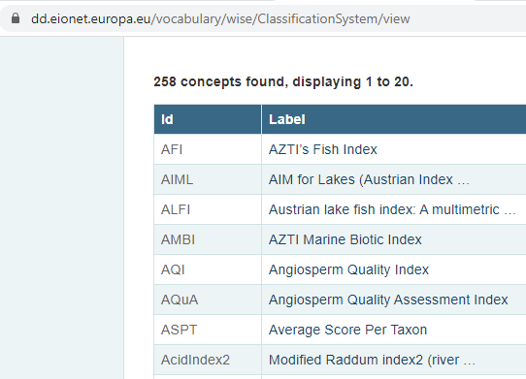
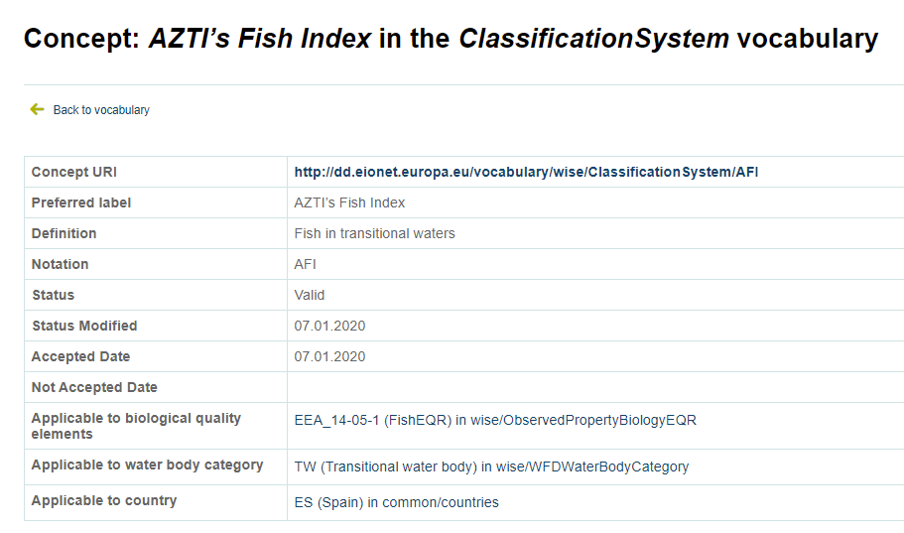
Supporting information on national classification systems
New vocabulary: ClassificationSystem – 258 concepts (metrics)
Information on the applicable BQE, water category and country
Reference tables provided together with the pre-filled classification tables
Notes:
- Note mandatory, but can be useful

Slide 49
Automatic Quality Checking
Most quality issues are now handled by automatic QC upon data delivery
Records with inconsistent information cause “Blocker”
national vs. normalised EQR
normalised EQR vs. status class
etc.
“Blocker” is used as a means of efficient feedback and correction
Questions are always welcome!
Notes:
Discussion with EEA about use of blocker vs. error vs. warning
Stricter response -> more efficient for both reporters and EEA/ETC
Please check aslo Warning & Error!

Slide 50
6. WISE-2 data for EEA indicators - representativity

Slide 51
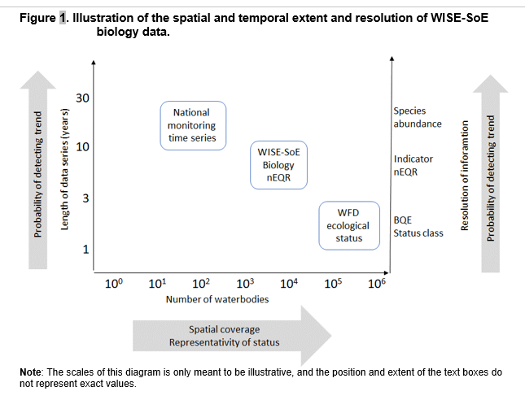
WISE-2 Biology can supplement WFD data

Slide 52
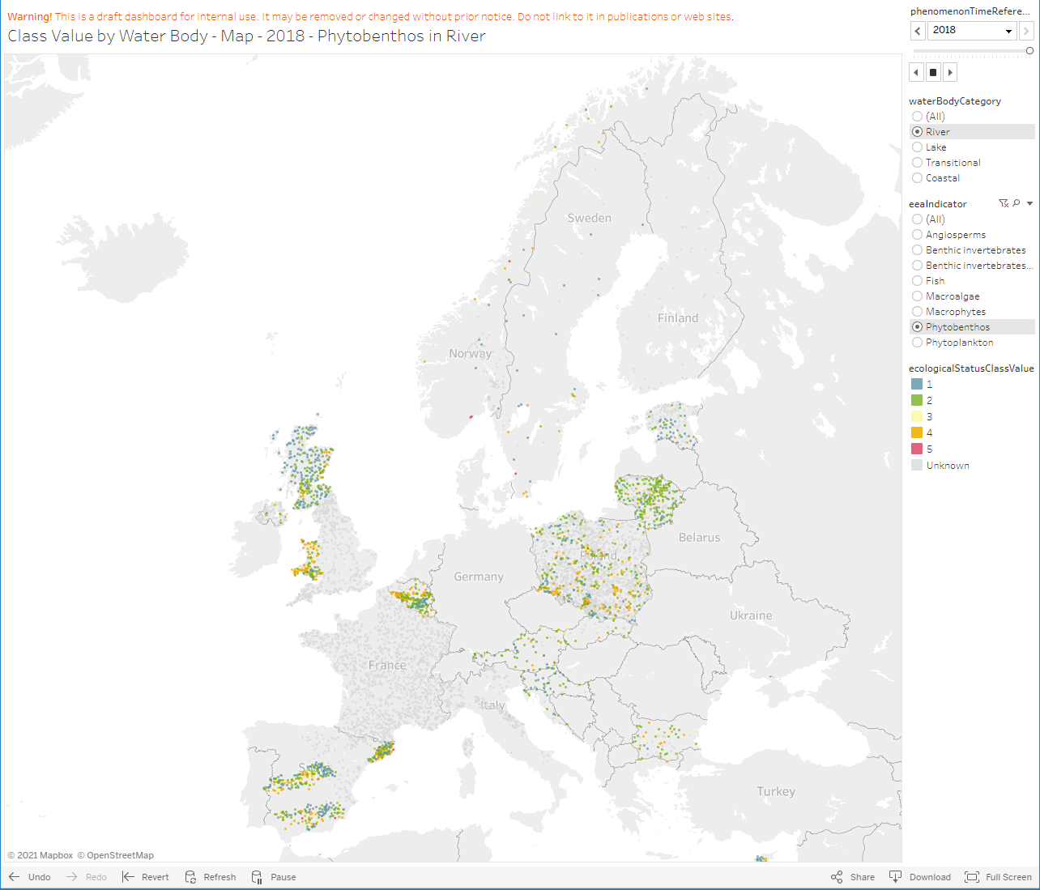
Representativity: geography
Geographic representativity is high in some countries
Overall higher geographic coverage is needed for a biological indicator
Notes:
Discussion with EEA about use of blocker vs. error vs. warning
Stricter response -> more efficient for both reporters and EEA/ETC

Slide 53
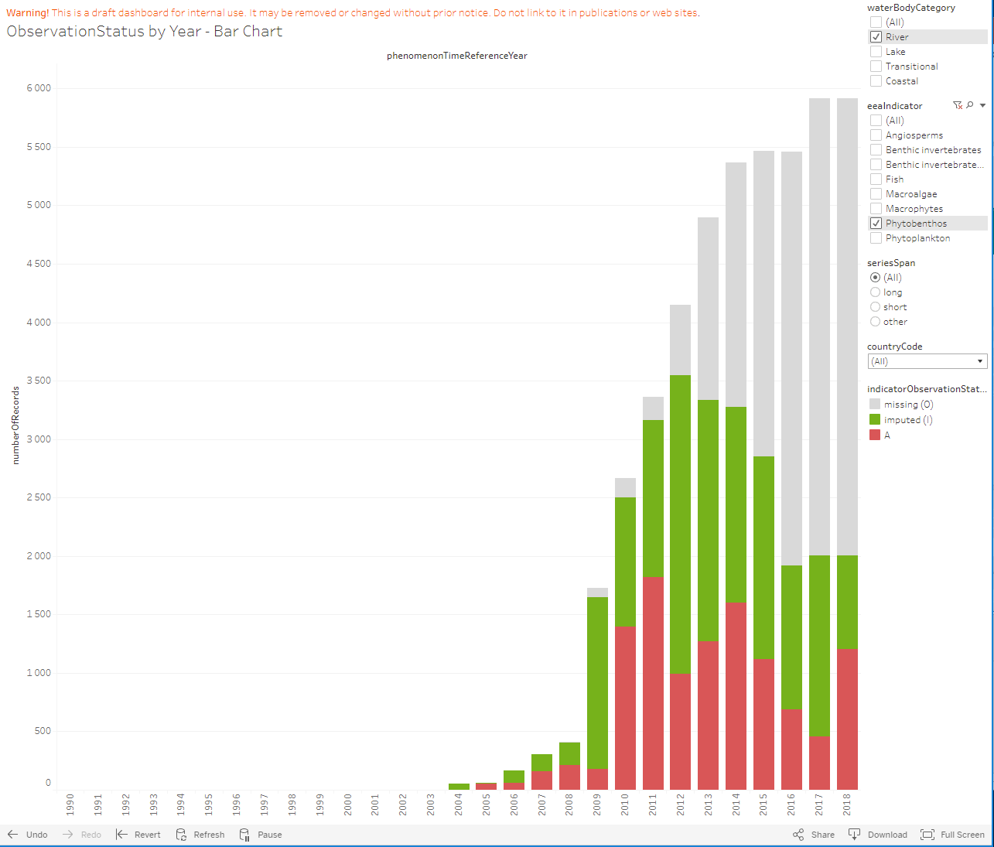
Representativity: time series
Total bar height: cumulative no. of waterbodies
Red: reported values
Green: imputed from reported values
interpolated 3-year gap
extrapolated ± 3 years
Grey: not possible to impute
too long gaps
Reporting from previous years can generate more series!
Notes:
...

Slide 54
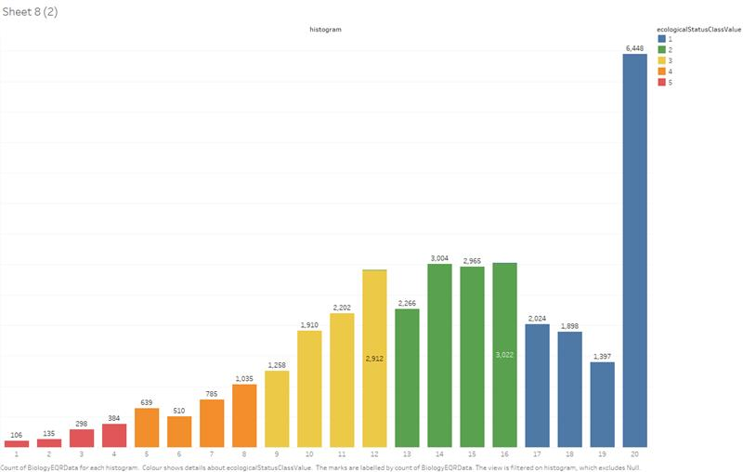
Representativity of status classes
Waterbodies with nEQR = 1 are over-represented
Reported EQR >1
Reporting of reference waterbodies?
Poor and Bad status are under-represented?
How to ensure better representativity of status classes?
Compare with distributions in WFD data
Post-stratification
Notes:
How to identify reference WBs: post-stratification (after non-random sampling, e.g. problematic areas overrepresented) => can calculate the weight that each class should have.
Can use the WFD database to get the expected representativity of the classes (post-stratification)! Can be done by each BQE! Marvellous procedure!
How to calculate the best unbiased estimate
Anne will say more about representativity

Slide 55
Representativity of status classes compared to WFD
Comparison of WISE-2 with WFD 2016
New public dashboards for WISE-2 (11.10.2021)
High status sites are NOT overrepresented in WISE-2!
Representativity of WISE-2 data will be further explored
All waterbodies reported to WFD
Subset of waterbodies reported to WISE-2
Notes:
How to identify reference WBs: post-stratification (after non-random sampling, e.g. problematic areas overrepresented) => can calculate the weight that each class should have.
Can use the WFD database to get the expected representativity of the classes (post-stratification)! Can be done by each BQE! Marvellous procedure!
How to calculate the best unbiased estimate
Anne will say more about representativity

