Slide 1
15 October 2021 I WISE-6 webinar
Pesticides in water indicator and feedback on hazardous substances reporting
ETC/ICM: Jeanette Völker, Gasper Subelj, Caroline Whalley

Slide 2
Goal
Aim of the indicator
To show the European overview of the status of pesticides in aquatic ecosystems (rivers, lakes, groundwater).
Feasibility of production and data source
Currently, no indicator showing pesticides in European waters is available.
Basis for indicator development: ETC/ICM Technical report 1/2020*.
Monitoring data officially reported by EEA member and cooperating countries to voluntary dataflow (SoE WISE 6); Data are public.
Data on available effect thresholds regulated at EU-level as well as national level.
*https://www.eionet.europa.eu/etcs/etc-icm/products/etc-icm-report-1-2020-pesticides-in-european-rivers-lakes-and-groundwaters-data-assessment

Slide 3
Policy relevance
Policies
Water Framework Directive and its daughter Directives
Surface waters: EQS Directive 2008, updated by Priority Substance Directive 2013
Groundwater Directive 2006, 2014
Sustainable Use of Pesticides Directive
Plant Production Products Regulation
Biocidal Product Regulation
Green Deal
Biodiversity Strategy, Farm to Fork Strategy
Zero Pollution Action Plan:
50% reduction in: use of chemical pesticides; use of most hazardous pesticides; risk that the use causes;
Reference year: 2011 – 2017;
Monitoring: Indicators for the quantified Green Deal targets
Notes:
(reduce the use and risk of pesticides by 50% until 2030)

Slide 4
Stepwise approach
Assessment
1.
Extract pesticide data
2.
Consider LoQ
3.
Aggregate data
6.
Calculate exceedance rates
4. Consolidate
5.
Identify effect thresholds
Select reference dataset

Slide 5
Extract pesticide data 2013 to 2019 - overview
 |  | 2013 | 2014 | 2015 | 2016 | 2017 | 2018 | 2019 | Total
Number of countries | SW | 18 | 19 | 25 | 25 | 25 | 26 | 24 | 29*
 | GW | 18 | 18 | 18 | 18 | 17 | 18 | 19 | 22*
Number of reported monitoring sites | SW | 2 317 | 2 476 | 3 653 | 2 782 | 2 877 | 4 500 | 4 906 | 9 329*
 | GW | 5 510 | 5 348 | 6 719 | 5 958 | 8 102 | 8 290 | 9 442 | 13 544*
Number of reported records (annual mean) | SW | 115 023 | 125 703 | 162 300 | 154 192 | 171 150 | 219 369 | 312 249 | 1 259 986
 | GW | 251 594 | 248 867 | 248 769 | 226 384 | 296 933 | 315 606 | 500 806 | 2 088 959
Number of reported pesticide substances | SW | 156 | 157 | 156 | 193 | 165 | 168 | 215 | 218#
 | GW | 143 | 145 | 144 | 155 | 161 | 158 | 223 | 223#
SW = surface water
GW = groundwater
* = total no. discrete sites
# = total no. discrete pesticides

Slide 6
Extract pesticide data 2013 to 2019 - overview
SW = surface water; GW = groundwater

Slide 7
Limits of Quantification (LoQ), Effect Thresholds and Quality Standard
LoQ
LoQ = the smallest concentration of a substance that can be reliably measured by an analytical procedure (Water Framework Directive: QA/QC Directive*)
Countries need to report LoQ for each pesticide**
LoQ for similar pesticide substances can vary between countries caused by different analytical methods used
A number of reported values were flagged as “below LoQ”; so we don’t know the exact measured value
Values reported with no LoQ value were excluded from detailed analysis
Effect Thresholds
EU-wide regulated for:
Priority substances (WFD) - EQS
Watch-list (WFD) – maximum acceptable detection limit
Regulated in Member States for:
River basin specific pollutants (WFD) - EQS
EQS vary between countries
Lowest reported ecotoxicological based EQS were used (precautionary principle)
Effect Thresholds were identified for 116 out of 237 pesticides (49%)
Quality Standard
One quality standard applies to all pesticides (0.1µg/L) – Groundwater Directive quality standard
* 2009/90/EC
** Plant protection products (PPP) and biocides

Slide 8
Result (a): Surface waters
Percentage of reported monitoring sites with pesticides exceeding thresholds in surface waters in Europe based on a country weighting factor
In 13 - 30% of all surface water monitoring sites, one or more pesticides were detected above effect threshold each year.
Notes:
This was mainly caused by the insecticides imidacloprid and malathion, and the herbicides MCPA, metolachlor and metazachlor. Except imidacloprid, these substances were approved for use in plant protection products during the monitoring period:
No trends can be derived at this time, owing to e.g.:
e.g. variation in losses from the application of pesticides between years,
variation in the frequency of monitoring of pesticides, or
changes to the approval status of pesticides.

Slide 9
Result (b): Groundwater
Percentage of reported monitoring sites with pesticides exceeding thresholds in groundwater in Europe based on a country weighting factor
Exceedances of one or more pesticides detected in 3 - 7% groundwater monitoring sites each year.
Notes:
In groundwater, exceedances were mainly caused by the herbicide atrazine and its metabolites. Atrazine was not approved for use in plant protection products during the monitoring period.
Reason why atrazine has been found in groundwater despite the ban that has been in place for years is primarily the high persistence of this substance.
No trends can be derived at this time.

Slide 10
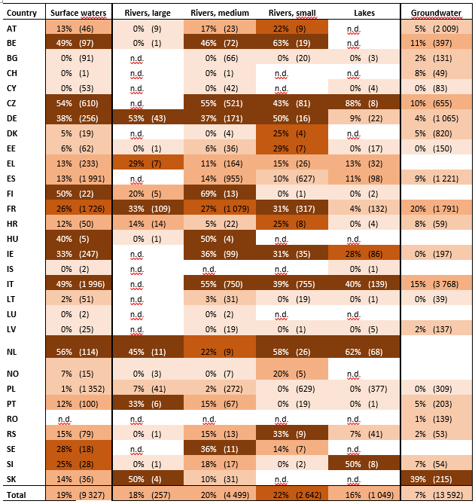
Result (c): Countries
Percentage of reported monitoring sites with pesticides exceeding thresholds in surface waters, different sized rivers, lakes and groundwater in European countries, 2013 – 2019.
Exceedance rates over 30% occurred in 14 of 29 countries in surface waters
Exceedance rates over 30% occurred in 1 of 22 countries in groundwater
High exceedance rates mainly related to monitoring sites in small and medium-sized rivers.

Slide 11
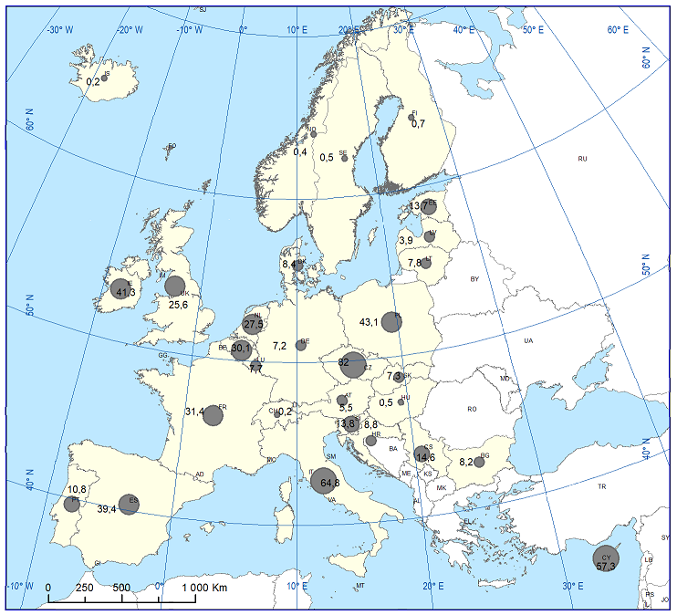
Uncertainties: data variability
Large range in number of monitoring sites per country
Large range in number of reported pesticides per country
Number of reported monitoring sites in surface waters varies between countries from
less than 10 sites (CH, HU, IS, LU) to
more than 1 000 sites (ES, FR, IT, PL)
A minimum number of reported monitoring sites per country and year would be necessary to reduce this imbalance.
Surface waters
Notes:
Unusually high or low exceedance rates within a country may impact upon the overall indicator.
This can also occur if only a few monitoring sites are reported, but a relatively high or low proportion of these are exceedances

Slide 12
Minimum number of monitoring sites
Country | Area [km²] | Reported sites SW | Reported sites GW | Minimum number of sites
AT | 83858 | 46 | 2009 | 5
BE | 32545 | 97 | 397 | 5
BG | 110912 | 91 | 131 | 5
CH | 41284 | 1 | 49 | 5
CY | 9251 | 53 | 83 | 1
CZ | 78866 | 610 | 655 | 5
DE | 357022 | 256 | 1065 | 24
DK | 43094 | 19 | 820 | 4
EE | 45100 | 62 | 150 | 3
EL | 131957 | 233 | 0 | 6
ES | 505992 | 1994 | 1221 | 19
FI | 338145 | 22 | 0 | 9
FR | 551500 | 1726 | 1791 | 24
HR | 56538 | 50 | 59 | 4
HU | 93032 | 5 | 0 | 6
IE | 70273 | 247 | 197 | 4
IS | 103000 | 2 | 0 | 3
IT | 301318 | 1996 | 3768 | 19
LT | 65300 | 51 | 39 | 4
LU | 2586 | 2 | 0 | 1
LV | 64600 | 25 | 137 | 4
NL | 41528 | 114 | 0 | 6
NO | 385155 | 15 | 0 | 8
PL | 312685 | 1352 | 309 | 15
PT | 91982 | 99 | 203 | 6
RO | 238397 | 0 | 139 | 10
RS | 77474 | 79 | 53 | 4
SE | 449964 | 18 | 0 | 11
SI | 20256 | 28 | 54 | 2
SK | 49033 | 36 | 215 | 4
Approach used in EQSD Watch-list:
Each Member State shall select
at least one monitoring site
+ one station if it has more than one million inhabitants,
+ the number of stations equal to its geographical area in km² divided by 60 000 (rounded to the nearest integer),
+ the number of stations equal to its population divided by five million (rounded to the nearest integer).

Slide 13
Uncertainties: missing spatial information
Share of monitoring sites without spatial information
Country | LW | RW
AT |  | 0,0%
BE |  | 0,6%
BG | 0,0% | 0,0%
CH |  | 0,0%
CY | 0,0% | 0,0%
CZ | 0,0% | 8,5%
DE |  | 0,0%
DK |  | 47,2%
EE | 0,0% | 0,0%
EL | 0,0% | 0,5%
ES | 0,0% | 0,0%
FI | 0,0% | 0,0%
FR | 3,6% | 0,2%
HR | 0,0% | 0,0%
HU |  | 0,0%
IE | 33,3% | 0,0%
IS | 0,0% | 0,0%
IT | 0,0% | 0,0%
LT | 0,0% | 0,0%
LU |  | 0,0%
LV | 0,0% | 0,0%
NL | 0,0% | 0,0%
NO |  | 0,0%
PL | 1,0% | 0,1%
PT | 0,0% | 0,0%
RS | 43,8% | 5,0%
SE |  | 21,7%
SI | 0,0% | 0,0%
SK |  | 0,0%
10% of all reported monitoring sites could not be assigned to a river size because of missing spatial information

Slide 14
Uncertainties: Limit of Quantification (LoQ)
For hazardous substances, important to be confident about “non-detects” when reviewing data from across Europe
Countries report LoQ and substance concentration
More than 90% of pesticide records flagged as ‘below LoQ’. In that case, the measured concentration is often reported as equal to the LoQ itself or LoQ/2.
Statistics can be calculated on the detects only, i.e. on records reported as above the LoQ
Statistics on both detects and non-detects introduce a bias - if many non-detects are in reality much lower than reported LoQ, the calculated average is overestimated

Slide 15
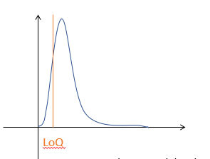
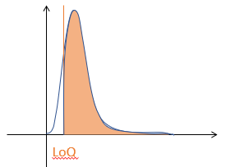
LoQ – area for development – study by J Vauille
Records for hazardous substances concentration be reported as equal to LoQ – “(left-) censored measurements” or “non-detects”
Investigation on atrazine data using 3 statistical techniques (MLE, Kaplan-Meier, ROS)
MLE and ROS most appropriate because no assumption on distribution
log-N distribution assumption was often acceptable at country level
Estimated statistics can be used for comparing countries and years
We are interested to hear about your experience comparing large datasets with varying LoQs…
MLE
ROS
Notes:
Maximum likelihood estimation (MLE)
Suitability: 50-80 % censoring, n>50, log-N assumption on detects and non-detects
Kaplan-Meier (KM)
Suitability: <50% censoring, n>50, no distribution assumption
Robust regression on order statistics (ROS)
Suitability: <50% censoring, n>50, log-N assumption on detects

Slide 16
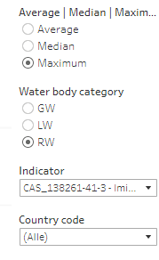
Dashboard (draft) to check country data
https://tableau.discomap.eea.europa.eu/t/Wateronline/views/PesticidesAggregatedData_Exceedance_2019/Indicator-LineChart?:embed=y&:isGuestRedirectFromVizportal=y&:display_count=n&:showVizHome=n&:origin=viz_share_link
By selecting different filters, you can get a quick overview of the concentrations reported for each substance for the time period 2013-2019
GW=groundwater
LW=lake water
RW=river water
This is the pesticide. You can filter by CAS code or by substance name
Filter to select your country

Slide 17
Next steps
Publication of pesticides in water indicator expected this year
Further development (2022) with focus on:
Calculation alternatives (i.e. country weighting factor vs. water network, arable land cover etc.)
Improving approach towards non-detects (‚below LoQ‘) using statistical methods
Increase number of effect thresholds for pesticides

Slide 18
Hazardous substances - Overview
Determinand / Group | Number of reported determinands
Hazardous substances - other | 519
Hazardous substances - Pesticides | 237
Nutrients | 30
Supportive determinands | 9
Grand Total | 795

Slide 19
Hazardous substances – Number of records

Slide 20
Hazardous substances – most reported substances

