Slide 1
WFD2016 Reporting Workshop
under the Common Implementation Strategy of the Water Framework Directive (WFD)
-
Introduction to Reporting Guidance Tools

Slide 2
Content
Reporting structure
Reporting resources
Reporting workflow: Annex 6
Reporting process
7

Slide 3
1. Reporting structure
2nd: National spatial data - GML files
GroundWaterBodyHorizon
GroundWaterBody
3rd: National RBDSUCA - XML file
4th: River Basin District x - XML files
GWB
RBDSUCA (River Basin Districts, Sub-Units and Competent Authority)
MonitoringSite
ProtectedAreaLine
ProtectedAreaPoint
ProtectedArea
RiverBasinDistrict
SubUnit
SurfaceWaterBodyCentreline
SurfaceWaterBody
SurfaceWaterBodyLine
1st: RBMP, PoM and background documents
GWMET
SWB
SWMET
Monitoring
PDF, Docs
RBMPoM
Annex 0 (if applicable)
Annex 0 (if applicable)

Slide 4
2. Reporting resources available
WFD 2016
XML Schemas for spatial and descriptive data
Access DB
XML
GML
Shapefiles
QA tools/doc
WFD Reporting Guidance and GIS Guidance
Docs/ Conversion tool
Conversion tools
UML
Annex6
Helpdesk log

Slide 5
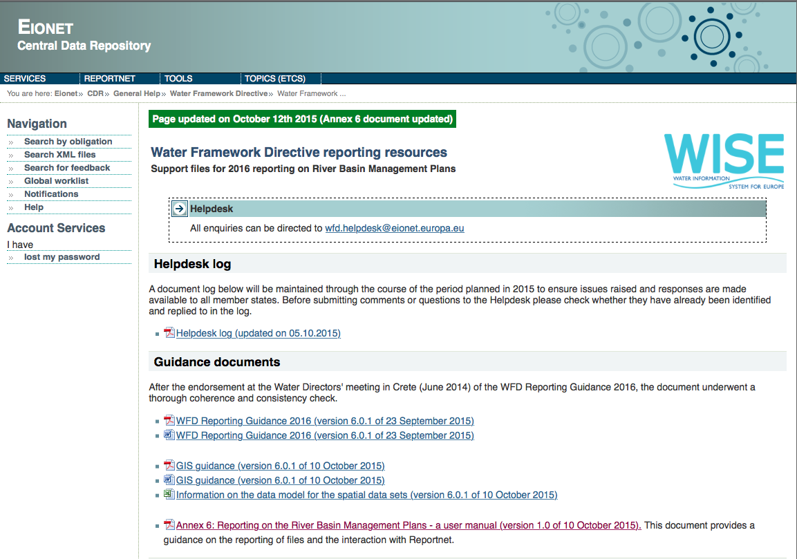
2. WFD2016 reporting resources page
DEMO

Slide 6
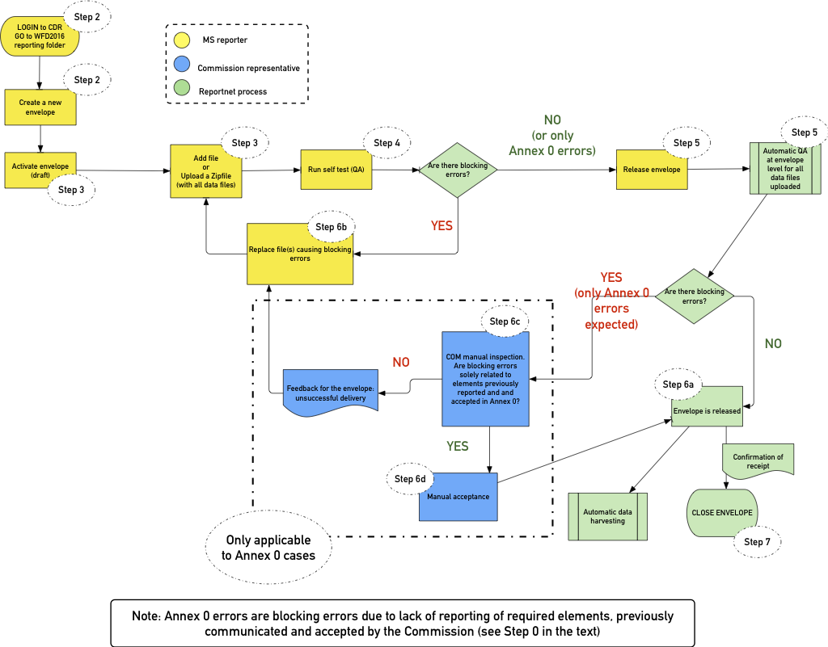
3. Reporting workflow: Overview

Slide 7
3. Reporting workflow: Step 0 Annex0 (if relevant)
MS not able to report all the data as required in the WFD Reporting Guidance – Explanatory note
Following a document template
Submitted via e-mail to the WFD HelpDesk
At least one month in advance
ENV will provide feedback in a week
Not accepted omissions on elements that break integrity and consistency of the EU database
Finally, to be uploaded at CDR together with XML/GML data:
National and/or RBD level

Slide 8
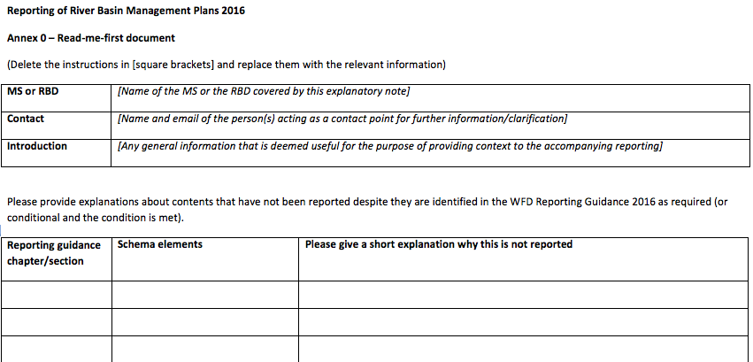
3. Reporting workflow: Step 0 Annex0 (if relevant)
Naming convention and template:
Annex0_CountryCode(2 characters).docx (for national Annex 0)
Annex0_CountryCode(2 characters)_EURBDCode.docx (for RBD Annex 0)

Slide 9
3. Reporting workflow: Reportnet interface
http://cdr.eionet.europa.eu/<you country>/eu/wfd2016/

Slide 10
3. Reporting workflow process
Log in at CDR with EIONET account

Slide 11
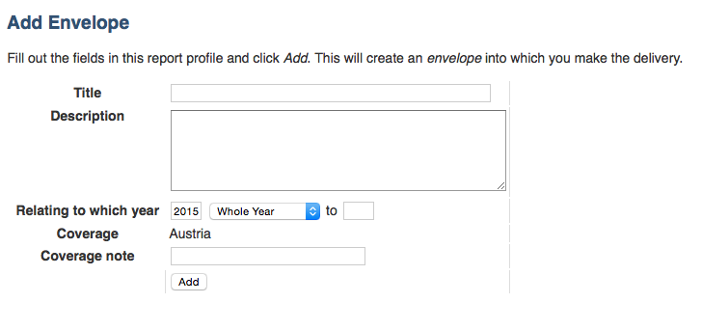
3. Reporting workflow process
Create an envelope
Title: YYYYMMDD

Slide 12
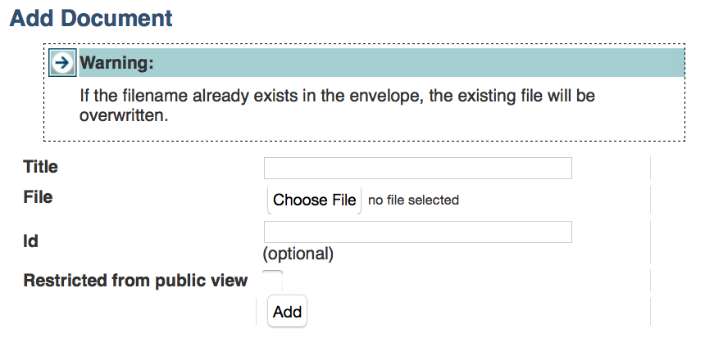
3. Reporting workflow process
Upload file(s)

Slide 13
3. Reporting workflow process
QA test + statistics on data uploaded
Schema validation
Within schema checks
Cross schema checks
Statistics
7
Or

Slide 14
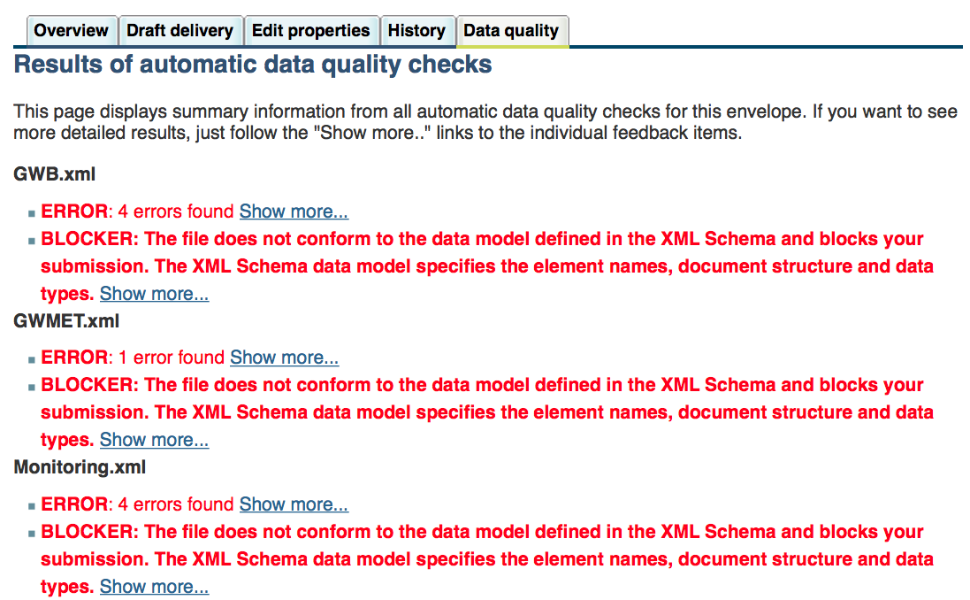
3. Reporting workflow process
Release envelope
QA results + statistics

Slide 15
3. Reporting workflow process
Release envelope II
Blocking errors exists:
envelope not released
replace wrong files
No blocking errors:
confirmation of receipt
envelope released
Or

Slide 16
3. Reporting workflow process
Release envelope III
Blocking errors:
Missing file(s) in the envelope required.
Missing or erroneous elements to keep the integrity of the data at EU level or undermine the consistency of the reported data.

Slide 17
3. Reporting workflow process: in case of Annex0
Release envelope IV
Manual assessment based on Annex0
ENV assessment
Envelope remains in draft
Files needed to be replaced
Envelope released
Successful
Notification > Close
Or

Slide 18
4. Reporting process: CDR collections
MS Folder
(http://cdr.eionet.europa.eu/<your country>/eu/wfd2016/)
National RBDSUCA
(/rbdsuca)
River Basin District 1 (/districts/<rbd code>)
RBMP, PoM background documents (/documents)
National spatial data
(/spatial)
Date 1
Date 2
Date 1
Date 2
River Basin District 2 (/districts/<rbd code>)
Date 1
Date 2
Date 1
Date 2
River Basin District 2
(/<rbd code>)
National
(/national)
Date 1
Date 1
Date 2
Date 2
Date 1
Date 2
River Basin District 1
(/<rbd code>)

Slide 19
4. Reporting process: CDR collections

Slide 20
Permissions for data reporters
Registered at:
http://rod.eionet.europa.eu/contacts?roleId=extranet-wise-nfp
Request registration for data reporters
Requested through WFD Helpdesk (wfd.helpdesk@eionet.europa.eu)
Guidelines provided in Annex6
National Coordinator
Data
Reporter(s)
Registered at:
http://rod.eionet.europa.eu/contacts?roleId=extranet-wfd-data

Slide 21
Questions?

Slide 22
THANK YOU
Alberto Telletxea
atelletxea@bilbomatica.es
Enrique Soriano
jenriquesoriano@guadaltel.es
Mikel Santamaría
msantamaria@bilbomatica.es
Marisa Ruiz
marisaruiz@guadaltel.es

