Slide 1
WFD2016 Reporting Workshop
under the Common Implementation Strategy of the Water Framework Directive (WFD)
-
Reporting National RBDSUCA

Slide 2
Content
0. Overview
Reporting data schemas
Quality control elements
Requirements for data exchange
7

Slide 3
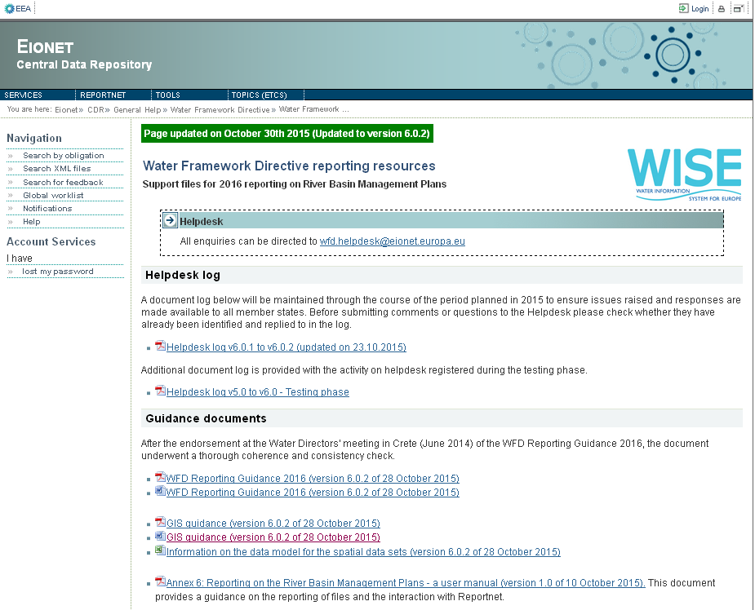
0. Overview
Resources & tools
WFD Reporting Guidance
UML Data Model
Schema:
http://dd.eionet.europa.eu/schemas/WFD2016
Access DB template
Guide to report Access DB
Conversion tool from Access to XML
http://cdr.eionet.europa.eu/help/WFD/WFD_521_2016
Notes:
Tool to visualize and explore UML
http://www.sparxsystems.com.au/bin/EALite.exe

Slide 4
0. Overview
RBDSUCA
XML
National level (1 file per MS)
Chapter 6
River Basin Districts, Sub-units and Competent Authorities
Notes:
Schema name
Type
Reporting scale
Contents
Chapter
RBDSUCA
XML
National (1 file per MS)
River Basin Districts, Sub-units and Competent Authorities
6

Slide 5
0. Overview
Competent Authorities
River Basin Districts
SubUnits
Identify the Competent Authorities involved in the implementation of the WFD
RBDs as the geographical extent for the coordination of water resources
Sub-units as the division of the RBDs

Slide 6
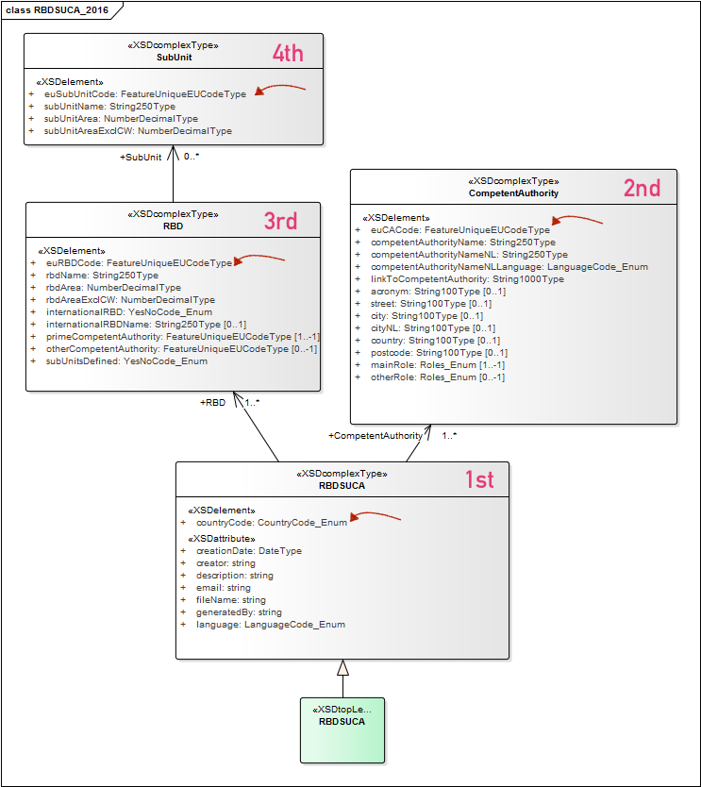
1. Reporting data schema: UML

Slide 7
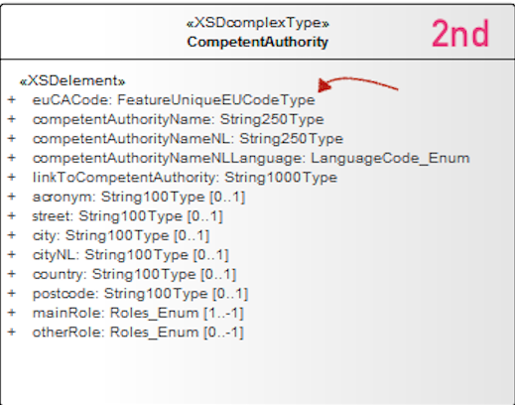
1. Reporting data schema
Competent authorities
Unique EU code
Name
Language
Website link
Role (Enumeration – Annex 8K)

Slide 8
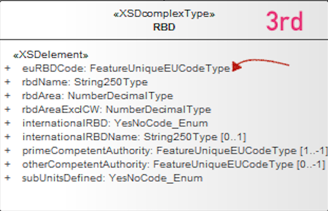
1. Reporting data schema
River Basin Districts
Unique EU code
Name
Area (km2) incluiding and excluiding coastal waters
International RBD?
Prime CA
Sub-units?

Slide 9
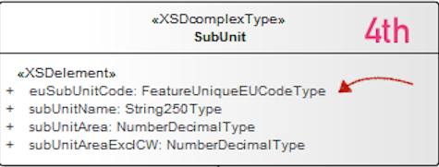
1. Reporting data schema
SubUnits (if exist)
Unique EU code
Name
Area (km2) incluiding and excluiding coastal waters

Slide 10
3. Quality control elements
Within schema checks

Slide 11
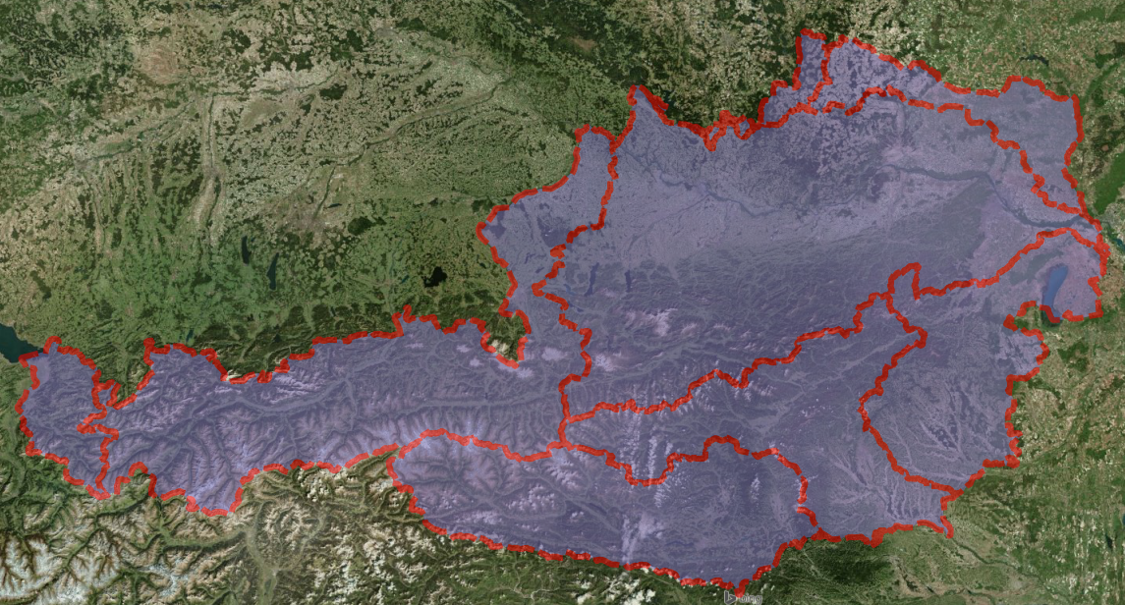
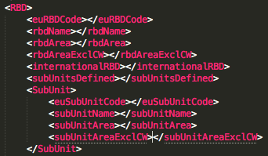
3. Quality control elements
Cross schema checks
Validation against spatial data (RBDs-SubUnits)

Slide 12
3. Quality control elements
Cross schema checks
Validation against spatial data

Slide 13
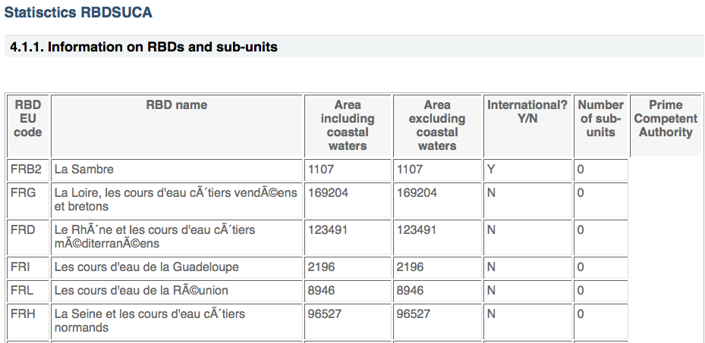
3. Quality control elements
Statistics: Summary
Information on RBDs and sub-units list
Information on Competent Authorities list

Slide 14
4. Requirements for data exchange
XML format
XSD schemas available-Data Dictionary schemas http://dd.eionet.europa.eu/schemaset/WFD2016/view
Access DB format
Access DB template
Guide mapping Access DB and Schema elements
Access to XML converter tool
http://cdr.eionet.europa.eu/help/WFD/WFD_521_2016

Slide 15
4. Requirements for data exchange
File naming convention
RBDSUCA_[Your ISO Country Code]_YYYYMMDD

Slide 16
Questions?

Slide 17
THANK YOU
Alberto Telletxea
atelletxea@bilbomatica.es
Enrique Soriano
jenriquesoriano@guadaltel.es
Mikel Santamaria
msantamaria@bilbomatica.es
Marisa Ruiz
marisaruiz@guadaltel.es

