Slide 1
WFD2016 Reporting Workshop
under the Common Implementation Strategy of the Water Framework Directive (WFD)
-
Reporting descriptive data at districts level

Slide 2
Content
0. Overview
Reporting data schemas
Quality control elements
Requirements for data exchange
7

Slide 3
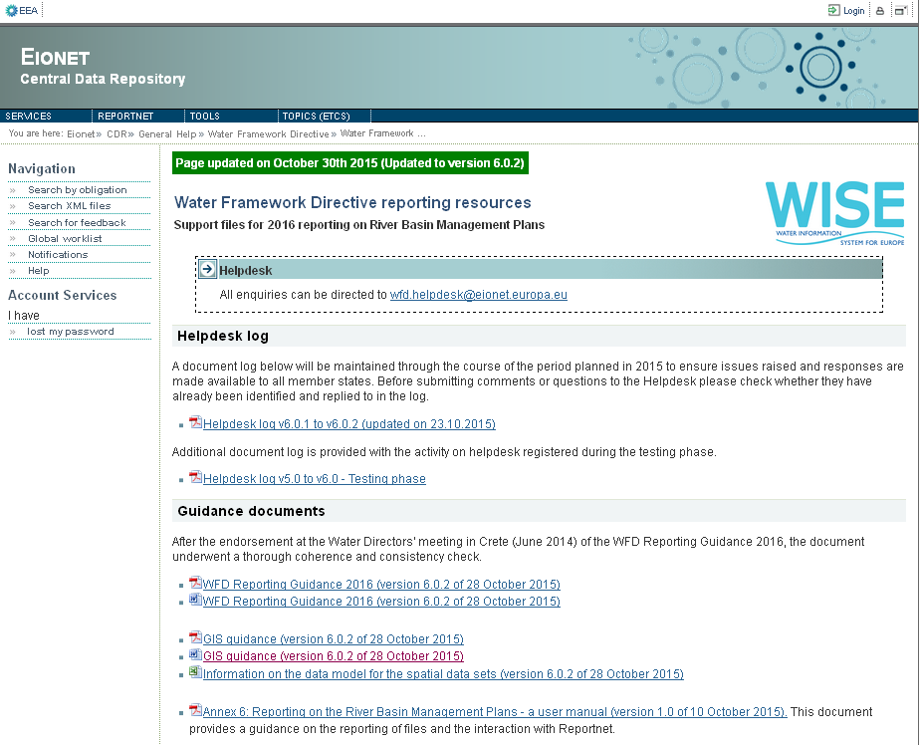
0. Overview
Resources & tools
WFD Reporting Guidance
UML Data Model
Schema:
http://dd.eionet.europa.eu/schemas/WFD2016
Access DB template
Guide to report Access DB
Conversion tool from Access to XML
http://cdr.eionet.europa.eu/help/WFD/WFD_521_2016
Notes:
Tool to visualize and explore UML
http://www.sparxsystems.com.au/bin/EALite.exe

Slide 4
0. Overview
SWB
XML
RBD level (1 file per RBD)
Chapter 2 and 5
Surface water bodies
Notes:
Schema name
Type
Reporting scale
Contents
Chapter
RBDSUCA
XML
National (1 file per MS)
River Basin Districts, Sub-units and Competent Authorities
6

Slide 5
0. Overview
GWB
XML
RBD level (1 file per RBD)
Chapter 3 and 5
Groundwater bodies
Notes:
Schema name
Type
Reporting scale
Contents
Chapter
RBDSUCA
XML
National (1 file per MS)
River Basin Districts, Sub-units and Competent Authorities
6

Slide 6
0. Overview
Monitoring
XML
RBD level (1 file per RBD)
Chapter 4 and 5
Monitoring programmes and monitoring sites for surface and groundwater bodies
Notes:
Schema name
Type
Reporting scale
Contents
Chapter
RBDSUCA
XML
National (1 file per MS)
River Basin Districts, Sub-units and Competent Authorities
6

Slide 7
0. Overview
SWMET
XML
RBD level (1 file per RBD)
Chapter 7
Information on methodologies linked to surface water
Notes:
Schema name
Type
Reporting scale
Contents
Chapter
RBDSUCA
XML
National (1 file per MS)
River Basin Districts, Sub-units and Competent Authorities
6

Slide 8
0. Overview
GWMET
XML
RBD level (1 file per RBD)
Chapter 8
Information on methodologies linked to groundwater
Notes:
Schema name
Type
Reporting scale
Contents
Chapter
RBDSUCA
XML
National (1 file per MS)
River Basin Districts, Sub-units and Competent Authorities
6

Slide 9
0. Overview
RBMPPoM
XML
RBD level (1 file per RBD)
Chapter 9,10 and 11
Information on the River Basins Management Plans, Programmes of Measures and Economic Analysis
Notes:
Schema name
Type
Reporting scale
Contents
Chapter
RBDSUCA
XML
National (1 file per MS)
River Basin Districts, Sub-units and Competent Authorities
6

Slide 10
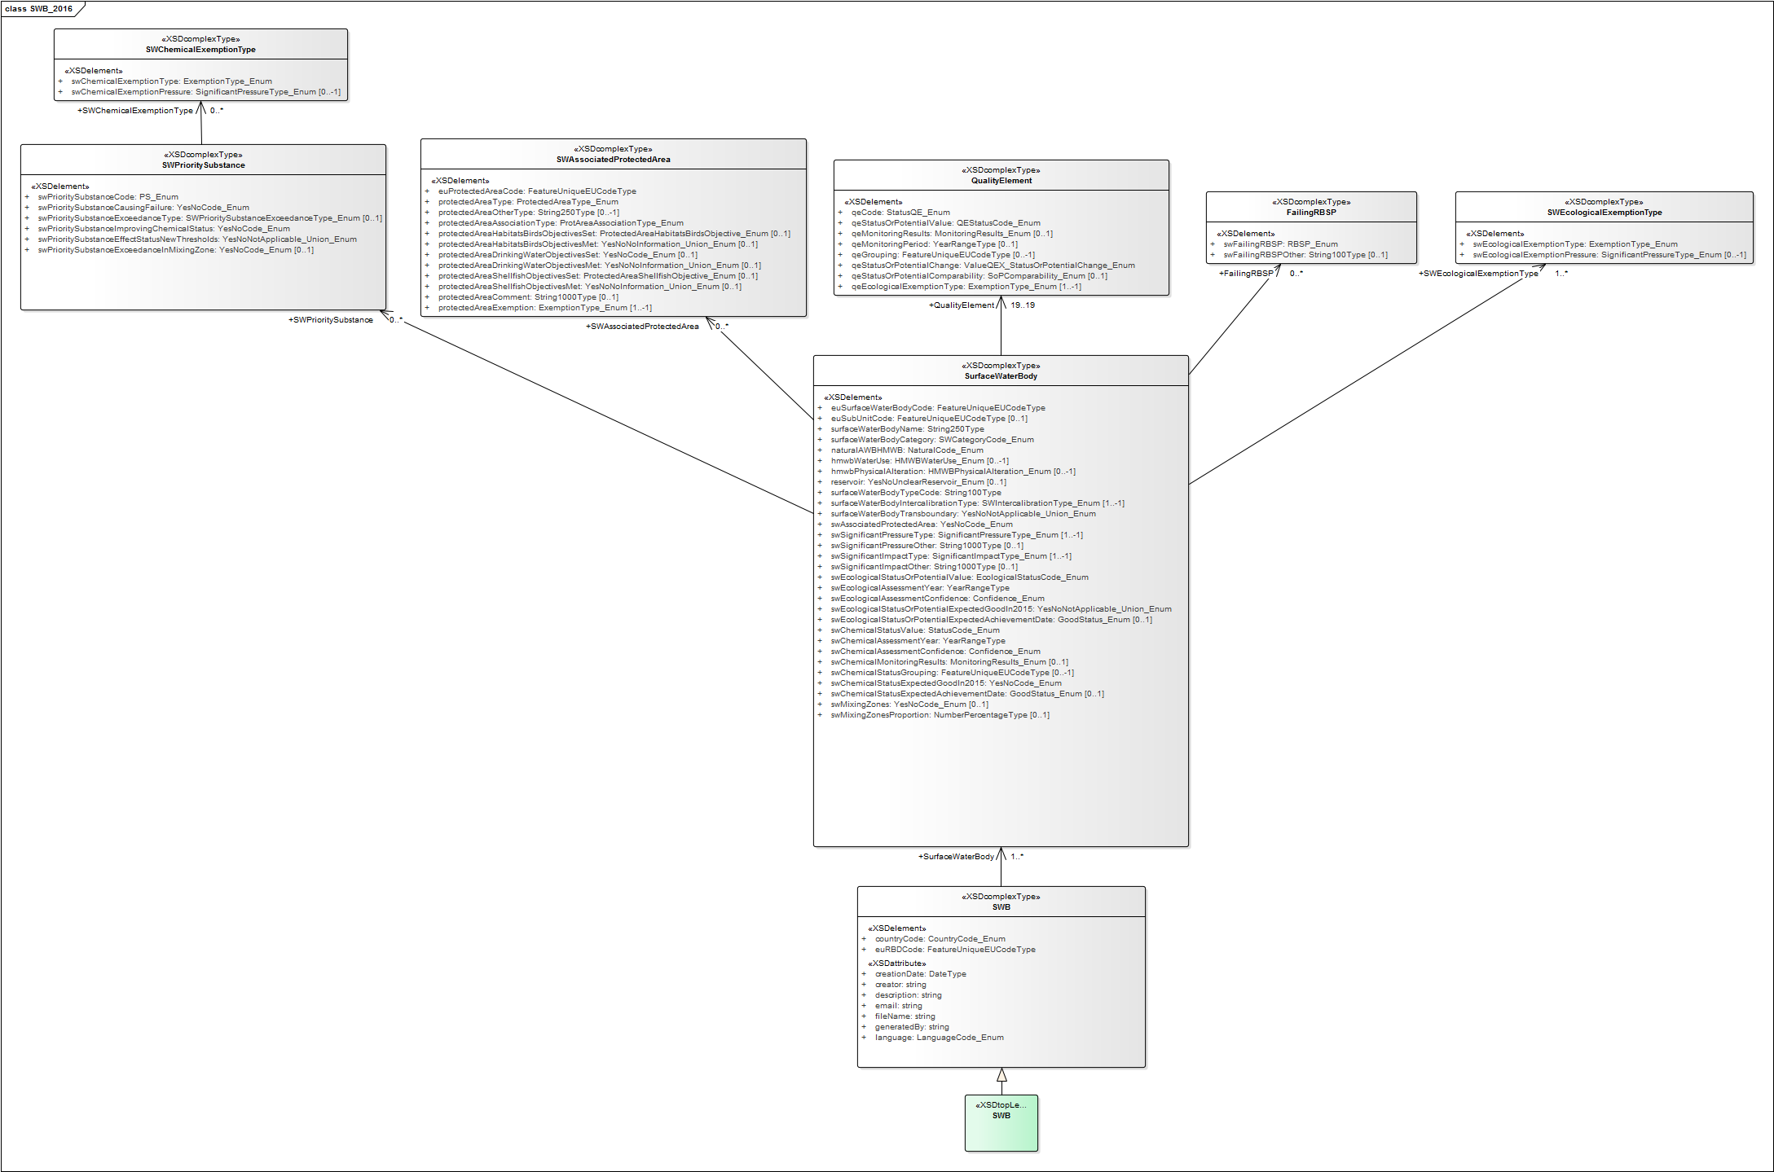
1. Reporting data schema: SWB UML

Slide 11
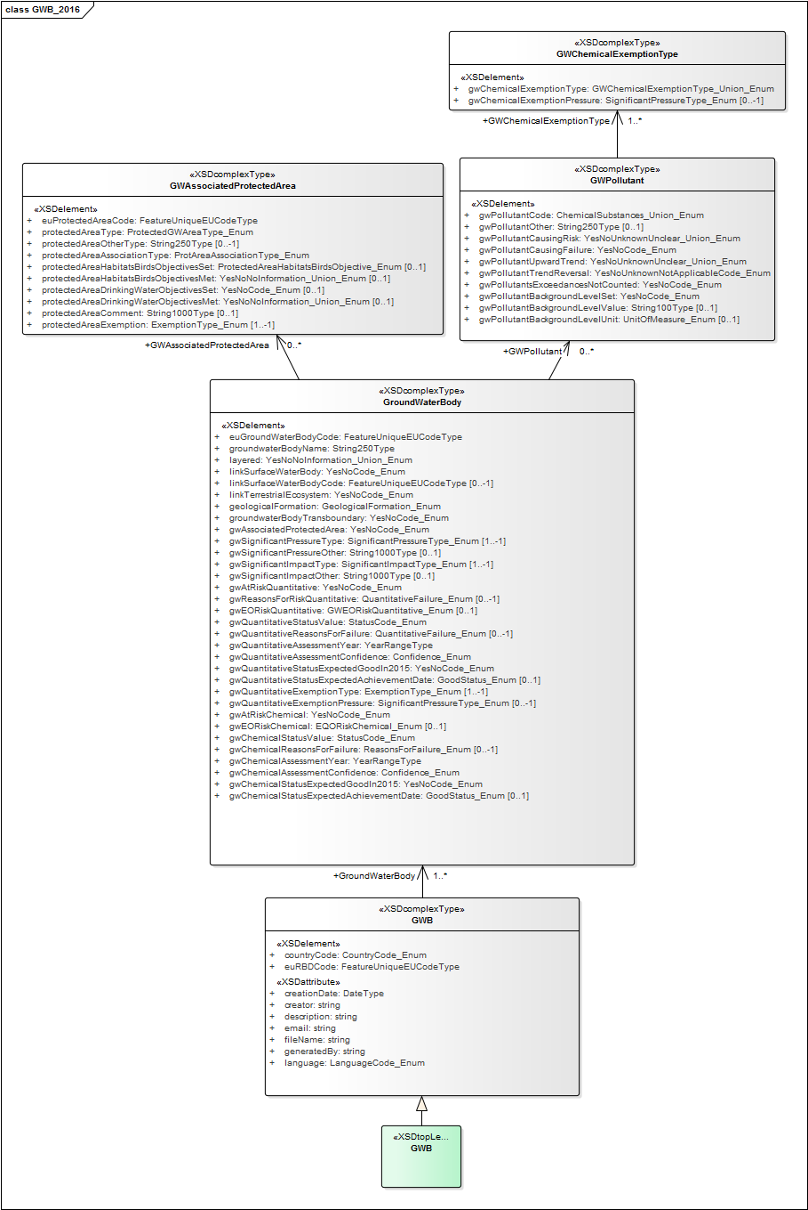
1. Reporting data schema: GWB UML

Slide 12
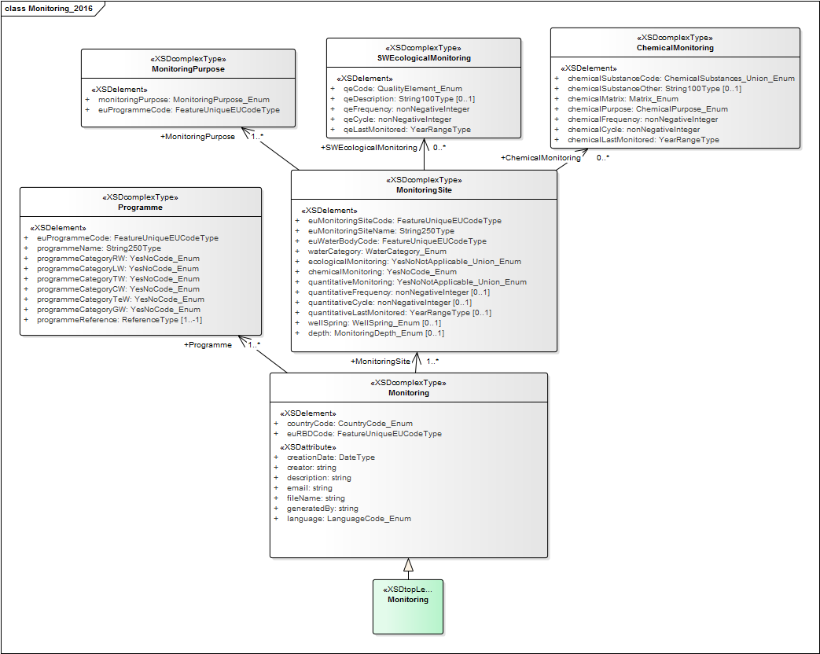
1. Reporting data schema: Monitoring UML

Slide 13
1. Reporting data schema: SWMET UML

Slide 14
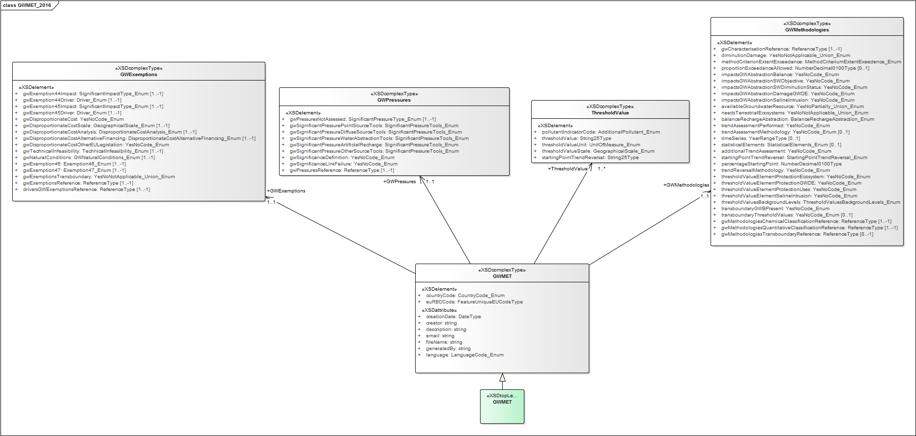
1. Reporting data schema: GWMET UML

Slide 15
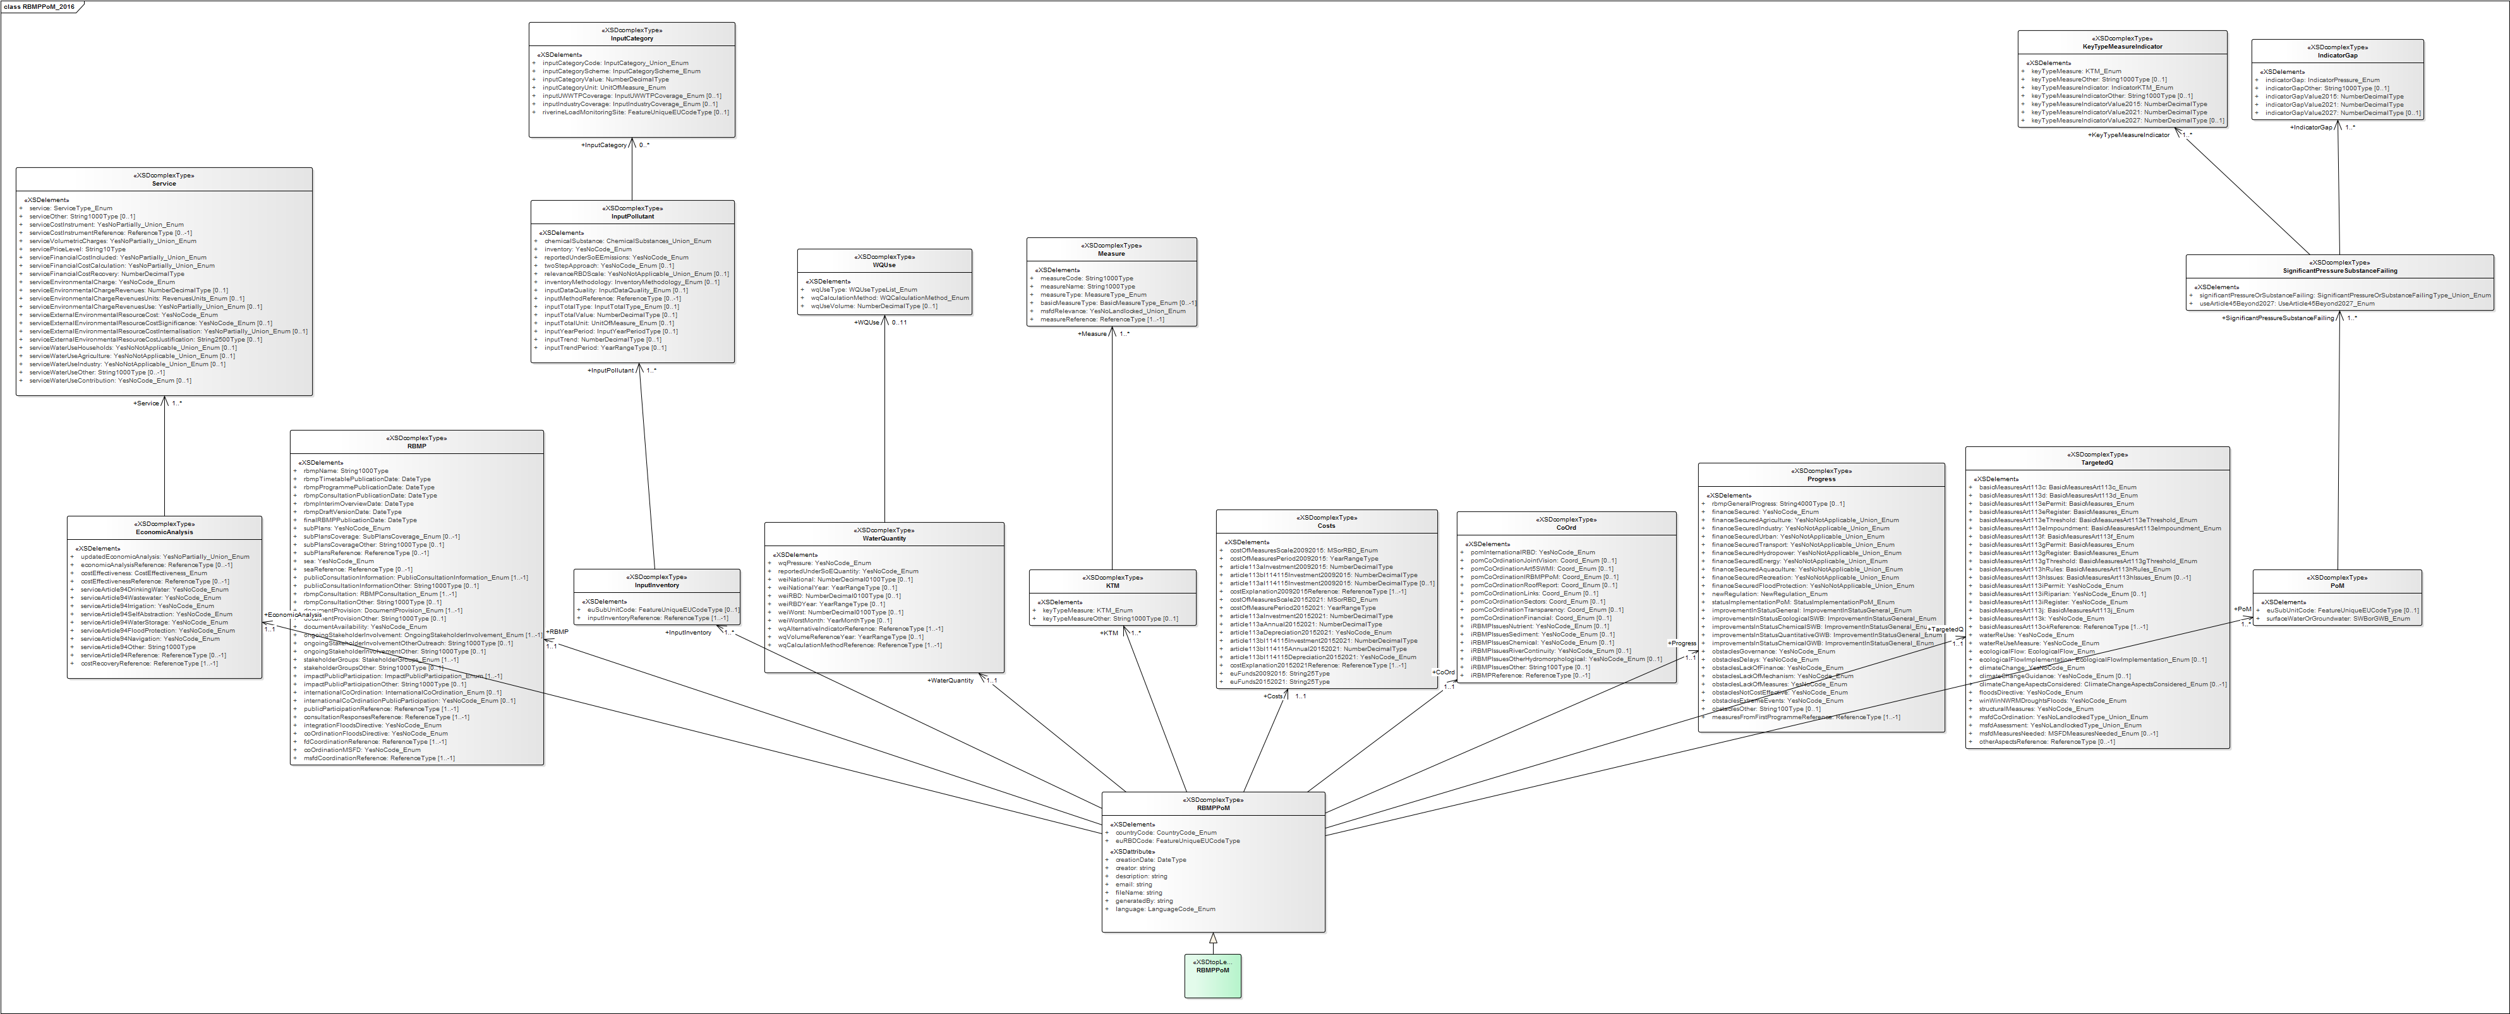
1. Reporting data schema: RBMPPoM UML

Slide 16
3. Quality control elements
Within schema checks
Validates integrity and correctness on the information reported at schema level (review on the QA documentation)

Slide 17
3. Quality control elements
Cross schema checks
Validation against the all the schemas reported under a RBD level
E.g. From QA documentatio

Slide 18
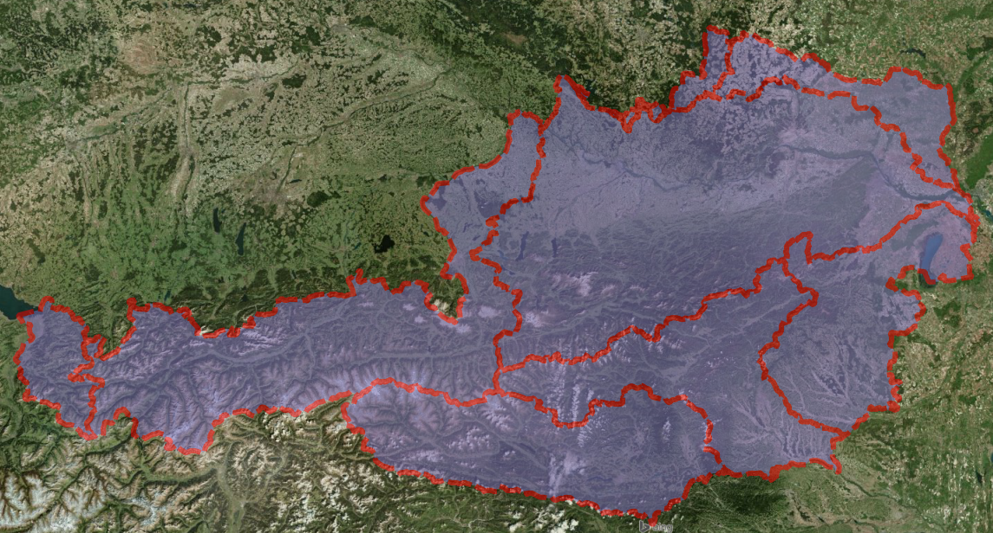
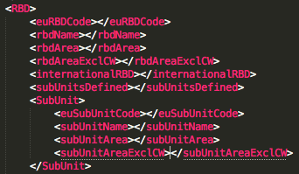
3. Quality control elements
Cross schema checks
Validation against spatial data (Surface water bodies, Groundwater bodies, Monitoring sites)

Slide 19
3. Quality control elements
Statistics: Summary (counts)
Summary of the reported data in the different schemas
Counts on the information reported for main information elements
SWB (31), GWB (29), Monitoring (2), SWMET (22), GWMET (12) and RBMPPoM (47)

Slide 20
4. Requirements for data exchange
XML format
XSD schemas available-Data Dictionary schemas http://dd.eionet.europa.eu/schemaset/WFD2016/view
Access DB format
Access DB template
Guide mapping Access DB and Schema elements
Access to XML converter tool
http://cdr.eionet.europa.eu/help/WFD/WFD_521_2016

Slide 21
4. Requirements for data exchange
File naming convention
SWB_[Your ISO Country Code]_YYYYMMDD
GWB_[Your ISO Country Code]_YYYYMMDD
Monitoring_[Your ISO Country Code]_YYYYMMDD
SWMET_[Your ISO Country Code]_YYYYMMDD
GWMET_[Your ISO Country Code]_YYYYMMDD
RBMPPoM_[Your ISO Country Code]_YYYYMMDD

Slide 22
Questions?

Slide 23
THANK YOU
Alberto Telletxea
atelletxea@bilbomatica.es
Enrique Soriano
jenriquesoriano@guadaltel.es
Mikel Santamaria
msantamaria@bilbomatica.es
Marisa Ruiz
marisaruiz@guadaltel.es

