Slide 1




WFD2016 Reporting Workshop
under the Common Implementation Strategy of the Water Framework Directive (WFD)
-
Reporting National Spatial Data

Slide 2
Content
0. Overview
Reporting data schemas
Life cycle management
Quality control elements
Requirements for data exchange

Slide 3
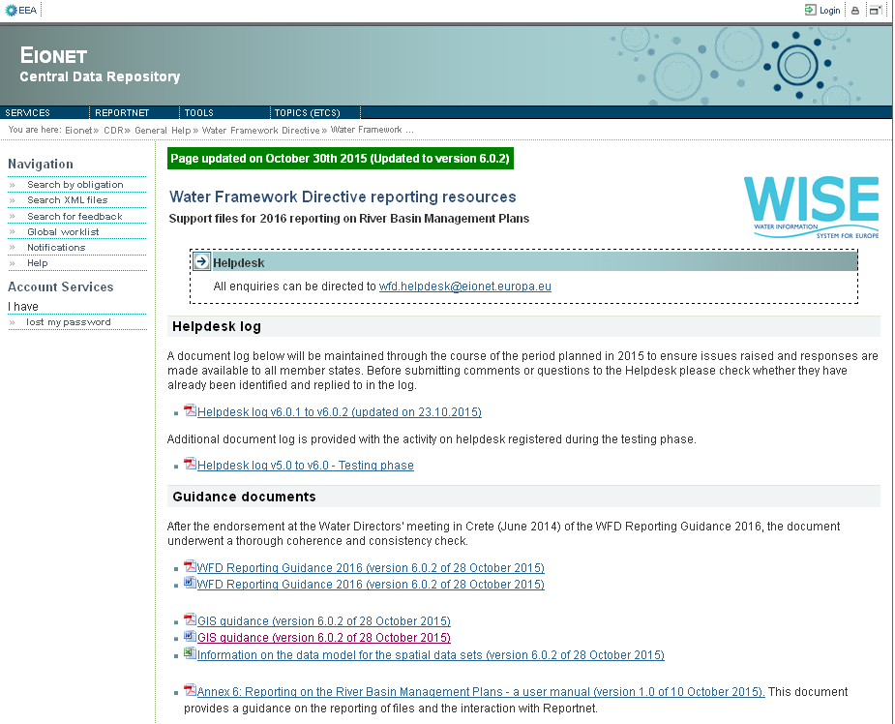
0. Overview
Resources & tools
GIS Guidance
Information on the data model for spatial datasets
UML Data Model
Shapefile templates
GML templates
http://cdr.eionet.europa.eu/help/WFD/WFD_521_2016

Slide 4

0. Overview
Resources & tools
EuroBoundaryMap version 9.1 - 1:100000
(restricted access)
http://forum.eionet.europa.eu/x_wise-reporting/library/restricted_distribution
Shapefile to GML conversion tool
http://cdr.eionet.europa.eu/help/WFD/WFD_521_2016
INSPIRE Metadata editor
http://inspire-geoportal.ec.europa.eu/
Tool to visualize and explore UML
http://www.sparxsystems.com.au/bin/EALite.exe

Slide 5
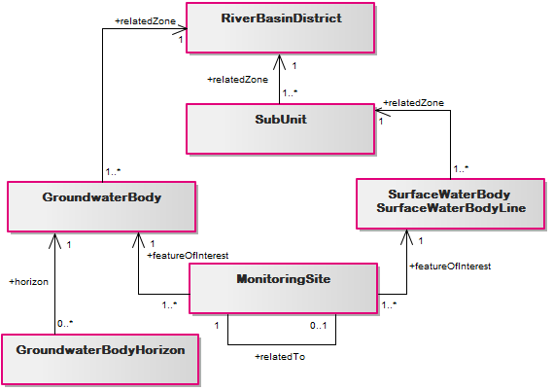
0. Overview
Reporting spatial data
Data model overview
Deliverables per dataset
gml file
xml metadata

Slide 6
0. Overview
Quick reference card
Datasets
Attributes
Restrictions

Slide 7
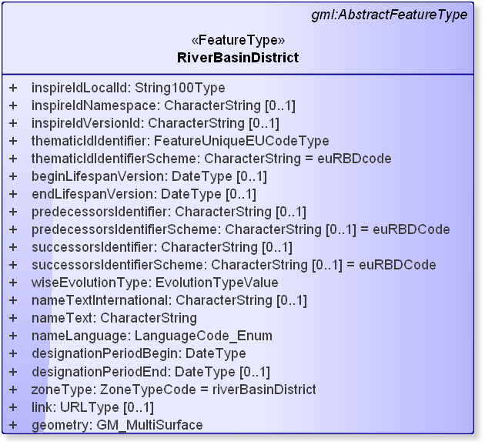
1. Reporting data schemas
RiverBasinDistrict
Data model
Tessellation of the national territory to the limit of the coastal waters
EuroBoundaryMap v9.1 released

Slide 8
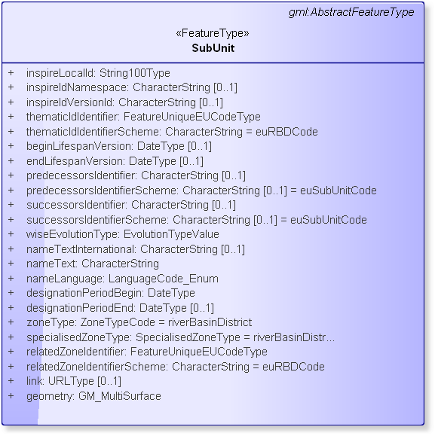
1. Reporting data schemas
SubUnit
Data model
Tessellation of the River Basin District
RBD geometry as SubUnit (if RBD not divided into SubUnits)

Slide 9
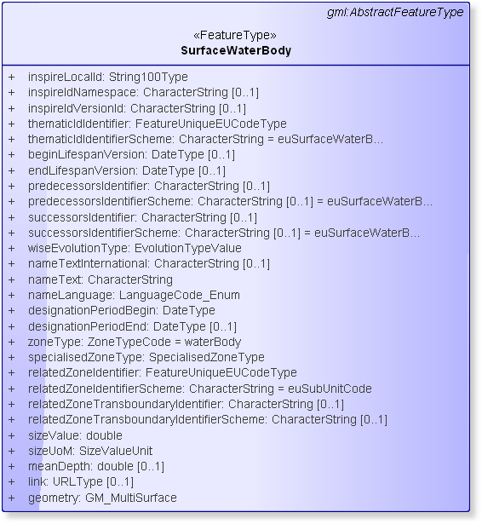
1. Reporting data schemas
SurfaceWaterBody
SurfaceWaterBodyLine
Data model
Contained in SubUnit
No overlaps between SWB
No surfaces overlap
No line crossing

Slide 10
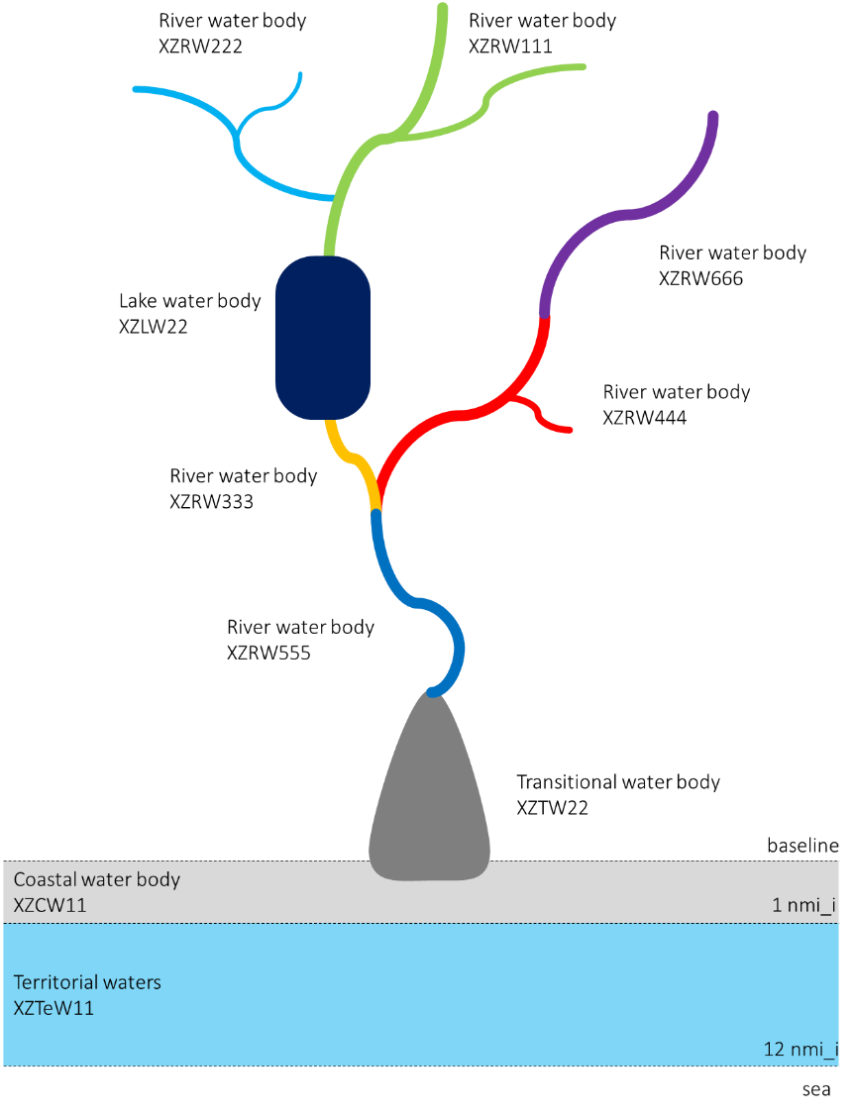
1. Reporting data schemas
SurfaceWaterBody
SurfaceWaterBodyLine
Rivers may be represented by:
Polygons
Lines

Slide 11
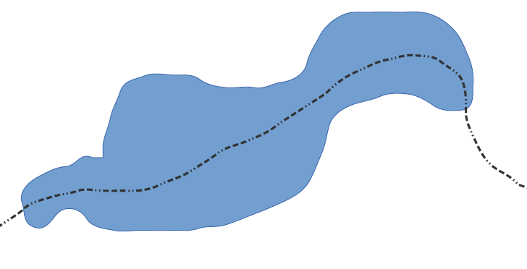
1. Reporting data schemas
SurfaceWaterBody
Transboundary Water Bodies
 | XZ | ZZ
thematicIdIdentifier | XZ111 | ZZ999
relatedZoneTransboundaryIdentifier | YY001 | YY001
COUNTRY XZ
111
999
COUNTRY ZZ

Slide 12
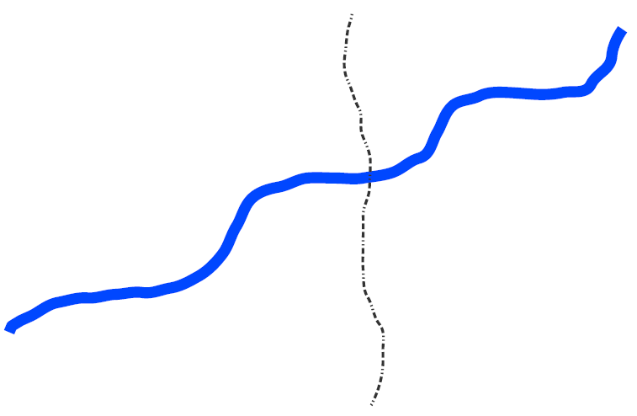
1. Reporting data schemas
SurfaceWaterBodyLine
Transboundary Water Bodies
COUNTRY ZZ
 | XZ | ZZ
thematicIdIdentifier | XZ111 | ZZ999
relatedZoneTransboundaryIdentifier | YY001 | YY001
999
111
111
999
COUNTRY XZ

Slide 13
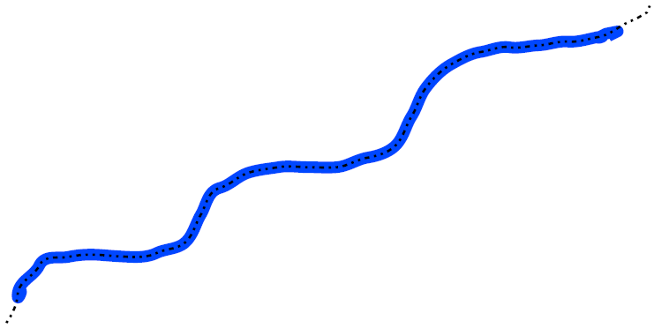
1. Reporting data schemas
SurfaceWaterBodyLine
Transboundary Water Bodies
 | XZ | ZZ
thematicIdIdentifier | XZ111 | ZZ999
relatedZoneTransboundaryIdentifier | YY001 | YY001
COUNTRY ZZ
999
COUNTRY XZ
111
999

Slide 14
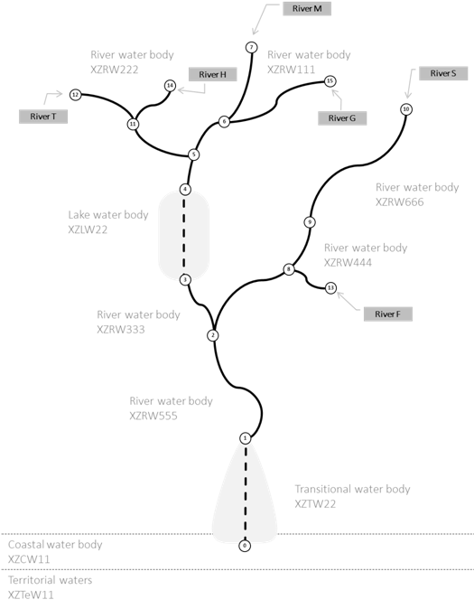
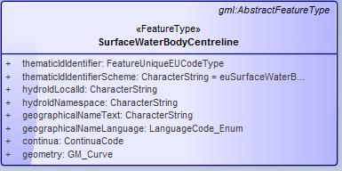
1. Reporting data schemas
SurfaceWaterBodyCentreline
Data model
Ensure network connectivity
No multipart geometry

Slide 15
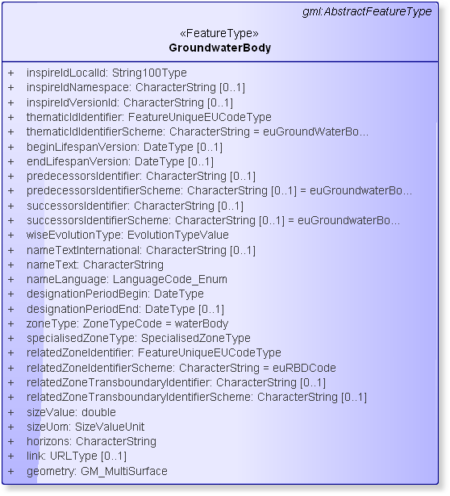
1. Reporting data schemas
GroundwaterBody
Data model
Contained in RBD
horizons identifies different horizon levels
(comma-separated list)

Slide 16
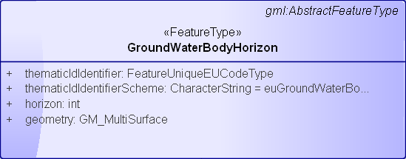
1. Reporting data schemas
GroundwaterBodyHorizon
Data model
Reporting Guidance
Annex IV

Slide 17
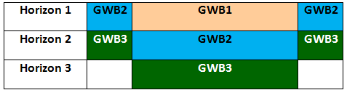
1. Reporting data schemas
GroundwaterBodyHorizon
Annex IV
GroundWaterBody
GroundWaterBodyHorizon
thematicID Identifier | horizons
GWB1 | 1
GWB2 | 1,2
GWB3 | 2,3
thematicID Identifier | horizon
GWB2 | 1
GWB2 | 2
GWB3 | 2
GWB3 | 3

Slide 18
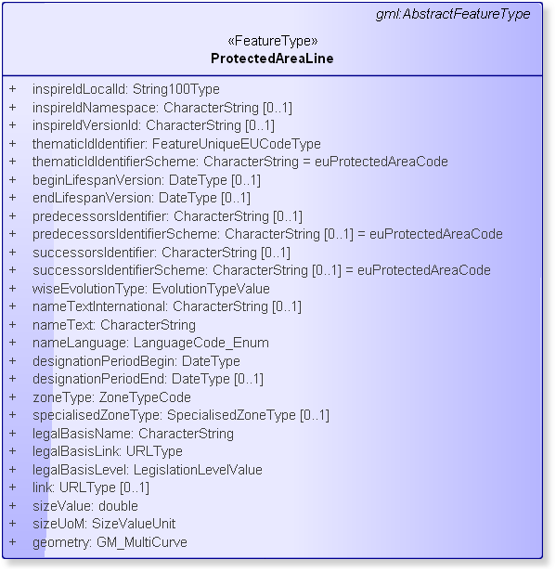
1. Reporting data schemas
ProtectedArea
ProtectedAreaPoint
ProtectedAreaLine
Data model
Related with RBD
Habitats or Birds zoneType not reported in WISE Spatial

Slide 19
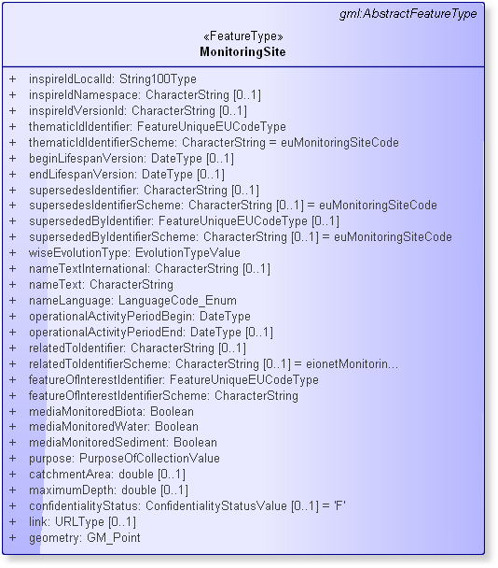
1. Reporting data schemas
MonitoringSite
Data model
Related with SWB or GWB
WB polygon inside WB
WB line <20 m

Slide 20
2. Life cycle management
Overview
beginLifespanVersion/endLifespanVersion
versionId
predecessorsIdentifier (supersedes)
successorsIdentifier (supersededBy)

Slide 21

2. Life cycle management
XZLW201601
Creation
Not reported previously
WFD2010
WFD2016
thematicID Identifier | Predecessor Identifier | beginLife SpanVersion | endLife SpanVersion | versionId | wise Evolution Type
XZLW201601 |  | 2016-01-01 |  | V1.0 | creation
(*) data shown are examples

Slide 22
2. Life cycle management
XZLW201601
Creation
Reported non-spatial data
Not reported spatial data
WFD2010
WFD2016
thematicID Identifier | Predecessor Identifier | beginLife SpanVersion | endLife SpanVersion | versionId | wise Evolution Type
XZLW201601 |  | 2016-01-01 |  | V1.0 | noChange
(*) data shown are examples
Note that this option must be used for the WFD water bodies that haven’t changed from the 1st to 2nd RBMP, but that were not previously reported in the spatial data sets

Slide 23


2. Life cycle management
Split predecessor
XZLW201601
XZLW201001
XZLW201602
WFD2010
WFD2016
thematicID Identifier | predecessor Identifier | beginLifeSpan Version | wiseEvolution Type
XZLW201601 | XZLW201001 | 2016-01-01 | splitting
XZLW201602 | XZLW201001 | 2016-01-01 | splitting
(*) data shown are examples

Slide 24


2. Life cycle management
Aggregate predecessors
XZLW201001
XZLW201002
XZLW201003
WFD2010
WFD2016
XZLW201004
XZLW201601
thematicID Identifier | Predecessor Identifier | beginLifeSpan Version | wiseEvolution Type
XZLW201601 | XZLW201001,XZLW201002, XZLW201003,XZLW201004 | 2016-01-01 | aggregation
(*) data shown are examples

Slide 25


2. Life cycle management
Aggregate & Split predecessors
XZLW201001
XZLW201601
XZLW201002
WFD2010
XZLW201003
WFD2016
thematicID Identifier | Predecessor Identifier | beginLifeSpan Version | wiseEvolutionType
XZLW201601 | XZLW201001, XZLW201002 | 2016-01-01 | changeBothAggregationAndSplitting
(*) data shown are examples

Slide 26


2. Life cycle management
Changes in geometry
WFD2010
WFD2016
XZLW201001
XZLW201001
thematicID Identifier | Predecessor Identifier | beginLife SpanVersion | endLife SpanVersion | versionId | wise Evolution Type
XZLW201001 | XZLW200401 | 2010-01-01 | 2015-12-31 | V1.2
XZLW201001 | XZLW200401 | 2016-01-01 |  | V1.3 | change
(*) data shown are examples

Slide 27
3. Quality control elements
Envelope level
.gml file exists for spatial data
.xml file exists for metadata
Naming convention
Metadata validation against INSPIRE validator
Coordinate Reference System validation
QA/QC specifications
http://cdr.eionet.europa.eu/help/WFD/WFD_521_2016/

Slide 28

3. Quality control elements
RiverBasinDistrict
Tesselation of the National territory to the limit of the coastal waters
No gaps, overlaps or self-intersecting
Element restrictions
Element enumeration lists

Slide 29
3. Quality control elements
SubUnit
relatedZoneIdentifier references RBD/thematicIdIdentifier
Tesselation of RiverBasinDistrict
No gaps, overlaps or self-intersecting
Element restrictions
Element enumeration lists

Slide 30
3. Quality control elements
SurfaceWaterBody (Line)
relatedZoneIdentifier references SubUnit/thematicIdIdentifier
Contained in SubUnit polygon
No overlaps (No crossing)
Element restrictions
Element enumeration lists

Slide 31
3. Quality control elements
SurfaceWaterBodyCentreLine
Element restrictions

Slide 32
3. Quality control elements
GroundwaterBody
relatedZoneIdentifier references RBD/thematicIdIdentifier
Contained on RiverBasinDistrict polygon
Overlaps allowed if different depths
Element restrictions
Element enumeration lists

Slide 33
3. Quality control elements
GroundwaterBodyHorizon
relatedZoneIdentifier references GroundWaterBody/thematicIdIdentifier
horizon value contained in GroundWaterBody/horizons
Union of geometry of different horizons must be equal to the referenced GroundWaterBody
Element restrictions
Element enumeration lists

Slide 34
3. Quality control elements
MonitoringSite
featureOfInterestIdentifier references appropriate SWB or GWB
Position checks for referenced SWB or GWB
Element restrictions
Element enumeration lists

Slide 35
3. Quality control elements
ProtectedArea
Element restrictions
Element enumeration lists

Slide 36
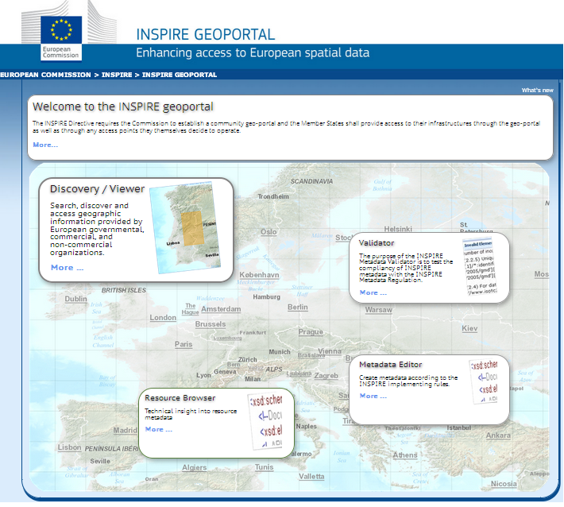
3. Quality control elements
Metadata
Validation against INSPIRE validator
http://inspire-geoportal.ec.europa.eu/

Slide 37
4. Requirements for data exchange
File formats to report
gml for spatial data
shapefile converter tool
xml for metadata
INSPIRE metadata editor (suggested)
Character encoding: UTF-8

Slide 38
4. Requirements for data exchange
GML format
XSD schemas available-Data Dictionary schemas http://dd.eionet.europa.eu/schemaset/WFD2016/view
Shapefile format
shapefile templates
shapefile to GML converter tool
http://cdr.eionet.europa.eu/help/WFD/WFD_521_2016

Slide 39
4. Requirements for data exchange
File naming convention
RiverBasinDistrict_XZ_2016-01-01
SubUnit_XZ_2016-01-01
SurfaceWaterBody_XZ_2016-01-01
SurfaceWaterBodyLine_XZ_2016-01-01
GroundWaterBody_XZ_2016-01-01
MonitoringSite_XZ_2016-01-01
ProtectedArea_XZ_2016-01-01
ProtectedAreaLine_XZ_2016-01-01
ProtectedAreaPoint_XZ_2016-01-01
SurfaceWaterBodyCentreline_XZ_2016-01-01
GroundWaterBodyHorizon_XZ_2016-01-01
.gml for spatial data
.xml for metadata

Slide 40
Results from WFD 2010
Non Spatial vs Spatial Codes
Information reported for WFD2010
Lists of codes and cross-check routines
Issues detected
Correspondence between spatial and non-spatial codes list
Information will be uploaded to restricted access area:
http://forum.eionet.europa.eu/x_wise-reporting/library/restricted_distribution

Slide 41
Questions?

Slide 42
THANK YOU
Alberto Telletxea
atelletxea@bilbomatica.es
Enrique Soriano
jenriquesoriano@guadaltel.es
Mikel Santamaria
msantamaria@bilbomatica.es
Marisa Ruiz
marisaruiz@guadaltel.es

